Slide 1
74 shampoo bottles refilled x 12 for each month = 888
How much single use plastic would we save if we managed to continue with these changes for a year ?
Our lifetime?

Slide 2
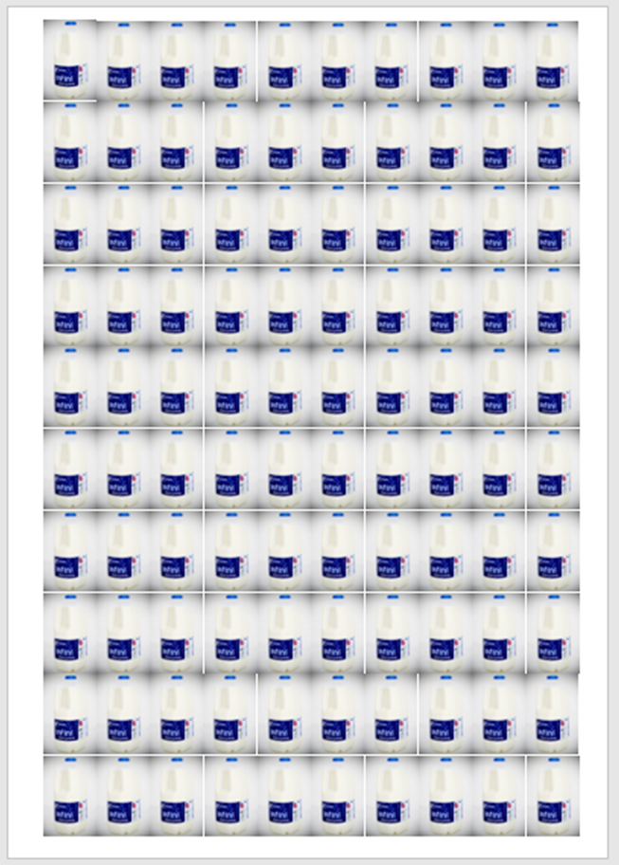
Successes so far

Slide 3
429 single use plastic milk bottles by switching to glass returnable bottles for staff room and breakfast club

Slide 4
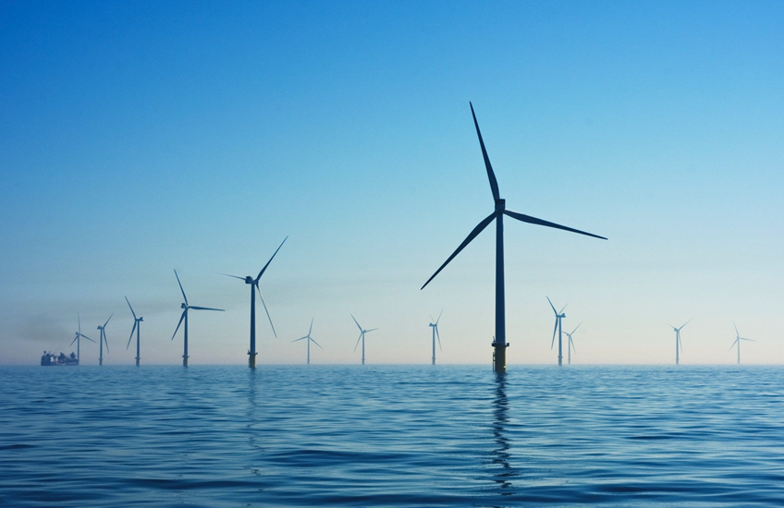
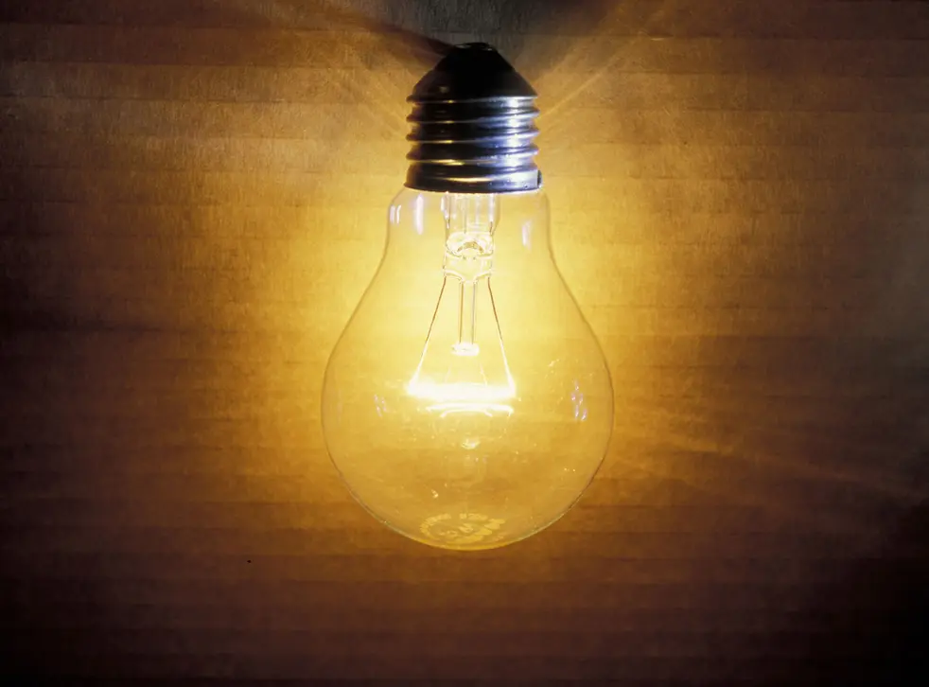
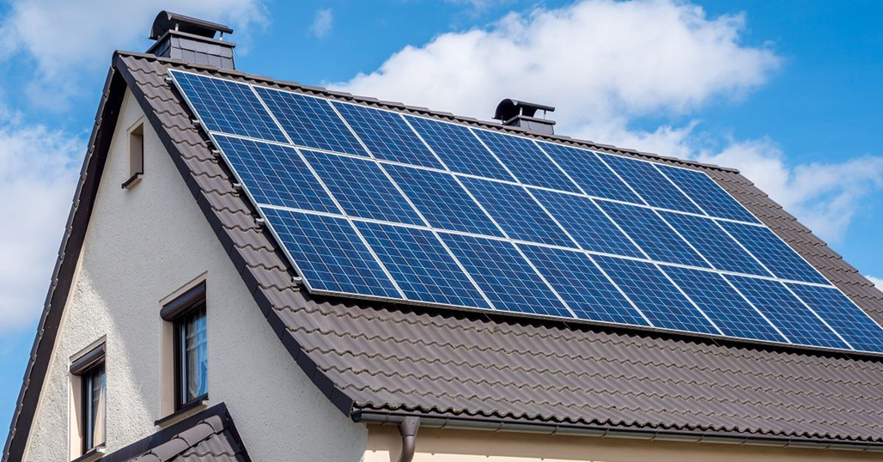
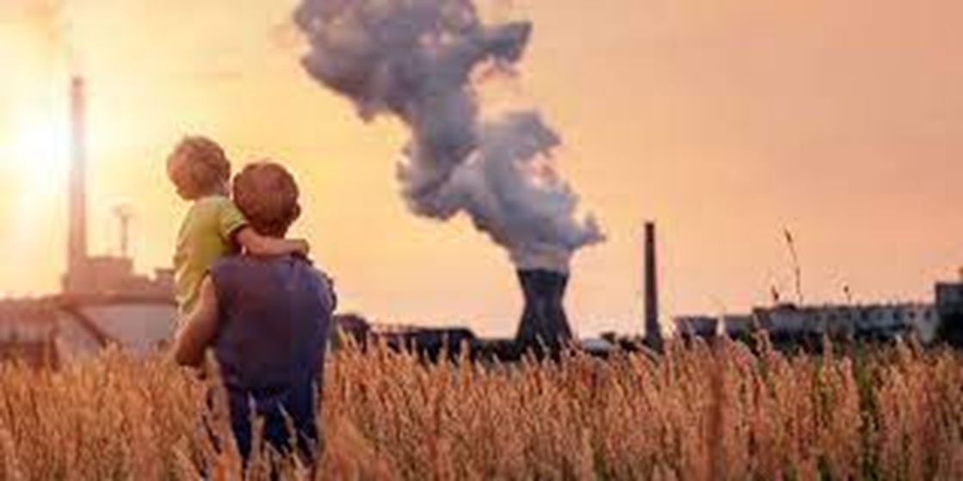
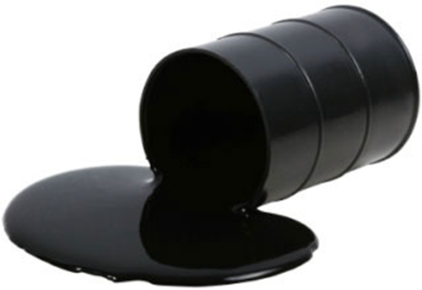
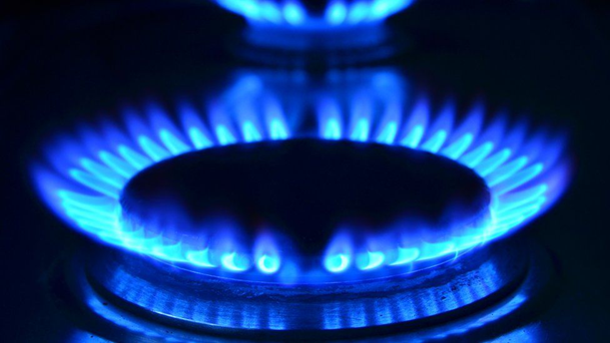
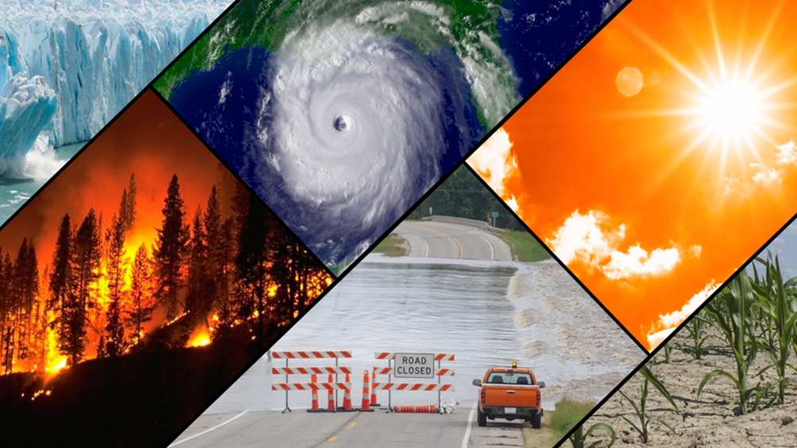
How are all these pictures linked? Our new focus….

Slide 5
We are going to be learning about…
Energy and Climate Change

Slide 6
What the assemblies will be about this term.
What is energy? Burning fossil fuels to produce energy– impact on environment
Renewable energy
Energy around the home – get caught saving energy
Energy around school – energy saving project/Energy Sparks/pledges in classes
Link with local organisations . E.g. Brighton Energy Coop. Art photography water/sun/wind
Feedback – photos, pledge etc

Slide 7
What is energy and what do we need it for?

Slide 8
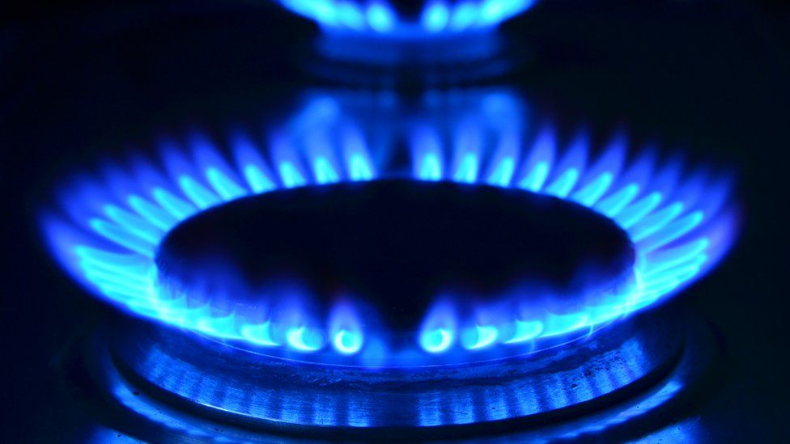
What are fossil fuels?
They are natural NON-RENEWABLE resources which give us energy when they are burned
Coal
Oil
Gas

Slide 9
These fuels were formed in the earth over millions of years.
Coal comes from ancient forests and plants.
Oil and gas come from tiny decayed sea creatures.

Slide 10
BUT when fossil fuels are burned to make energy, they release greenhouse gases and cause climate change.

Slide 11
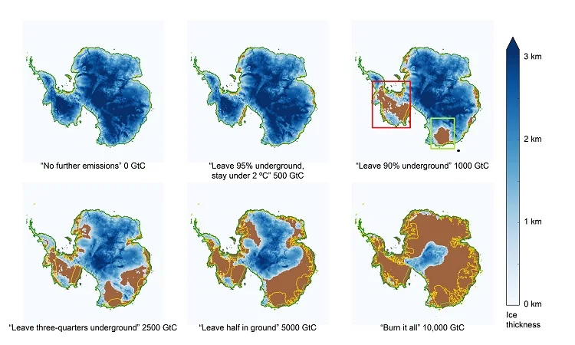
The Antarctic

Slide 12
Fossil fuels are also non-renewable
Once you burn oil, gas, and coal it’s gone for good – and fossil fuels will run out.
They will run out between 50-100 years.
That means this is a major problem for us, our children, and our grandchildren.

Slide 13
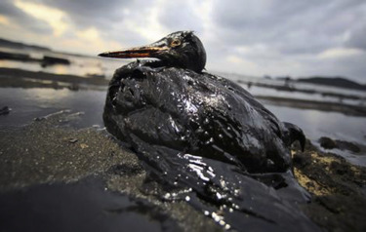
Fossil fuels cause water pollution and oil spills
.

Slide 14
Fossil fuels cause air pollution

Slide 15
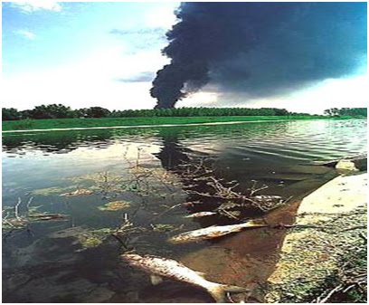
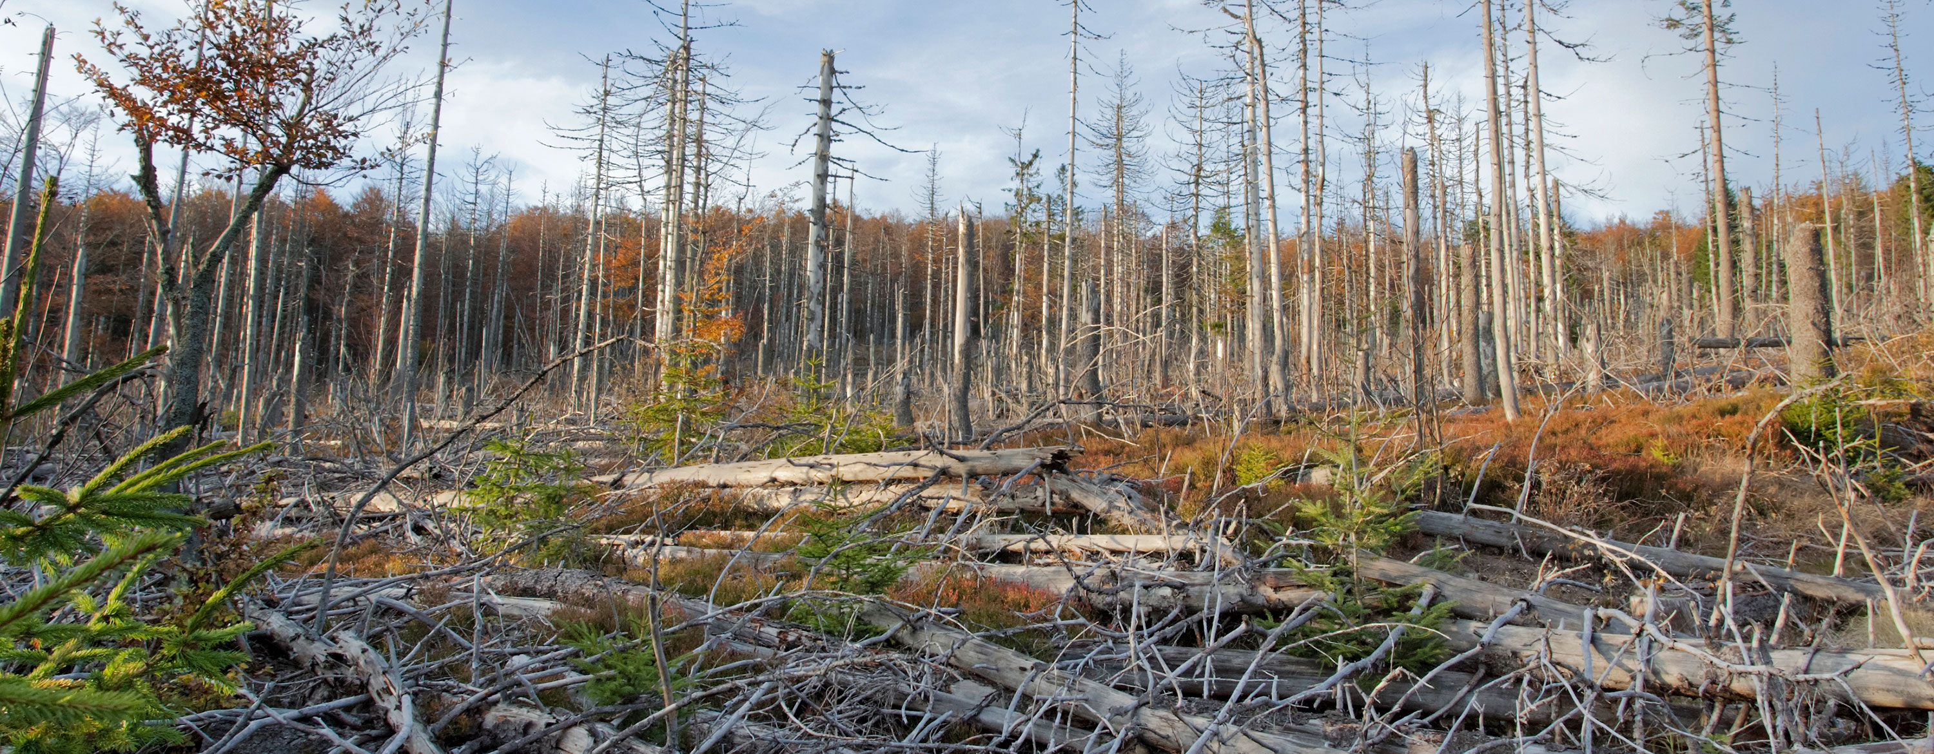
Fossil fuels cause acid rain Acid rain is a serious problem and damages trees, lakes, rivers, architecture, statues, crops, and wildlife

Slide 16
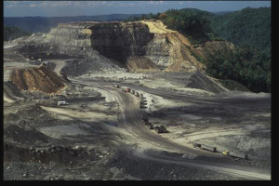
Finding fossil fuels destroys land and wildlife

Slide 17
The less energy we use the fewer fossil fuels we need and…
The more the planet is protected

