Slide 1
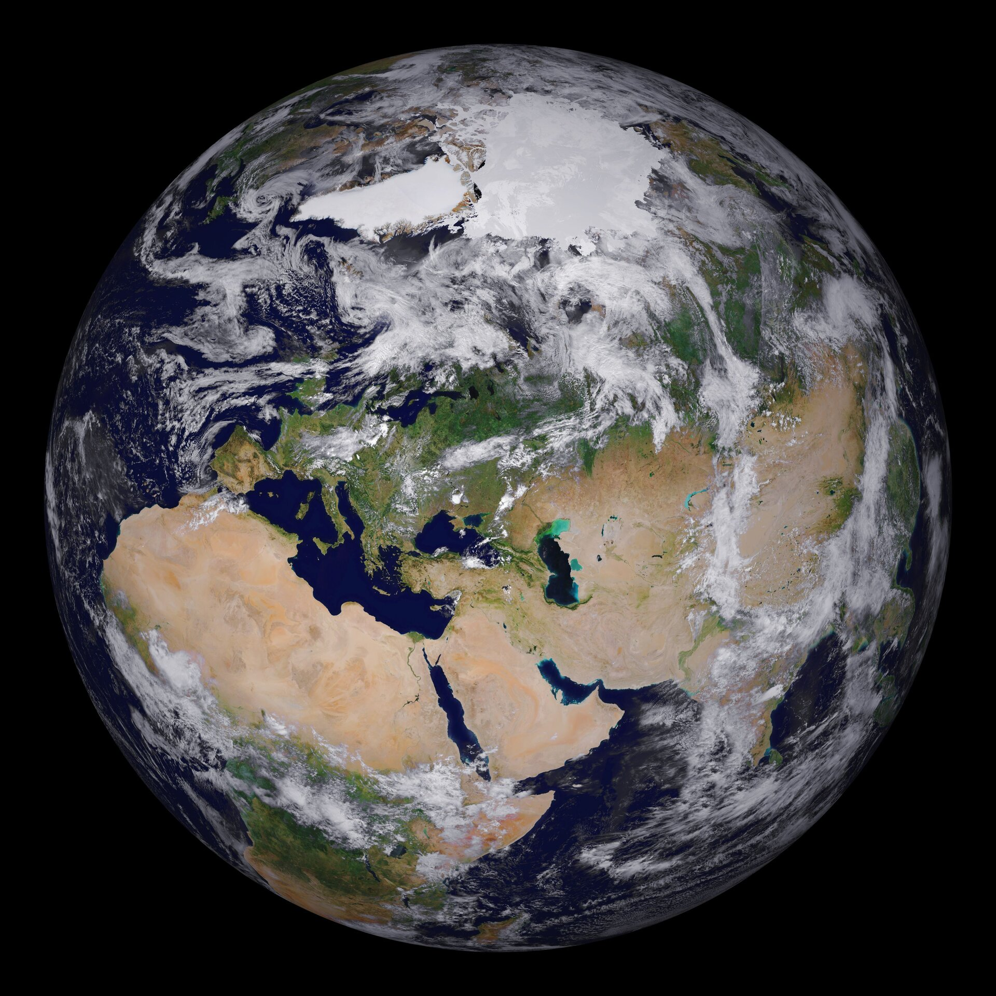
Let’s start with a short film
Tell me what you most enjoyed seeing

Slide 2
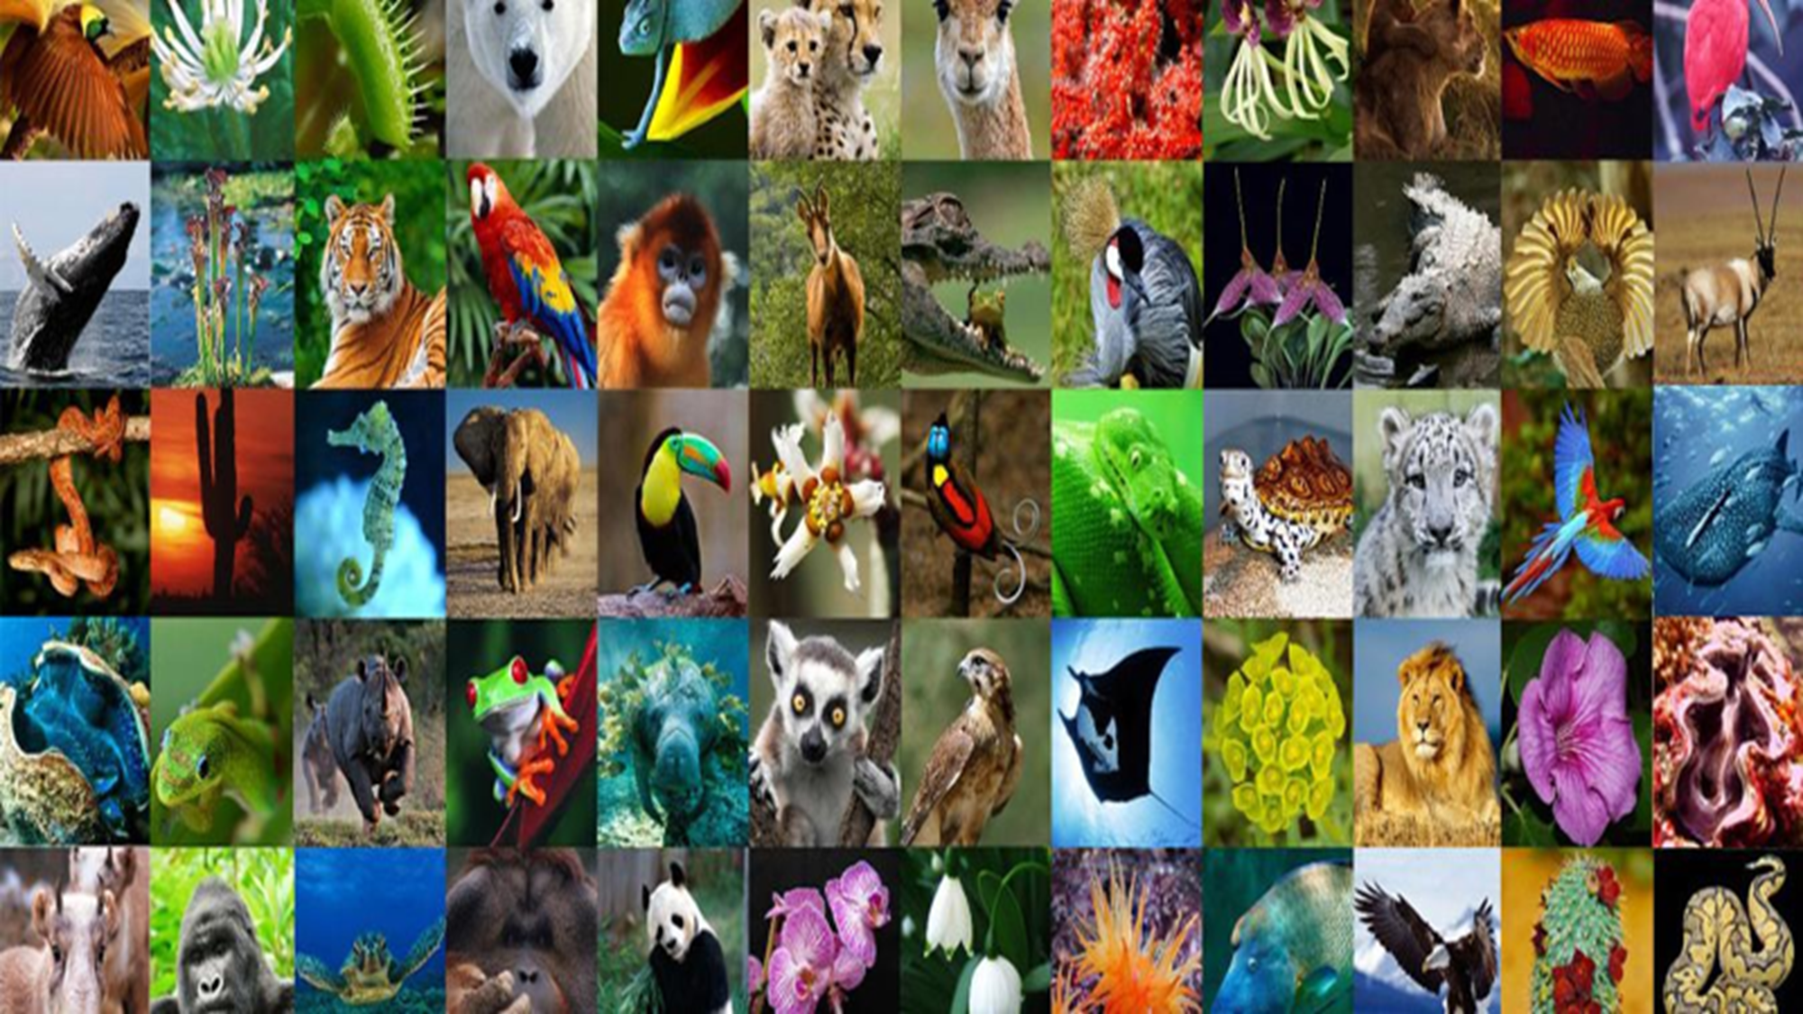

Slide 3
This term we are going to be thinking and talking about biodiversity

Slide 4
BIODIVERSITY
BIO
Comes from ancient Greek meaning ‘life’
DIVERSITY
Many different types

Slide 5
So what is biodiversity and why is it important?

Slide 6
All these diverse plants and animals are part of an: ECOSYSTEM

Slide 7
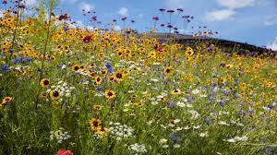
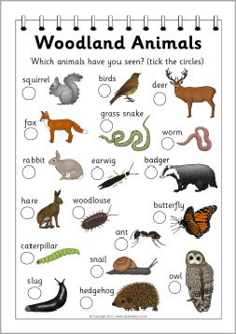
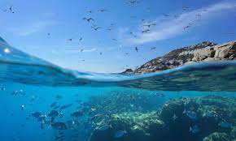
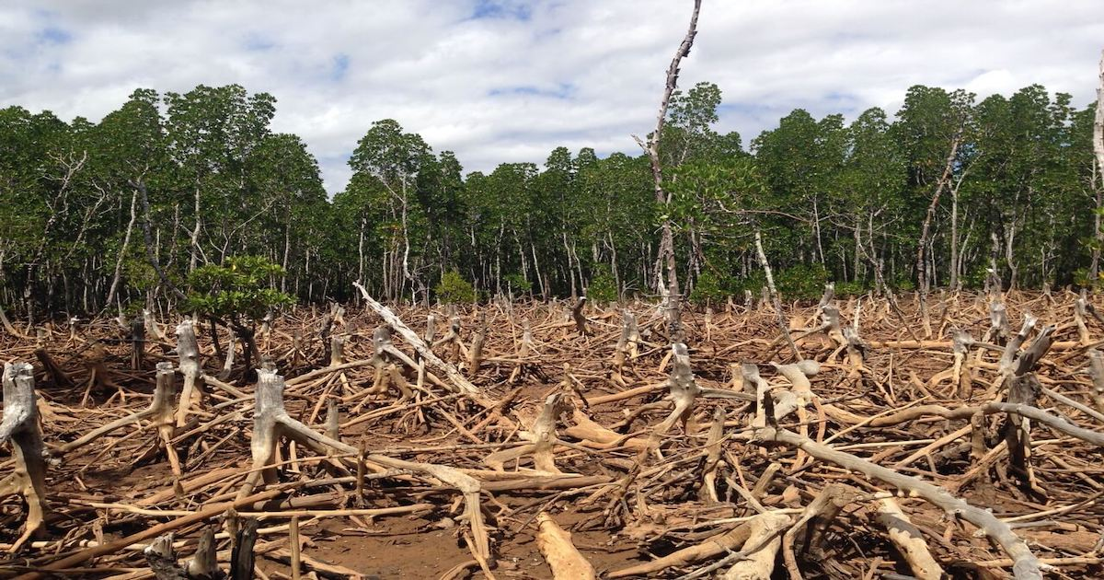
An ecosystem is a community of living things that are all linked together and are linked with their environment
An ecosystem can be very small such as a pond, a flowerbed or a puddle
It can also be as big as an ocean or a desert
The balance of an eco-system is important – all things must work together to provide a good living environment
For example if there is not enough water plants and animals will not be able to survive or if there are not enough plants to eat or trees are cut down some animals will starve

Slide 9
Web Of Life

Slide 10
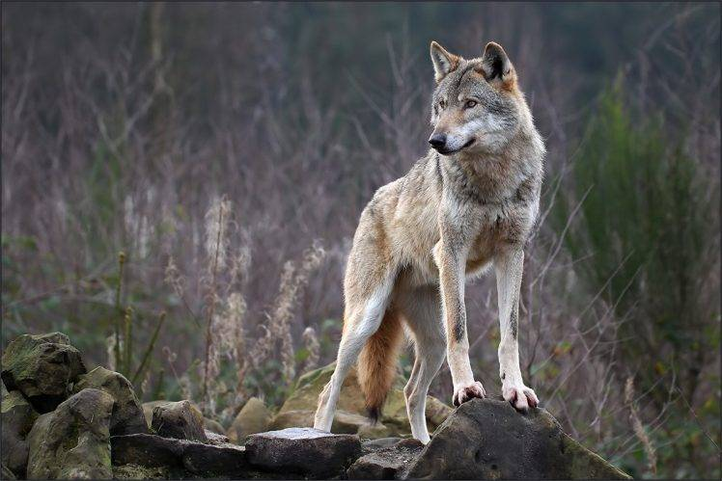
Next time we will look at the wolves of Yellowstone park in America and the incredible story of how their return transformed the ecosystem and the biodiversity

