Slide 1
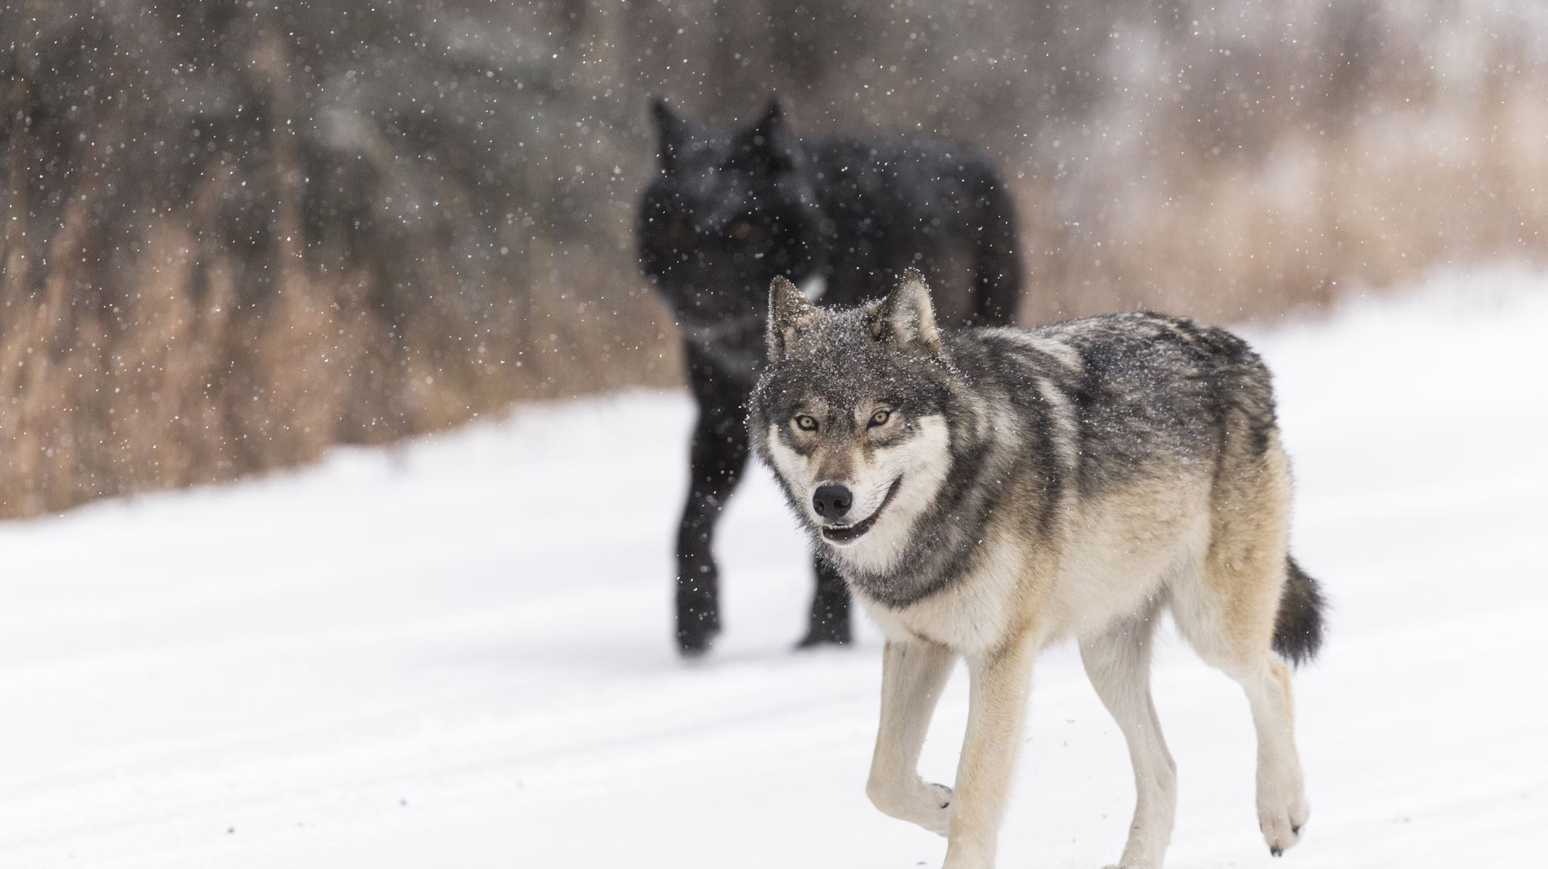
The wolves of Yellowstone Park and a trophic cascade

Slide 2
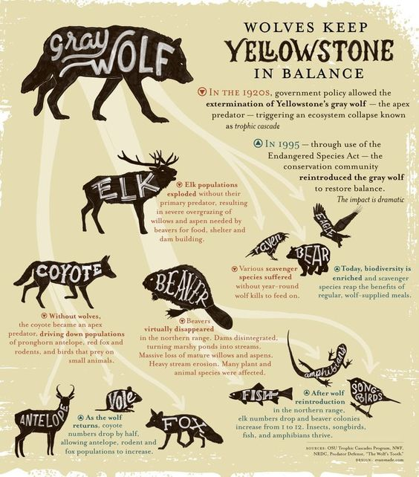

Slide 3
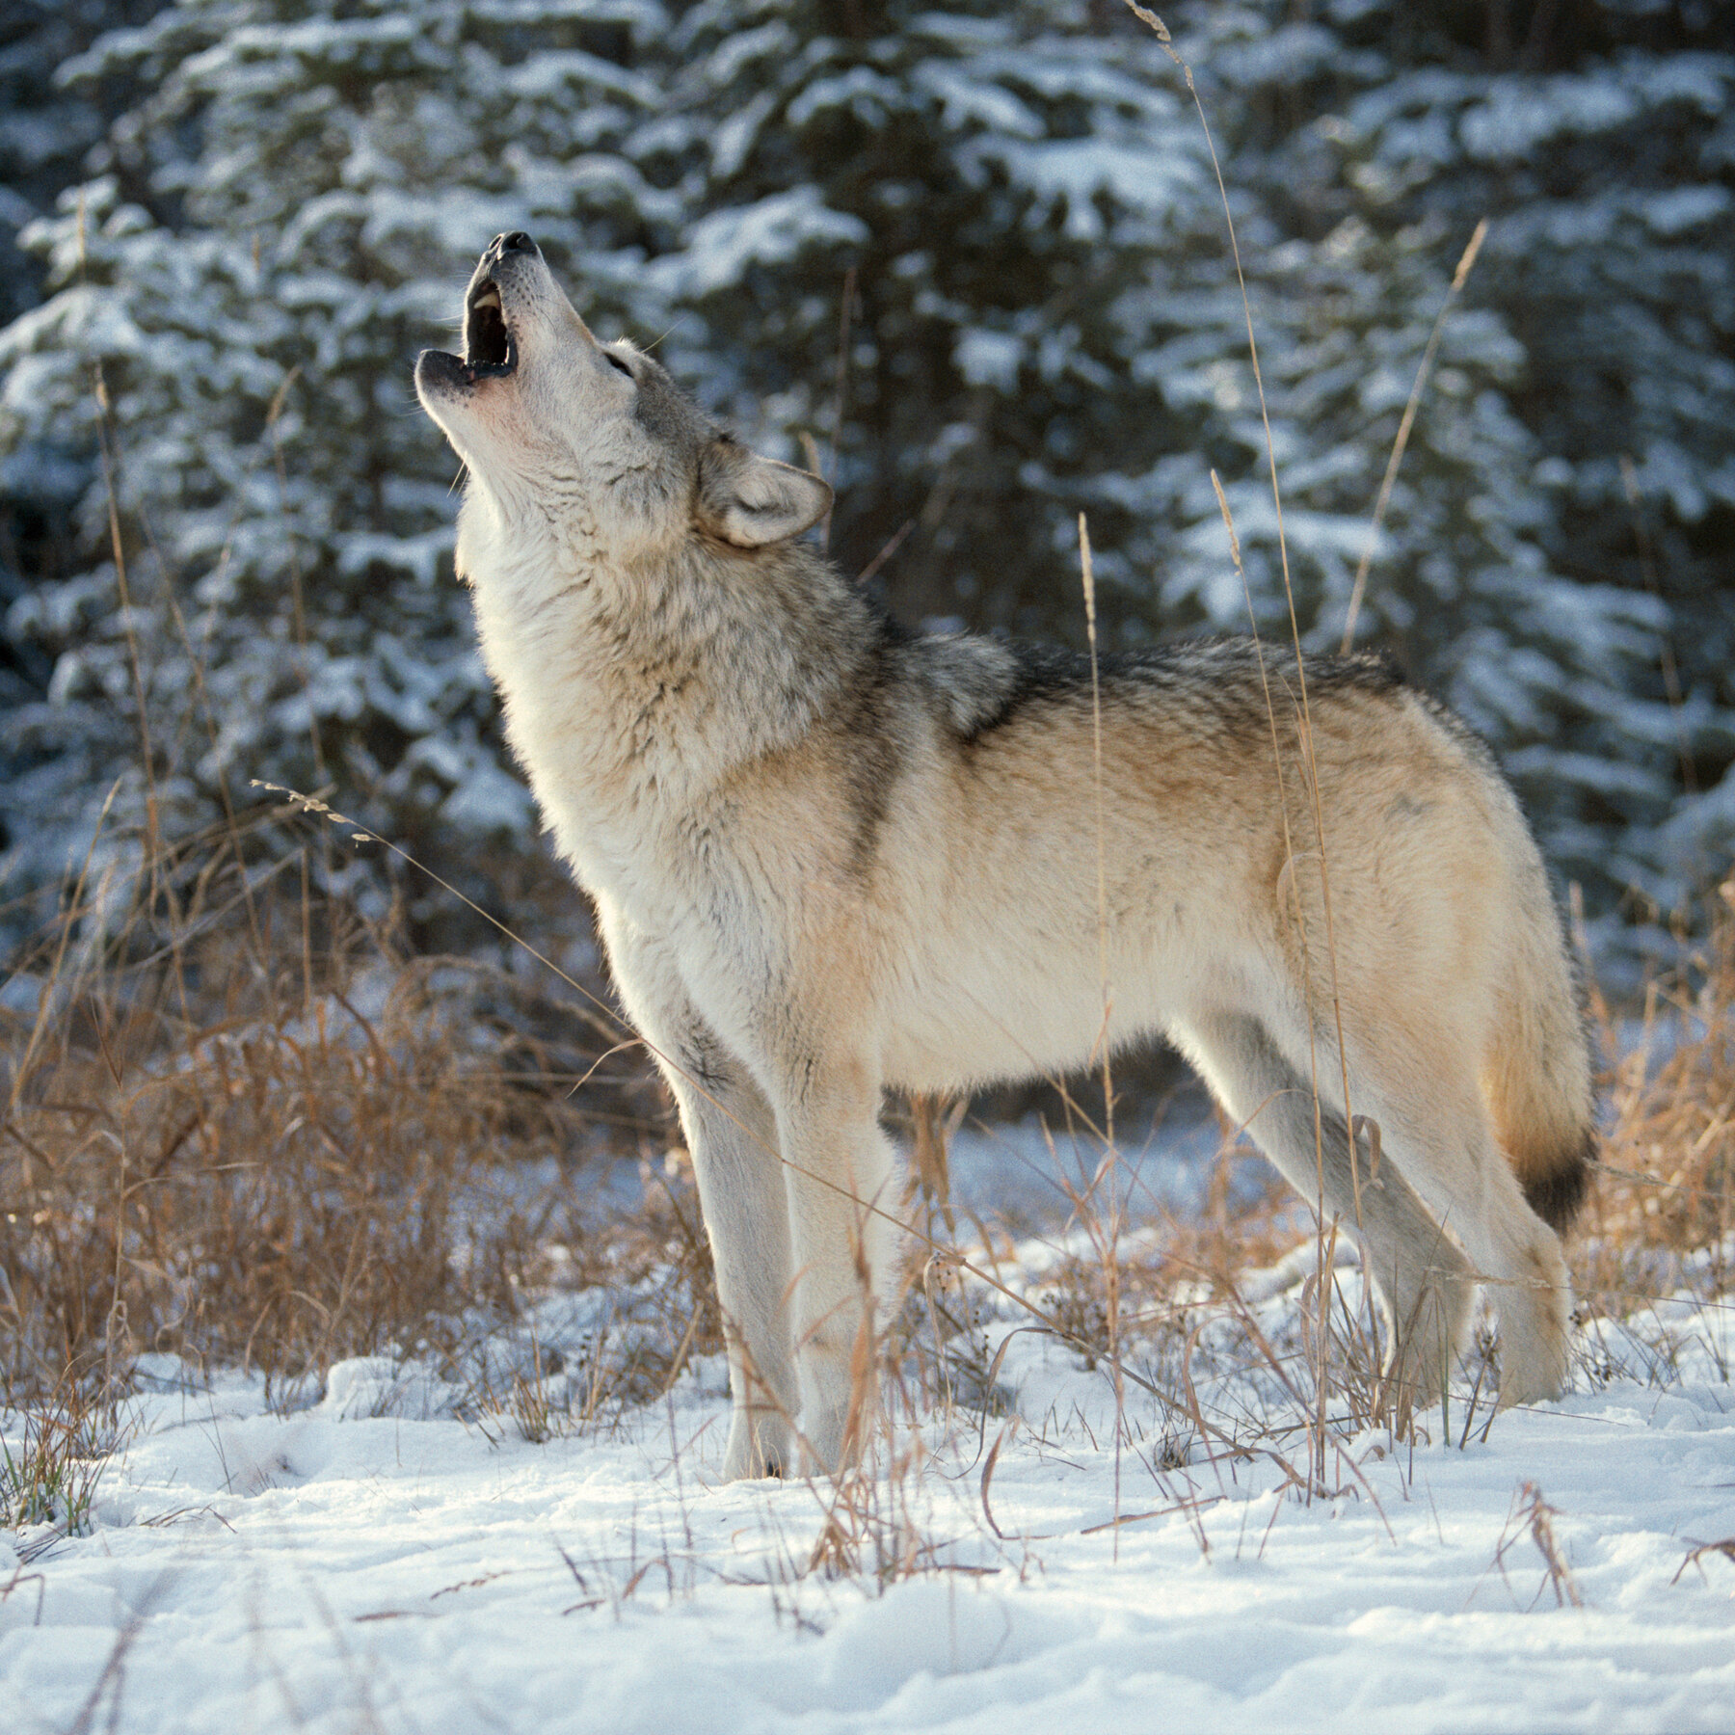
Now let’s see what happens when they reintroduced the wolf back into Yellowstone Park

