Slide 1
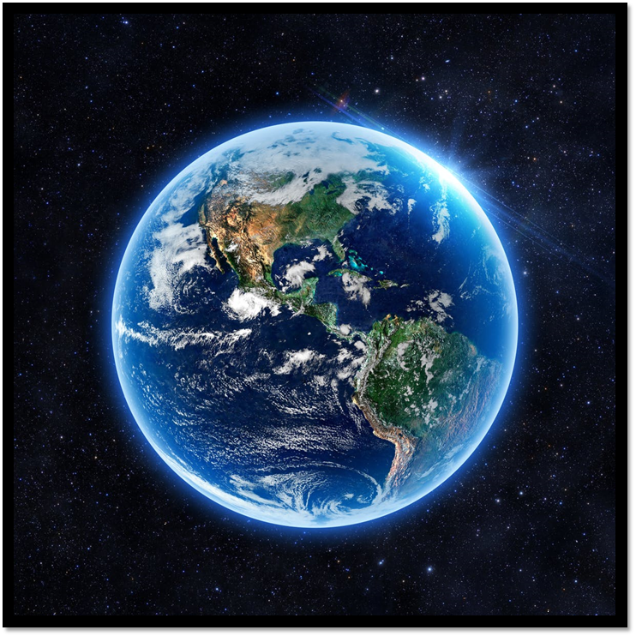
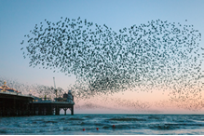
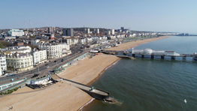
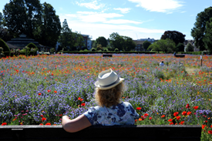
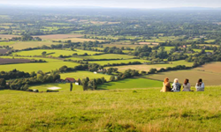
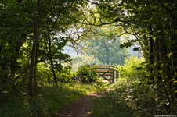
INTRODUCTION TO OUR LIVING COAST – A UNIQUE BIOSPHERE* AND ECOSYSTEM
*The biosphere is the surface of the earth where soil, water, and air combine to support life.

Slide 2
What do you like about living between the sea and the South Downs National Park?

Slide 3
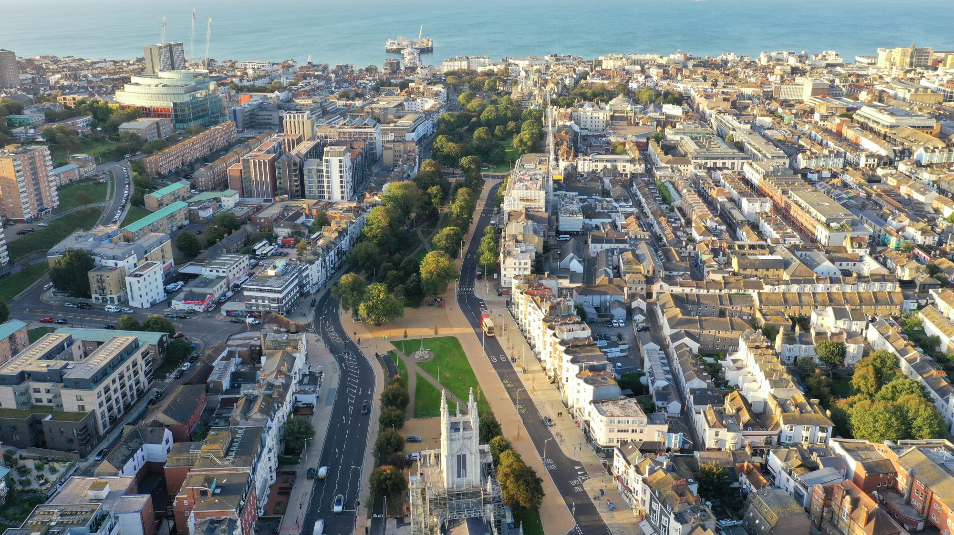
Let’s have a look at some of the people who enjoy living here

