Slide 1
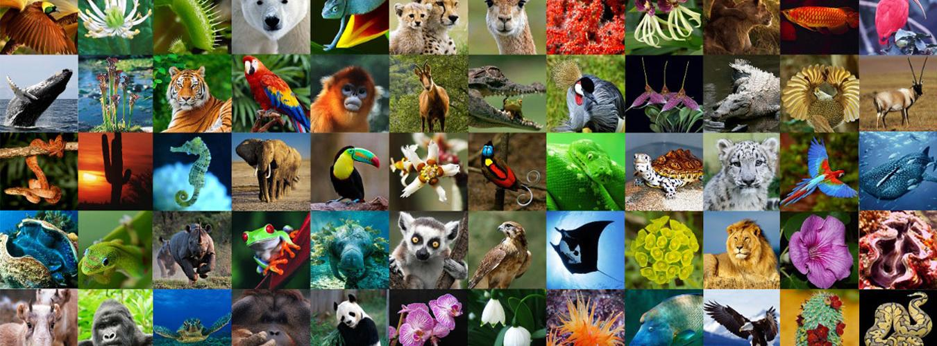

Slide 2
Our planet is home to:
Around 8 million animal species
1 million species of plants and fungi
5400 species of mammals
50,000,000,000 birds
3,500,000,000,000 fish
10,000,000,000,000,000,000 insects

Slide 3
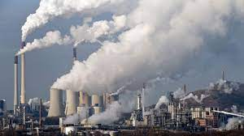
Our planet is home to:
8,000,000,000 humans
Human actions have wiped out about 60 percent of the world's wildlife populations in the last four decades

Slide 5
100 years ago there were the same number of wild mammals as there were human beings

Slide 7
So what have we done to our planet and its biodiversity?

Slide 8
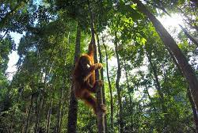
HEALTHY FOREST

Slide 9
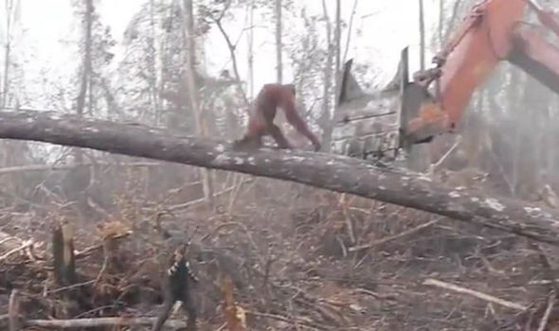
DEFORESTATION

Slide 10
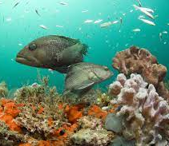
HEALTHY CORAL REEFS

Slide 11
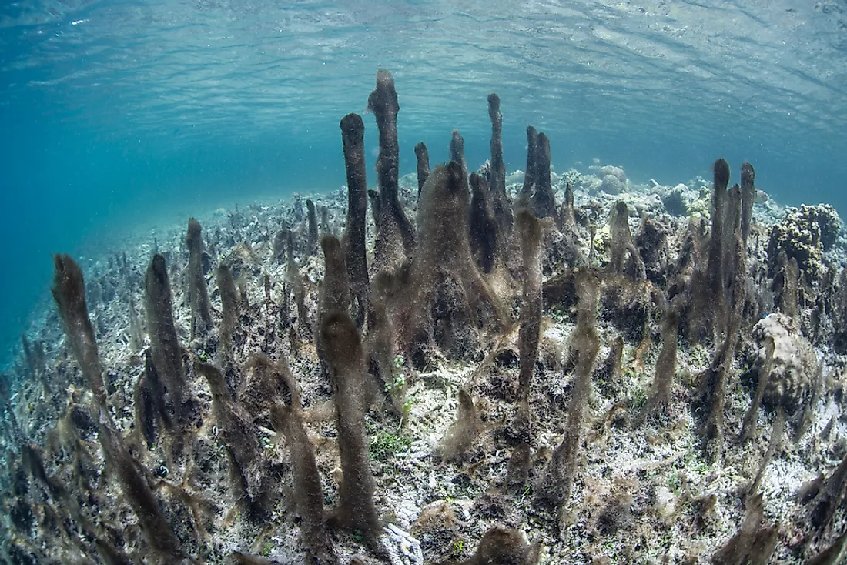
CORAL BLEACHING FROM GLOBAL WARMING

Slide 12
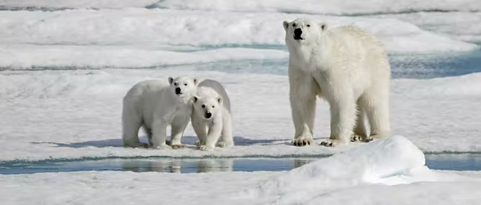
HEALTHY POLAR CAPS

Slide 13
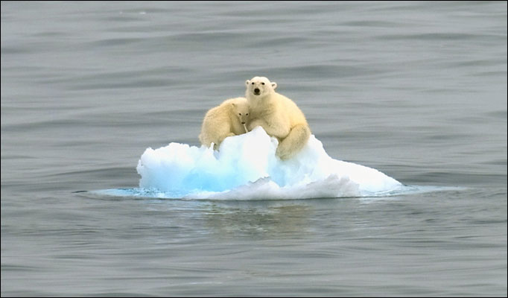
POLAR CAPS MELTING DUE TO GLOBAL WARMING

Slide 14
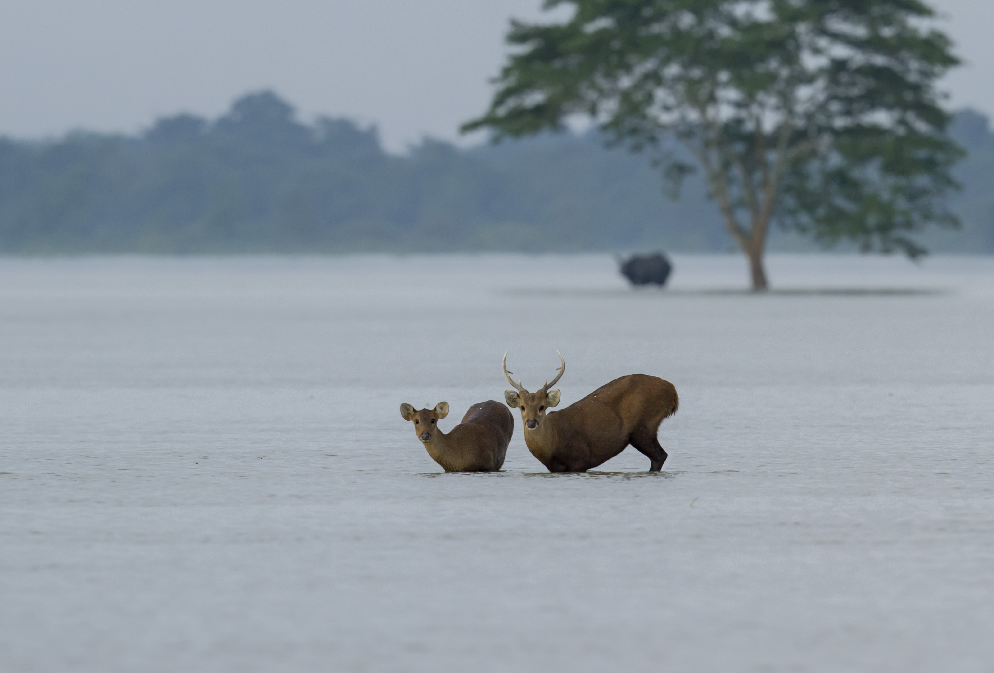
FLOODING CAUSED BY CLIMATE CHANGE

Slide 15
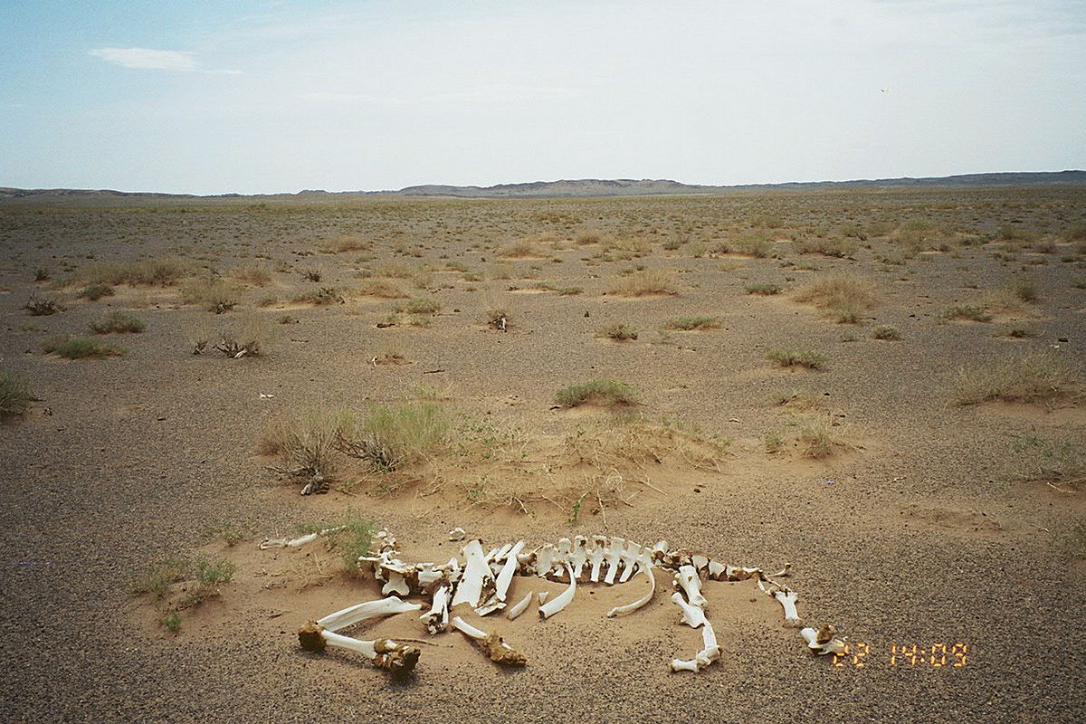
DESERTIFICATION CAUSED BY GLOBAL WARMING

Slide 16
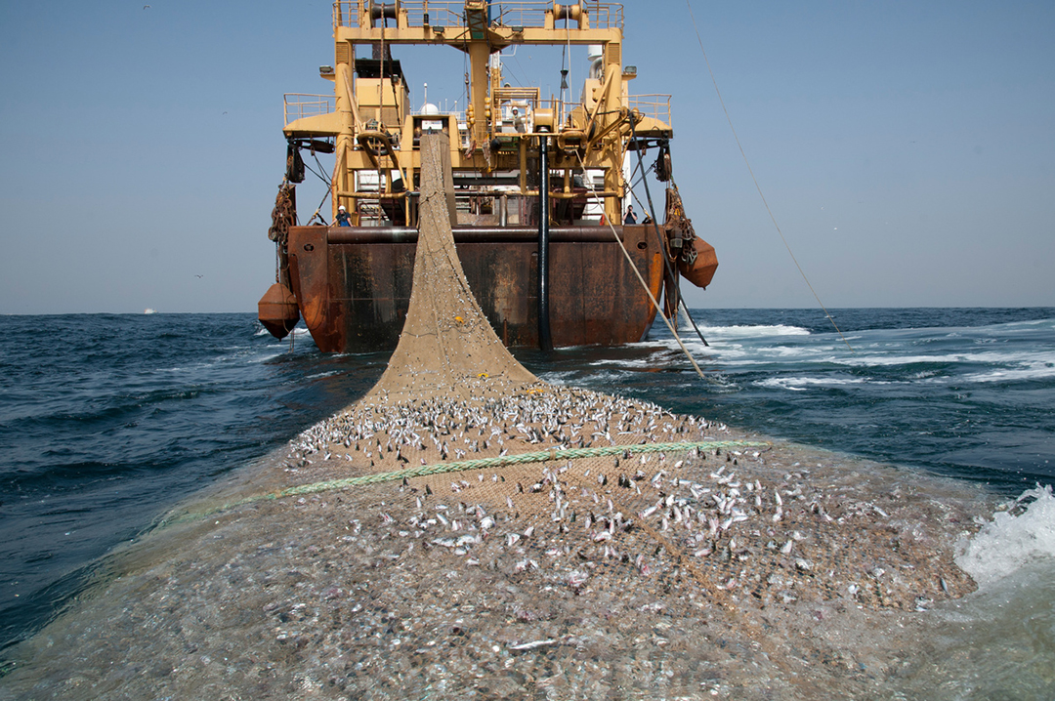
MASSIVE DECLINE IN THE NUMBER OF FISH DUE TO OVERFISHING

Slide 17
