Slide 1
Water and climate change

Slide 2
We don't just use water for drinking.
We:
wash in it
clean with it,
use it for our gardens
use it to produce everything from clothing to food
feed our livestock ( farm animals)

Slide 3
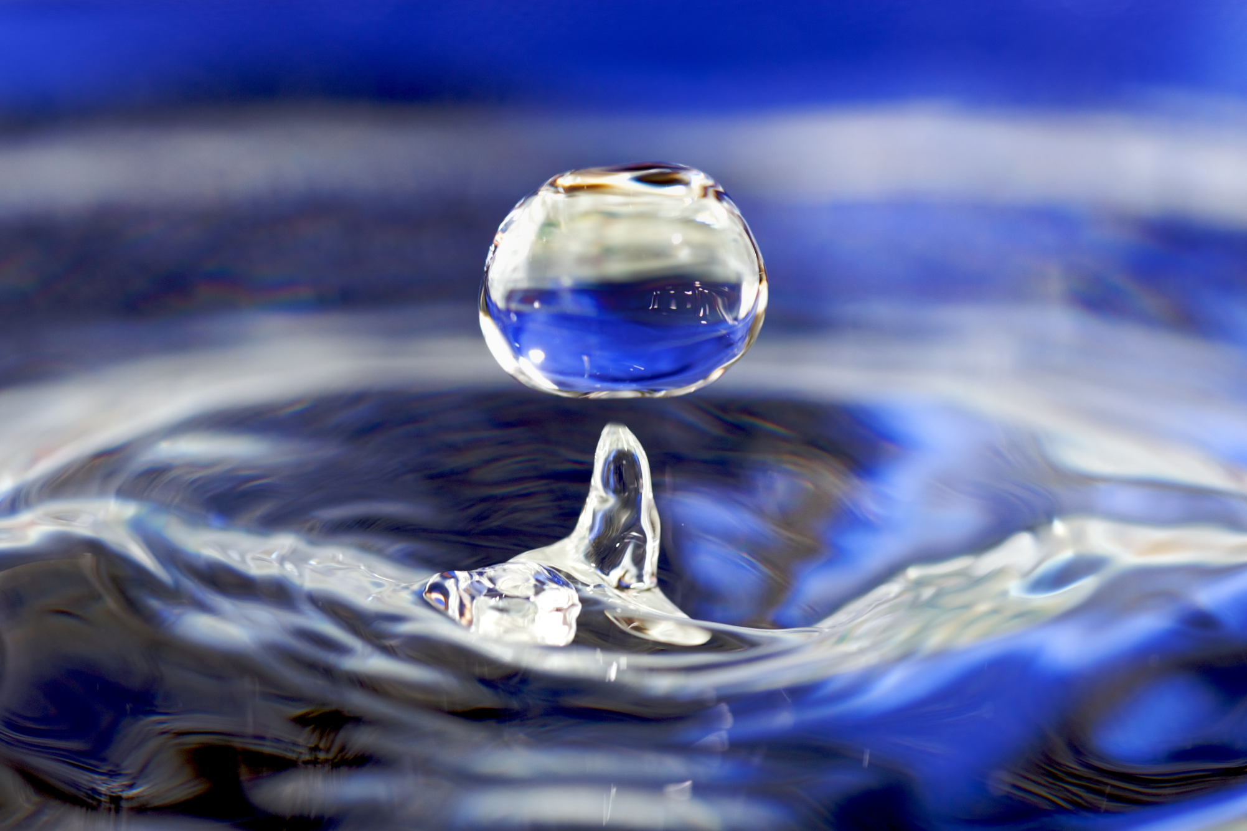
Water in our world

Slide 4
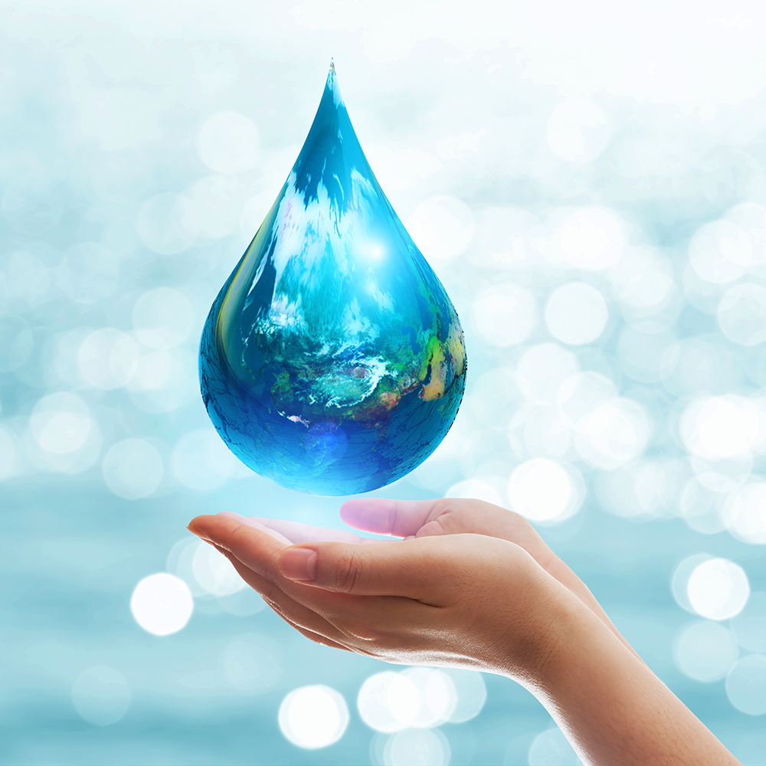
How can we save water?

Slide 5
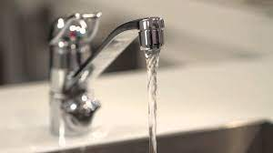
Turn off the taps
Save 6 litres of water a minute by turning off your tap while you brush your teeth.
Fix leaky taps too – and stop what could be 60 litres of water going straight down the drain every week.

Slide 6
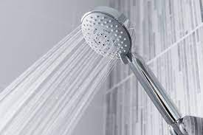
Shower with less
Every minute you spend in a power shower uses up to 17 litres of water . Set a timer on your phone to keep your showers short, sweet and water-saving.

Slide 7
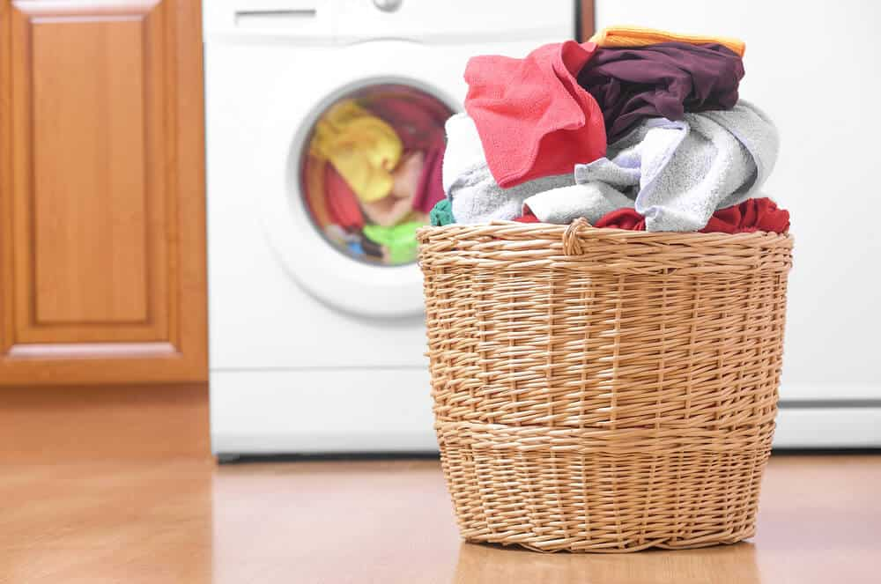
Save up your dirty clothes
Washing a full machine load of clothes uses less water and energy than 2 half-loads . This means lower bills as well.

Slide 8
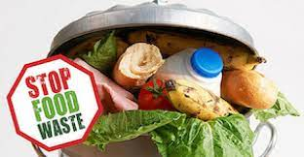
4. Reduce food waste
It takes a lot of water to produce our cereal, fruit and other food.
More than half of the 7 million tonnes of food and drink UK households bin every year could be eaten.
Wasting less food could save you £540 a year .

Slide 9
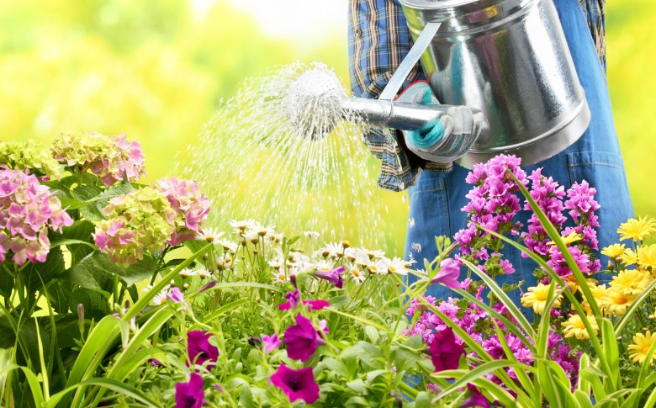
5. Time your gardening
Water outdoor plants in the early morning or at the end of the day to stop water immediately evaporating in sunlight and heat. Water the soil so that the liquid goes straight to the roots, where it’s needed.

Slide 10
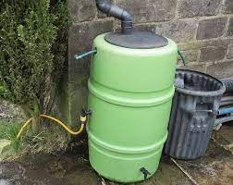
Catch rainwater
Installing water butts saves up to 5,000 litres of water a year . And your plants will thank you for rainwater rather than treated tap water.

Slide 11
Quality and seasonal eating
Rearing animals for meat and dairy and harvesting crops like avocado at a large and unsustainable scale is incredibly water-intensive. By cutting down on meat and dairy and eating seasonal vegetables you'll be helping to conserve water.

Slide 12
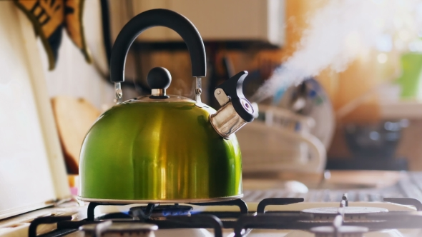
Boil what you need
Save water, money and energy by only boiling as many cups of water as you need.

Slide 13
Next Time
Clothes and water

