Slide 1
Climate Change
CLIMATE CHANGE
WATER
WATER

Slide 2
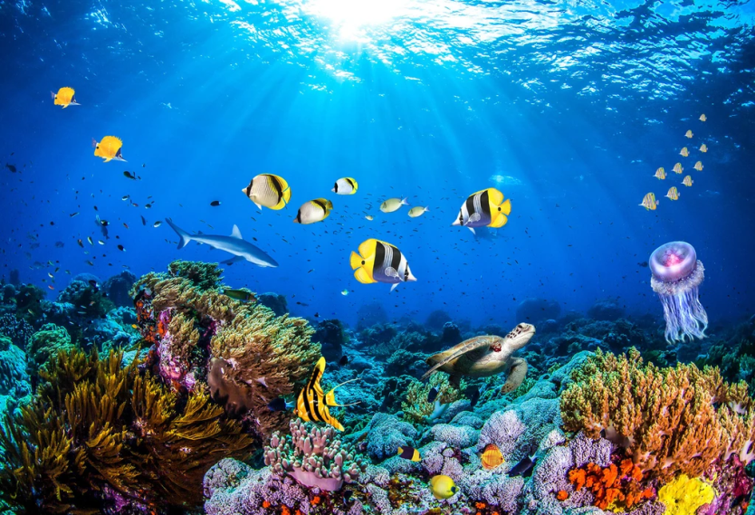
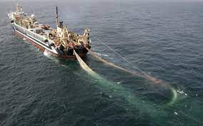
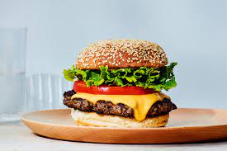
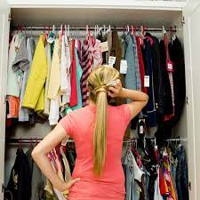
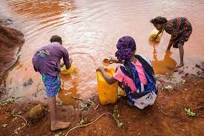
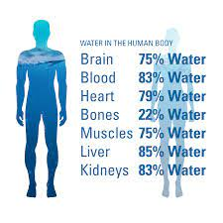
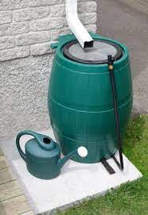
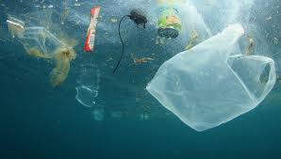

Slide 3
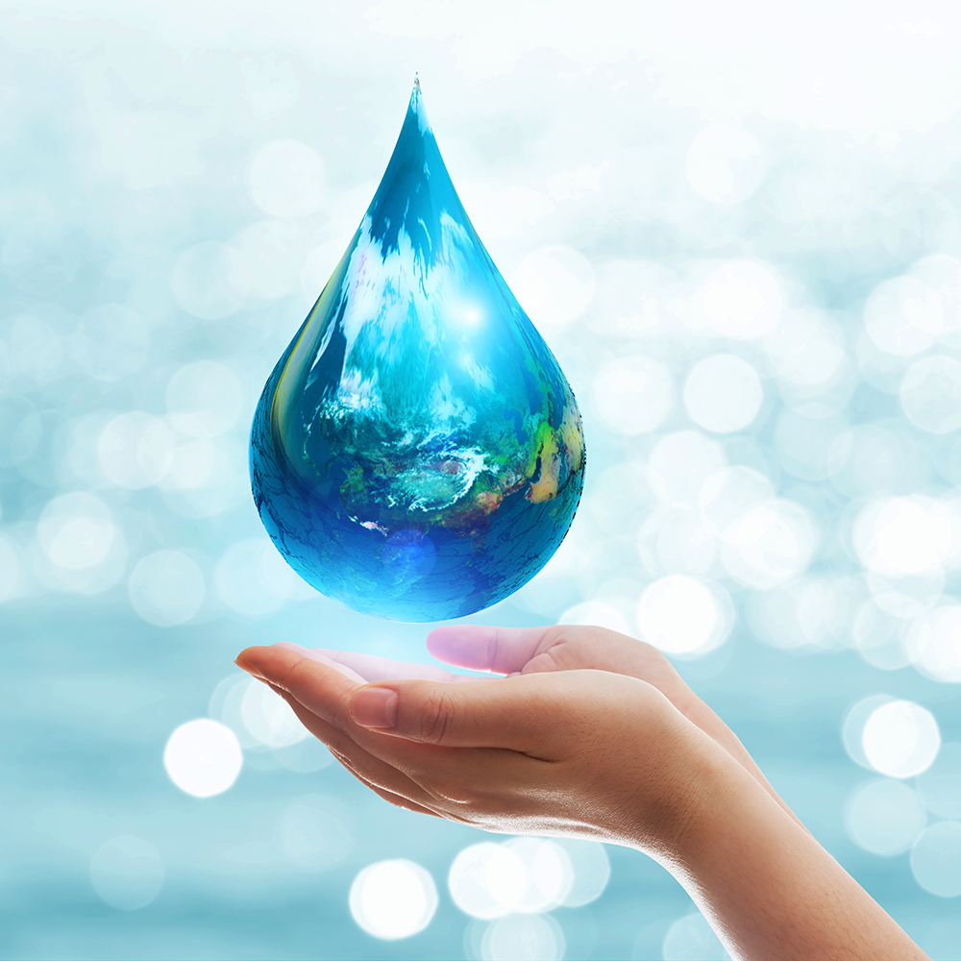
How can we save water?

Slide 4
6 litres of water a minute by turning off your tap while you brush your teeth.
Fixing leaky taps can stop 60 litres of water going straight down the drain every week
Every minute you spend in a power shower uses up to 17 litres of water
Washing a full machine load of clothes uses less water and energy than 2 half-loads

Slide 5
It takes a lot of water to produce our cereal, fruit and other food. More than half of the 7 million tonnes of food and drink UK households bin every year could be eaten. Wasting less food could save you £540 a year
Watering outdoor plants in the early morning or at the end of the day stops water immediately evaporating in sunlight and heat.

Slide 6
Installing water butts saves up to 5,000 litres of water a year . And your plants will thank you for rainwater rather than treated tap water.
You can save water, money and energy by only boiling as many cups of water as you need.

Slide 7
You need to think about how much meat and dairy you eat - 2393 litres of water to produce a burger
You need to think about how much coffee/tea you drink - 140 litres of water to produce one cup of coffee/30 litres for a cup of tea
You need to think about how much clothing you buy or buy more second hand clothes- 2700 litres of water in a T-Shirt

Slide 8
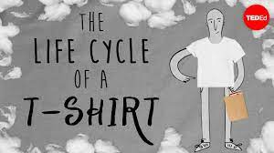

Slide 9
If the global population rises as expected to 8.5 billion people by 2030, it is projected that the overall clothing consumption will rise by 63%, 62 million tons today to 102 million tons in 2030.

