Slide 1
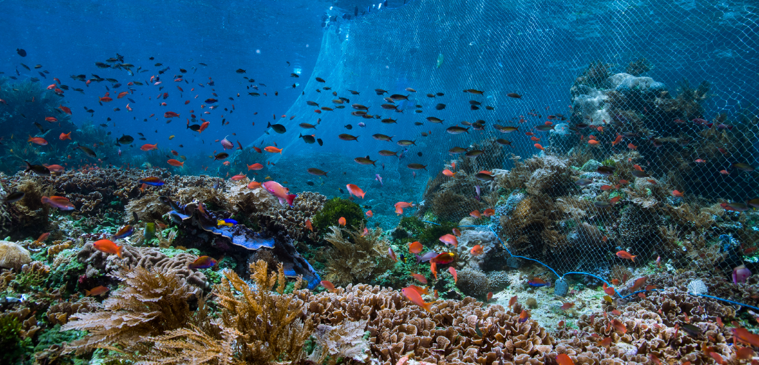
Our beautiful oceans
Ocean film

Slide 2
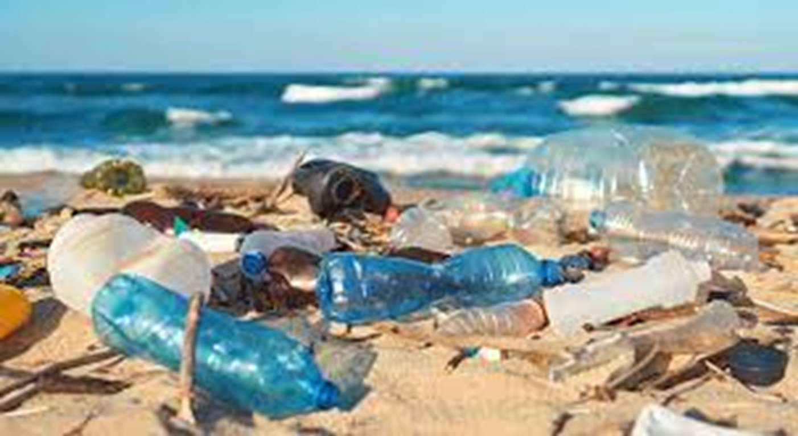
Plastic pollution

Slide 3
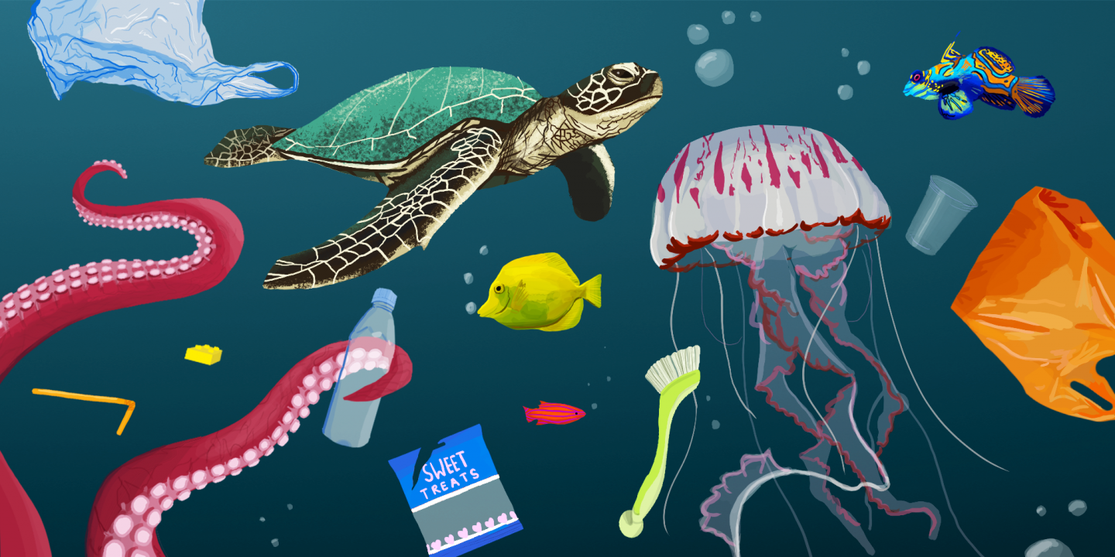
How does plastic end up in our oceans?

Slide 4
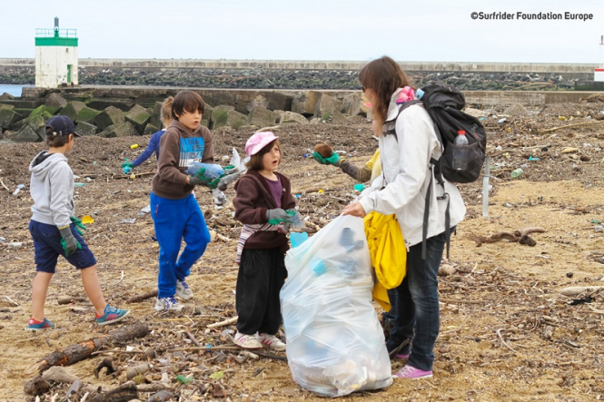
Taking action
Children Taking Action

Slide 5
Tracing the journey of the plastic
https://www.nationalgeographic.org/video/tracking-plastics-sea-source/?utm_source=BibblioRCM_Row

Slide 6
Inventions to stop the use of plastic
Stopping plastic usage

