Slide 1
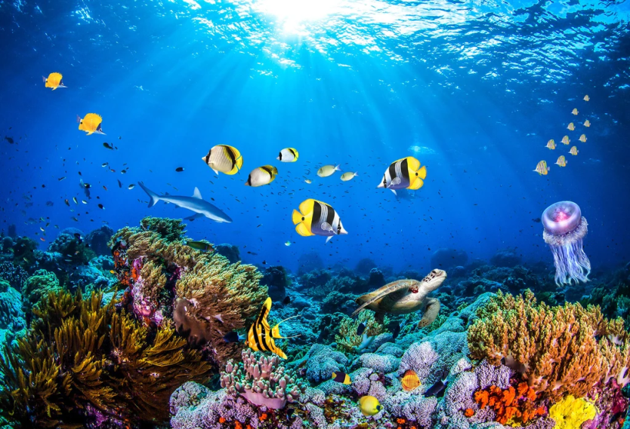
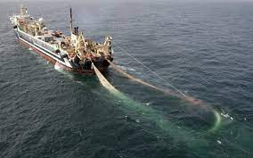
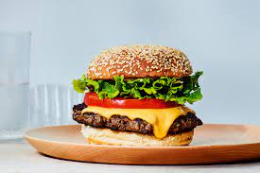
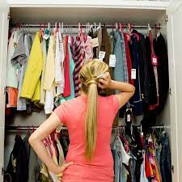
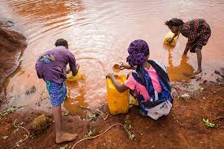
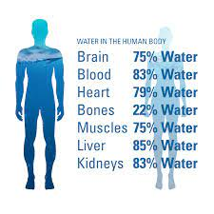
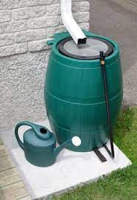
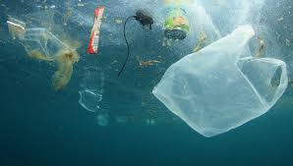

Slide 2
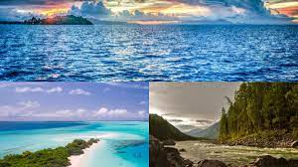
Climate Change
CLIMATE CHANGE
WATER
WATER

Slide 3
The wonders of our Blue Planet

Slide 4
Keep your eyes wide open!
Listen, reflect, act!

Slide 5
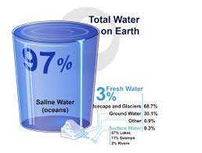

Slide 6
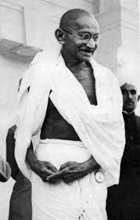
Earth provides enough for everyone’s need but not enough for everyone’s greed
Be the change you want to see in the world
Mahatma Gandhi

Slide 7
What do you want to know more about?

Slide 8
Be the change song
https://www.youtube.com/watch?v=gK-edW7TSOk

