Slide 1
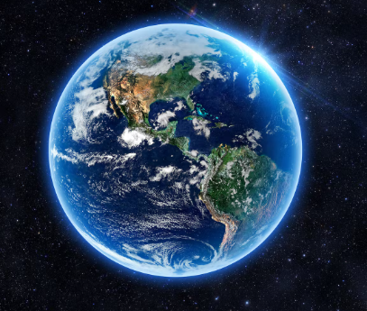
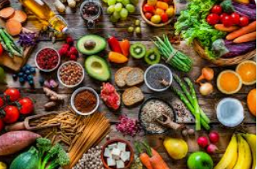
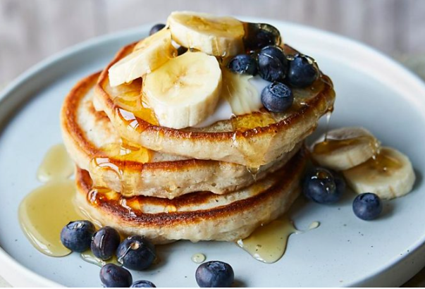
Why do we need FOOD?

Slide 2
Every living thing needs food for life. Our food gives us the energy we need to live and the carbohydrates, fats, protein, vitamins and minerals that we need to stay healthy. The food we eat also links us to our family and friends who we share food with and the farmers who produce food in the UK and around the world.

Slide 3
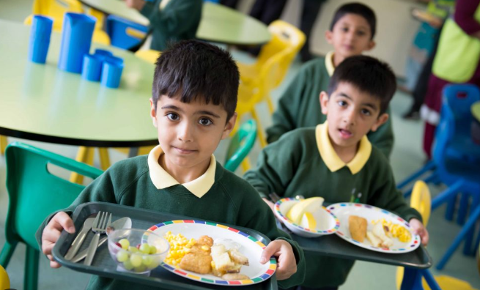
Where does our food come from?

Slide 4
How is land used to produce food?

Slide 5
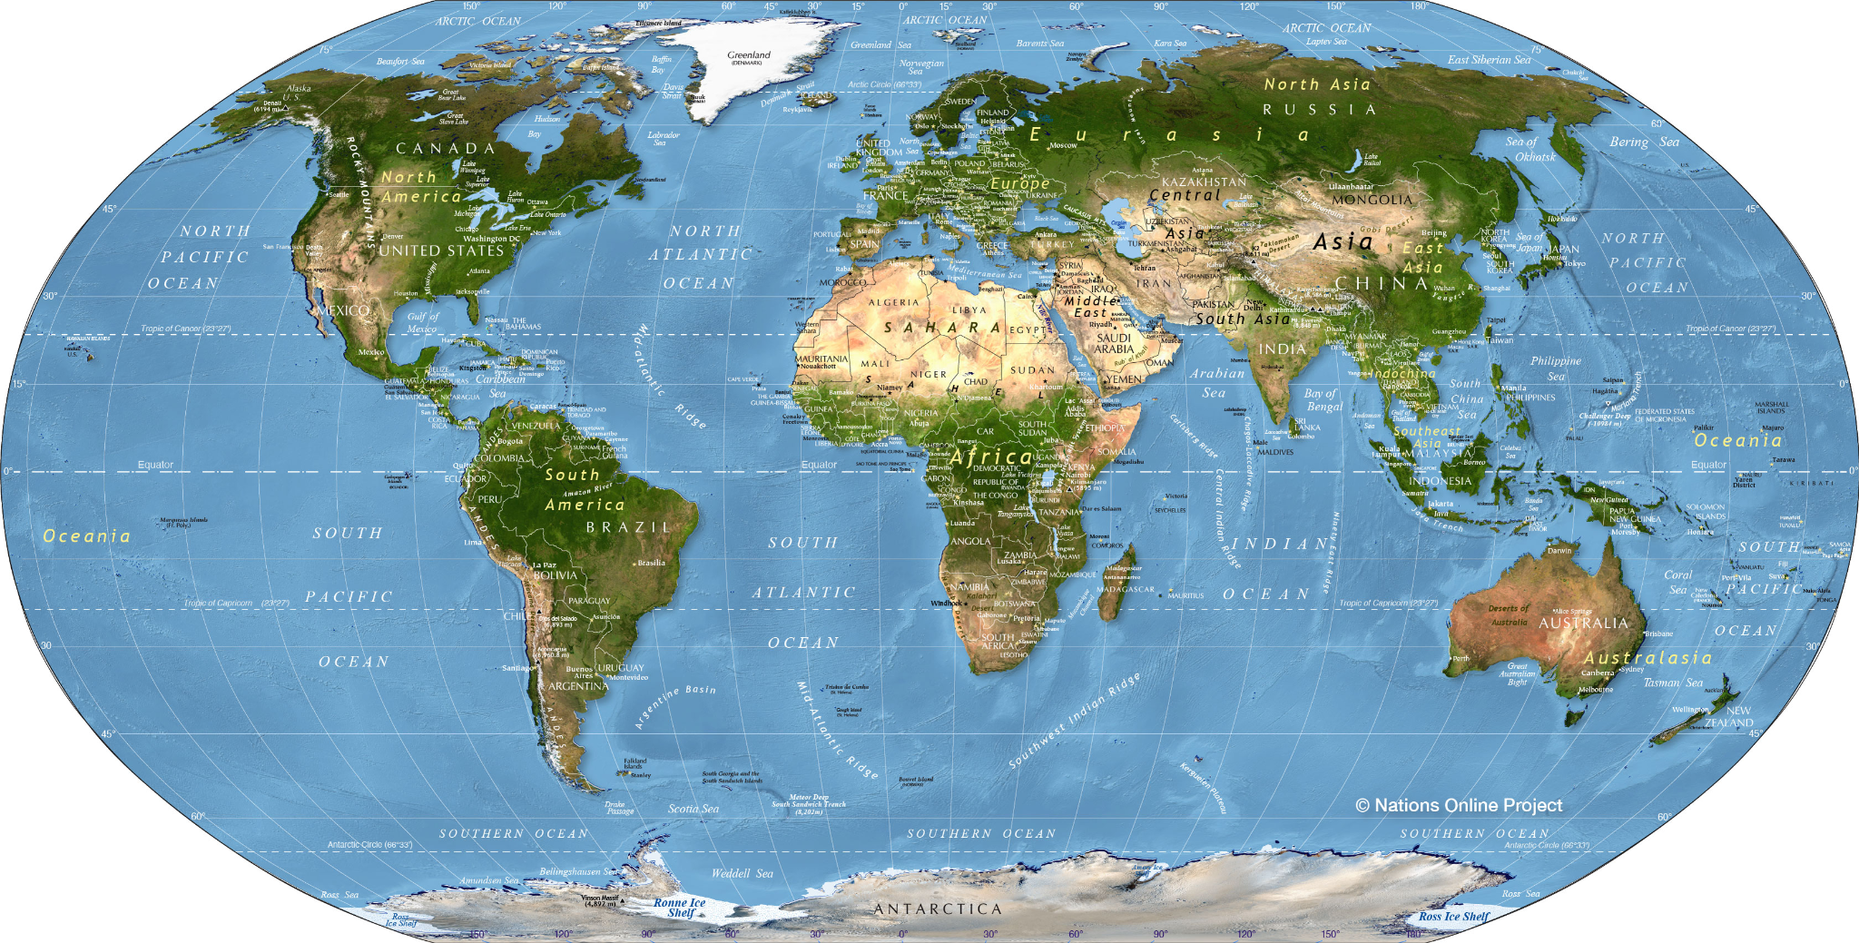
Our planet, Earth, provides us with all our food. A large part of the world’s land surface is used for farming and making food.

Slide 6
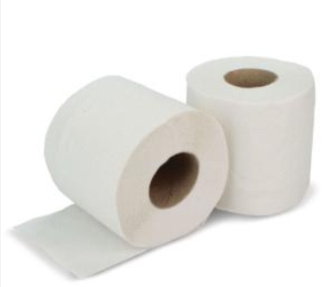
Many people think the main reason forests are cut down is to make paper.
What do you think the main reason is for cutting down forests around the world?

Slide 7
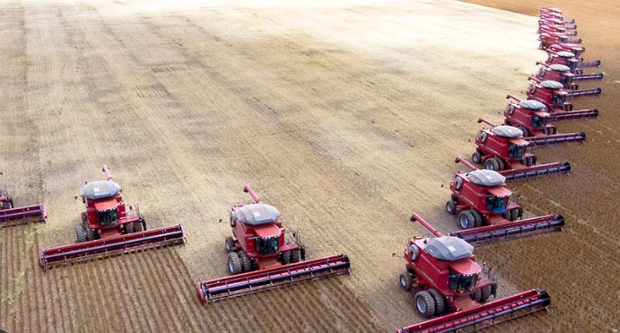
It’s actually farming!
Farming or ‘agriculture’ includes both growing crops and raising animals.
Notes:
Farming affects all of us in our daily lives, even if you might not realise it.

Slide 8
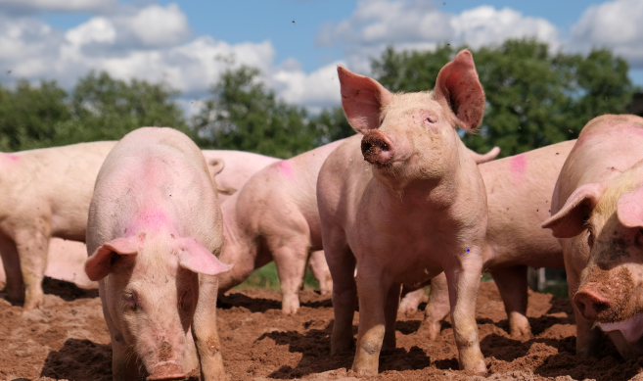
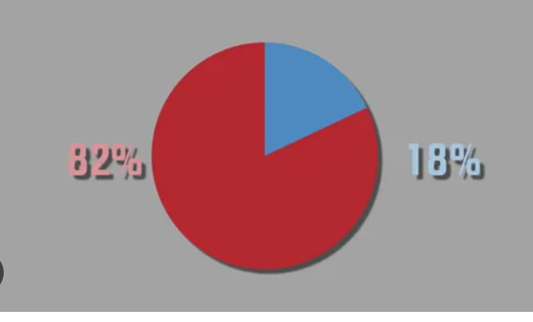
Farmed Land
77% of farmed land is used to produce animal products - this provides 18% of our food.
23% of farmed land that produces plants - supplies 82% of our food.
What do you think of this?
Notes:
77% - much of this land is used to produce crops to feed these animals. It takes a lot of land to produce a little bit of meat.

Slide 9
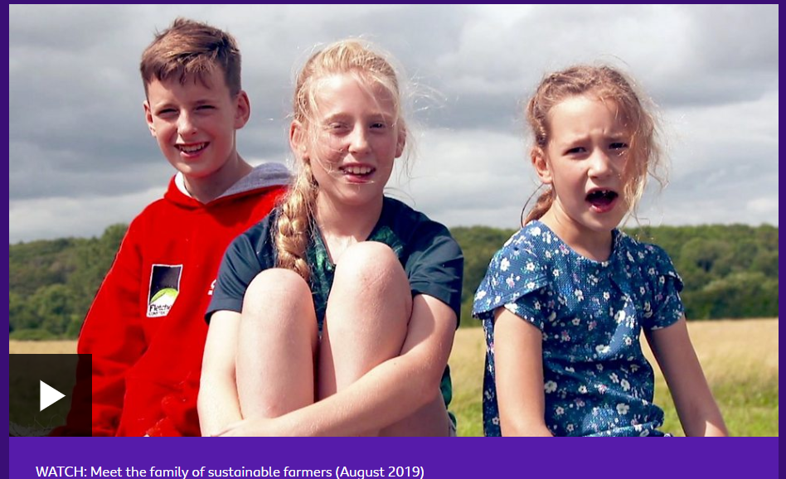
Clip on Sustainable farming
Climate change: What's it got to do with farming? - CBBC Newsround
Watch clip about sustainable farming
Notes:
https://www.bbc.co.uk/newsround/49371062

Slide 10
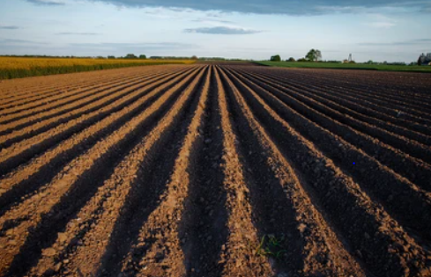
Is ploughing good or bad?
Notes:
It rapidly removes weeds
Damages the health of natural soil, destroys natural fungal strands that keep soil healthy and alive

Slide 11
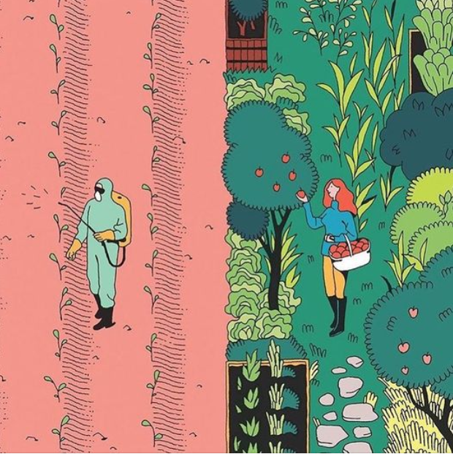
Has anyone heard of these words?
Monoculture
Permaculture

Slide 12
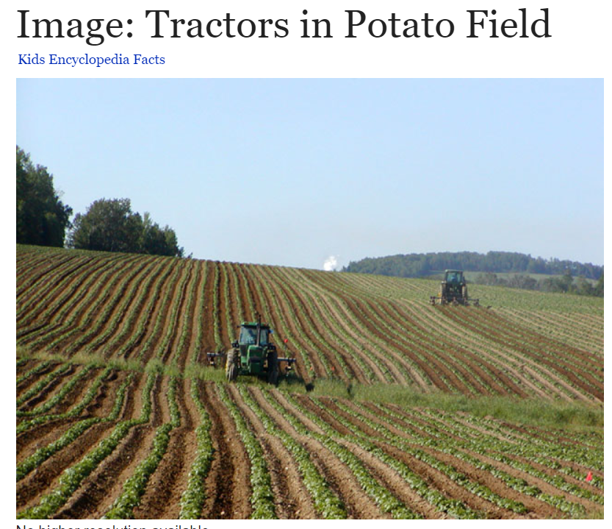
Monoculture is the growing of only one crop or keeping only one type of animal on an area of farmland.
Monocultures have problems. They are bad for the health of the soil and surrounding nature in the long term. We use monocultures because
they’re easier to farm industrially on a large scale.

Slide 13
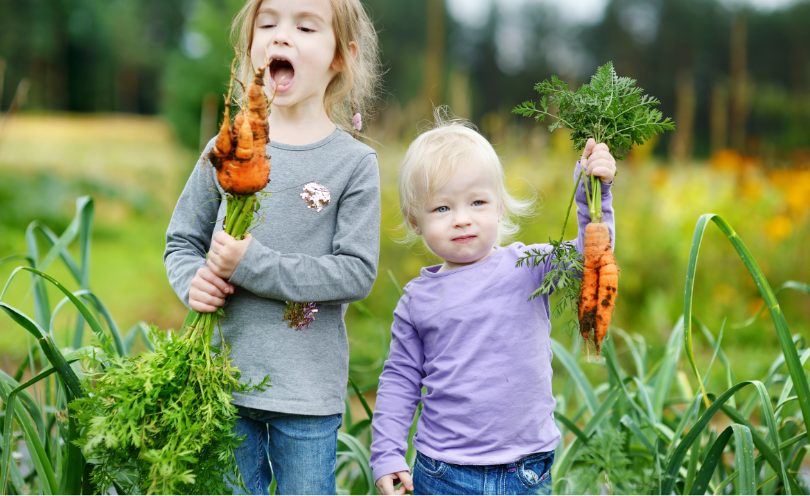
Permaculture A way for growing crops, and plants that does not damage the environment.
What do you think this looks like?
Notes:
Information https://medium.com/invironment/permaculture-and-kids-ba5a8d441765

Slide 14
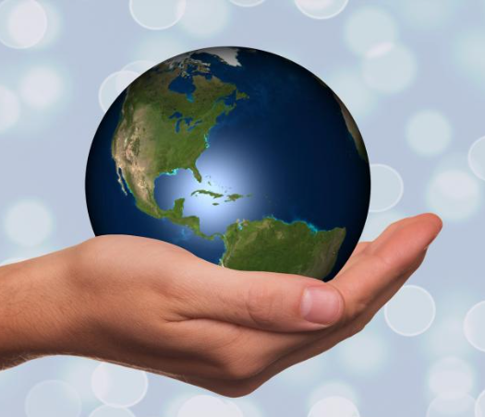
If you were a farmer, how would you make sure you are looking after our planet?

