Slide 1
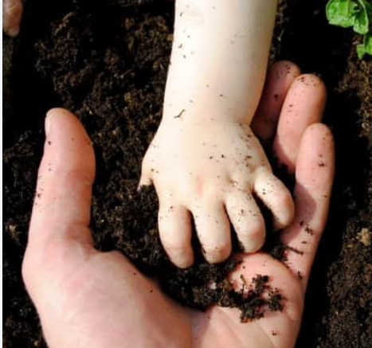
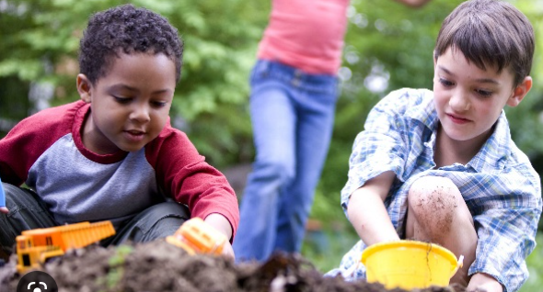
The wonder that is soil

Slide 2
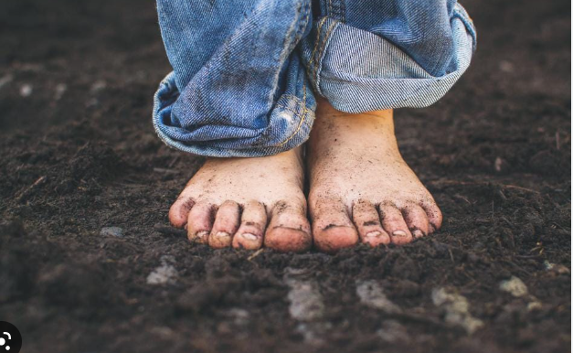
Why is soil so AMAZING?

Slide 3
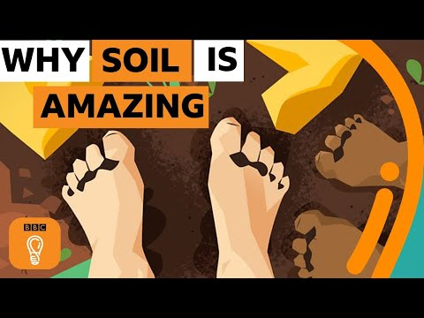
Notes:
https://www.youtube.com/watch?v=MmJUj4Aa2kM&t=6s

Slide 4
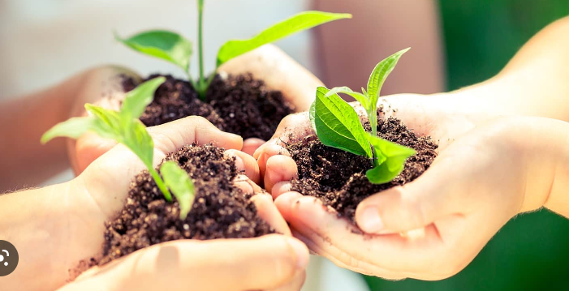
What have you learnt today?
Why is soil so AMAZING?
What is happening to our soil?

Slide 5
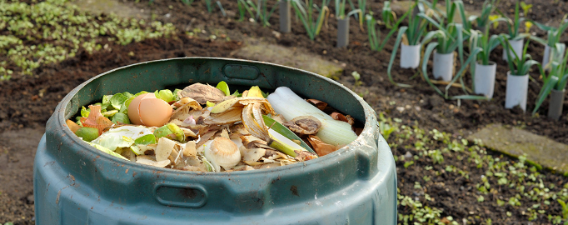
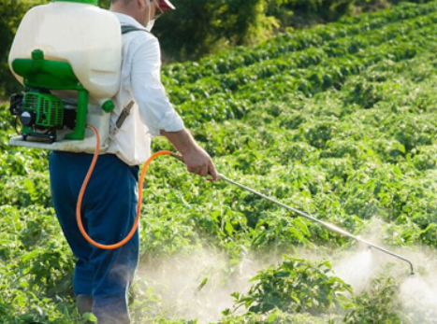
How can we protect our soil?
What could we do at our school?
What could we do at home?

Slide 6
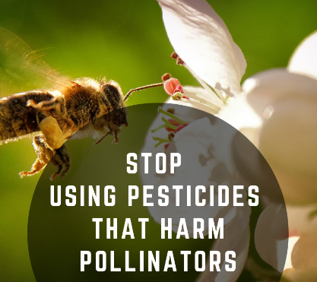
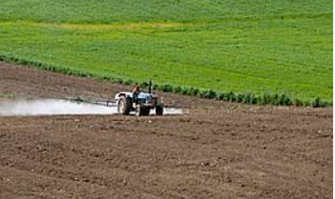
Some solutions
Farmers could use fewer chemical pesticides. This means that the topsoil is not harmed and birds and other insect-eating creatures are more likely to live on farmland.
Protecting forests and planting more trees can also help soil stay healthy.
Farmers can ‘rotate’ their crops. This means planting lots of different crops. Increased biodiversity improves the range of nutrients (the good stuff!) in the soil.

Slide 7
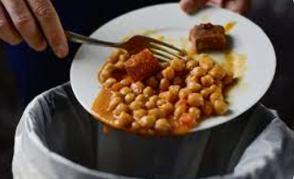
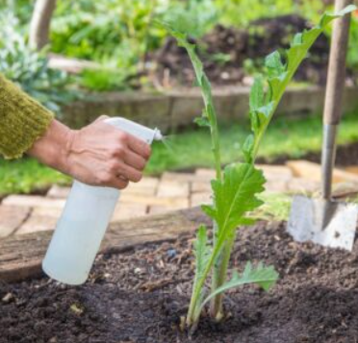
Some solutions
We can stop wasting food.
This means less food has to be grown in the first place.
We can compost food and garden waste so the nutrients can be returned to the soil.
We can use fewer chemical products such
as pesticides in our gardens so that these
do not damage the soil.

