Slide 1
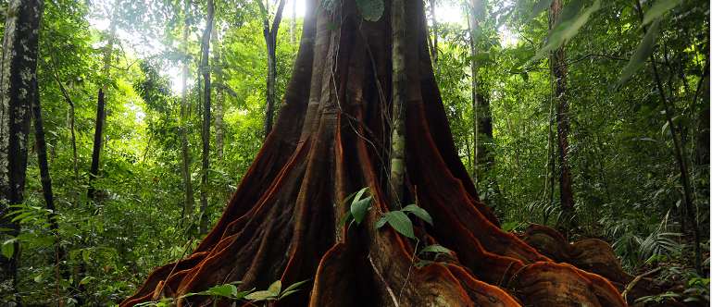
Why are forests important?

Slide 2
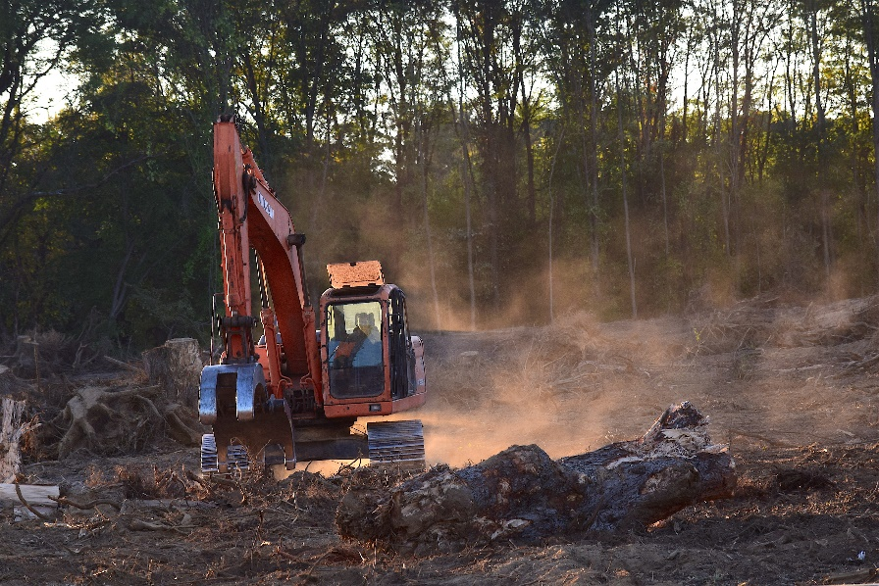
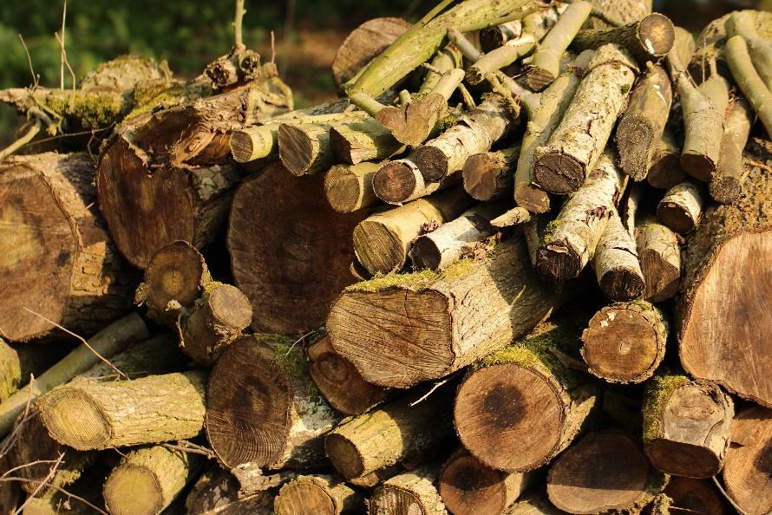
What is deforestation?

Slide 3
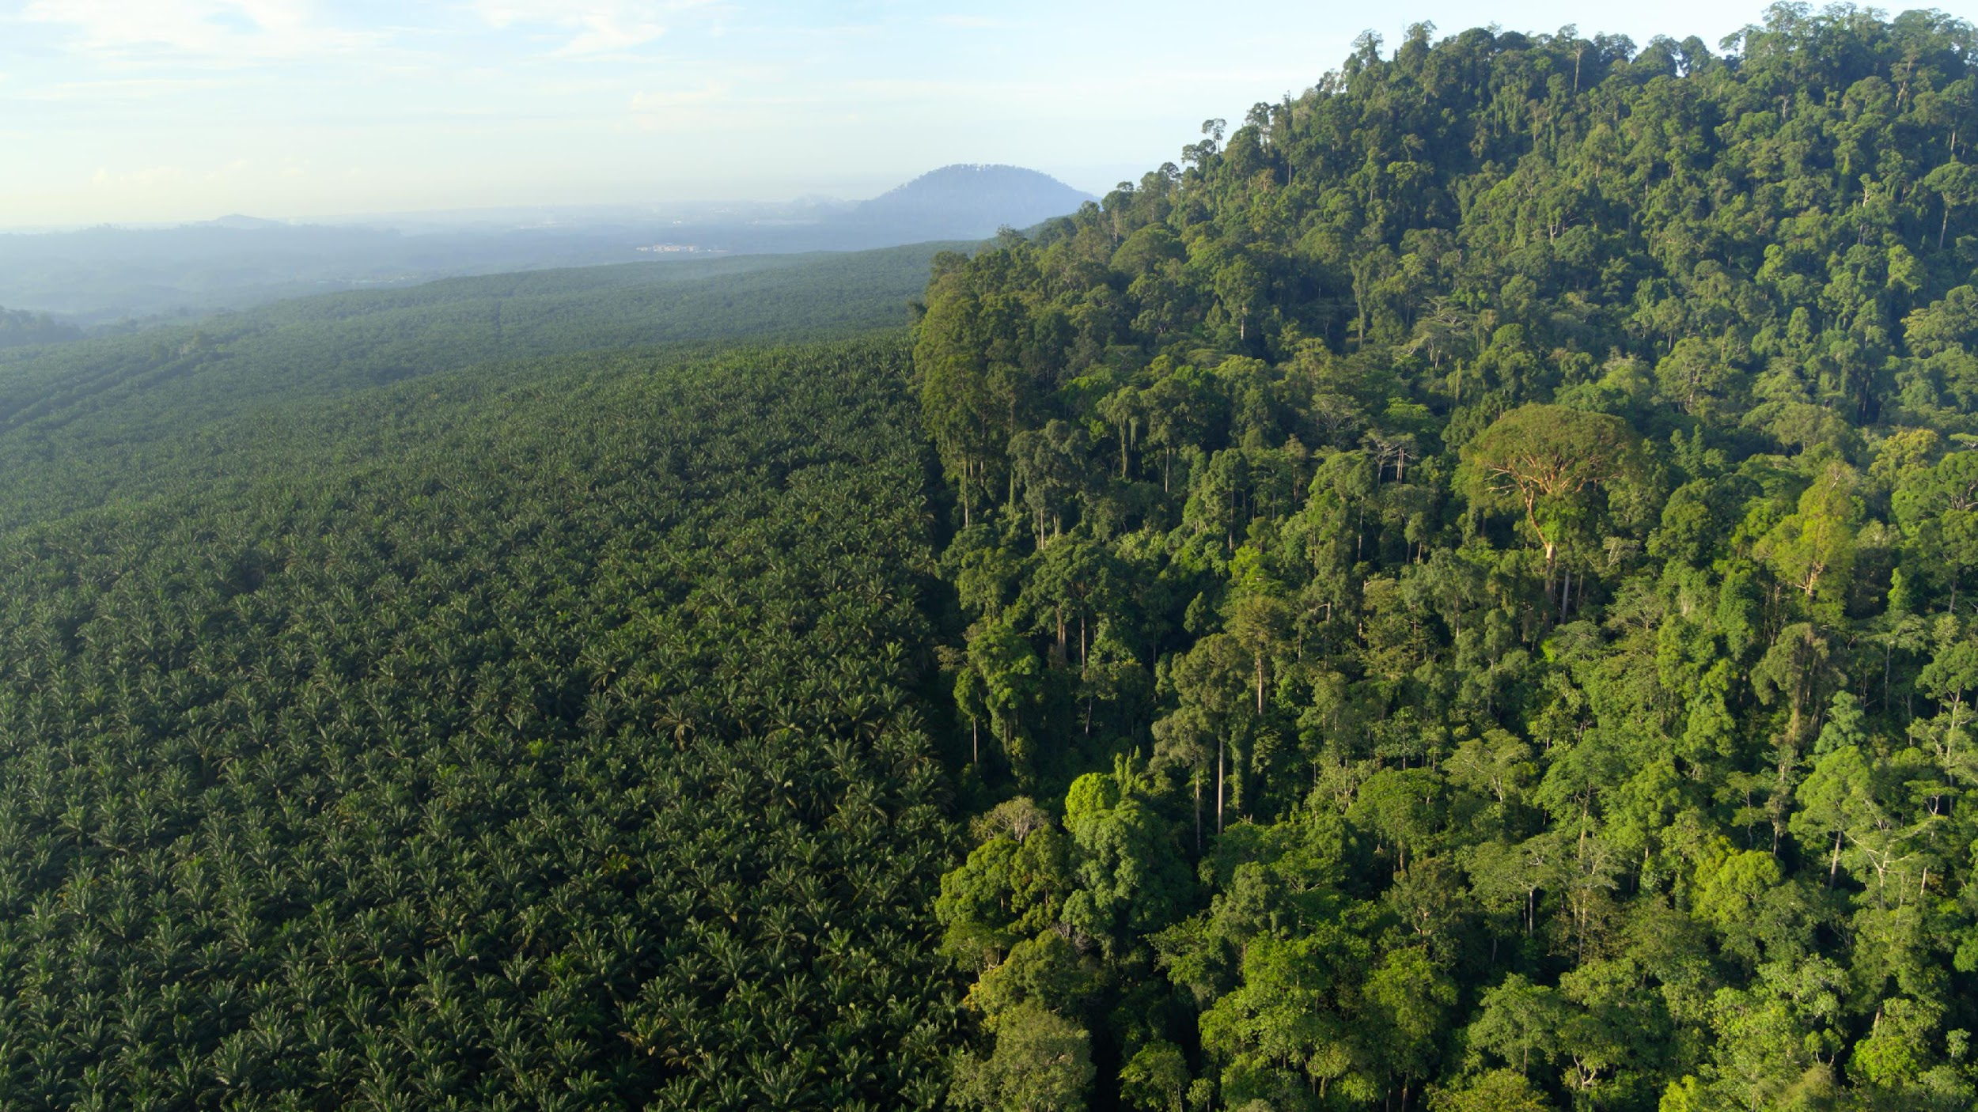
What Is Deforestation?
Deforestation is the deliberate removal of forests. This is done by cutting down trees and shrubs and starting fires. This happens so that the land can be used for other things, including planting crops and grazing cattle, as well as the development of towns and cities.
Did You Know…?
Every minute, an area of rainforest the size of a football pitch is cut down. If this rate continues, there will be no rainforests in 100 years.
Netflix / David Attenborough: A Life On Our Planet

Slide 4
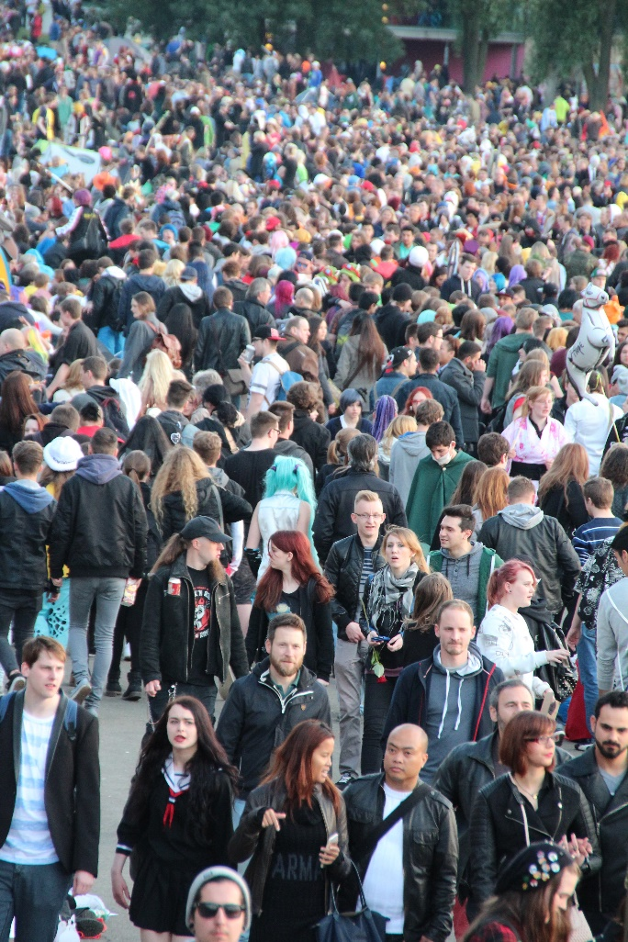
There are over 7 billion people on the planet. This number keeps growing. All of these people need food so land is cleared for farming. Forests are cleared for animal grazing, which provides meat. Land is also used to grow crops, such as sugar cane and palm oil. Huge areas of forest are cut down to grow soya, which is used to feed cattle and pigs.

Slide 5
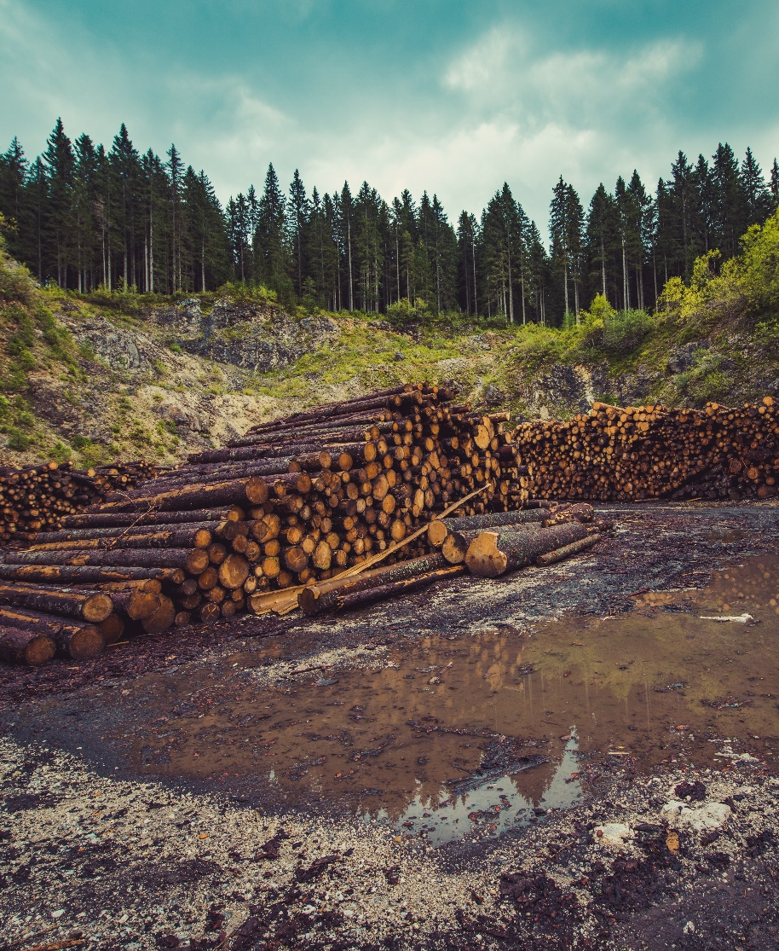
What are the effects of deforestation?
Deforestation destroys the homes (habitats) of many trees, plants, animals and other living creatures.
Tree roots help hold the soil together and stop it from being washed away. Without trees, the soil is washed into rivers and streams, causing flooding.
Scientists believe deforestation is harmful for our climate. Trees store carbon dioxide. When they are cut down, the gas is released and builds up in the atmosphere. Carbon dioxide contributes to global warming.
Deforestation also means that some people who live in the rainforests are losing their homes.

Slide 6
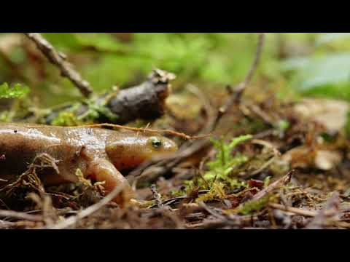
How To Save Our Forests and Rewild Our Planet David Attenborough
Notes:
https://www.youtube.com/watch?v=Ig9Tfc_hNsE

Slide 7
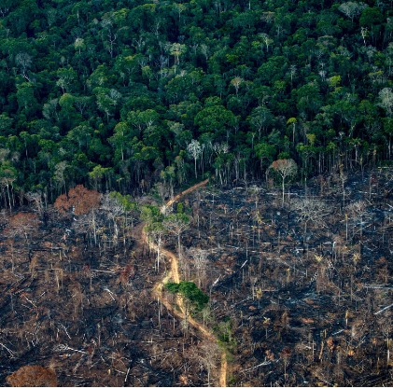
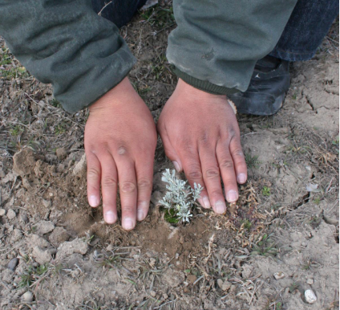
How can we combat deforestation?

