Slide 1
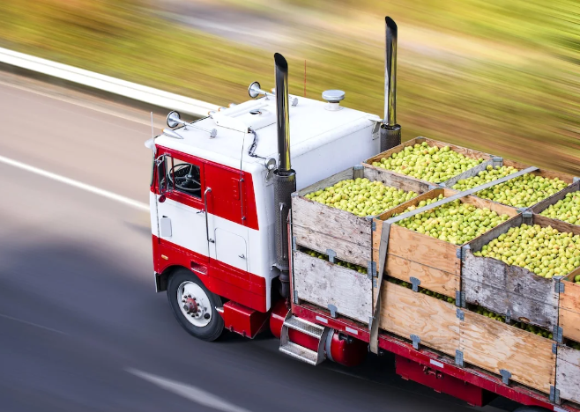
Food and Transportation

Slide 2
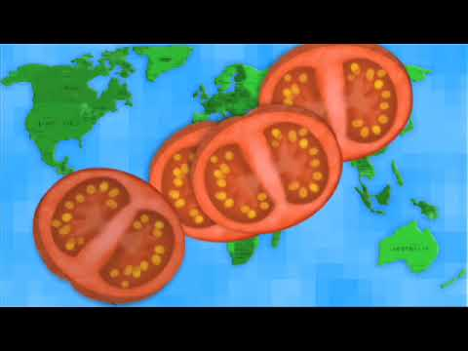
How far has your cheese sandwich travelled? How does this affect the environment?

Slide 3
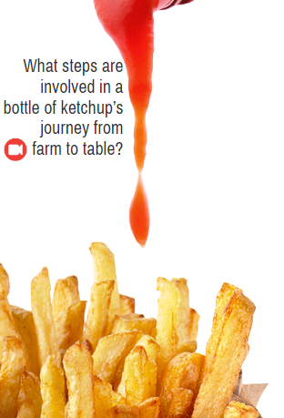
Who likes ketchup?
But where does it really come from?
https://foodandclimate.ecoliteracy.org/interactive-guide/page_0002.xhtml
Click on this icon

Slide 4
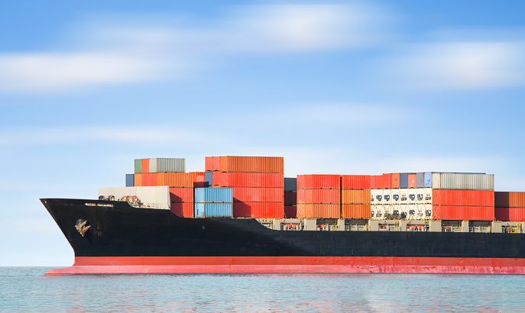
What have you learnt today about food and transport?

Slide 5
What can we do to reduce the miles our food travels? What is your pledge?

