Slide 1
Food What does it mean to ‘shop local’?

Slide 2
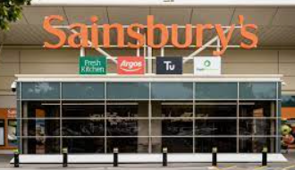
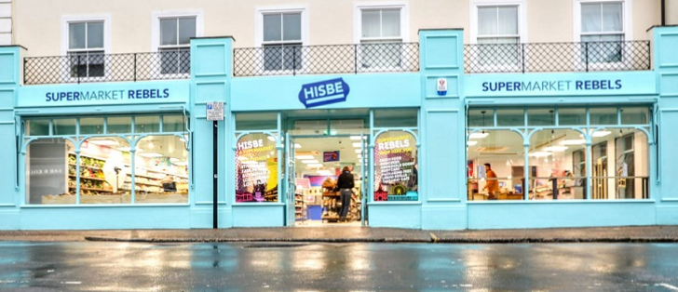
Do you recognise these shops?
What is the same and what is different between these shops?

Slide 5
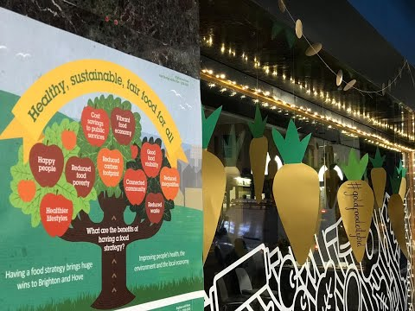
Watch video
Decide whether appropriate for your school/children

Slide 6
Let’s remind ourselves about food miles
https://www.bbc.co.uk/bitesize/topics/zfmpb9q/articles/zs9gsk7

Slide 7
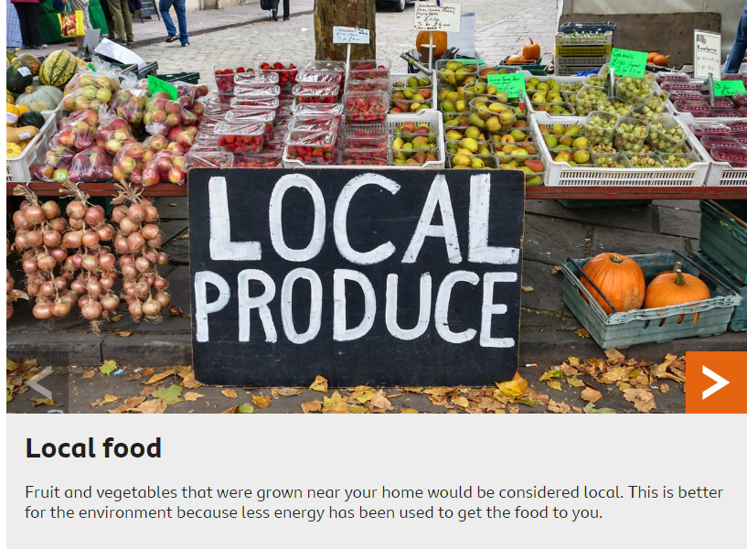

Slide 8
What is good about buying local food or shopping in local shops?
Local food travels fewer miles
Local food tastes better
Local produce stays fresher longer
Local food connects you to the land through the farmers who grow your food.
Local produce benefits the environment and wildlife.
Notes:
https://www.superkidsnutrition.com/benefits-locally-grown-produce/

Slide 9
Why is Brighton brilliant when it comes to food and looking after our planet?
What can we do to reduce food miles?

