Slide 1
Background info for teacher – referred to on slide 9
https://www.lovefoodhatewaste.com/take-action-save-food/our-planet-your-food?gclid=Cj0KCQjwkt6aBhDKARIsAAyeLJ0llyJD1CfYQNJiAKay5KkZg3dyr01DaFpRHTu4-ofTzupn60tA0YgaAlq1EALw_wcB

Slide 2
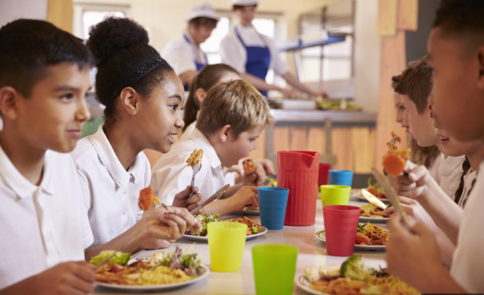
What is food waste?

Slide 3
Food Waste:
Food that is wasted, lost or uneaten along all parts of the supply chain - from farm, to production, to supermarkets and in our homes.

Slide 4
We are going to think about how food waste can have an impact on climate change.

Slide 5
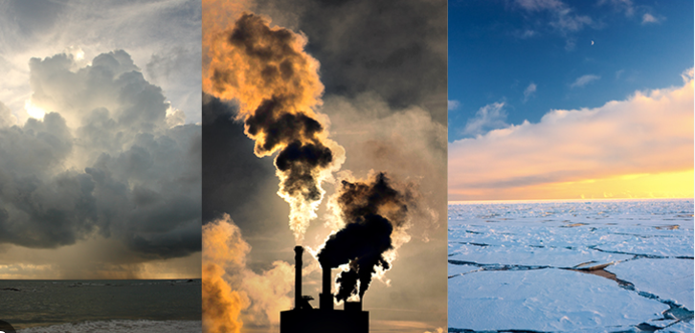
What is climate change?
Changes in the world’s weather (heat and rain) as a result of human activity, which increases the level of carbon dioxide in the atmosphere. This causes more frequent extreme weather events , eg heatwaves, storms, droughts, fires.

Slide 6
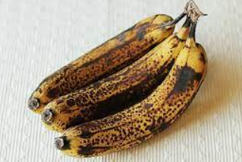
How does an overripe banana or stale loaf of bread being binned harm our planet?

Slide 7
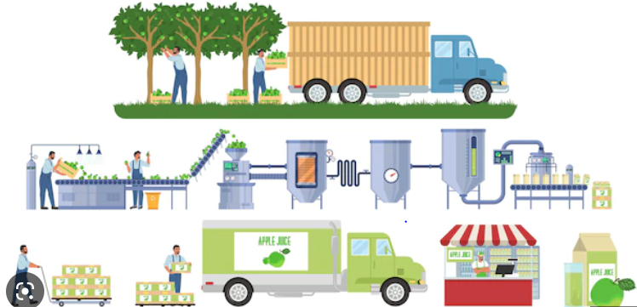
What is happening in this picture?
Notes:
When looking at why food waste harms the environment, it’s important to look at the whole lifecycle of our food: from farm, to fork, to the bin. Each stage in the journey of our food uses resources from our planet and produces greenhouse gas emissions, therefore contributing to climate change.
If we can make sure only the food we are going to eat reaches our homes, and no good food ends up in the bin, we could save the emissions created producing that food from ever needing to be created in the first place.
Using up all of the food you buy and not letting it go to waste is an important way to reduce your carbon footprint and help tackle climate change.

Slide 8
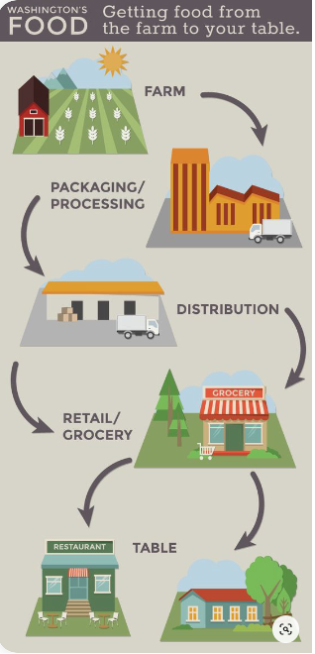
How can food production harm our environment?
How does each stage use resources from our planet?

Slide 9
Lifecycle of our food – how does it affect our planet?
Land we use to grow food (deforestation?)
Growing our food ( fertilizers, tractors)
Processing our food (e.g. energy used to turn potatoes into chips)
Getting our food to the shops ( transport)
Preparing food at home (energy for fridges/freezers/ovens/ microwaves)
Throwing food away (When we throw food away, it rots and releases methane, a greenhouse gas, into the atmosphere. Methane has more than 80 times the warming power of carbon dioxide)
Notes:
https://www.lovefoodhatewaste.com/take-action-save-food/our-planet-your-food?gclid=Cj0KCQjwkt6aBhDKARIsAAyeLJ0llyJD1CfYQNJiAKay5KkZg3dyr01DaFpRHTu4-ofTzupn60tA0YgaAlq1EALw_wcB

Slide 10
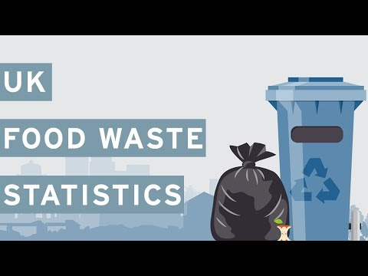
Notes:
https://www.youtube.com/watch?time_continue=8&v=89w-g-XmIOU&embeds_euri=https%3A%2F%2Fwww.ourcityourworld.co.uk%2F&feature=emb_logo

Slide 11
What can we do stop food waste?
What will you pledge to do?

