Slide 1
We consume so much at home. What we can do about it?

Slide 2
Think about..
Energy
Clothes
Toys
Books

Slide 3
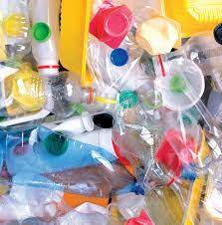
Living without single use plastic
IS IT POSSIBLE?

Slide 4
What is single use plastic?

Slide 5
How would you live without it?
30 day challenge film!

