Slide 1
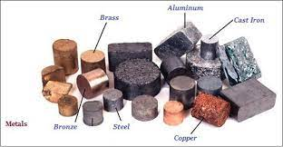
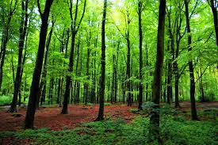
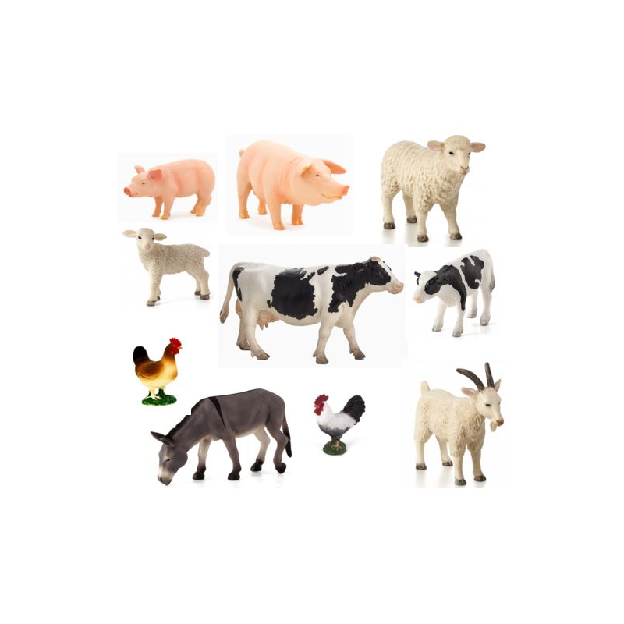
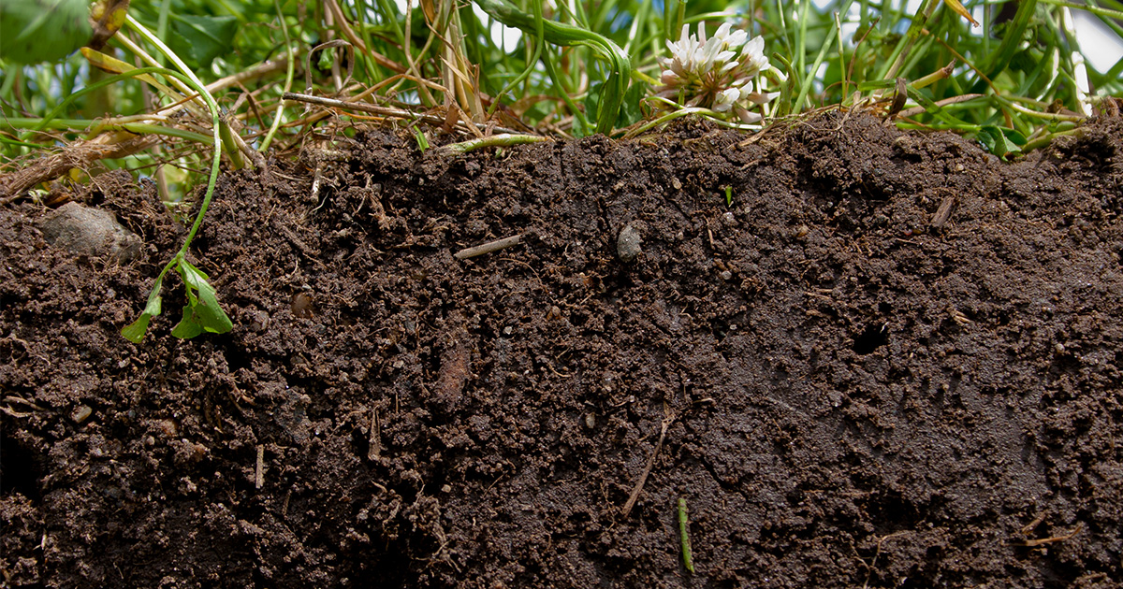
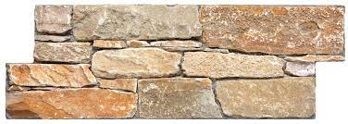
What links all of these together?

Slide 2
What are natural resources?

Slide 3
Materials from the Earth that are used to make things we use.
Oil
Coal
Gas
Metals
Stone
Sand
Air (Wind)
Sunlight
Soil
Water

Slide 4
What do we use natural resources for?
To make things
To grow food
To eat and drink
To travel
To make energy

Slide 5
What does consumption mean?
27 billion tonnes in 1970
92 billion tonnes in 2017
12 tonnes/year for every person on Earth!

Slide 6
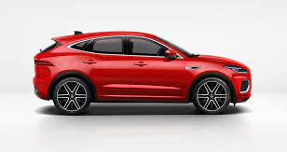
2.5 elephants
Your weight
X 456

Slide 7
This rate of material consumption is expected to rise to between 170 and 184 billion tonnes by 2050.
18 tonnes/year for every person on Earth!

Slide 8
“The world has enough for everyone's need, but not enough for everyone's greed.” Mahatma Ghandi

Slide 9
Which natural resources renewable? – resources which the earth can replace

Slide 10
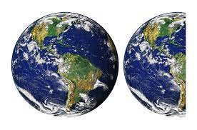
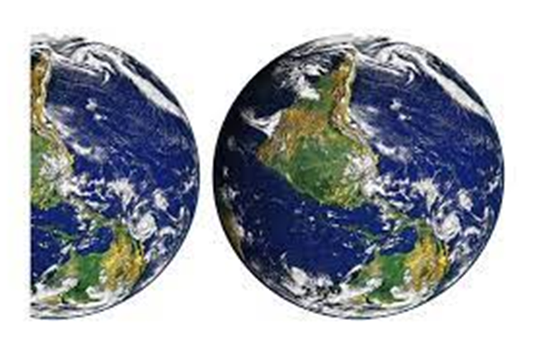
1.5 EARTHS to meet the needs of the world's population in a sustainable way.
2021
2050
3 EARTHS

Slide 11
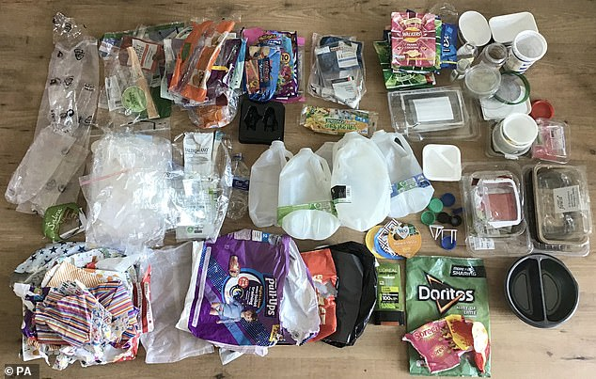
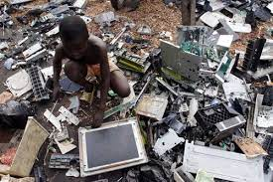
Reduce
Recycle
Refuse
Reuse
Rethink

