Slide 1
We can make a difference!
Children campaigning

Slide 2
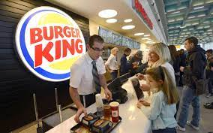
Protesting against plastic toys in Burger King

Slide 3
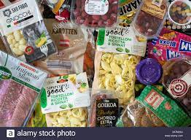
Complaining about packaging in supermarkets

