Slide 1
What really matters in life?
An assembly discussion

Slide 2
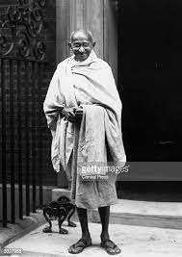
“The world has enough for everyone's need, but not enough for everyone's greed.” Mahatma Gandhi
What really matters in life?

