Slide 1
Transport and Air Quality
Take a deep breath
We all take approximately 20,000 breaths every day
Today we're going to have think more about the air we breathe

Slide 2
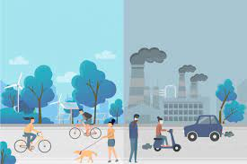
Transport and Air Quality
What is air pollution?
Where does it come from?
Is it bad?
What can we do about it?

Slide 3
OR Book an assembly on air quality with Paul Turner, Clean Air Officer for Sustrans paul.turner@sustrans.org.uk You could use part of the recorded assembly on the next slide

Slide 4
Here's Paul from Sustrans talking to a local school about air quality
Suggested sections:
2.55 - 6.38 min. What is air pollution and why we need to create change
10.00 - 11.34 How to improve air quality
11.50 - 12.30 School streets

Slide 5
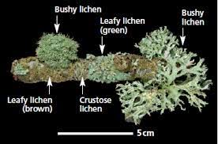
More about Air Quality
Lichen grow on trees. They can be crusty, leafy or bushy.
Bushy lichen can only grow in clean air. It’s a good indicator of good air quality.
Trees and hedges are good at absorbing air pollution.
Can you plant any more trees in or around your school?
Can you spot any bushy lichen in your playground or local park ?
Find out where the best air quality is in your neighbourhood.

Slide 6
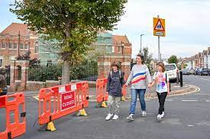
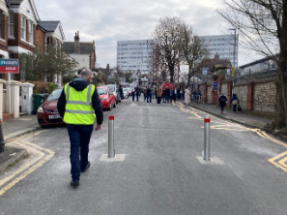
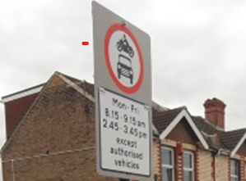
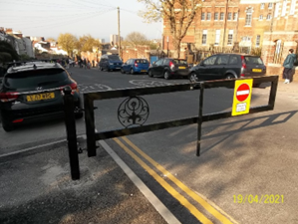
School Streets in Brighton & Hove
Streets around schools are closed during drop off and pick up to allow safer walking, scooting and cycling and also improve air quality around a school
There are 8 school streets already in Brighton & Hove and 7 more being planned
Are 'School Street's a good idea?
What else could your school do to improve air quality around your school?

Slide 7
Clean Air Day - 15 June 2023
Lots of resources available on the website below
For Clean Air Day | Schools resources (actionforcleanair.org.uk)

Slide 8
Get ready for our next assembly:
What do you think about transport in Brighton & Hove?

Slide 9
Or Alternative slides borrowed from a Sustrans assembly

Slide 10
What is air pollution?

Slide 11
Air pollution is gases, dust, fumes (smoke) and smells that are harmful to people, animals and plants.
You can’t always see it.
You can’t always smell it.

Slide 12
Where does air pollution come from?

Slide 13
Fumes from cars, lorries, trains, planes and boats
Factories
Producing heating and electricity for our homes
House hold cleaning products
Chemicals used on farms
Livestock…cows!

Slide 14
Why is air pollution bad?

Slide 15
Asthma
Damages our lungs
Contributes to heart disease
Can cause cancer
Damage the planet!

Slide 16
How can we reduce air pollution?

Slide 17
September 22nd 2023
Notes:
Needs updating for 2019

Slide 18
Work together to help reduce air pollution at our school!
Notes:
Reminder….

