Slide 1
Note to teachers
These 6 slides on transport are for each school to use and adapt as needed. Please send in any additional slides we can share with other schools
Assembly 1 – Transport and climate change
Assembly 2 - Transport and air quality
Assembly 3 – Transport in Brighton & Hove
Assembly 4 – How do you get to school? Including B&H Walking Festival 2023
Assembly 5 – Personal pledges
Assembly 6 - School pledges
Assembly 1 slide 8 – you will need to click on the video embedded in the webpage

Slide 2
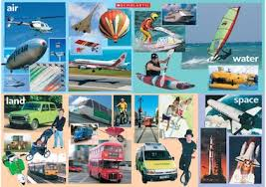
How many different forms of transport can you think of?
In the next 6 assemblies, we're going to be thinking about
travel and transport
Transport is very useful..........
but....

Slide 3
Most cars, buses, planes and trains still run on fossil fuels like petrol or diesel.
And when these fuels are used, engines produce harmful gases, dust and smoke

Slide 4
Petrol and diesel come from oil which is made from organisms that lived and died millions of years ago.
When we remove oil from the ground and use it as fuel, carbon dioxide is released. This contributes to global warming. ​

Slide 5
Can you see how much of of the UKs greenhouse gases are produced by transport?

Slide 6
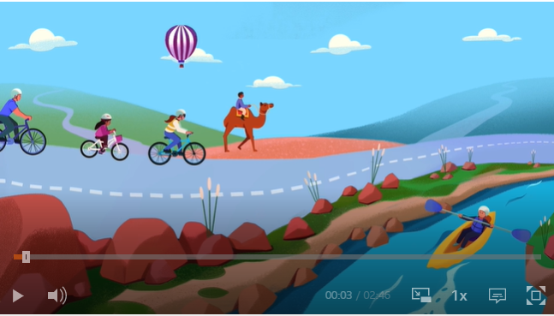
Let's find out more about transport and climate change
Click here

Slide 7
Which form of transport produces the most emissions per passenger / km ?

Slide 8
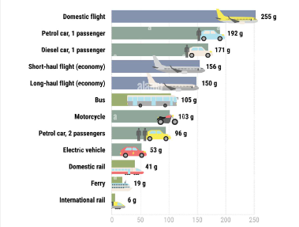
The Carbon Emissions from Different Types of Transport
grams C02 per passenger Km
What does this tell us?

Slide 9
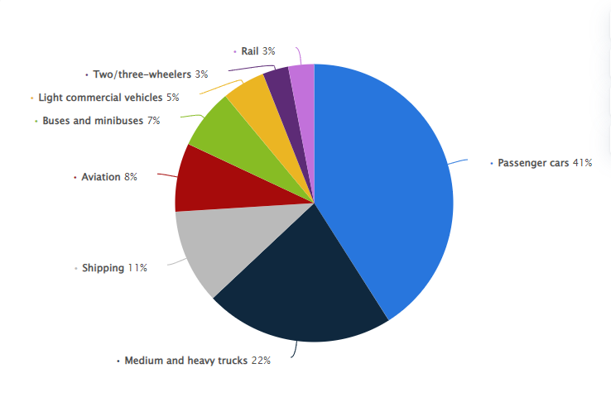
Overall Global Carbon Emissions from Different Types of Transport
Passenger cars create the greatest emissions.
In the UK, 4/10 journeys made by car are less than 3miles long.
How could trucks and shipping be connected to your school?

Slide 10
Get ready for our next assembly:
What do you know about air pollution and how we can make our air cleaner?

