Slide 1
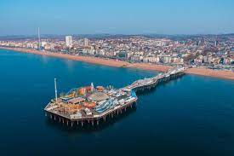
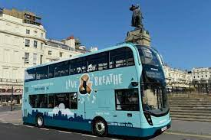
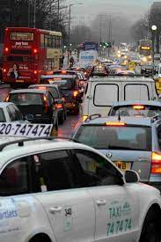
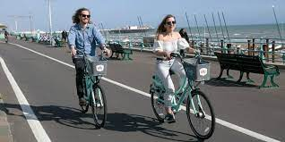
In our last assemblies, we've been thinking of how transport can impact climate change and air quality
What do YOU like or not like about transport in Brighton & Hove ?

Slide 2
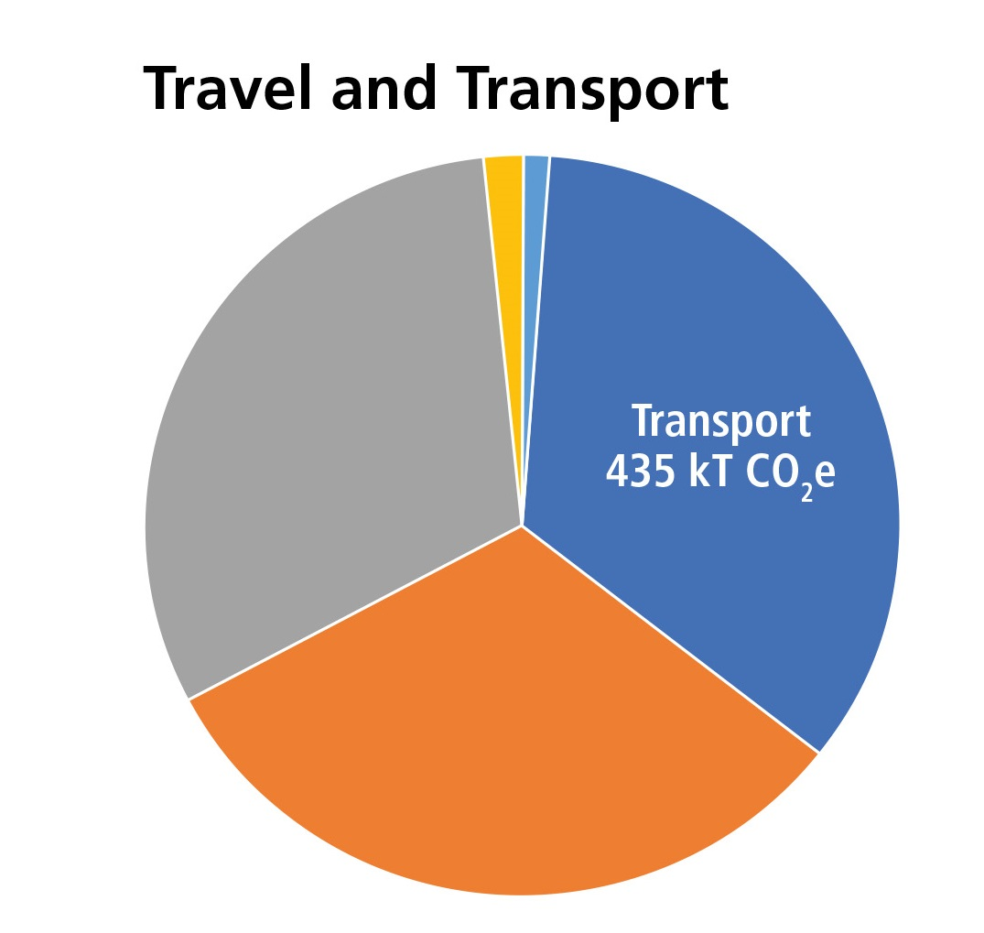
Did you know?
Brighton & Hove CO2 emissions
Carbon dioxide emissions from travel and transport are around one-third of the total emissions from Brighton & Hove.
In 2020 a group of ordinary people in Brighton & Hove formed a climate assembly and were asked “How can we reduce transport related carbon emissions in the city?”
What would you suggest?

Slide 3
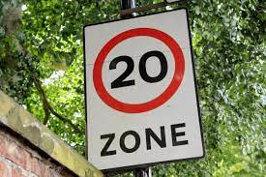
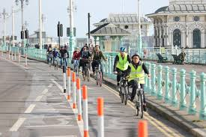
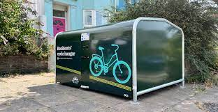
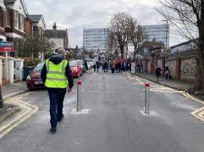
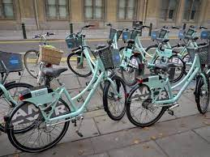
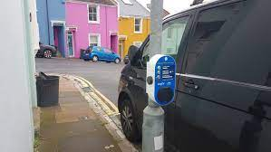
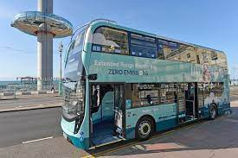
These are some of the actions Brighton & Hove City Council have recently supported
Better cycle storage
Lower speed limits
Safer cycling
School streets
Low traffic neighbourhoods
More shared bikes
More electric charging points
Electric / hybrid buses
How do they reduce emissions? What else do YOU think they could do?

Slide 4
Get ready for our next assembly:
How do you get to school?
Could you get to school more sustainably?

