Slide 1

How did you get to school today?
How did children from state primary schools in Brighton and Hove get to school last year?
Walk - 55.5 %
Car – 37.5%
Bike – 2.3%
Bus – 4%
Let's start by looking at some extreme journeys that children across the world make to get to school

Slide 2
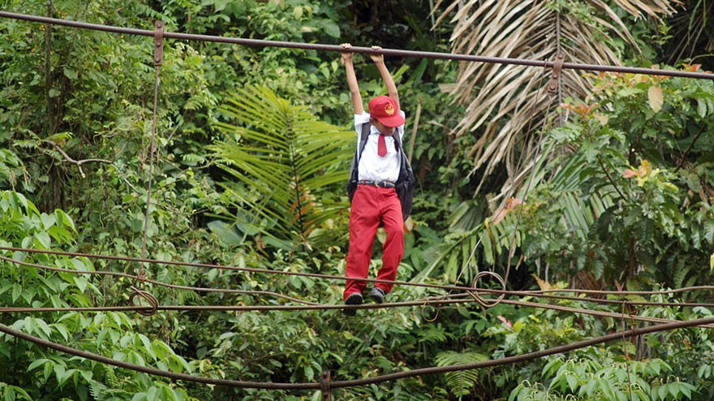
10 meters above a river
Padang, Sumatra, Indonesia

Slide 3
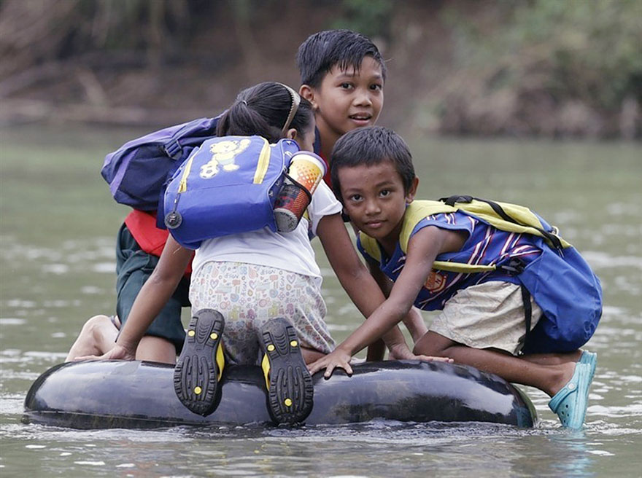
Crossing a river
Rizal Province, Philippines

Slide 4
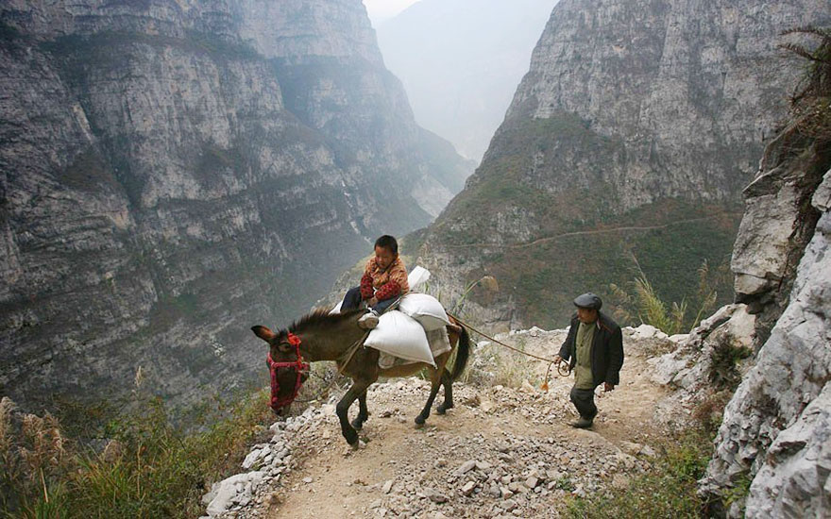
5-hour journey
Gulu, China

Slide 5
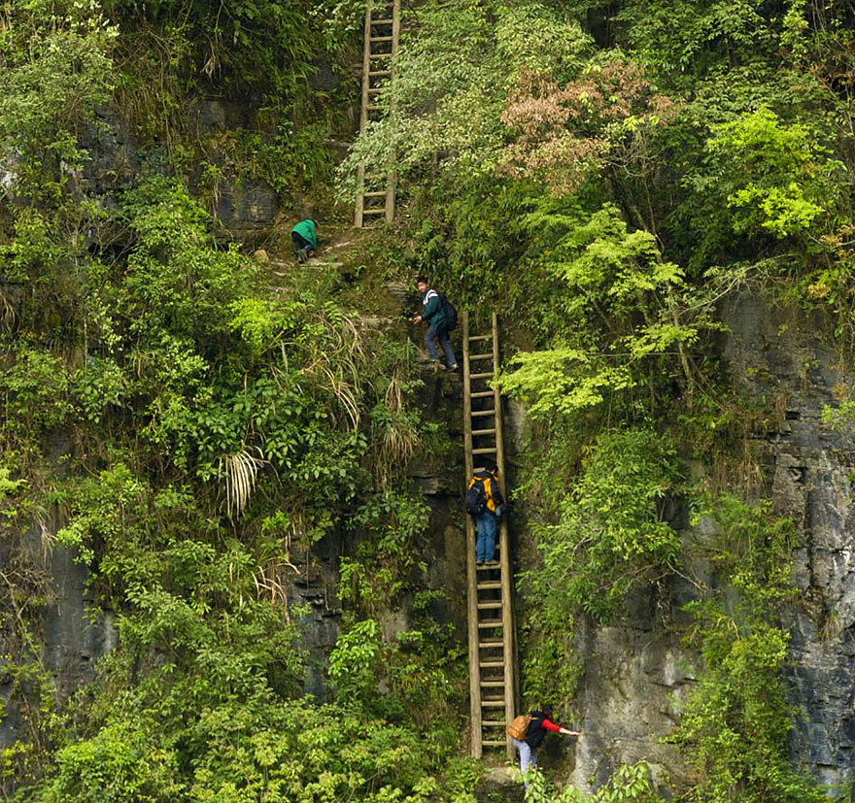
Zhang Jiawan Village, Southern China

Slide 6
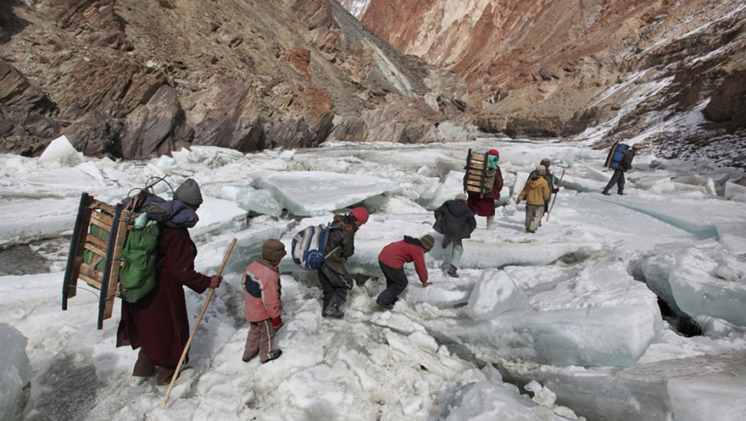
Traveling to a boarding school
Zanskar, Indian Himalayas

Slide 7
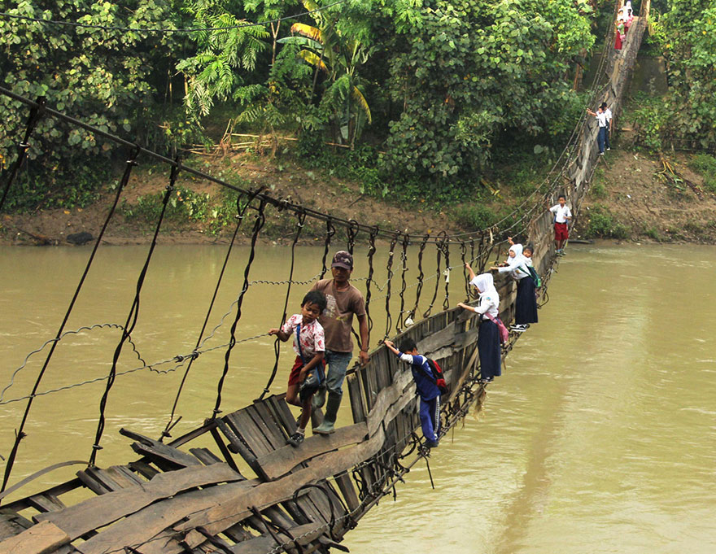
Pupils Crossing A Damaged Suspension Bridge, Lebak, Indonesia
Lebak, Indonesia

Slide 8
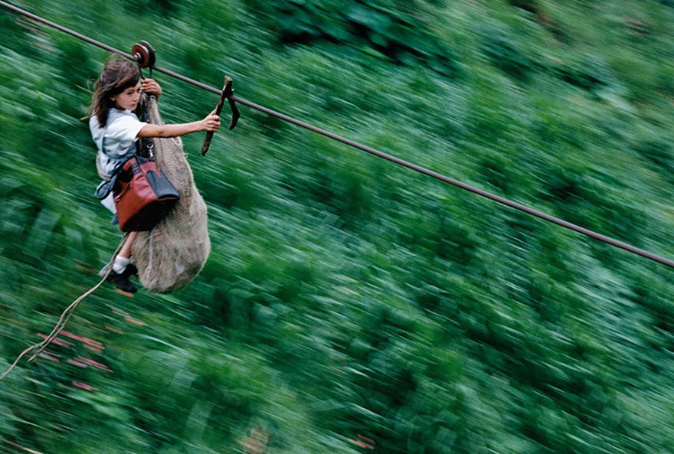
Kids Flying 800m On A Steel Cable 400m Above The Rio Negro River, Colombia
Flying 800m 400m above the Rio Negro River.
Colombia

Slide 9
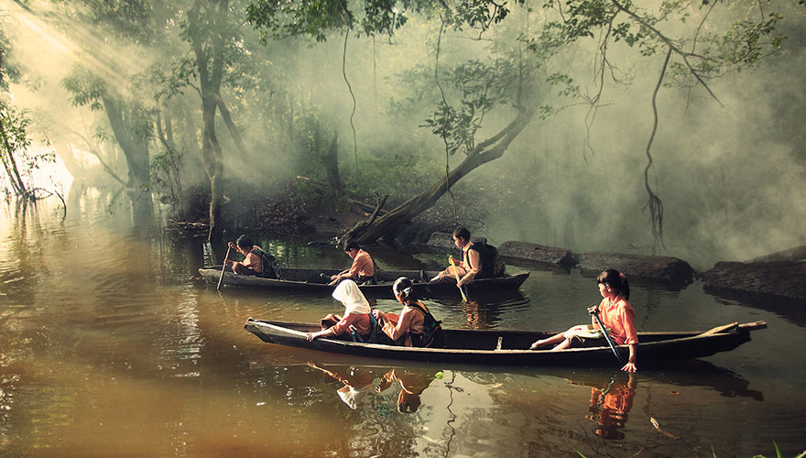
Pupils Canoeing To School, Riau, Indonesia
Riau, Indonesia

Slide 10
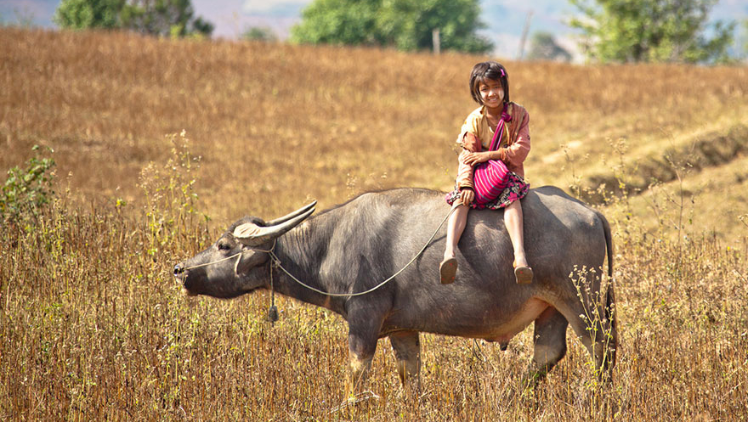
Myanmar

Slide 11
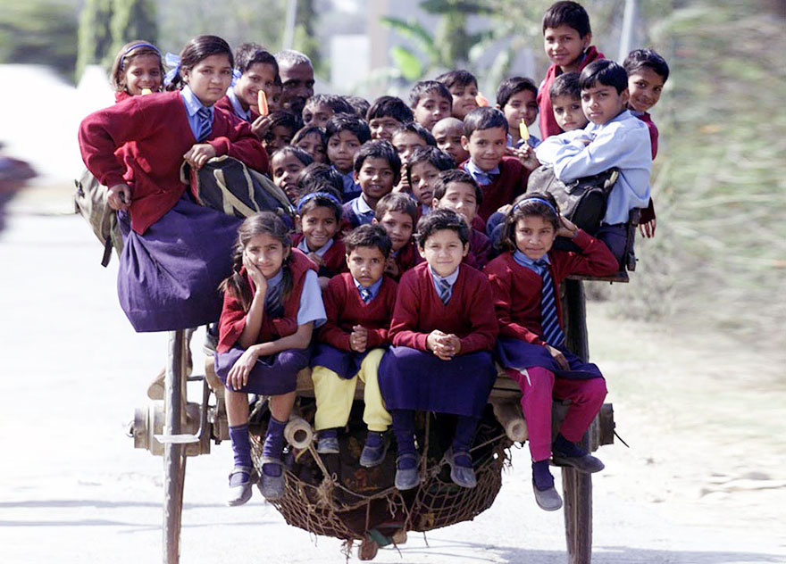
Delhi, India

Slide 12
Think about your journey to school today
Think about these children's journey to school
Do you think they enjoyed it?
Did they travel with friends or family?
Were there any dangers?
How did they overcome it?
Was their journey sustainable?
Did you enjoy it?
Did you travel with friends or family?
Were there any dangers?
How did you overcome it?
Was your journey sustainable?
Could it be more sustainable?

Slide 13
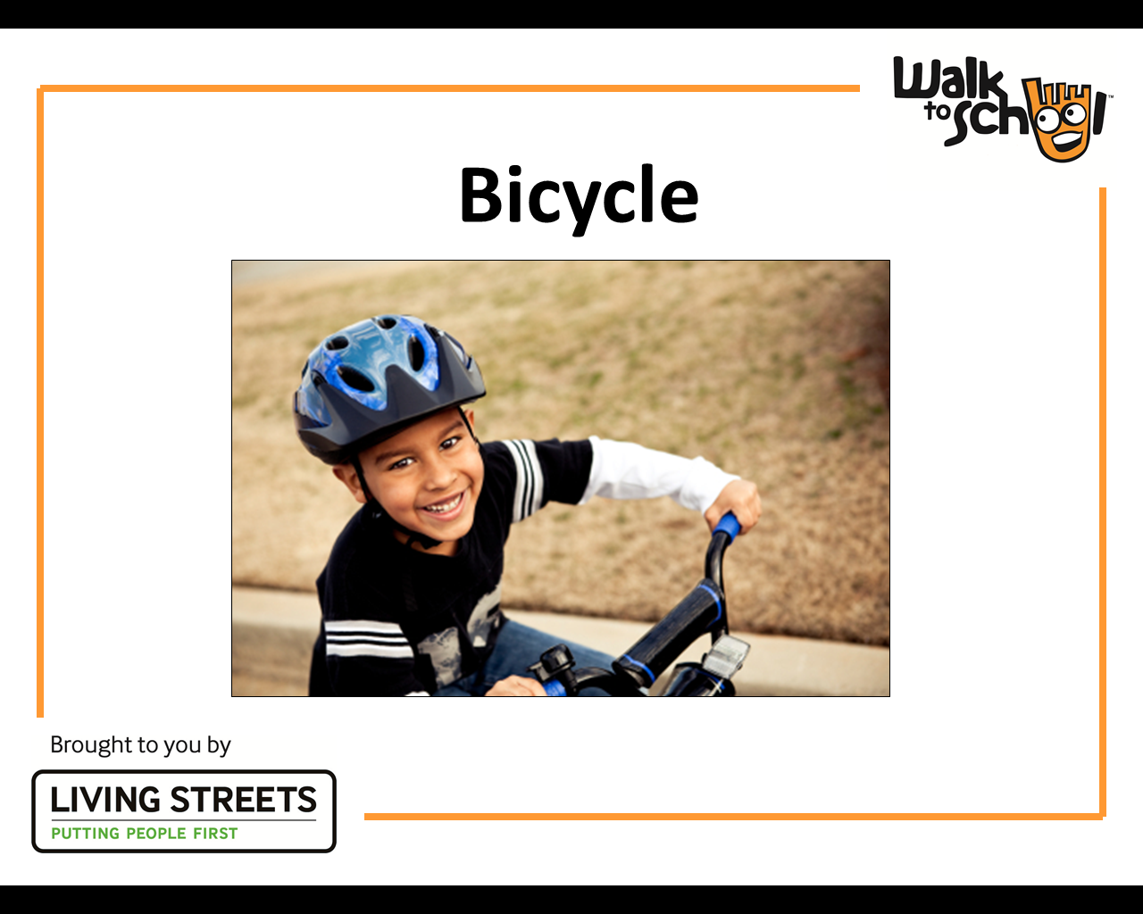
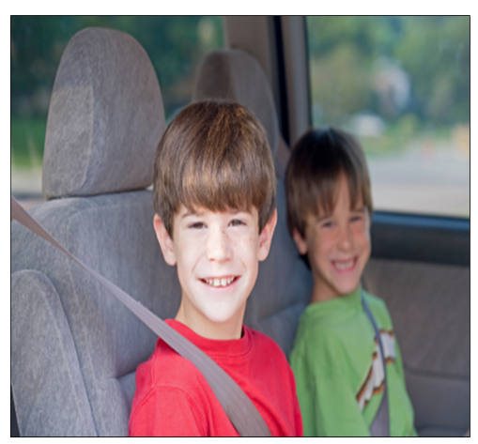
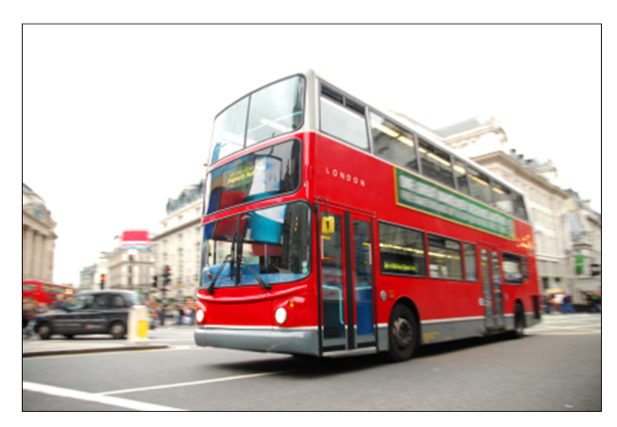
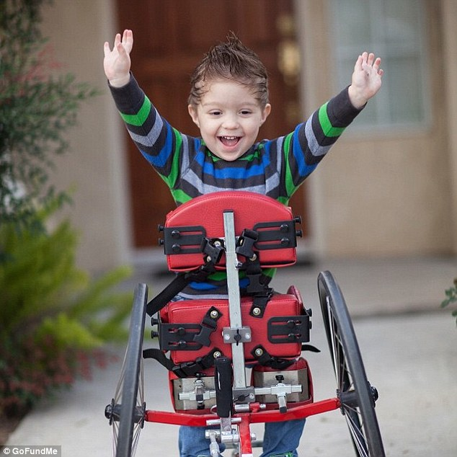
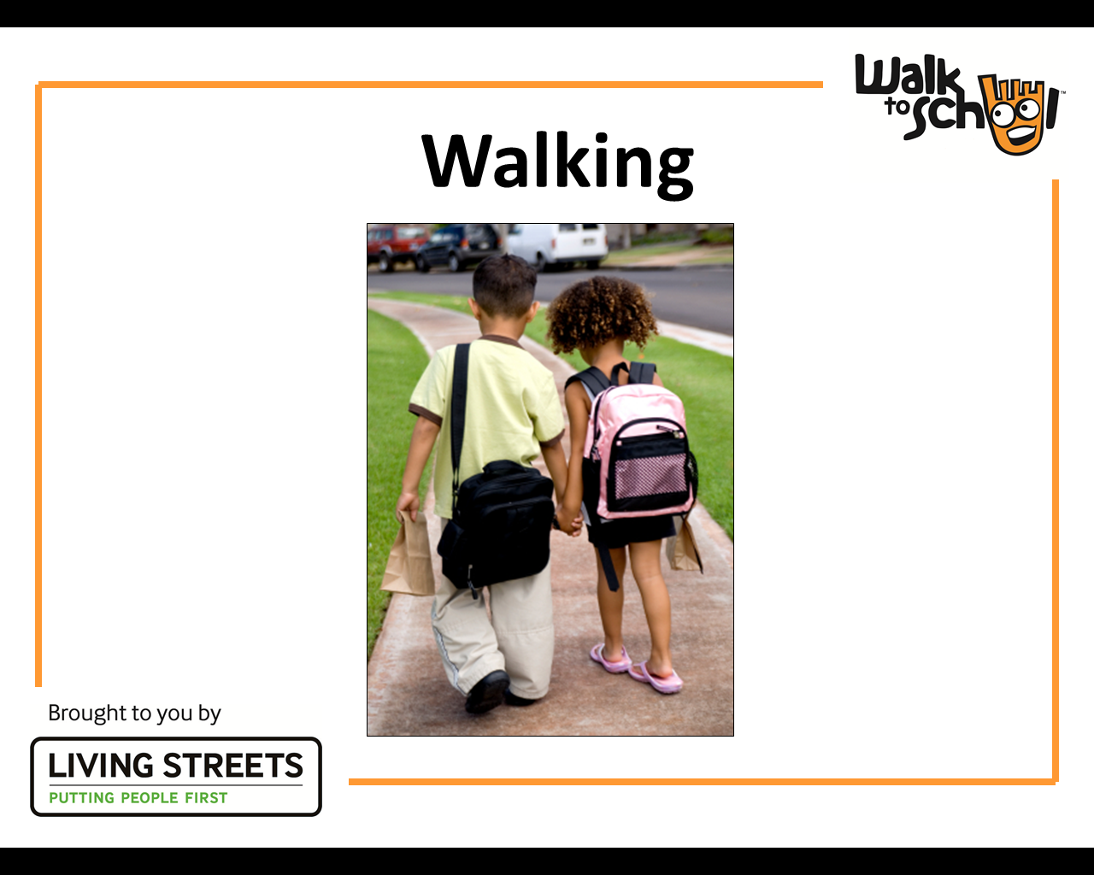
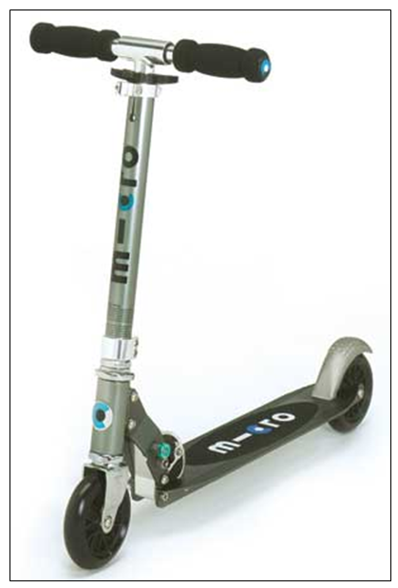
Part sustainable travel to school
Sustainable travel to school
Park and Stride
Bus and Stride

Slide 14

Walk to School Week – June 2023
Will your school get involved?
How can you encourage more people to walk?
Look out for schools posters, record sheets, stickers and banners

Slide 15
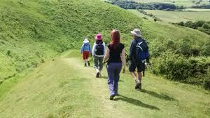
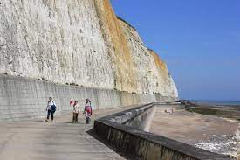
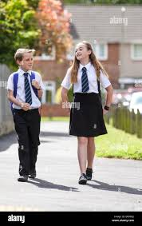
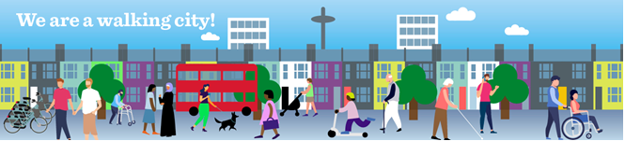
The first ever
Brighton & Hove Walking Festival
24 June – 9 July 2023
Where will you go?!

Slide 16

Get ready for our next assembly:
What could you do to make your journey to school more sustainable?

