Slide 1
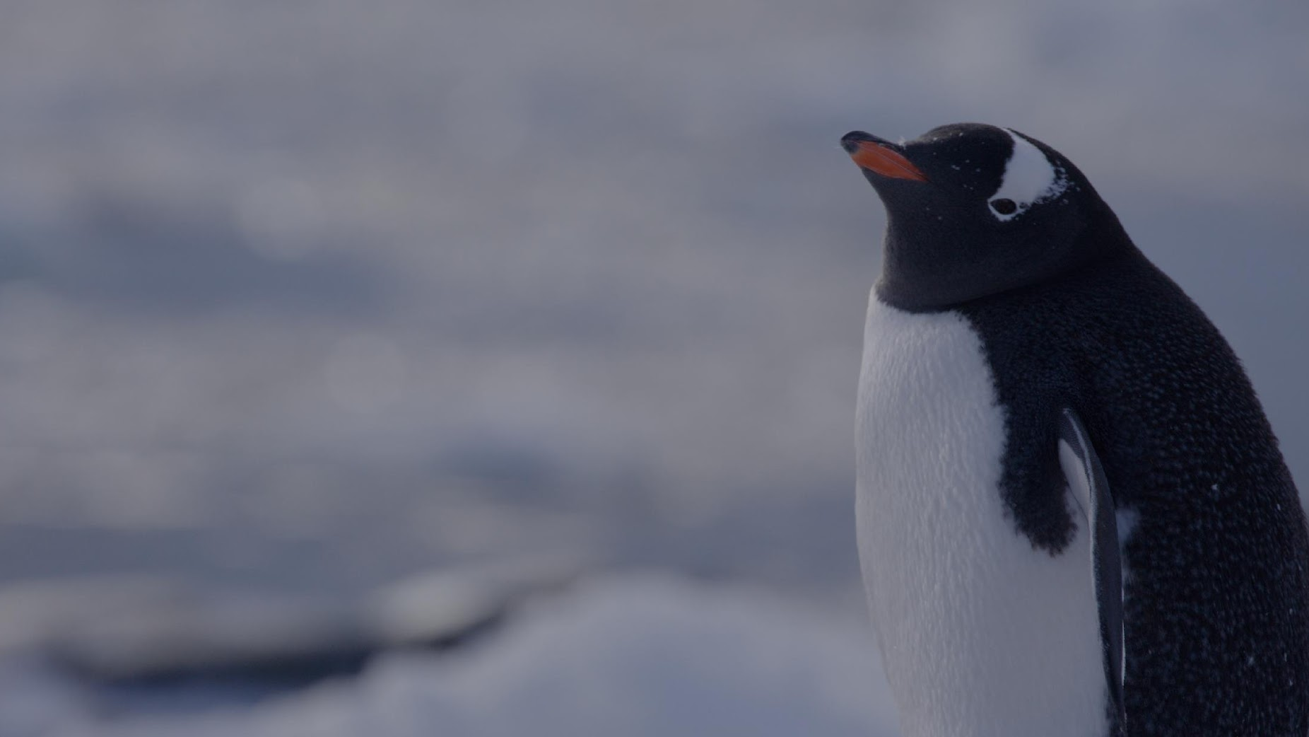
1st December is
ANTARCTICA DAY

Slide 2
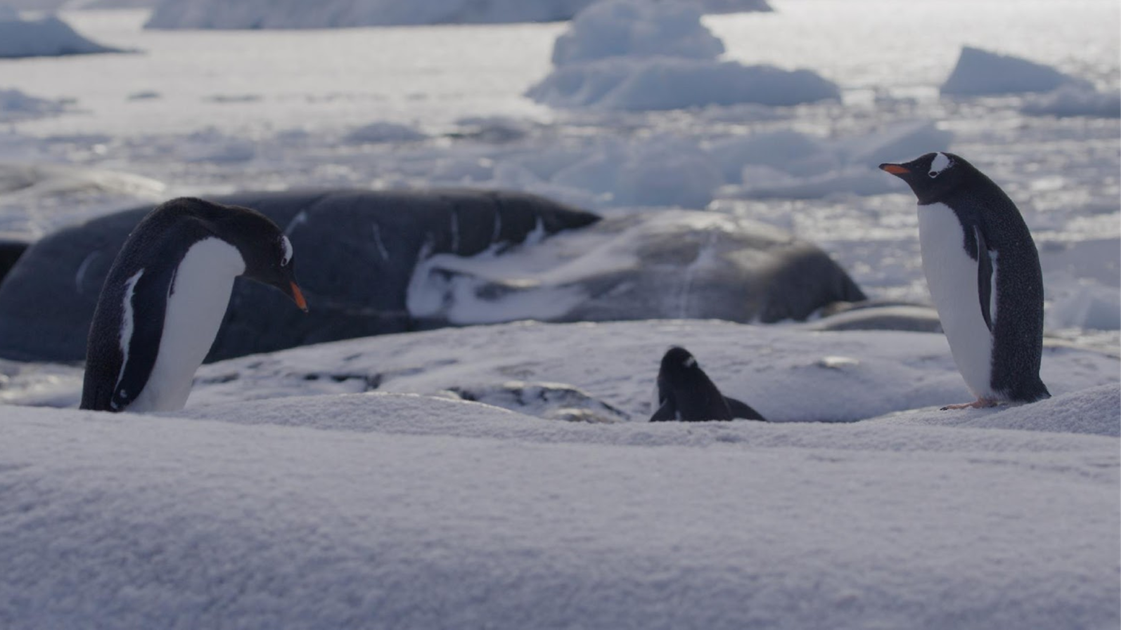
1st December is Antarctica Day, which is celebrated on the anniversary of the signing of the Antarctic Treaty in 1959. In 1959, several countries were disagreeing, and even fighting, over who had the right to own Antarctica, and there were fears that the continent would be used to host military bases, or for nuclear testing. In the beginning, the treaty was signed by 12 countries who had staked claims to Antarctica, and who had scientists working there, including Argentina, the UK, Australia and Japan. Since then, the treaty has been signed by 55 nations representing more than two-thirds of the world's human population

Slide 3
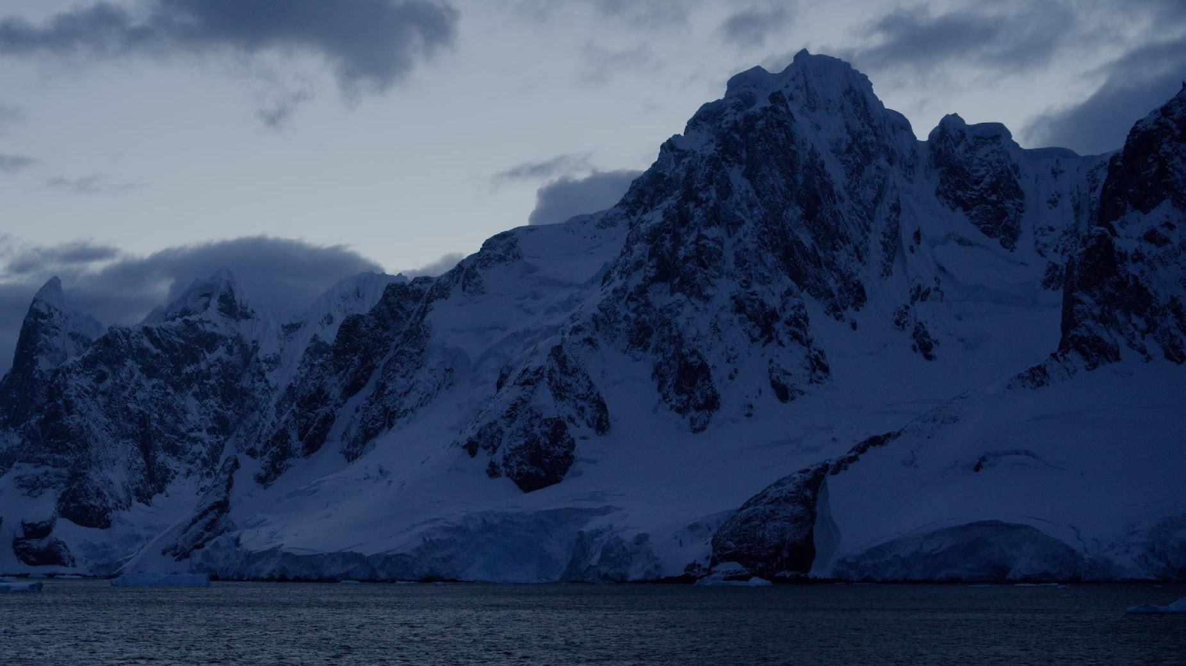
“…a natural reserve, devoted to peace and science”.

Slide 4
What animals do you know that live in Antarctica? ( clue: Arctic comes from the Greek word meaning Bear. Antarctic is really the anti – Arctic. The prefix “anti” means no/against so Antarctic literally means “no bears”).

Slide 5
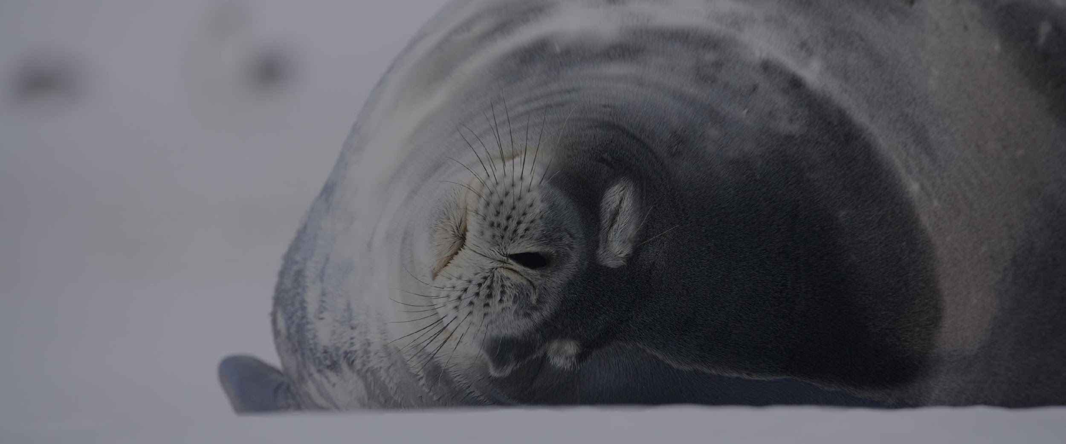

Slide 6
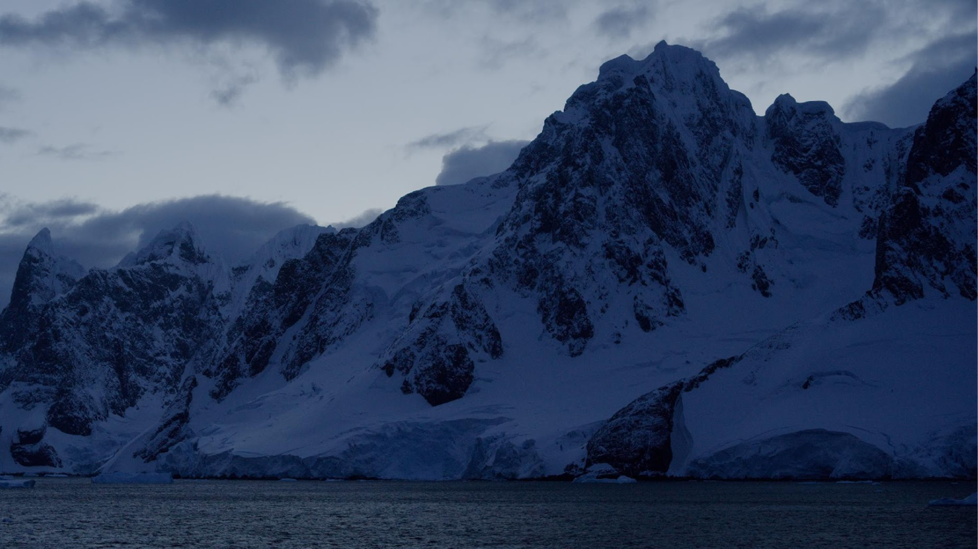
How did the video make you feel?

Slide 7
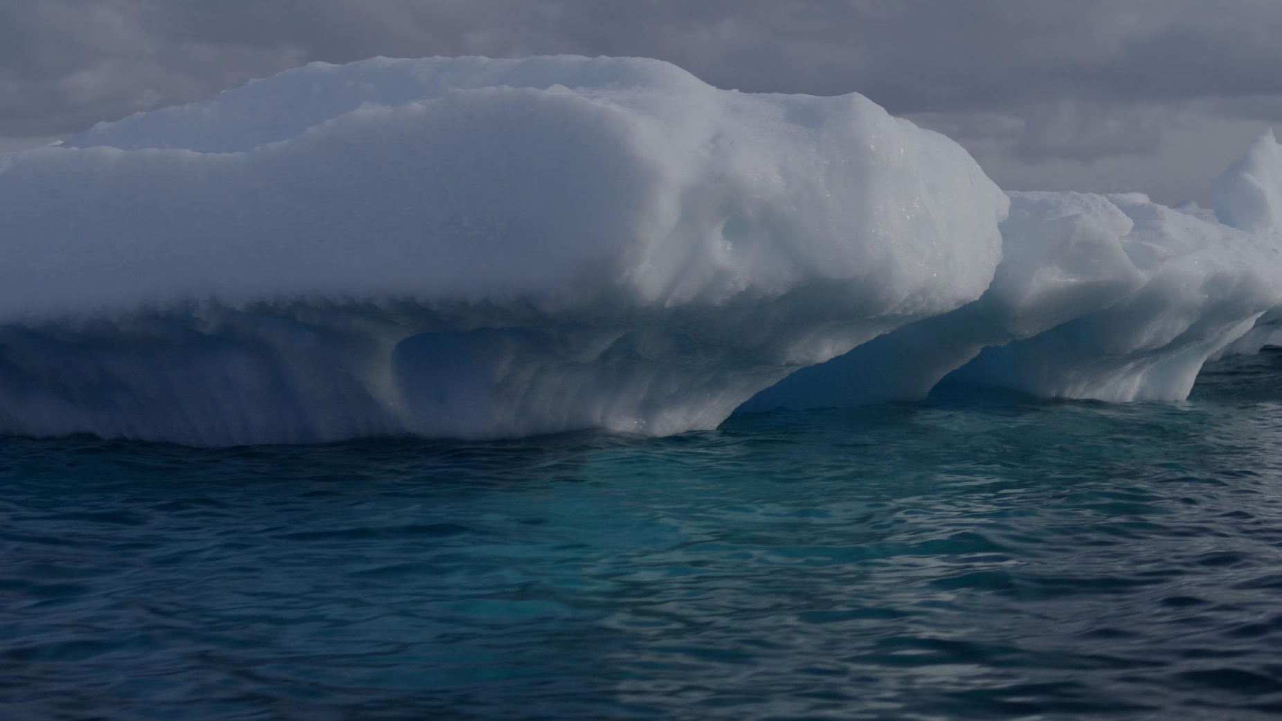
What does Antarctica do for us?
Reflects heat
Ocean food web
Ocean circulation and weather patterns
What are we doing to Antarctica?
Treaty protects Antarctica from weapons testing
Burning fossil fuels causes climate change
Notes:
Antarctica is covered in ice - which is great at reflecting large amounts of
heat from the sun away from our planet. The ocean around Antarctica is
really good at absorbing carbon and actually pushes a conveyor belt of
warm ocean water around the world.
But, just as when the Antarctic Treaty was originally signed, human
actions are putting this frozen continent at risk.When we burn fossil fuels
to warm our homes, power our cars, and provide energy, they release
gases which stay in our atmosphere, trapping the heat from the sun and
causing the planet to heat up.
These warming temperatures are causing the ice in Antarctica to melt
more quickly, and scientists have warned that Antarctica’s largest glacier
may have just 5 years left until it breaks apart
The melting ice is impacting the animals that live in Antarctica, as it’s
where many of them live, breed, and eat. Animals like krill, fish and
penguins are having to migrate to find new homes where there is enough
to eat, and where the ice is stable enough to look after their eggs and
chicks.
But it’s not just those living in Antarctica that are affected.
When the ice in Antarctica melts into the sea, the melt water warms up
and expands, and this raises sea levels. As global temperatures increase
and sea levels rise, this results in more extreme weather events around
the world like floods, hurricanes, forest fires and storms. These are
damaging homes and food sources in many countries.

Slide 8
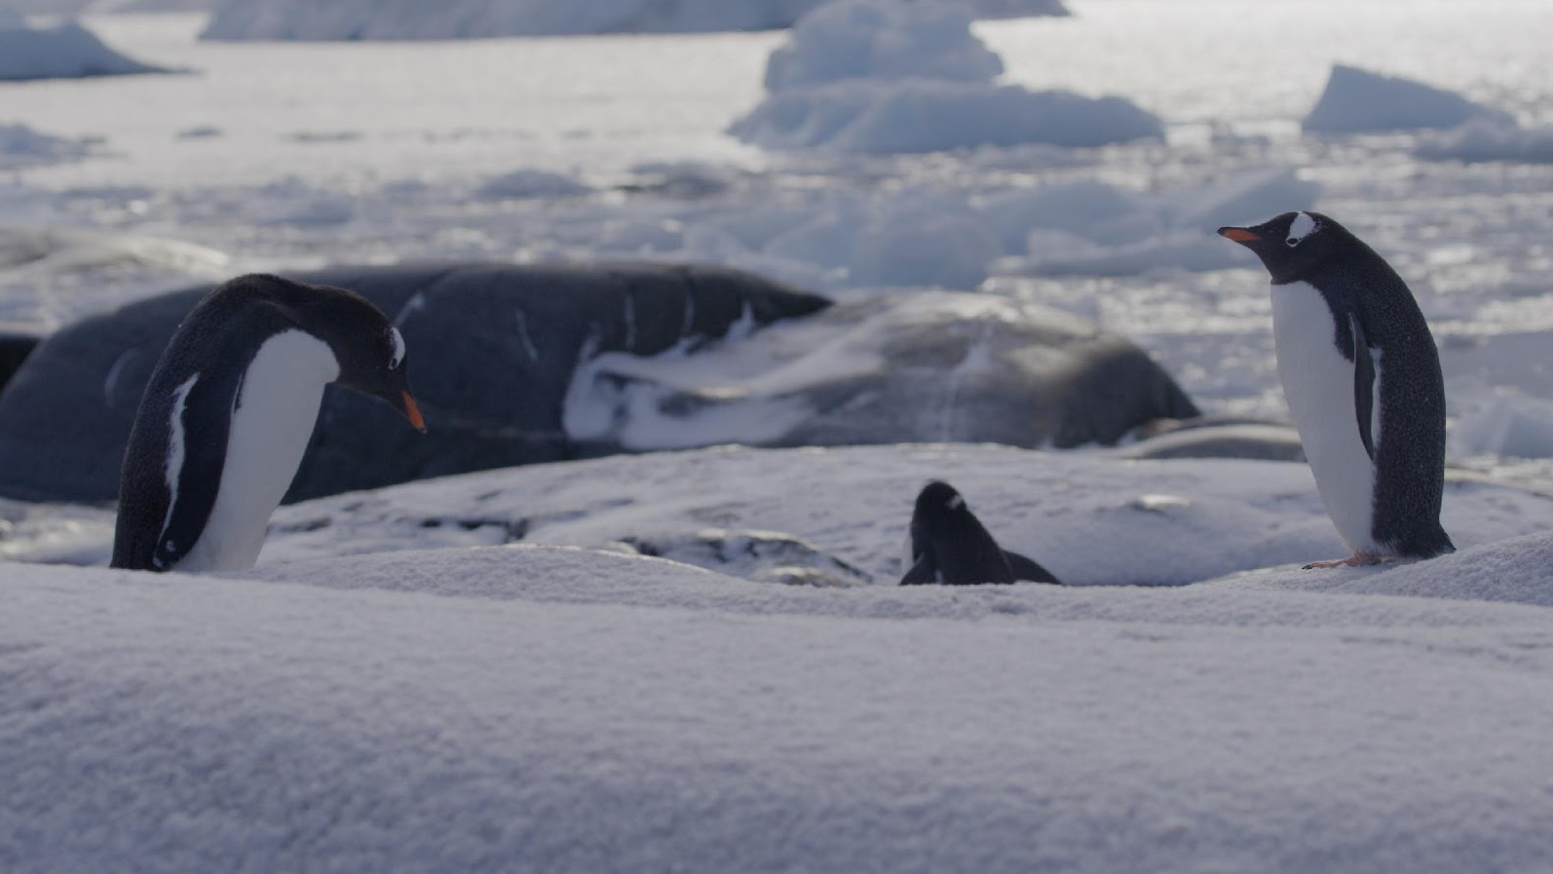
Global warming means ice is melting.
Food sources, homes, and safe places to raise families are all at risk.
Sea level rise
Change in global weather patterns

Slide 9
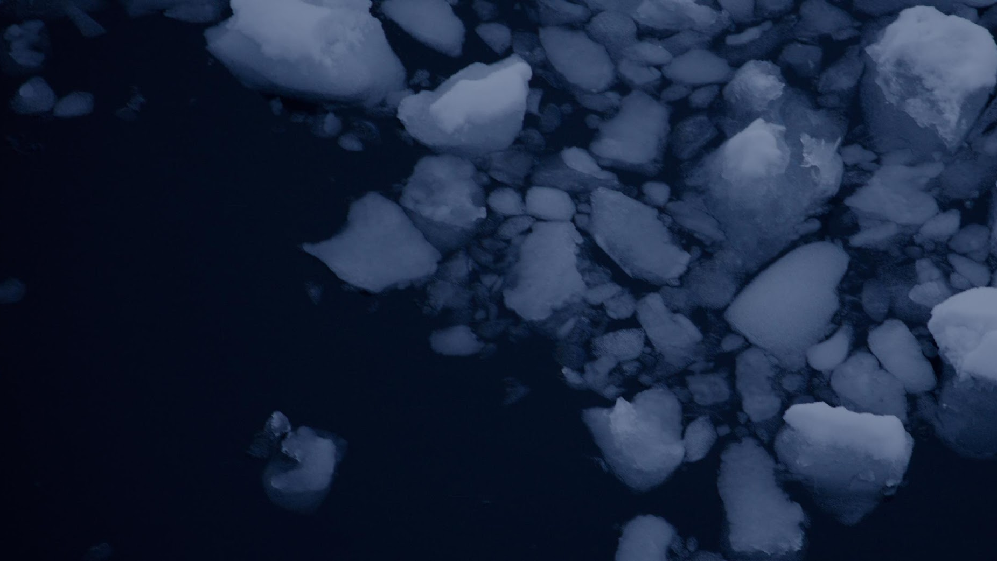
Our actions make a difference.
We can treat the planet as we would like to be treated.
Notes:
In the same way that nations around the world came together in 1959 to
protect Antarctica, we need to come together again now to protect our
shared home.
There is one simple message which can help us to do this, which has been
passed down by societies, communities and religions all over the world,
over thousands of years. It is called the Golden Rule, and it tells us to "treat
others and the planet as we would wish to be treated".
It is a simple and useful guide to help us in every decision we make -
asking us to stop and think about how our words and actions make a
difference to the people and places around us.
Every one of us can make a difference through the way we treat each
other and the planet.
Treating others and the planet as we would wish to be treated means
treating it with the same kindness, respect, and appreciation that we
would like to experience in our own lives. When it comes to Antarctica, this
kindness and respect means doing whatever we can to keep our planet
from heating up and melting the ice. This doesn't just help Antarctica, but
it will help every living being on this planet - even those who live on the
other side of the world.

Slide 10
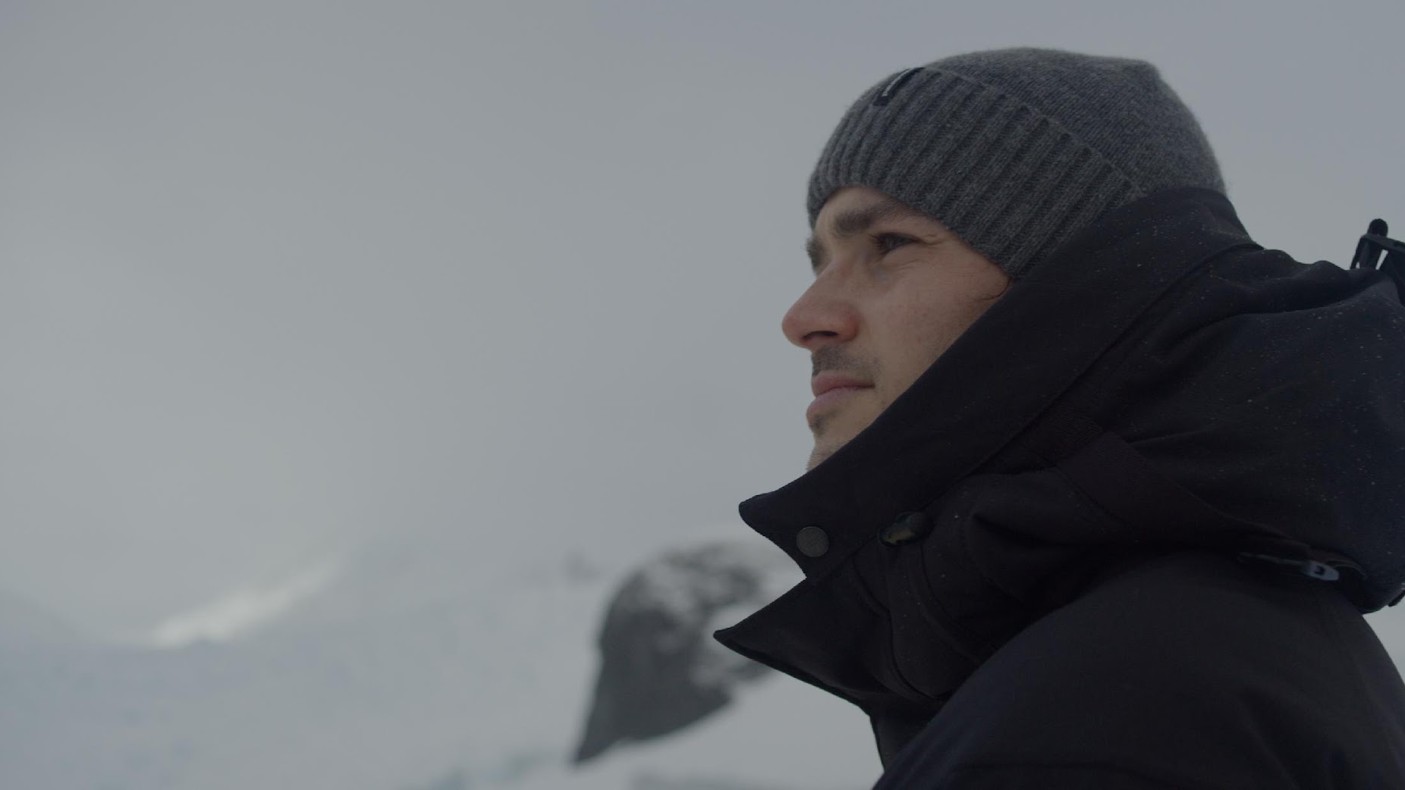
How can you use your voice and your actions to make a difference to Antarctica?
Notes:
Whether we choose to cycle or walk to school more often, write letters to
our local MPs, or recycle our paper and plastic, we all have the power to
listen to what Antarctica needs, and take action in our own lives.
How can you use your voice and your actions to make a difference to
Antarctica?

