Slide 1
Biodiverisity
Own your own, think about what the word biodiversity means, and why it might be important . After a minute tell the person next to you about your ideas.

Slide 2
BIO DIVERSITY
diversity= the amount of variation
very diverse=very different!
bio=
biological organisms (living things)

Slide 3
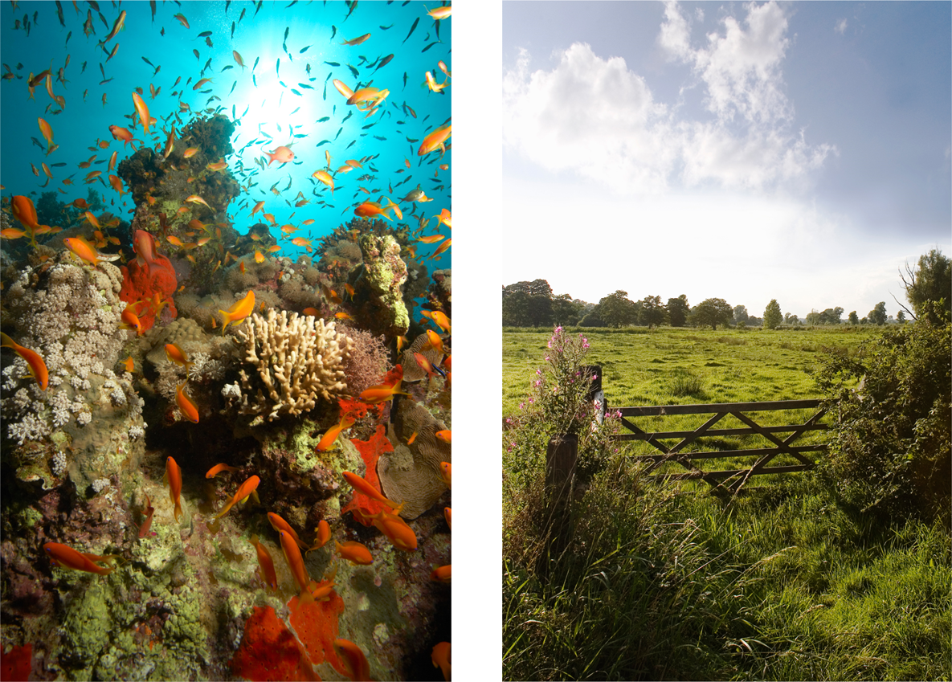
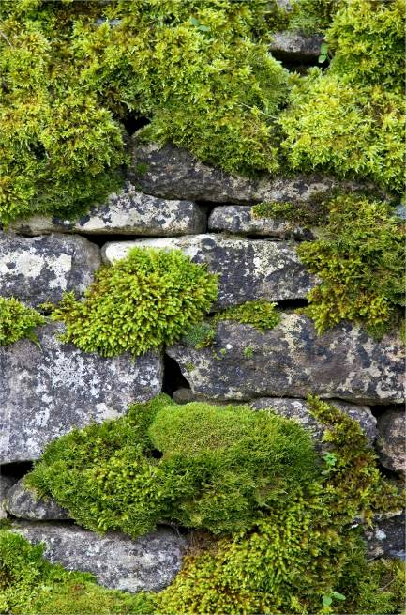
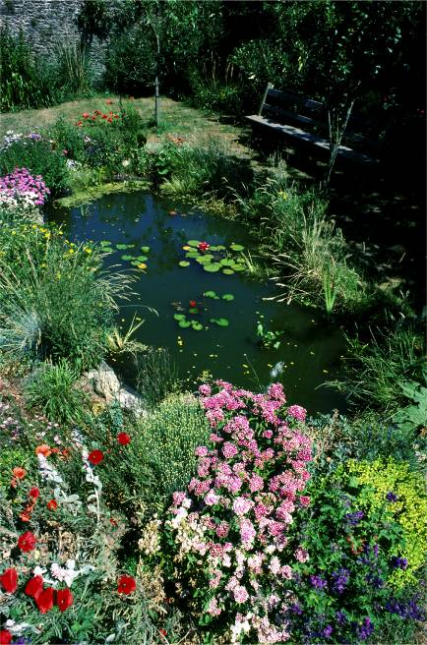
Notes:
Biodiversity describes the variety of life on Earth.
It encompasses all forms of life – from the smallest living things we can only see under microscopes, to oak trees and giant mammals, like whales. Biodiversity can be found in all kinds of places (like these pictures show): forests, oceans, city centres, even wastelands and school ponds.

Slide 4
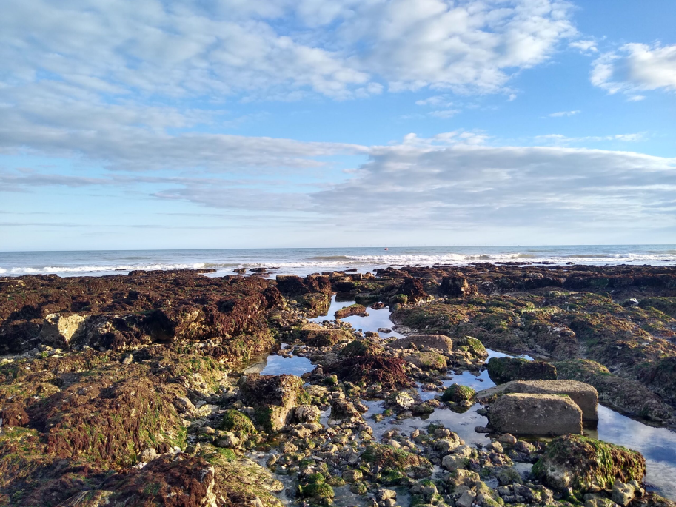
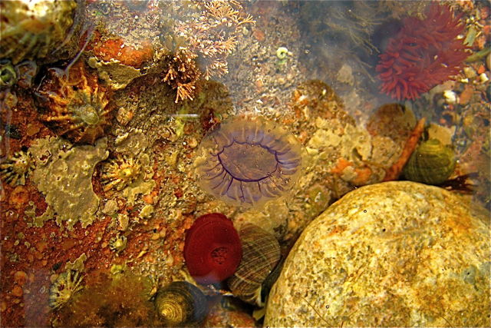
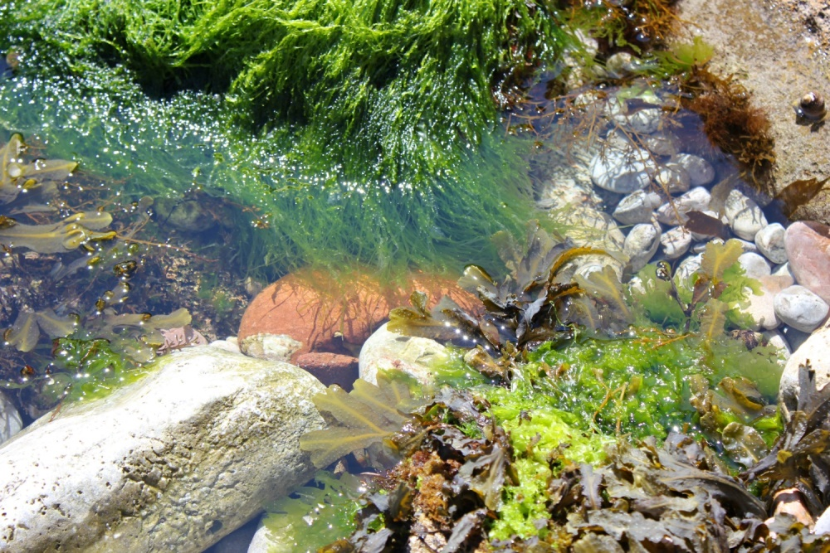
What can you see in the rock pool?
Notes:
Biodiversity matters because it helps preserve the natural living systems – or ecosystems – that provide us with food, fuel, health, wealth, and other vital services.
This rock pool is an example of an ecosystem.
Ask pupils what they can see in the rock pool.
An ecosystem describes an area where the living environment (plants, animals, bugs and other organisms) interacts with the non-living environment. They are important because they provide us with many of the things we use in everyday life (from aspirin to timber) and also play a huge part in regulating and supporting how the Earth works.

Slide 5
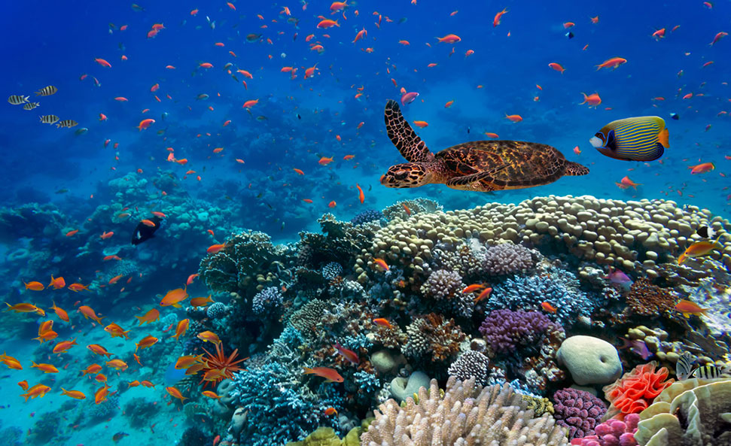
Threats to biodiversity
Biodiversity is affected
by problems like:
pollution
climate change
people’s need for land to
grow food and build houses
Notes:
Threats to biodiversity include destruction or fragmentation of habitats; modern farming methods; pollution and the introduction of new species to existing ecosystems. Climate change could also have a dramatic impact on biodiversity, altering lifecycles, migratory events, lengths of growing seasons and species distributions.
If we lose biodiversity, we could also lose one of our ways of tackling the impact of climate change. For example, areas of biodiversity can reduce vulnerability to natural disasters: mangrove swamps help protect coastal areas from the damage of tropical storms. Also, plants and soil store CO2 (a greenhouse gas that contributes to climate change), reducing how much is released into the atmosphere.

Slide 6
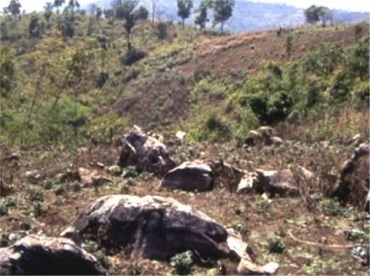
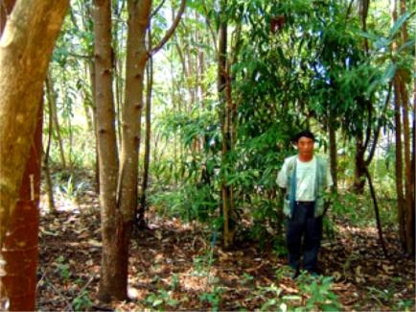
Protecting biodiversity
Biodiversity may be under threat but the good news is there are organisations working hard to prevent the extinction of species and restore natural habitats.
Notes:
The Convention on Biological Diversity was set up at the Rio ‘Earth’ Summit in 1992 to conserve biodiversity around the world. But there are also smaller, national and even regional initiatives with similar aims.
FORRU in Thailand is one such example. FORRU stands for Forest Restoration Research Unit. It’s an organisation operating out of Chiang Mai University and they are dedicating to restoring forests in northern Thailand.The country has lost more than half of its natural forest cover since 1961, but FORRU is working hard to replace this. It is working with local community groups to train them on how to replant deforested parts of the rainforest, and focus on key species to attract wildlife into the area and increase the biodiversity of plants and animals.

Slide 7
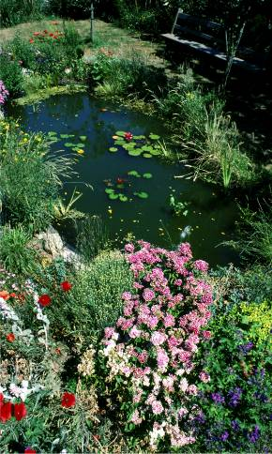
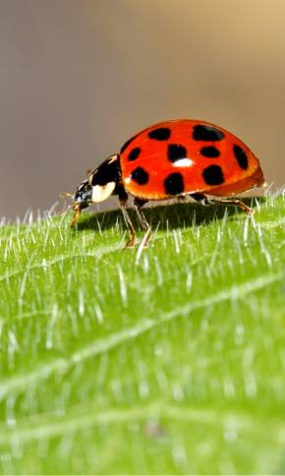
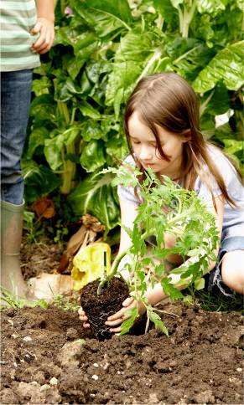
Supporting biodiversity means:
Encouraging local plants & wildlife
Protecting native species
Being a greener school

Slide 8
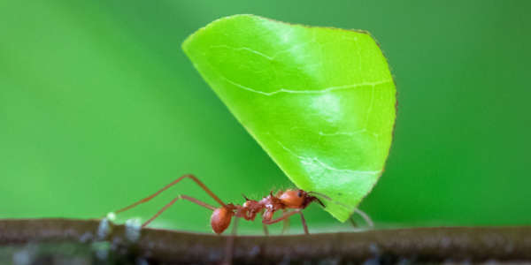
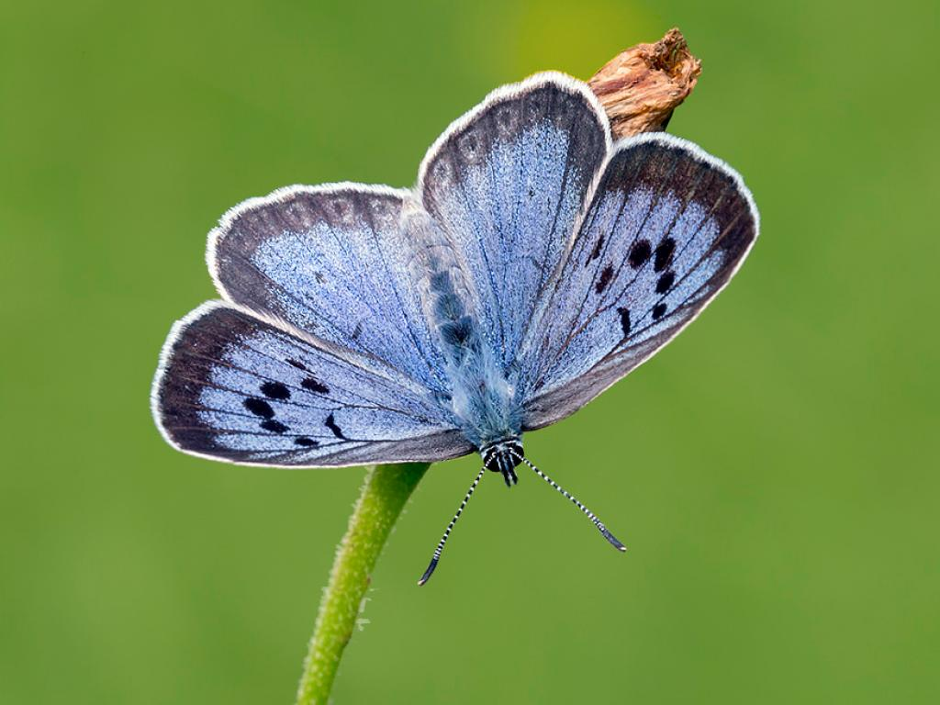
Why insects are important
FACT:
Insects were farmers long before humans: termites cultivate fungus gardens under their mounds; leaf-cutter ants make underground compost heaps; and many ant species tend and protect ‘herds’ of aphids to gather their honeydew.
Source: National Insect Week
FACT:
The beautiful large blue butterfly, which was extinct in the UK by 1979, has now been reintroduced and is thriving in several locations in southern England after researchers discovered how its life cycle is intimately linked to that of a particular species of red ant.
Source: National Insect Week

Slide 9
What could you do to help?
Tread carefully in the woods and countryside. Keep to paths so you don't trample on delicate plants. Use natural items you find on the ground for your crafts and games - don't pick them from plants and trees.
Walk or cycle to school if you live close enough and use public transport whenever you can rather than going by car. This will help cut down the air pollution caused by traffic.
Recycle
Cut back on plastic. Some types of plastic can't be recycled, and plastic isn't biodegradable - that means it doesn't break down naturally like food and paper.
Provide extra food for the creatures that visit your garden by making a bird feeder or a butterfly feeder.
It's also a good idea to let a bit of your garden grow wild so they have somewhere to hide. You could even build a frog pond to help amphibians, or a hedgehog home for our spiky mammal friends.

