Slide 2
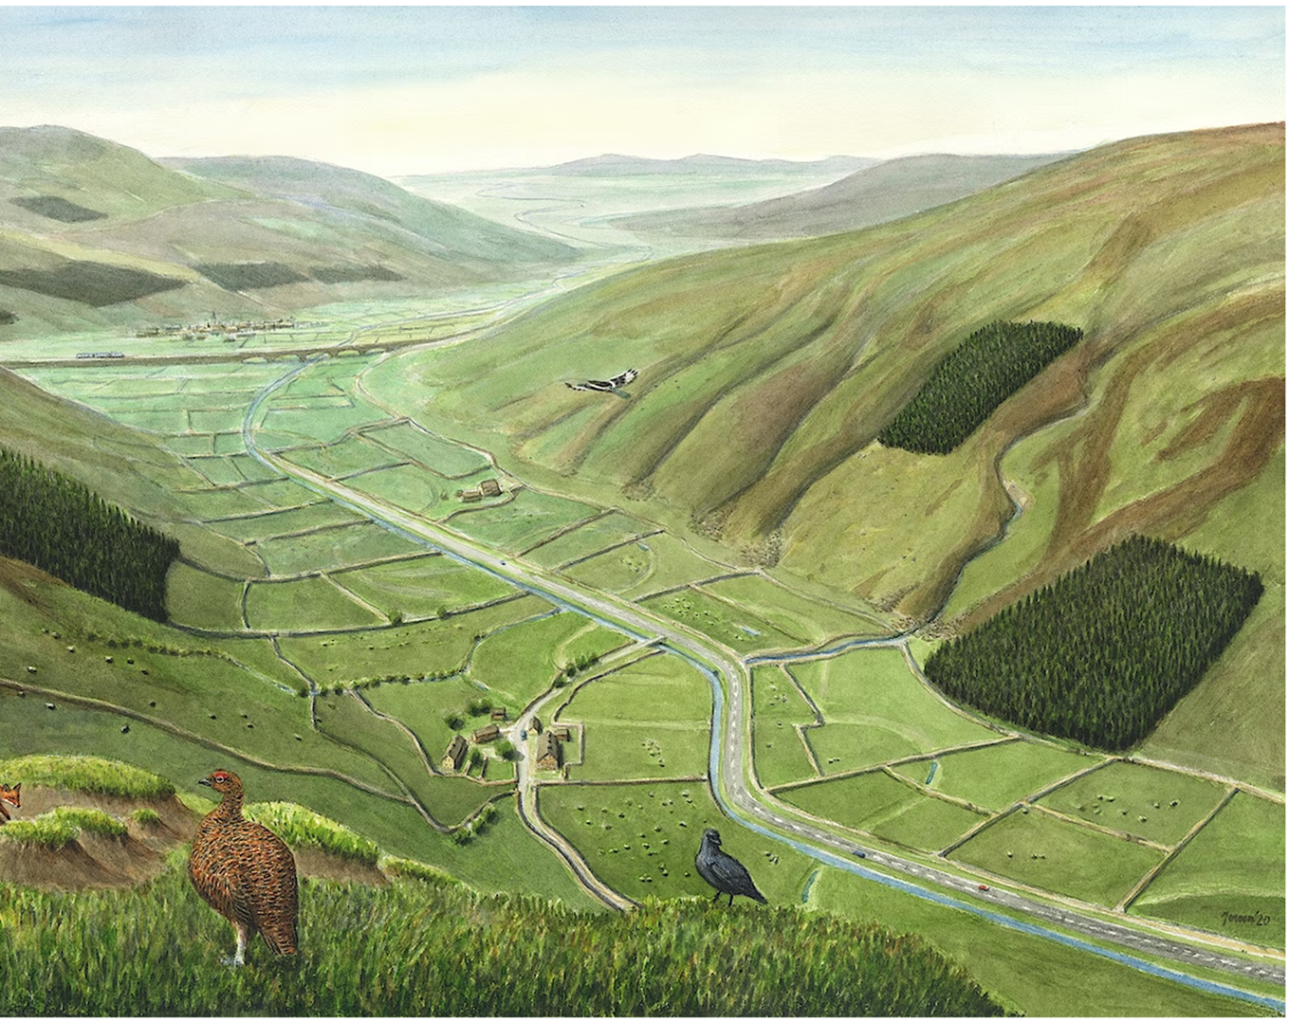
How do you feel when you look at this picture?
What can you see?
Notes:
Or perhaps that should read, what can’t you see? Britain’s native trees and plants are mostly missing in this picture, which is typical of many upland areas. There’s very little wildlife overall, and not many people.
Human activity appears to be largely restricted to sheep farming, grouse shooting, and commercial forestry. People may come to stay and walk here in the ​‘great outdoors’ but they won’t see much wildlife. Options for young people to earn a living are likely to be limited.
There’s a town on the railway line off in the distance. Is it thriving or struggling…?
Heather and eroding peat dominate the slopes on the left. Peat hags — degraded by historic acid rain, sheep grazing and repeated burning — are in the foreground of the picture. Moorland burning is continuing in the distance.
Trees are largely confined to regimented blocks of non-native conifers with little or no connection to their surroundings. Tiny fragments of broadleaved trees have managed to hang on, including the fledgling birch in the foreground of the picture and a thin ribbon lining the bottom of the stream flowing down to the valley floor.
Sheep have over-grazed the hills in much of this landscape. The ground is compacted through centuries of trampling. This is causing bad erosion and landslips, and contributes to the flood risk already exacerbated by the lack of vegetation.

Slide 3
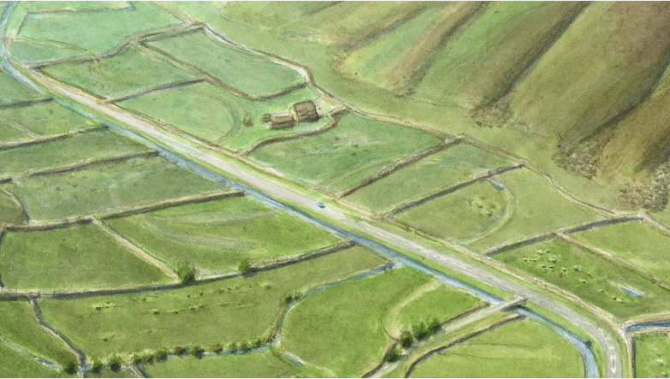
Altered rivers and flood risk
Notes:
ALTERED RIVERS AND FLOOD RISK
The river is unnaturally straight. Like so many rivers in Britain, it has been straightened, widened and deepened. In some places, it has been separated from its floodplain by embankments. You can see the faint outlines of its original meandering course in the fields, the river’s floodplain. Some water is settling there.
During heavy rains most of the rain that falls in this catchment will rush off these billiard table hills and hurtle down this channel, increasing flood risk downstream.
There are no longer any trees or plants beside this river, which is a shame because falling timber can help slow the flow of water. This loss of riparian ecosystem diminishes biodiversity (leaf litter in rivers provides nutrients for amphibian life, for example).
We all like to get around with ease but modern roads have divided and fragmented habitats for wildlife, contributed pollution and made it more difficult for wildlife to move around. The road here is following the path of the river. In the past, an older track or highway would have been built to the side of the original meander.

Slide 4
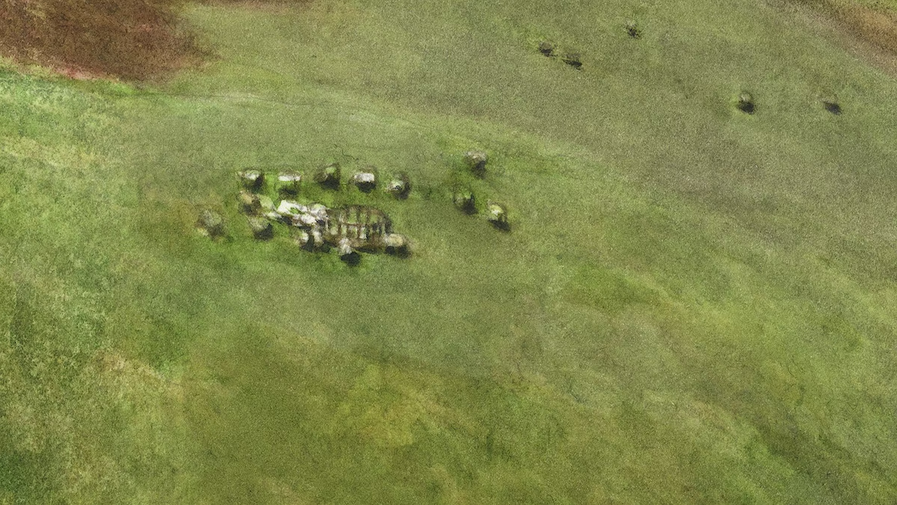
Sheep, sheep and more sheep!
Notes:
Sheep are the dominant animal in this scene. There are over 15 million sheep in England, more than 10 million in Wales and nearly 7 million in Scotland. According to the National Sheep Association, the sector employs 34,000 people on farms and a further 111,405 jobs in allied industries. Sheep herding has been subsidised in the last few decades by the EU’s Common Agriculture Policy.
Sheep are believed to have first come to Britain around 4,000 BC, then in greater numbers during the Bronze Age as woodland diminished. It’s thought that there was only one type of sheep, the Soay or similar, until the Romans introduced different breeds.
Ecologically, the large scale intensive grazing of millions of mouths over centuries has shaped many of our upland and lowland areas, suppressing the growth of trees and other vegetation. This has dramatically reduced biodiversity.
The monoculture, billiard-table character of the intensively sheep-grazed areas attract generalist species, which are easily able to adapt and even thrive in these conditions. The picture shows a typical mix of these species: red fox (often disliked and persecuted by farmers because they kill young lambs), carrion crow and magpie.

Slide 5
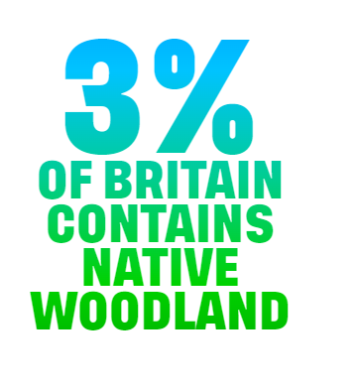
Why is this a problem?
What does native mean?

Slide 6
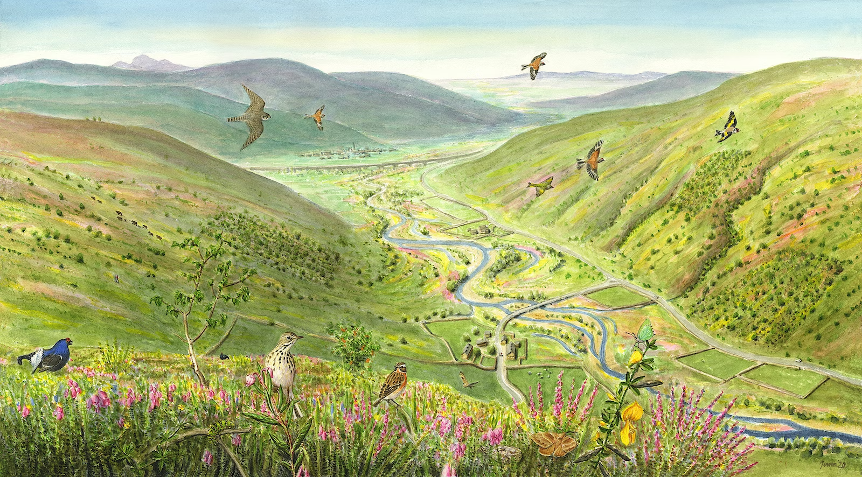
Notes:
Nature is recovering! Thanks to significantly reduced grazing pressure, seedlings can grow and the ground is less compacted. Fewer chemicals, fertilisers and animal medications are entering the soil and water.

Slide 7
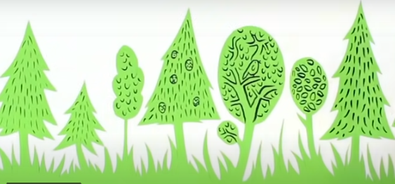
Notes:
https://www.google.com/search?q=rewilding+assembly+ks2&rlz=1C1GCEU_enGB883GB883&sxsrf=AJOqlzWPuoYLmI_EFpc-GG0vHPaEuovHtA:1675349833532&source=lnms&tbm=vid&sa=X&ved=2ahUKEwju5869jPf8AhWRQ0EAHZTHCjcQ_AUoAnoECAEQBA&biw=1745&bih=881&dpr=1.1#fpstate=ive&vld=cid:4d664f0f,vid:X-qquAUA1TI

