Slide 1
Close your eyes and listen
Where do you think we are?
Notes:
https://youtu.be/8myYyMg1fFE

Slide 2
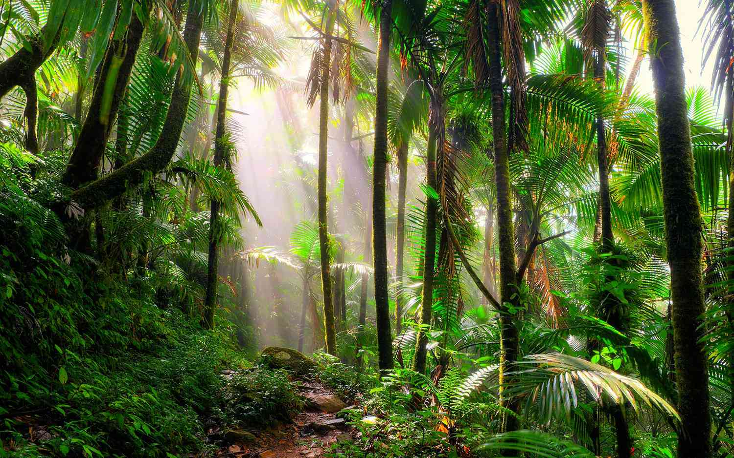
Shut your eyes and imagine yourself in a forest. Beautiful, isn’t it? What can you see? What can you hear?

Slide 3
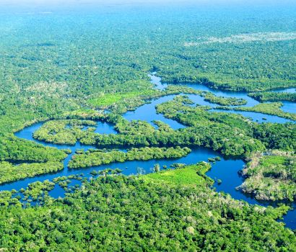
Rainforests are forests full of tall trees and, as you might expect, have high levels of rainfall. They can be found all across the world, but the best-known is the Amazon rainforest in Brazil, South America. Tropical rainforests have been called the ‘jewels of the Earth’ because of the beauty and richness found within them.

Slide 4
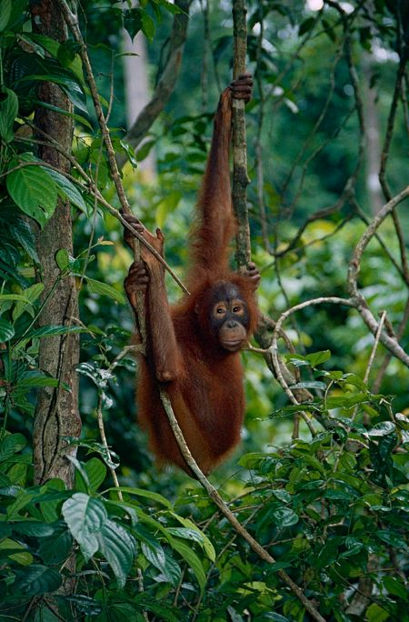
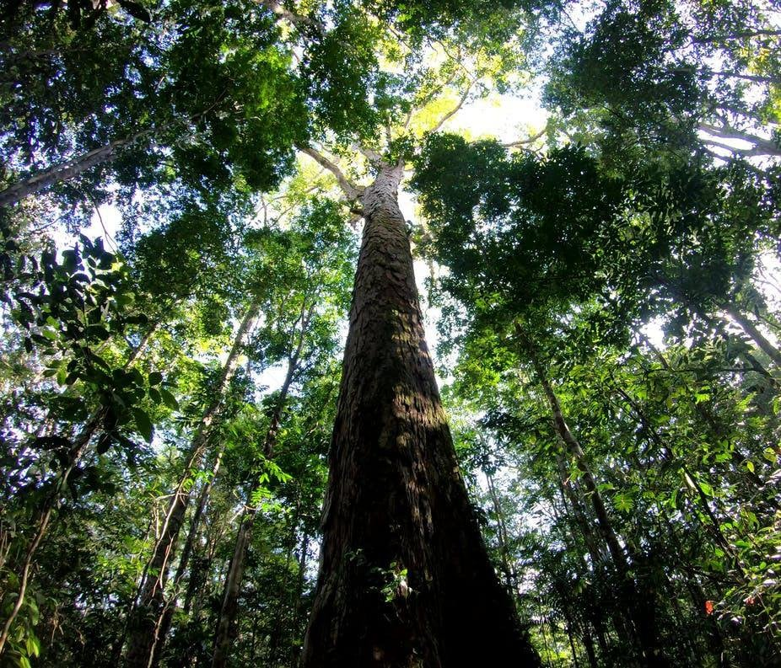
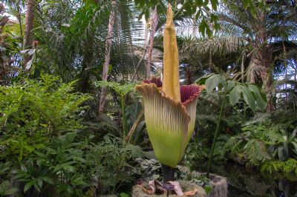
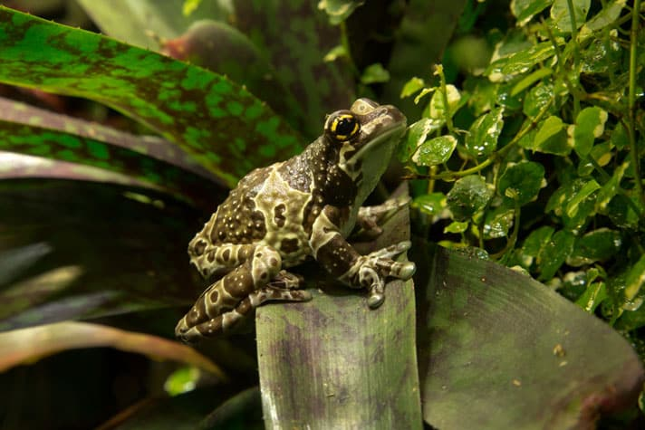
We have heard the sounds of the rainforest, but what if the rainforest could actually speak? What if the trees and animals had voices that we could understand? What do you think they would say to us?

Slide 5
I am a tree. Not just any tree…
Notes:
I am a tree. Not just any tree – I am the tallest tree in the rainforest. As far as the eye can see, no other tree stretches up as high above the forest into the sky as I do. I am now just over 60 metres tall, but I intend to grow to 80 metres.
If I get the chance, that is. I’ve seen trees like me falling down way in the distance. I’ve heard the cries of the eagles, bats and monkeys whose homes have been destroyed. I’ve heard the terrible gnashing and chomping of the metal monsters – the machines you humans call chainsaws and bulldozers. I’ve choked on the smoke of the terrible fires scorching and killing everything in their path.
I know that they are getting closer and closer. I know it will not be long. I have stood tall in the strongest winds and the hottest temperatures for hundreds of years, but even I cannot fight this.
Humans don’t know what they are doing. We are the ‘lungs of the planet’. You need us. Not cut down for timber for houses and furniture and paper, but alive. Humans need us alive. You need us breathing. We are responsible for more than a quarter of the world's oxygen turnover. We recycle carbon dioxide into oxygen.

Slide 6
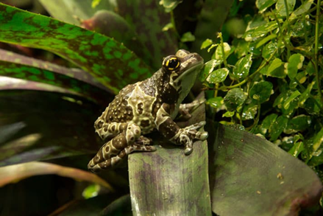
I am a frog – one of the most beautiful frogs in the Amazon rainforest, if I say so myself.
Notes:
I am a frog – one of the most beautiful frogs in the Amazon rainforest, if I say so myself. Only about 5 per cent of the sunlight shining on the rainforest canopy reaches the understorey where we all live, but I’m sure you’ll agree, we more than make up for that!
You would not believe the variety of creatures that live deep in the rainforests. The colours, the shapes, the sizes, the sounds . . . you could not begin to imagine. There are many millions of species of plants, insects and other forms of life still undiscovered in our rainforests. Many millions of living creatures you still know nothing about.
Humans probably never will know. We’ve heard the news. We know what’s coming. Humans are clearing away our homes to make more homes of your own. Our beautiful rainforest cities are making way for ugly concrete jungles.
So many amazing creatures that do not exist anywhere on this planet any more. You cannot imagine how many more are on the edge of extinction. Human experts estimate that we are losing 137 plant, animal and insect species every single day due to rainforest deforestation.

Slide 7
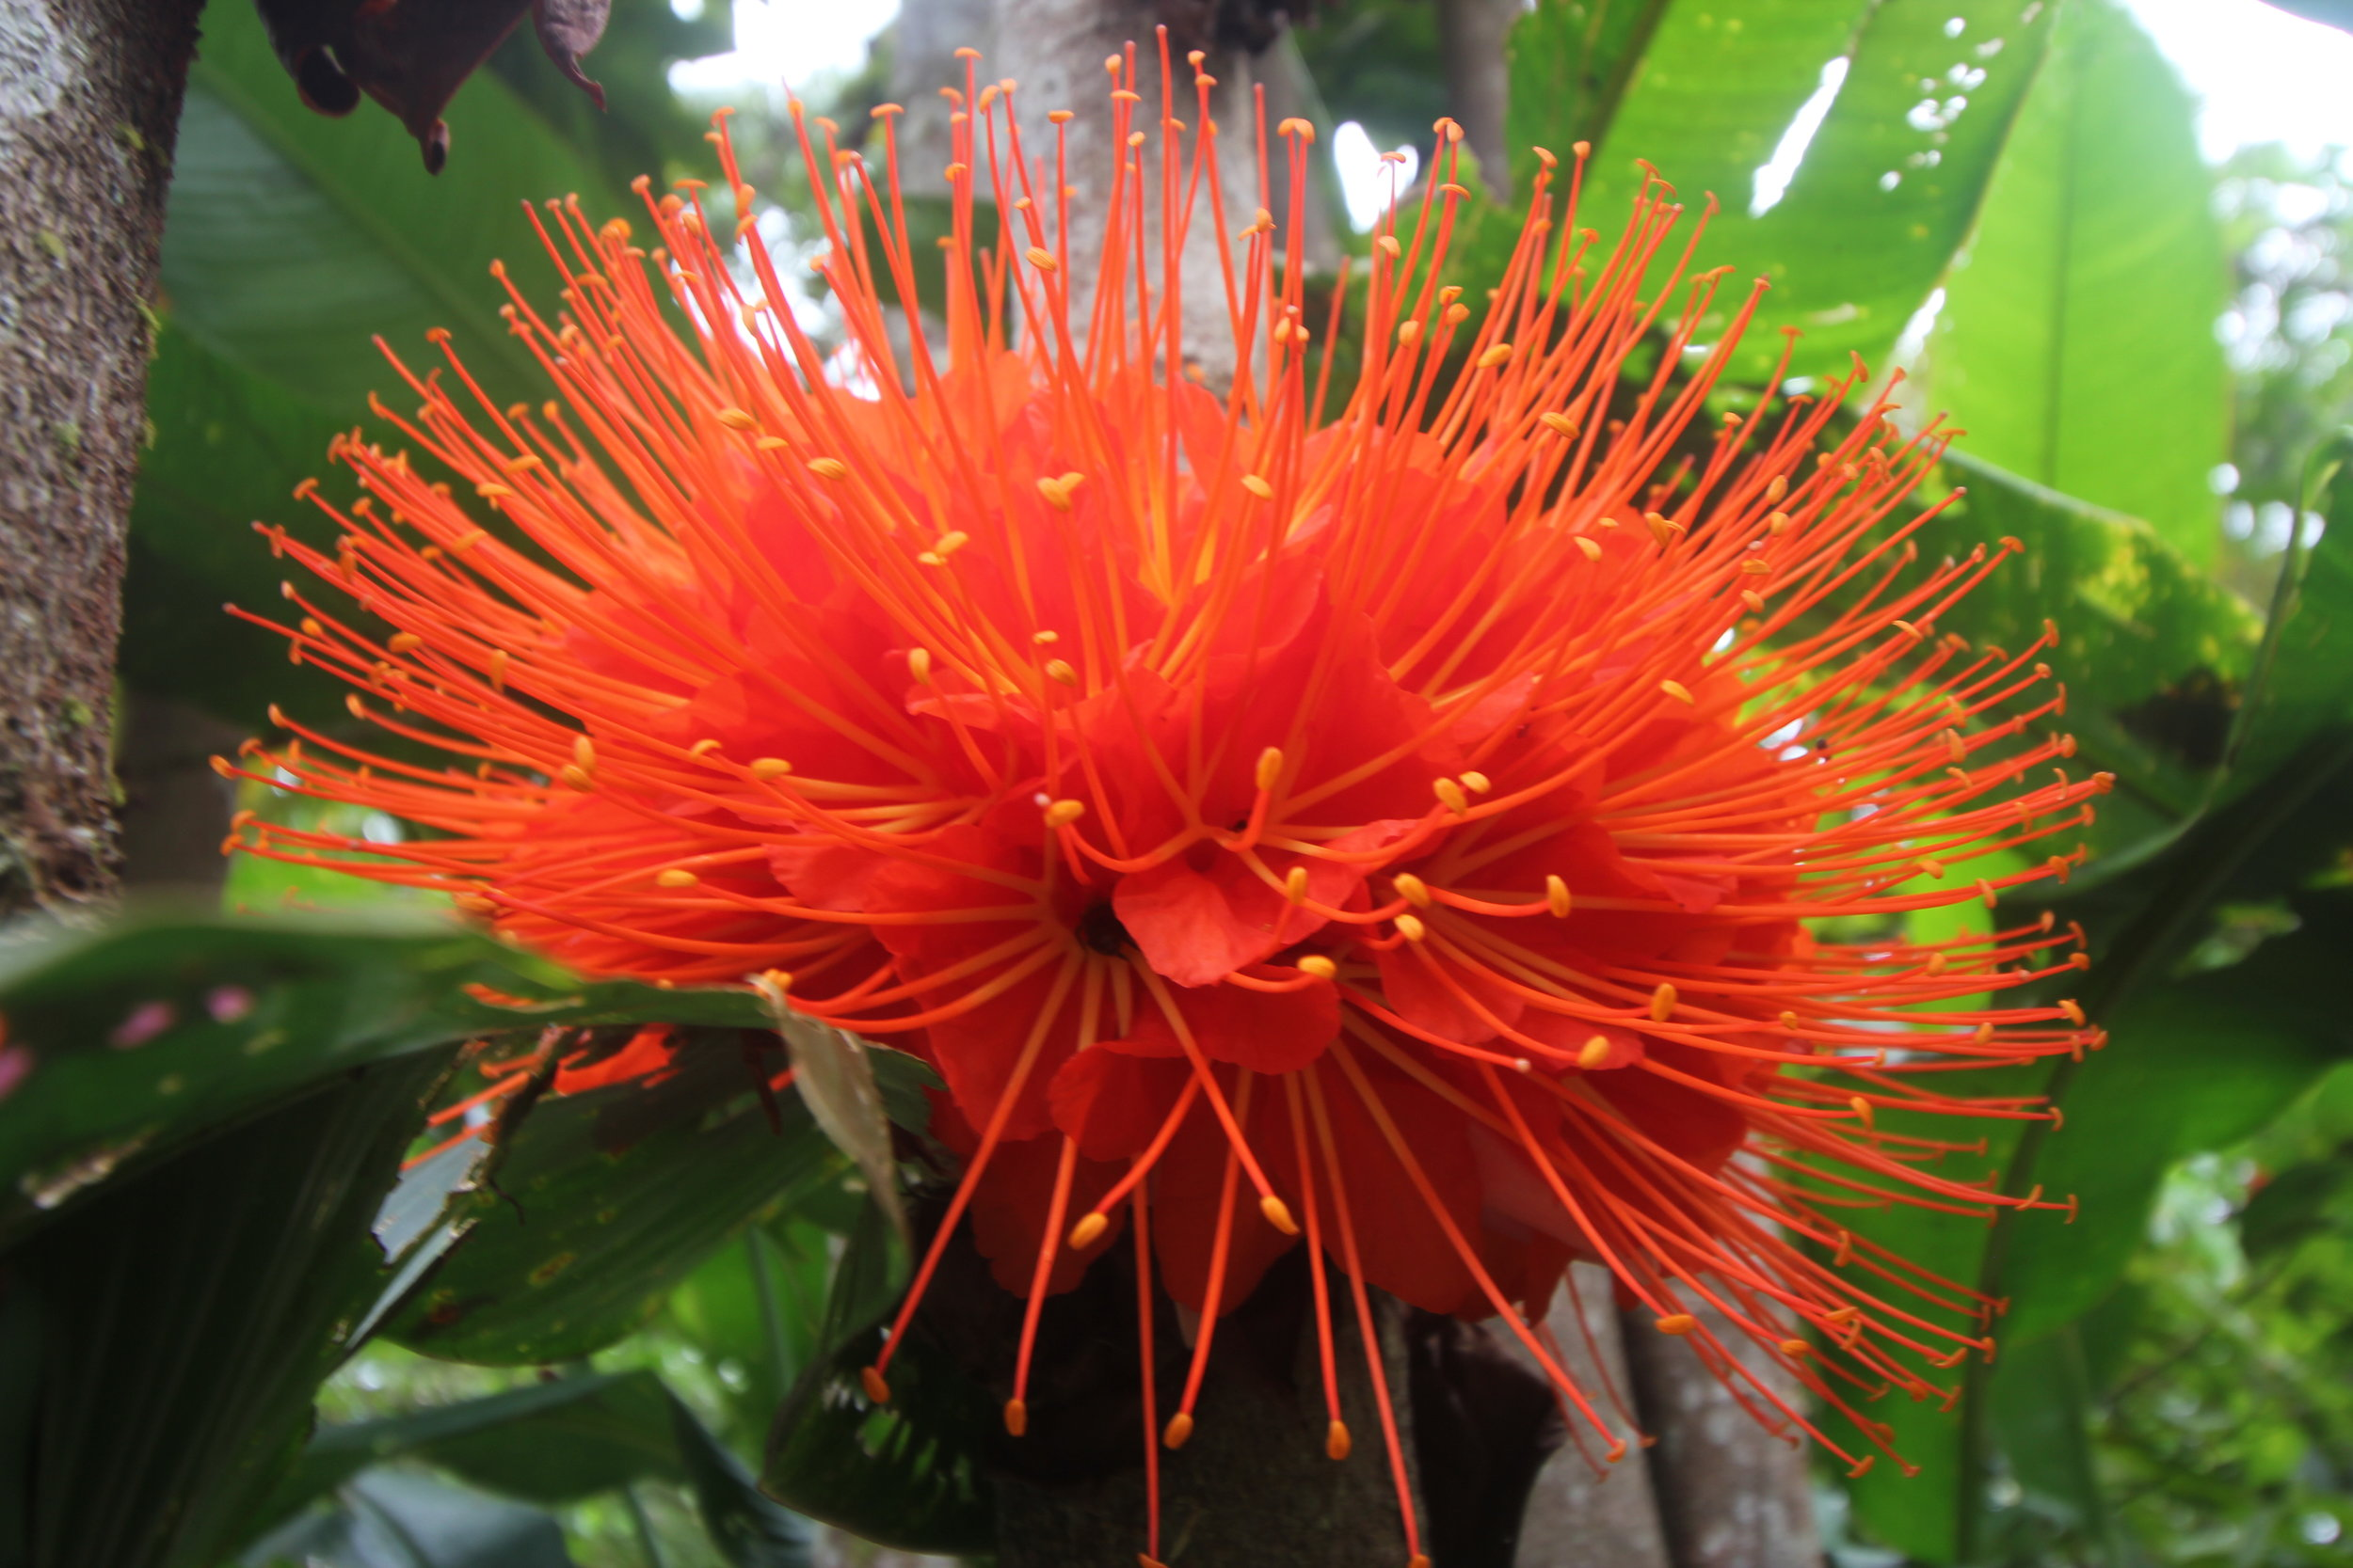
I am a beautiful rainforest plant, the most beautiful of all in my humble opinion – and there is a lot of competition for that title, I can tell you. Around 50 per cent of all the plant species in the world live in the rainforests.
Notes:
I am a beautiful rainforest plant, the most beautiful of all in my humble opinion – and there is a lot of competition for that title, I can tell you. Some 50 per cent of all the plant species in the world live in the rainforests.
Did you know that at least 80 per cent of your diet originated in the tropical rainforest? Spices, nuts, coffee, chocolate, vanilla, sugar, numerous vegetables and fruits all come from here. At least 3,000 fruits are found in the rainforests. The peoples of the forest use over 2,000. You only know of about 200, such as avocados, coconuts, figs, oranges, lemons, grapefruit, bananas, guavas, pineapples, mangos and tomatoes.
Back to me, I am not just stunningly beautiful. Oh no. I am a part of the ‘world's largest pharmacy’. About one quarter of natural medicines have been discovered in the rainforests and I am one of them. Medicines derived from rainforest plants are commonly used for fever, infections, burns, stomach problems, pain and breathing problems. That’s right, we make you better; we can cure you.
Maybe we will never get the chance to show you what we can do, though. We know that humans are destroying us all to grow crops and develop grazing land for their cattle. As the rainforest disappears, so do many possible cures for life-threatening diseases.

Slide 8
What is happening in the rainforests?

Slide 9
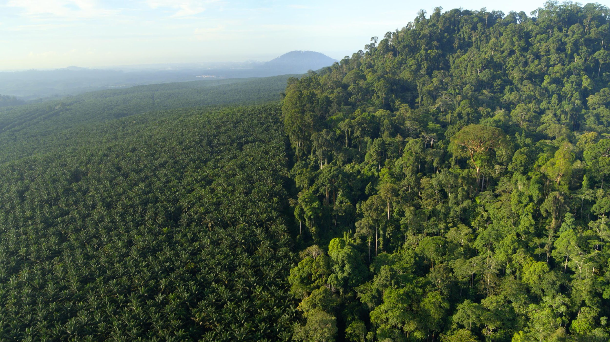
Deforestation is the deliberate removal of forests. This is done by cutting down trees and shrubs and starting fires. This happens so that the land can be used for other things, including planting crops and grazing cattle, as well as the development of towns and cities.
Did You Know…?
Every minute, an area of rainforest the size of a football pitch is cut down. If this rate continues, there will be no rainforests in 100 years.

Slide 10
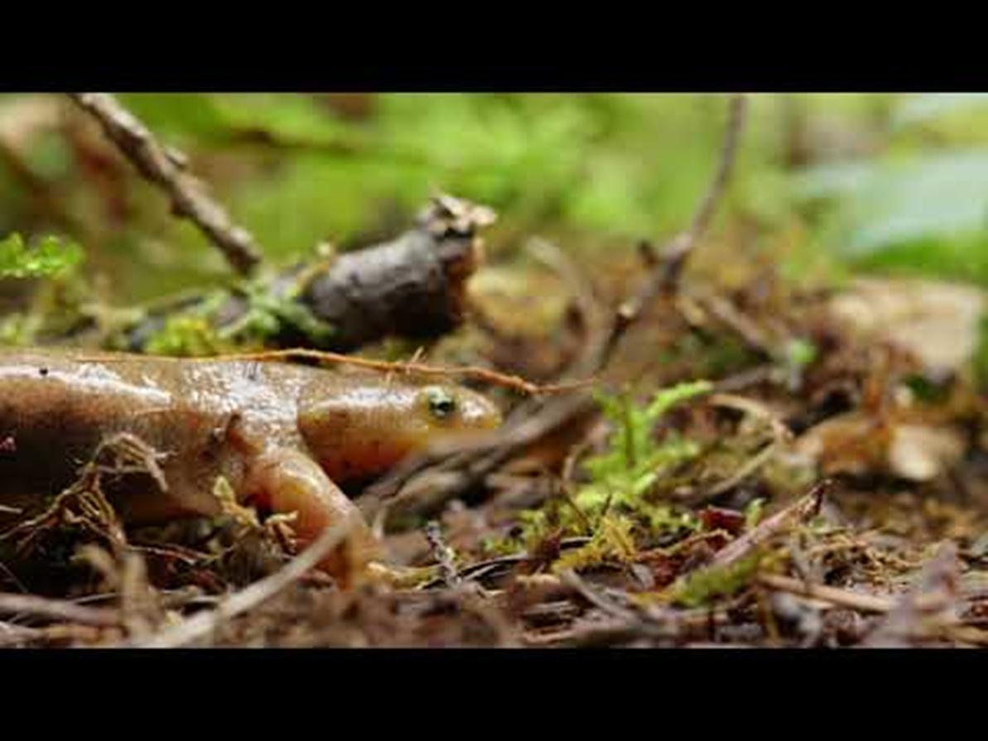
How To Save Our Forests and Re-wild Our Planet
Notes:
https://www.youtube.com/watch?v=Ig9Tfc_hNsE

