Slide 1
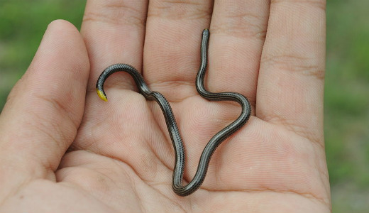
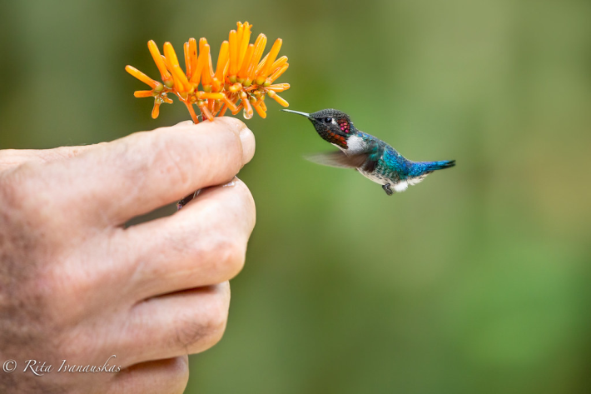
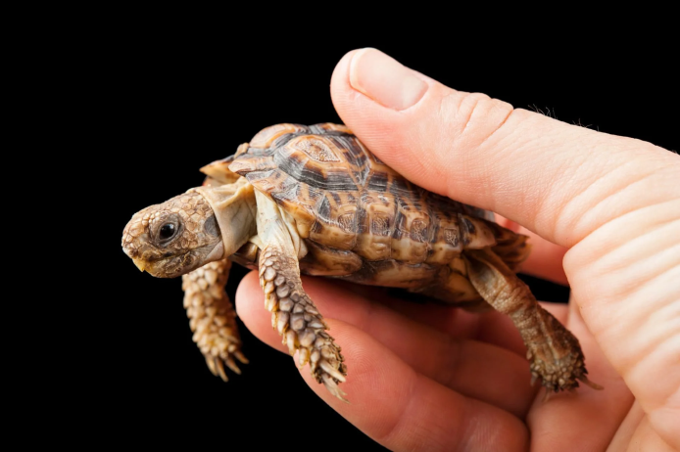
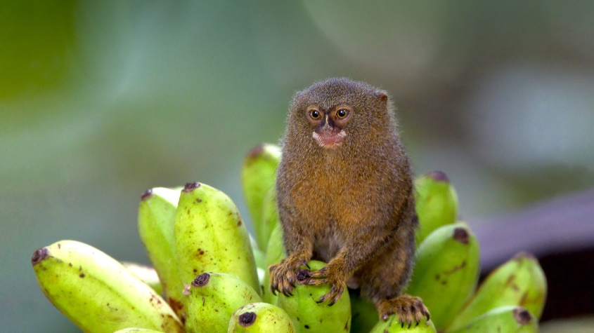
What do all these animals have in common?
Slender Blind Snakes
Bee Hummingbird
Pygmy Marmoset
Speckled Padloper Tortoise
Paedocypris

Slide 2
Notes:
https://www.assemblies.org.uk/sec/3887/from-small-beginnings

