Slide 1
What is your favourite animal and why?

Slide 2
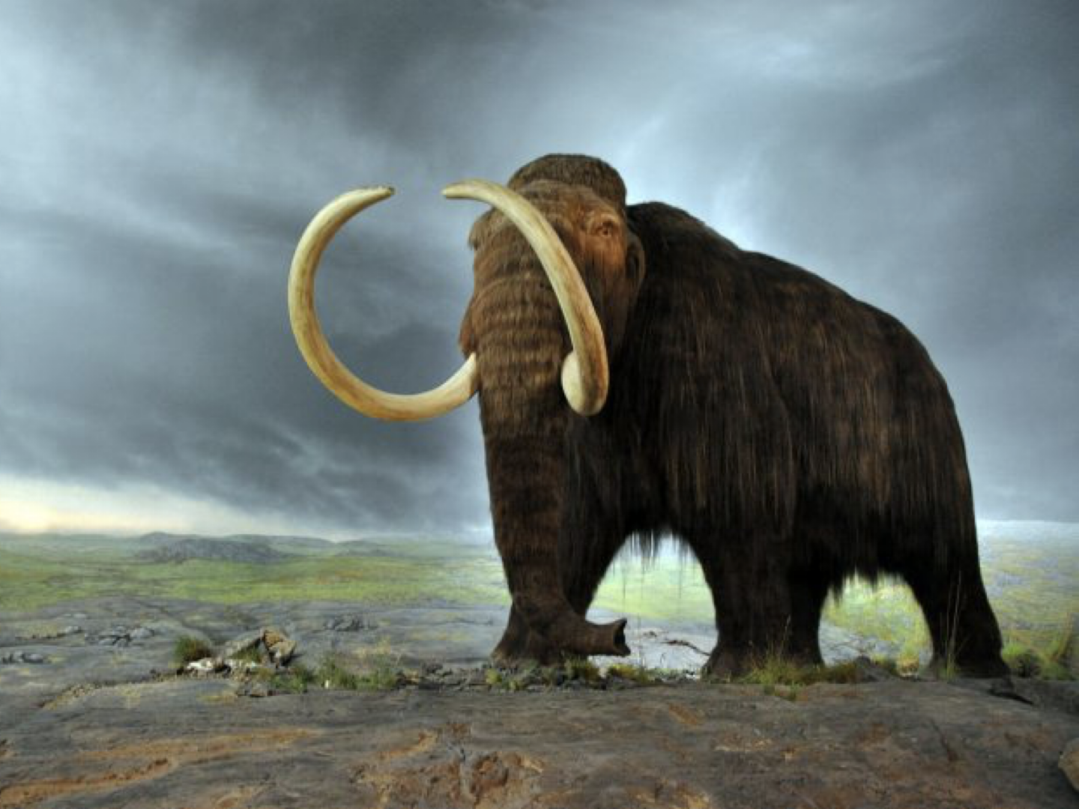
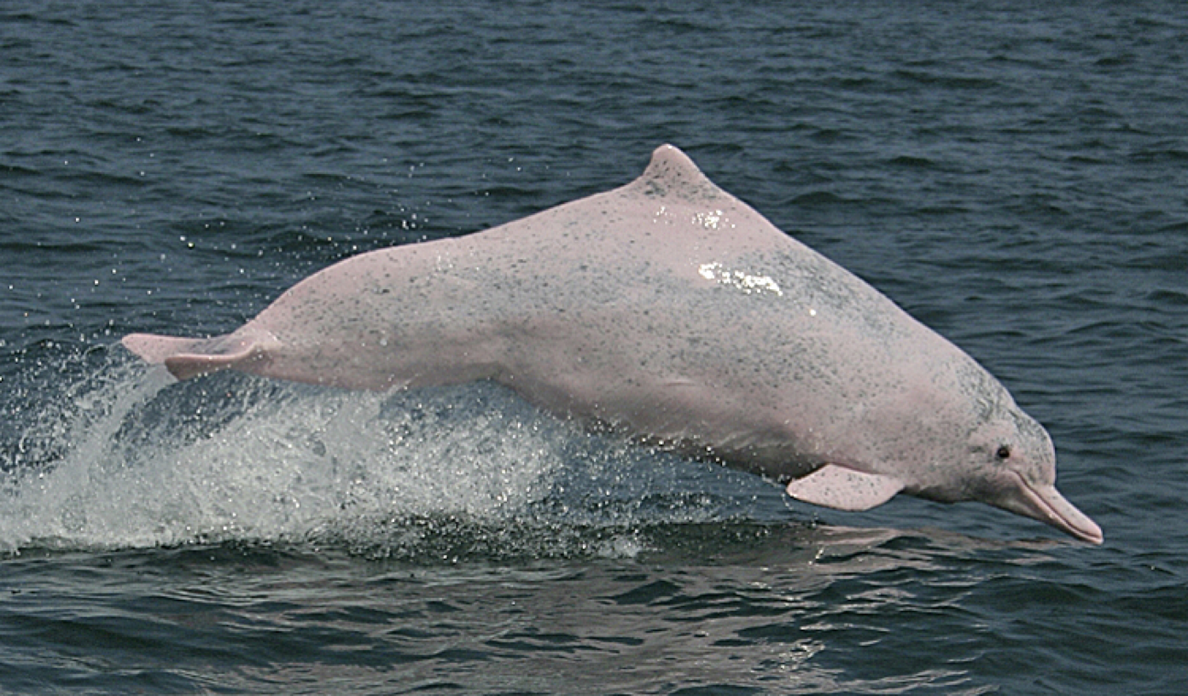
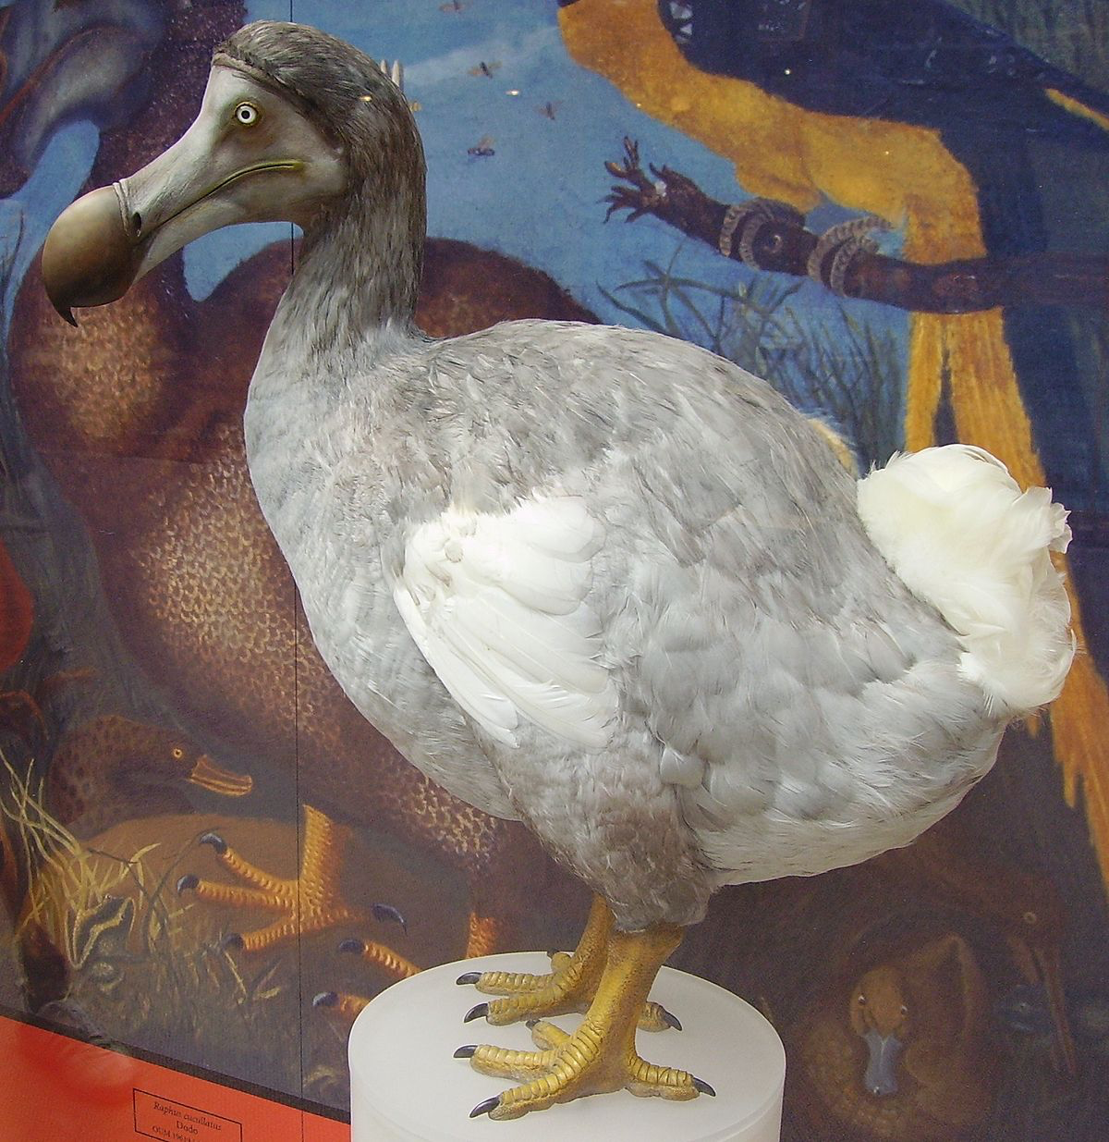
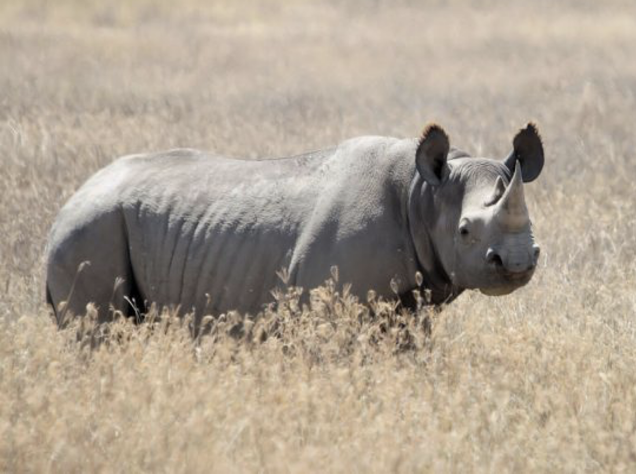
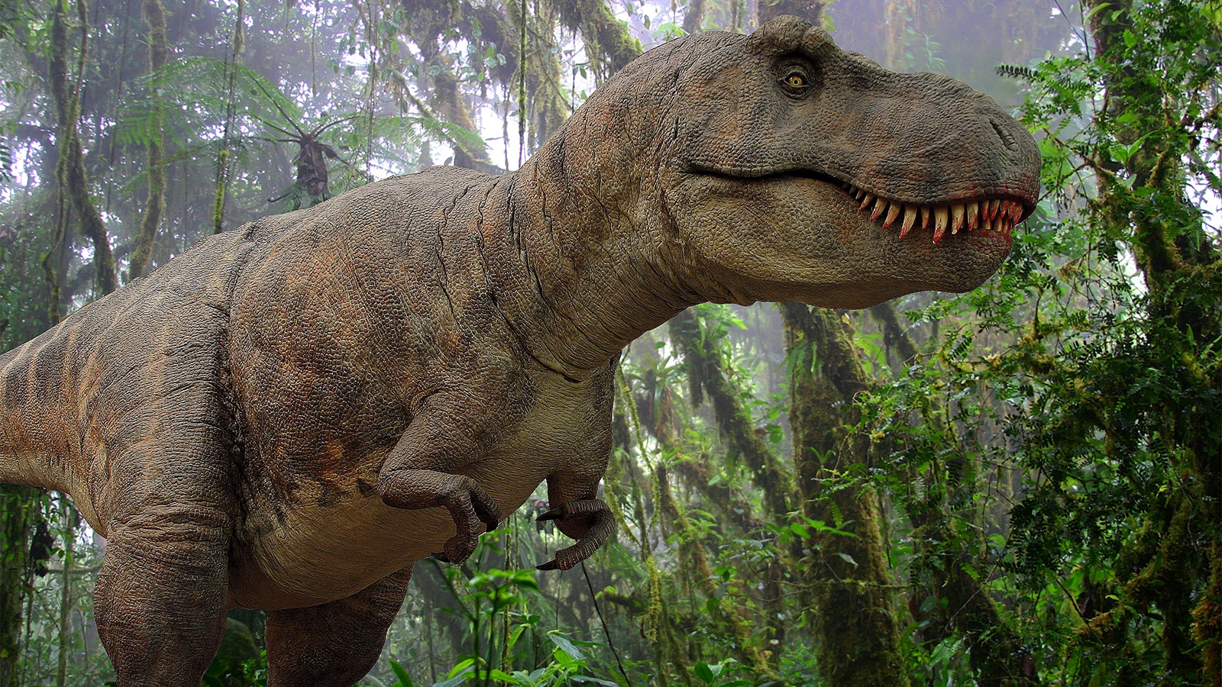
What do all these animals have in common?
Notes:
West African Black Rhinoceros
Mammoth
BaiJi white dolphin
T-rex
Dodo

Slide 3
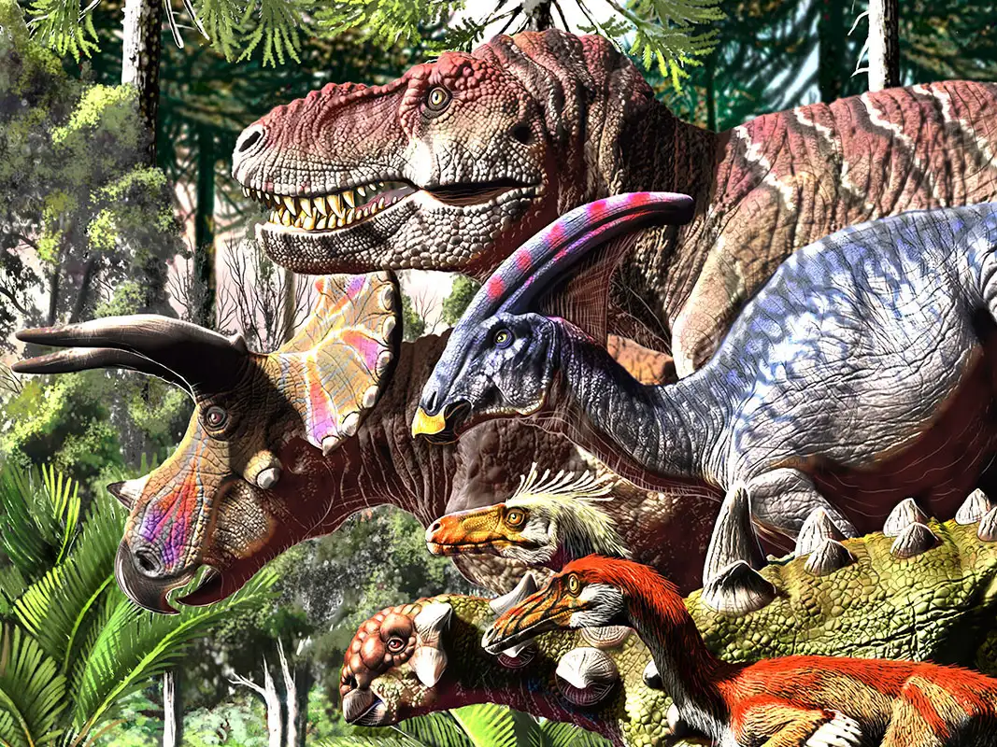
These animals are extinct
This means that a species, family or group of animals or plants no longer exists.
Dinosaurs are a well-known example of extinct animals. We know that they existed because many bones have been found.

Slide 4
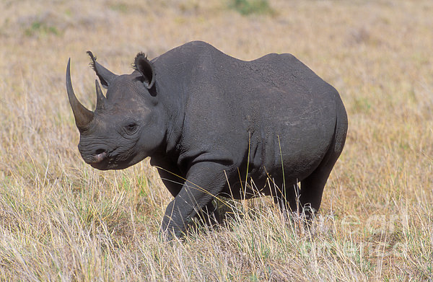
However, unfortunately, it isn’t only animals who lived thousands of years ago that have become extinct.
This is a West African black rhinoceros. It was officially declared extinct in 2011, only 12 years ago!

Slide 5
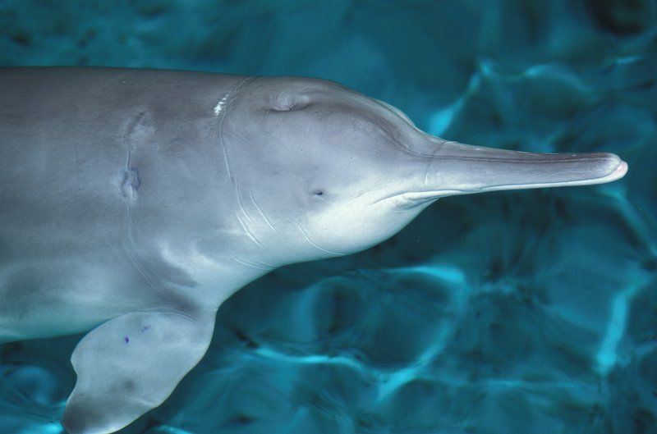
This is a baiji white dolphin. It hasn’t been declared extinct yet, but it hasn’t been seen for many years.

Slide 6
What might cause an animal to become extinct?
Sometimes, a natural disaster or a change in the environment can make animals extinct. However, it is more common for animals to become extinct through people’s actions. For example, the West African black rhinoceros was hunted to extinction because people wanted to use its horns.
Notes:
Point out that all of us have a responsibility to look after the world.

Slide 7
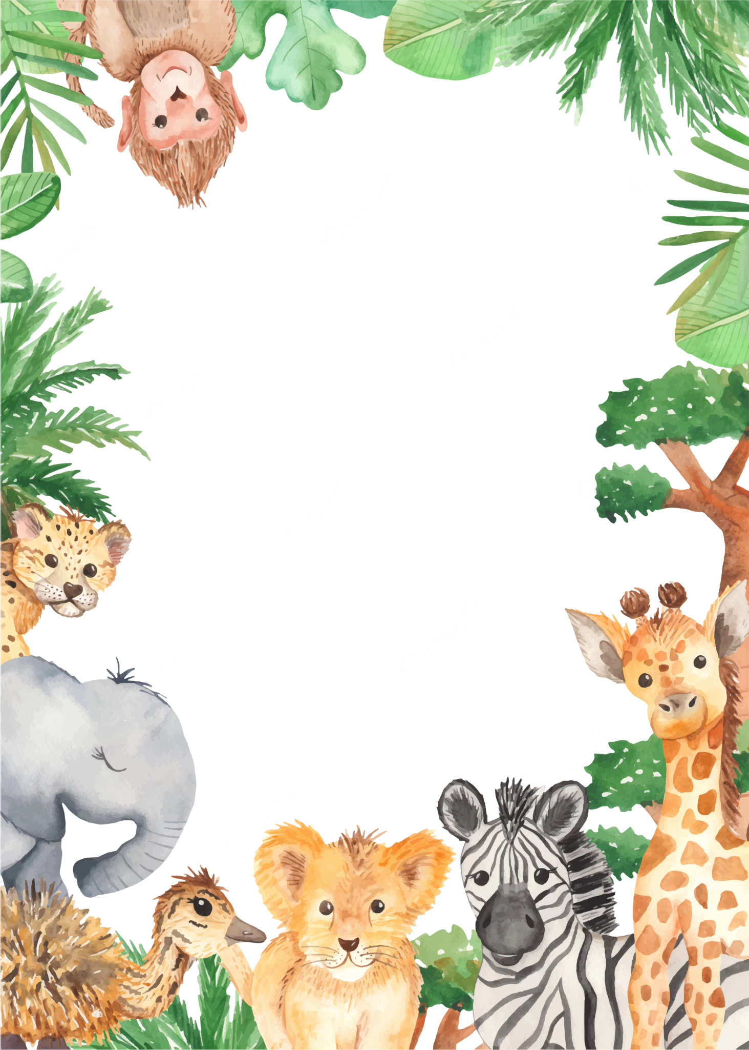
And as we close our eyes, let us pause to decide
To do all that we can to keep each creature alive.
To protect all the wildlife, to treat the world right,
So the animals can settle to sleep every night.
Sleep tight, animals . . . goodnight.
Sleep peacefully tonight.

Slide 8
What could we do to help protect animals?

Slide 9
There are some simple things that we can do to protect animals:
- Climate change affects animals. By doing something as simple as walking to school or turning off a light when we leave a room, we can protect the environment and the animals within it.
- Pollution has a huge impact on animals. By not dropping rubbish that an animal might swallow or become tangled in, we are protecting animals.
- Sometimes, chemicals such as fertilizer that we use in our gardens can get into the waterways and affect animals. By being careful and reading labels on garden products, we can protect animals.
- We can research different types of animals and learn more about how we can help to keep them safe.
-Write to a local animal charity, inviting them to visit school and tell you more about their work.
Notes:
https://kids.nationalgeographic.com/nature/save-the-earth/article/save-animals

