Slide 1
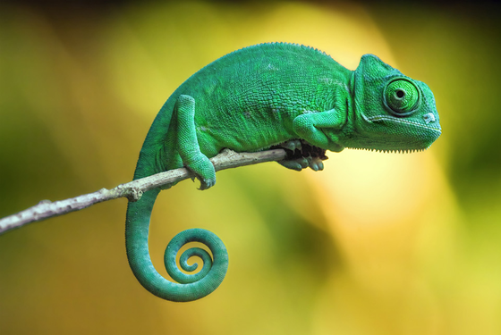
What animal is this?
Notes:
Watch the video of chameleons with chn.
https://www.youtube.com/watch?v=h88091zO3nc

Slide 2
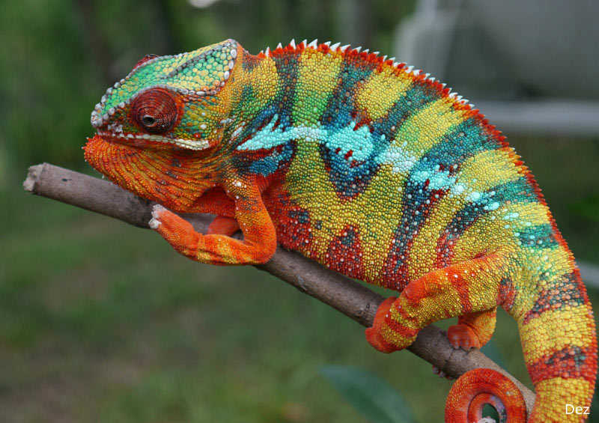
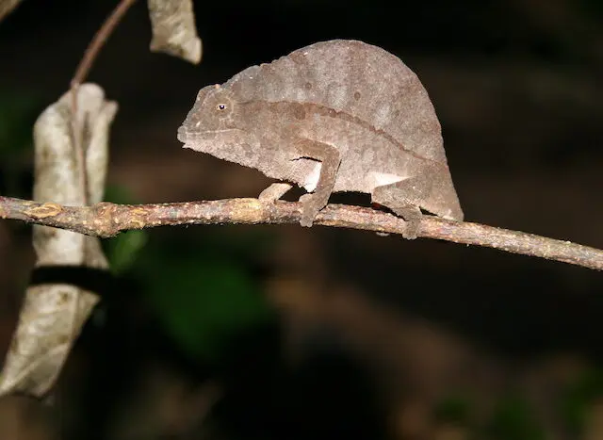
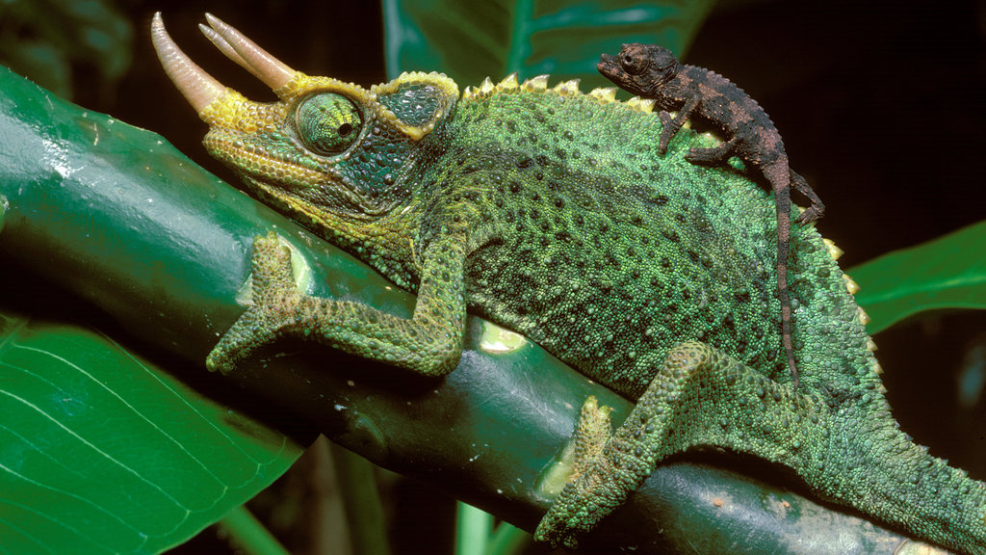
What are the features of the chameleons?
Notes:
Ask the children to look carefully at the images and describe the different features of the chameleons, both their similarities and differences. Ask if anyone can give more details about chameleons.

Slide 3
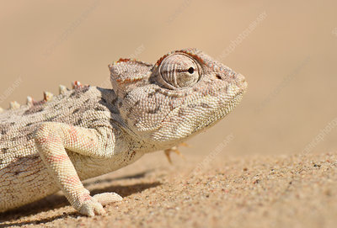
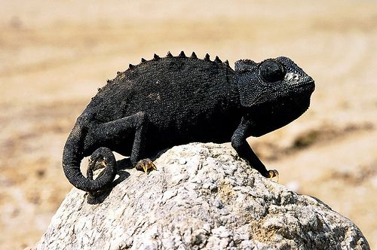
Chameleons are a type of lizard. There are many different varieties of chameleon and they are usually found in warmer climates that range from desert conditions to the rainforest. They come in a range of colours and some can change colour to match their environment. This feature is mainly used for camouflage and communication.
However, chameleons such as the desert-living Namaqua chameleon use their ability to change colour to help regulate their body temperature. They change their colour to light-grey to reflect the heat when they are hot and change to black when they need to absorb heat more efficiently.

Slide 4
Chameleons can adapt themselves to changes in their immediate environment. They do so quickly and efficiently.

Slide 5
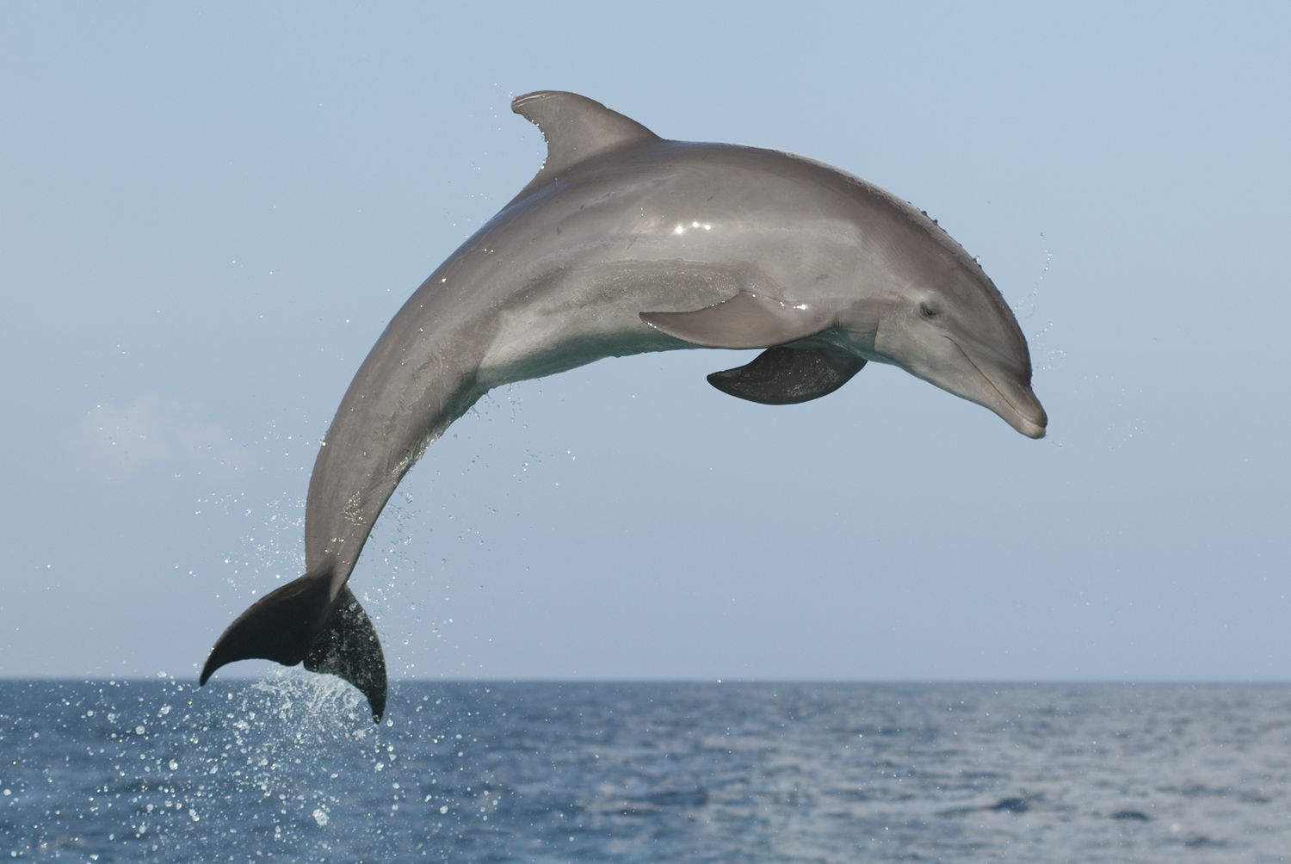
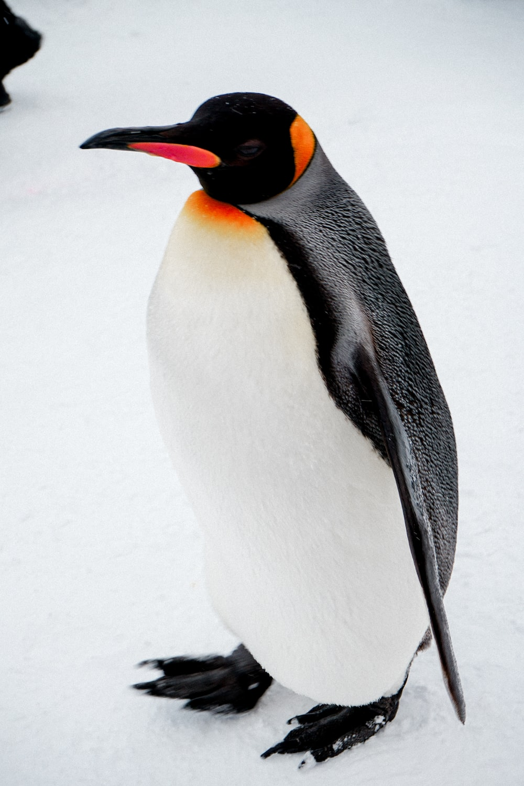
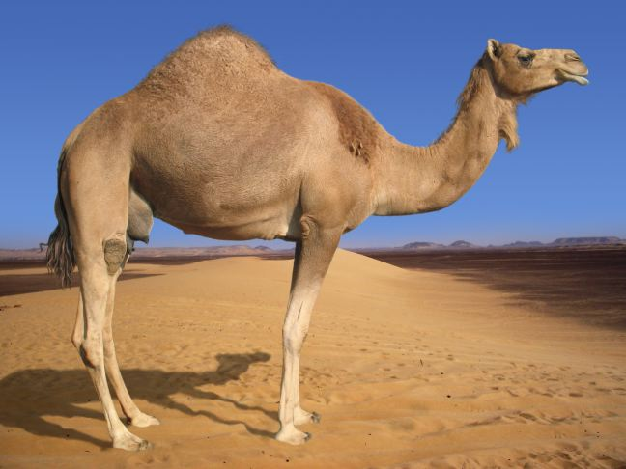
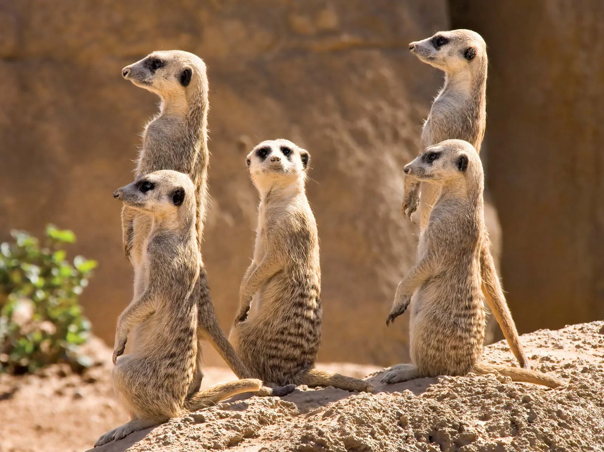
How have these animals adapted to their environments?

Slide 6
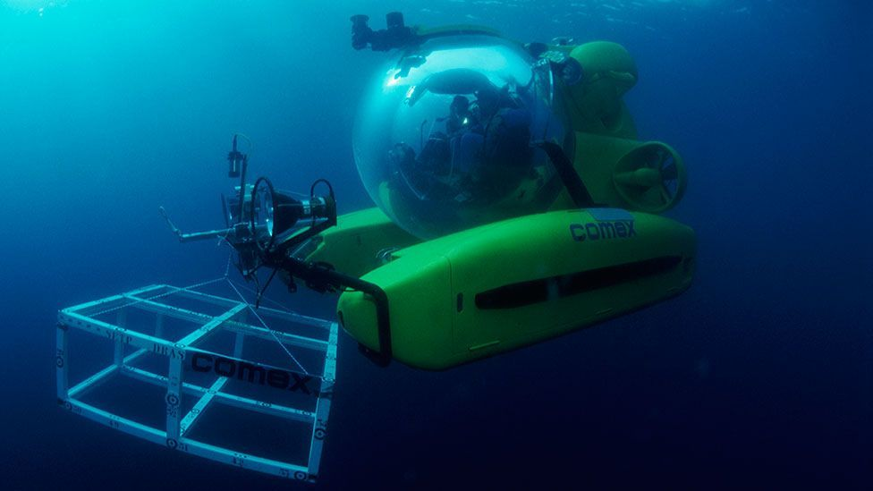
Notes:
Imagine you are a scientist in a submarine. close your eyes and visualise being part of a submarine journey towards the bottom of the ocean. Imagine fading light, chilling temperatures, increased water pressure and the presence of many weird and wonderful creatures that populate the different zones of the ocean waters.

Slide 7
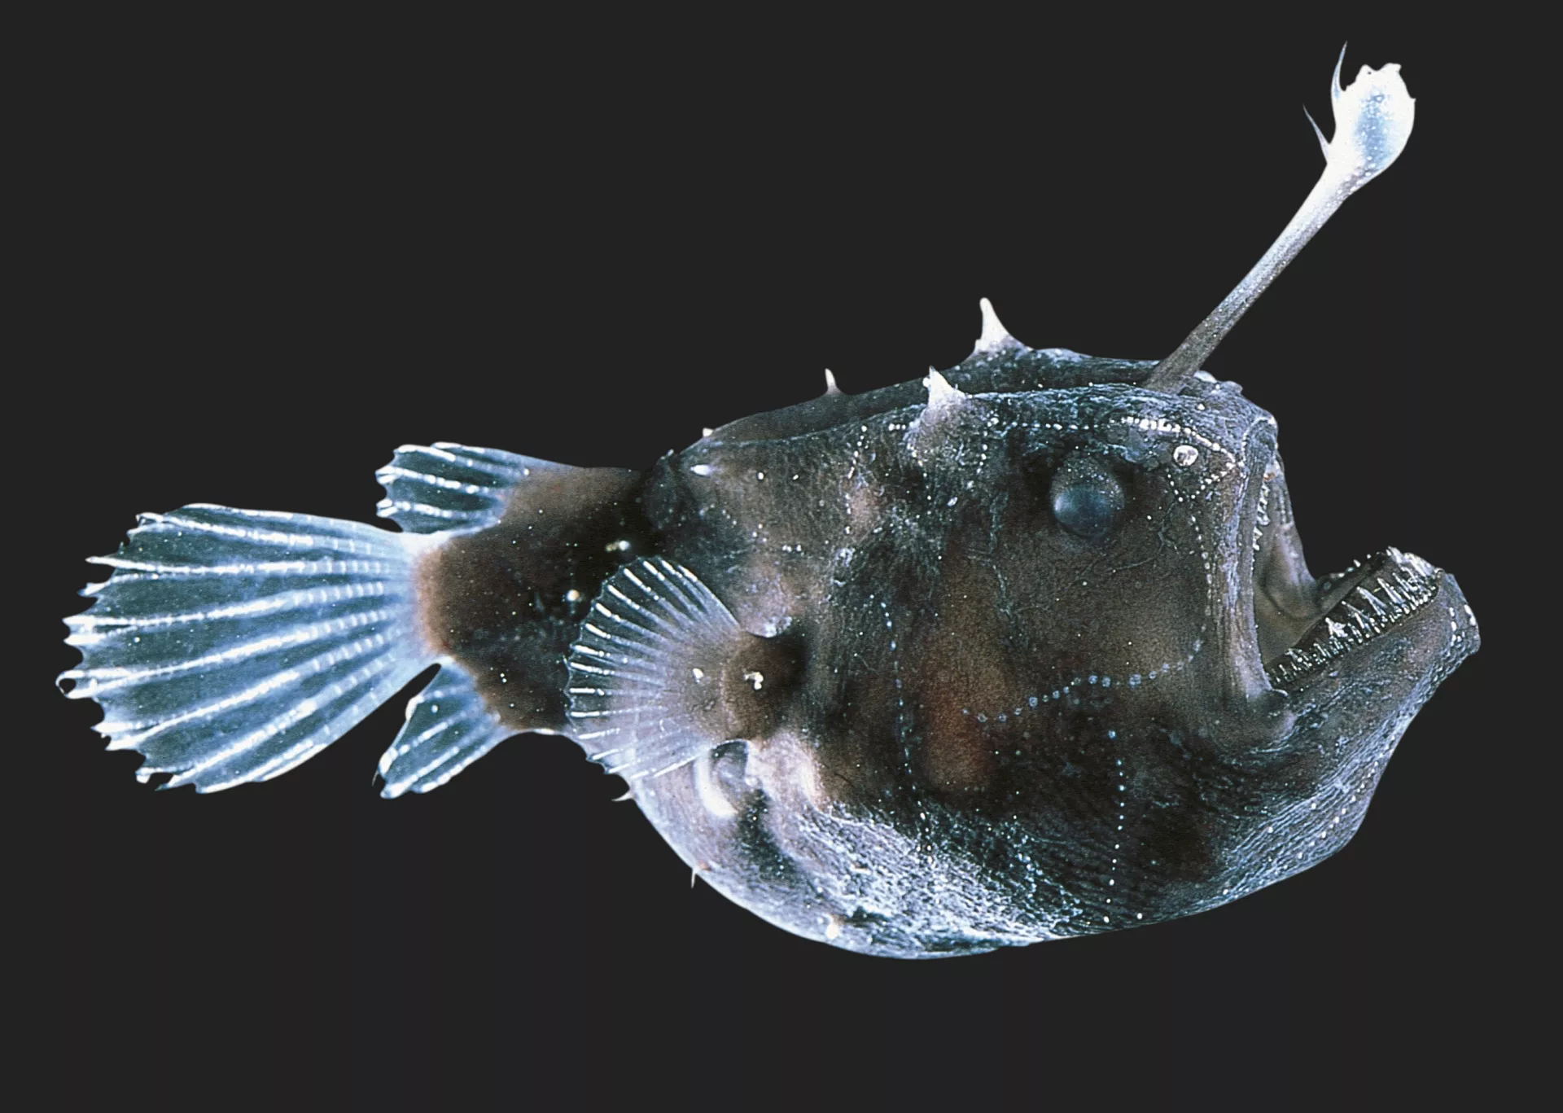
You come across an Angler fish
Notes:
These creatures are thought to have originated around 130 million years ago and have adapted in fascinating ways over the years. Due to its habitat being 6,000m below the ocean’s surface, they have undergone both structural and behavioural adaptation. The most striking feature of all is it’s infamous ‘fisherman’s hook’. The fish uses bioluminescence to attract its prey and then strike at the opportune moment.

Slide 8
Why is adaptation important?
Notes:
There’s a growing awareness among educators and families that today’s curriculum needs to evolve to meet tomorrow’s reality in particular about climate change. With Our City, Our world , we are developing new skills to help us problem solve, collaborate effectively, and express ideas in new ways.
As a school, as a community we will continue to evolve together through being resilient and facing the future with optimism.

