Slide 1
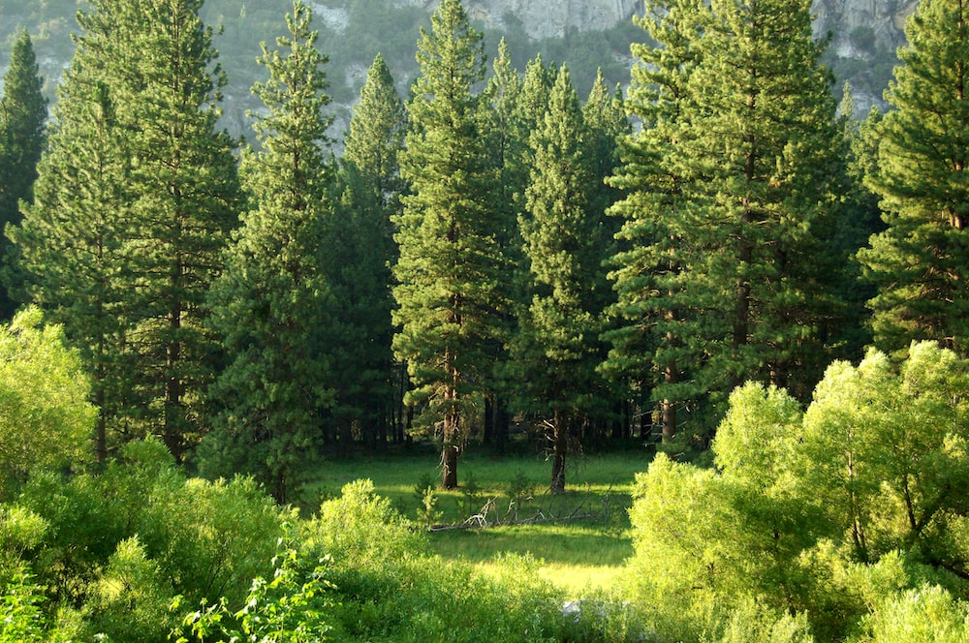
Why do we need trees?
Notes:
trees and plants and grass secretly talk to each other underground. They are
linked by a vast web of connections – a huge system, through which they pass information
and resources to and from each other. What links them is a network of long, thin filaments of
mycorrhizal fungi — in Greek mykós means fungus and riza means root.
These fungi create a mat of threads that connect an estimated 90% of land plants by linking
their root systems. These networks are huge: every cubic metre of forest soil that scientists
have examined holds dozens of miles of connecting fungi. Scientists call this fungal network
the Wood Wide Web. Through it, ‘adult’ trees can share sugars with younger trees, sick trees
can send their remaining resources back into the network for others, and they can
communicate with each other about dangers like insect infestations. These are not
connections between plants from the same species. The underground social network links all
plants and trees together alike, making a cooperative system and turning individual trees into
an integrated super organism. Some older trees even nurture nearby smaller trees, acting as
‘mothers’. This network is everywhere.

Slide 2
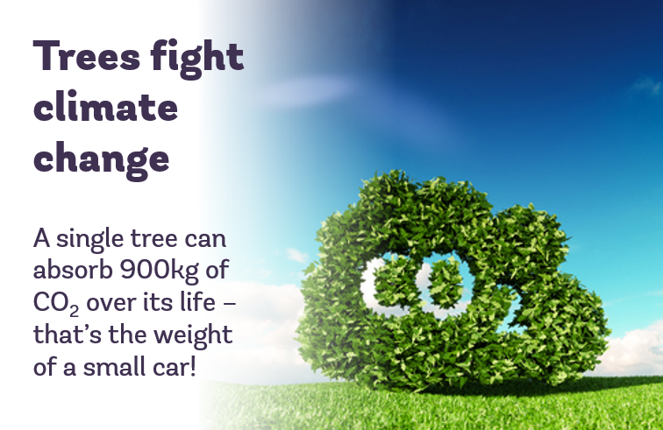
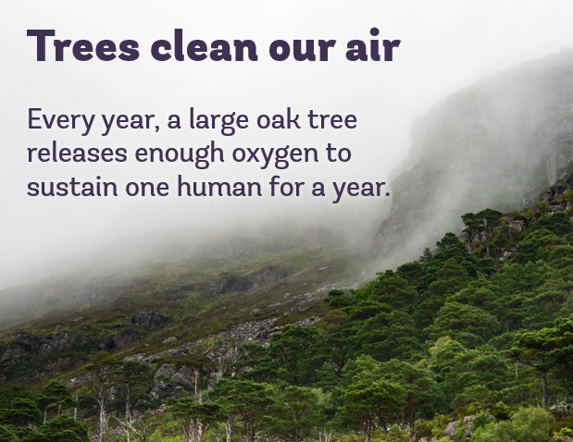
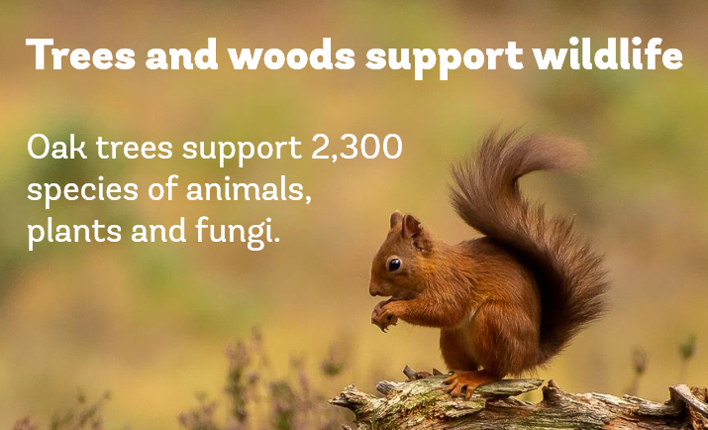
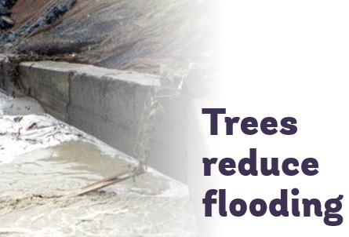
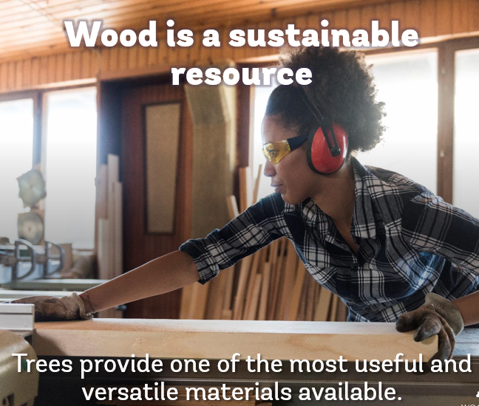

Slide 3
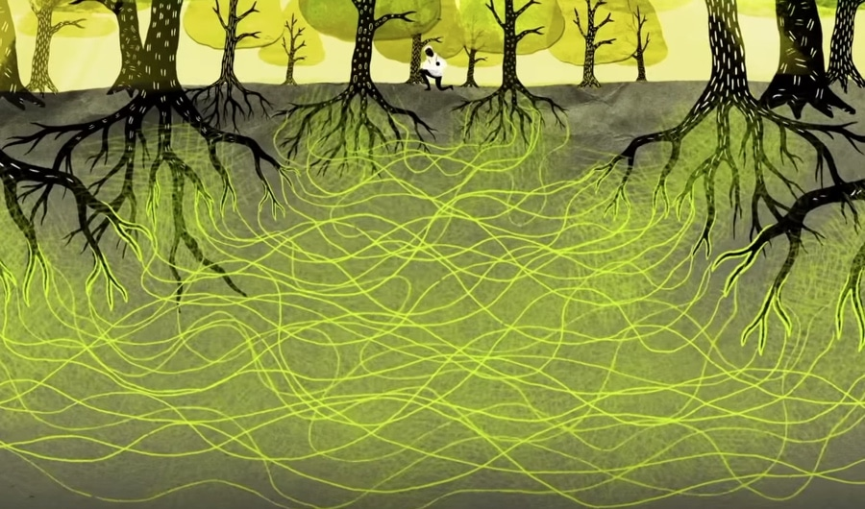
What is this picture showing?
Notes:
trees and plants and grass secretly talk to each other underground. They are
linked by a vast web of connections – a huge system, through which they pass information
and resources to and from each other. What links them is a network of long, thin filaments of
mycorrhizal fungi — in Greek mykós means fungus and riza means root.
These fungi create a mat of threads that connect an estimated 90% of land plants by linking
their root systems. These networks are huge: every cubic metre of forest soil that scientists
have examined holds dozens of miles of connecting fungi. Scientists call this fungal network
the Wood Wide Web. Through it, ‘adult’ trees can share sugars with younger trees, sick trees
can send their remaining resources back into the network for others, and they can
communicate with each other about dangers like insect infestations. These are not
connections between plants from the same species. The underground social network links all
plants and trees together alike, making a cooperative system and turning individual trees into
an integrated super organism. Some older trees even nurture nearby smaller trees, acting as
‘mothers’. This network is everywhere.

Slide 4
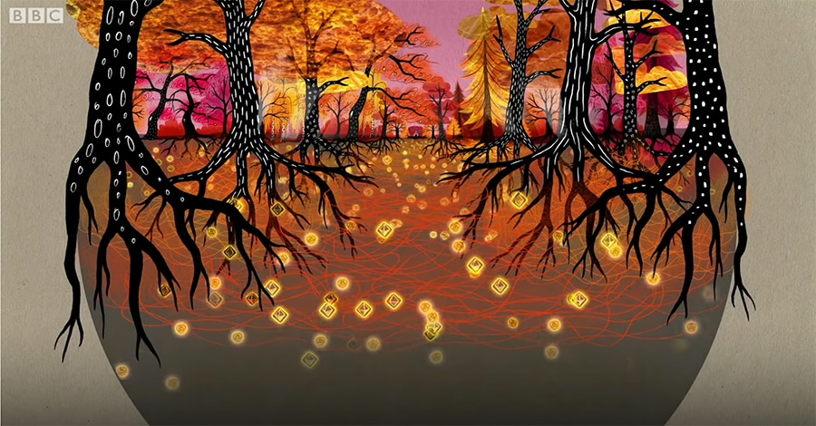
What is the Wood Wide Web?
What information can trees share?
Notes:
https://youtu.be/yWOqeyPIVRo

Slide 5
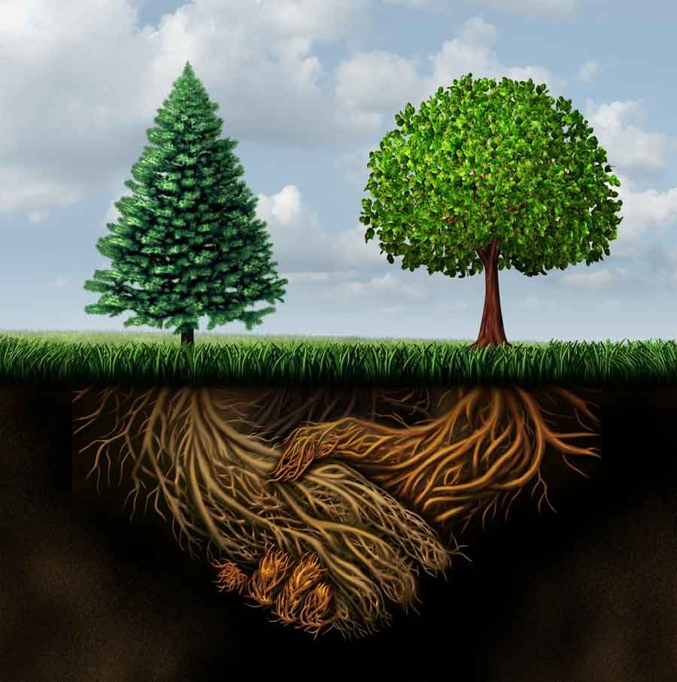
What could you compare the wood wide web to?

Slide 6
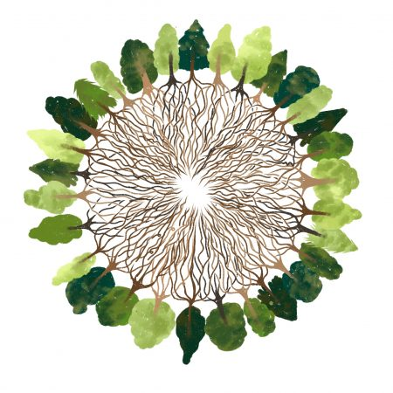
Why is the wood wide web important?
Notes:
Helps trees to support one and other
This provides habitats for animals
The fungi aids growth of all plants- can provide food sources

Slide 7
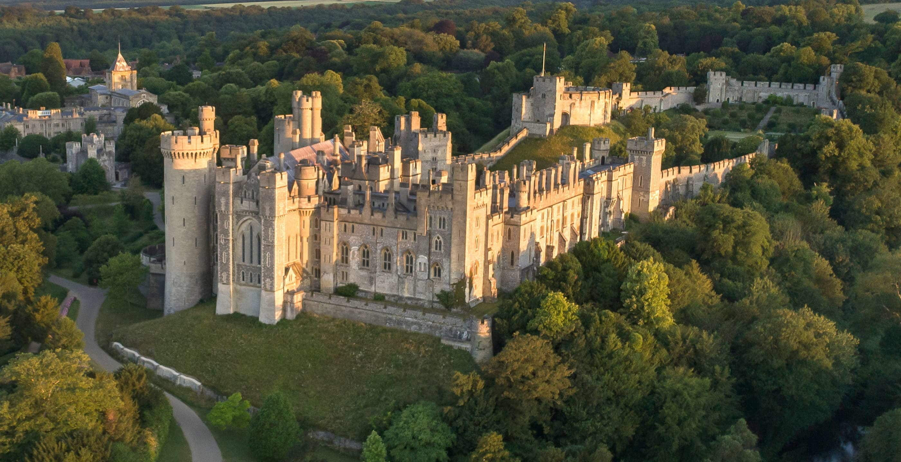
Arundel castle
If the council decided to build a bypass through the castle what might people say?
What might building a bypass here do to the wood wide web?
Notes:
It will destroy the connections the tress have made
Animals who live there will be in more danger
Co2 emissions will increase

Slide 8
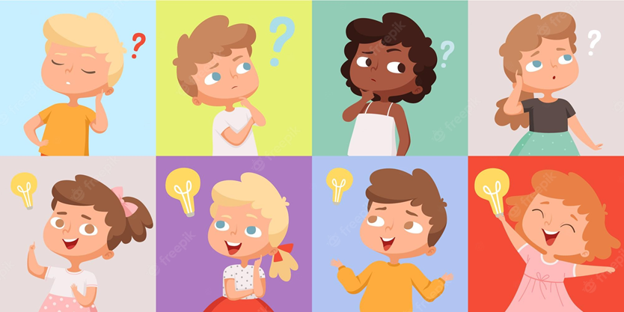
What can we do to help trees and plants?

Slide 9
