Slide 1
Climate change and its causes
WaterAid/ Keoma Zec
Learning Question:
What is climate change?
Learning Objectives:
I can explain the greenhouse effect.
I can explain what activities create climate change.

Slide 2
What is Climate Change?
Notes:
Link: https://youtu.be/y66KFJtmUuk OR click the blue button in the top right hand corner to be taken to the video

Slide 3
What is difference between Weather and Climate?
Weather:
Weather can be described as the condition of the atmosphere around us over a short period of time.
It is about being hot or cold, wet or dry, stormy or calm, cloudy or sunny.
Climate:
Climate is the average weather conditions over longer periods of time (years!) and over large areas (countries and continents).

Slide 4
Is it weather or is climate?
TASK: You will see some sentences about weather or climate on the screen. You need to decide whether that sentence is about weather or climate.
Using your paddle show which of the two choices you believe is weather and which is climate.

Slide 5
Paddle for Weather or Climate Activity
Weather

Slide 6
Paddle for Weather or Climate Activity
Climate

Slide 7
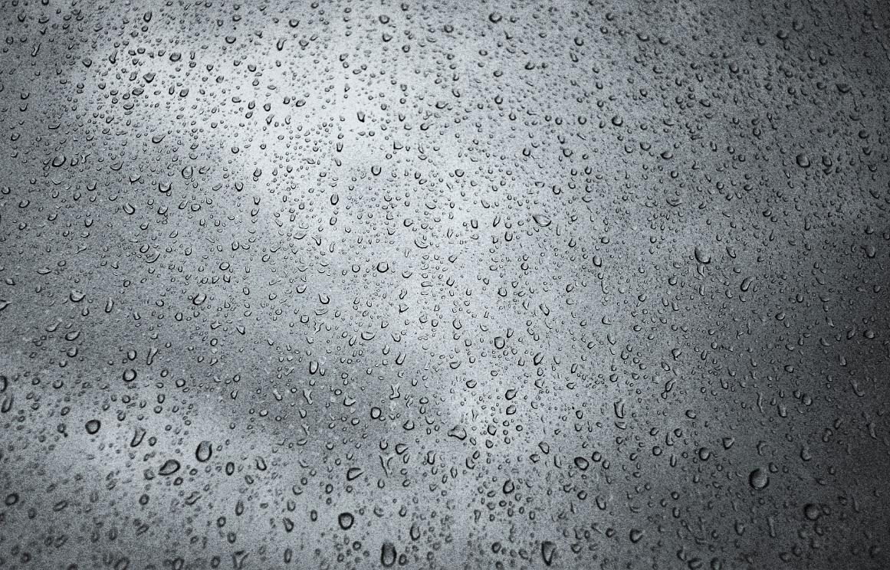
Is it weather or is climate?
Average rainfall in June is 62mm

Slide 8
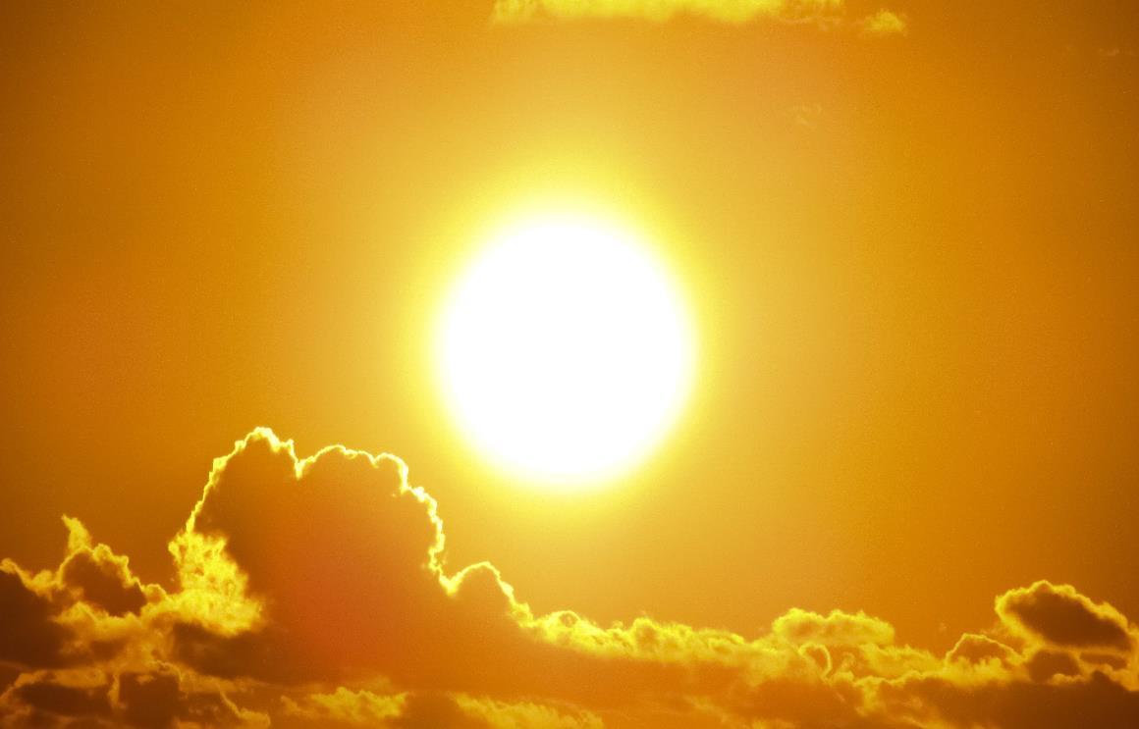
Is it weather or is climate?
Today is a sunny day

Slide 9
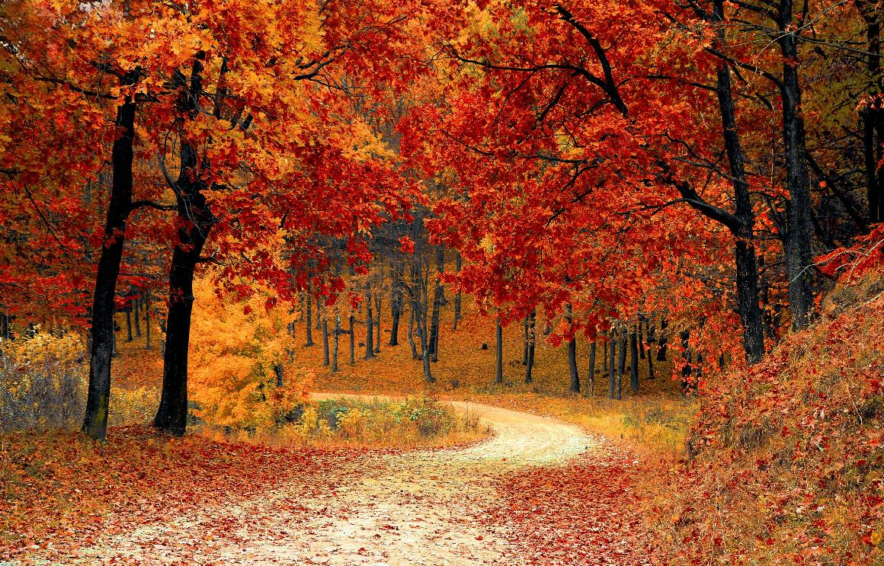
Is it weather or is climate?
Autumn in the UK usually looks like this

Slide 10
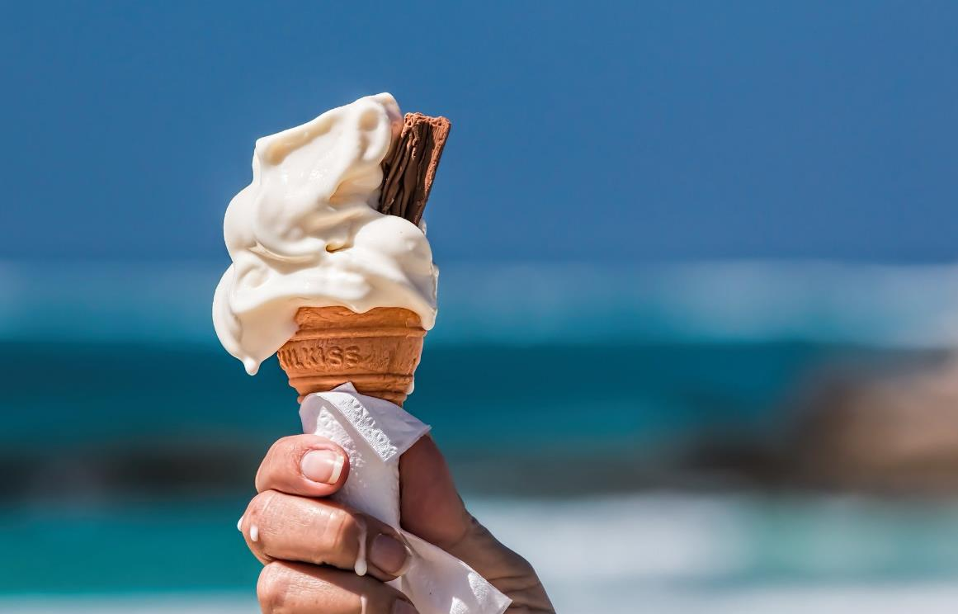
Is it weather or is climate?
The hottest summers in the UK have all happened since 2002

Slide 11
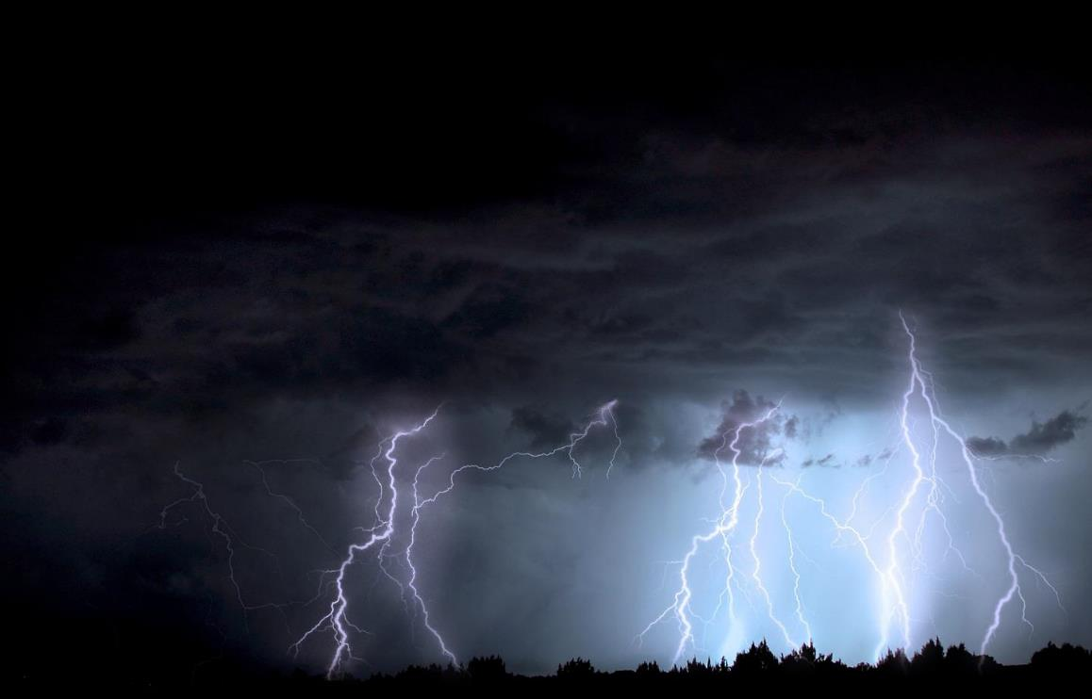
Is it weather or is climate?
There is a severe storm alert for tonight

Slide 12
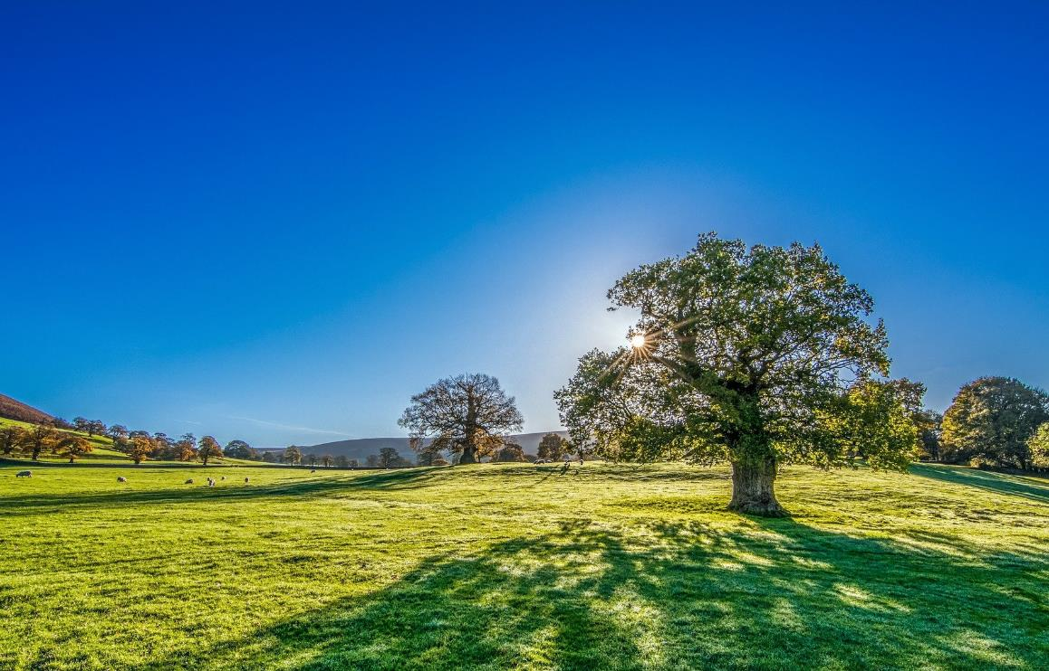
Is it weather or is climate?
It is going to be 26°C tomorrow with no clouds.

Slide 13
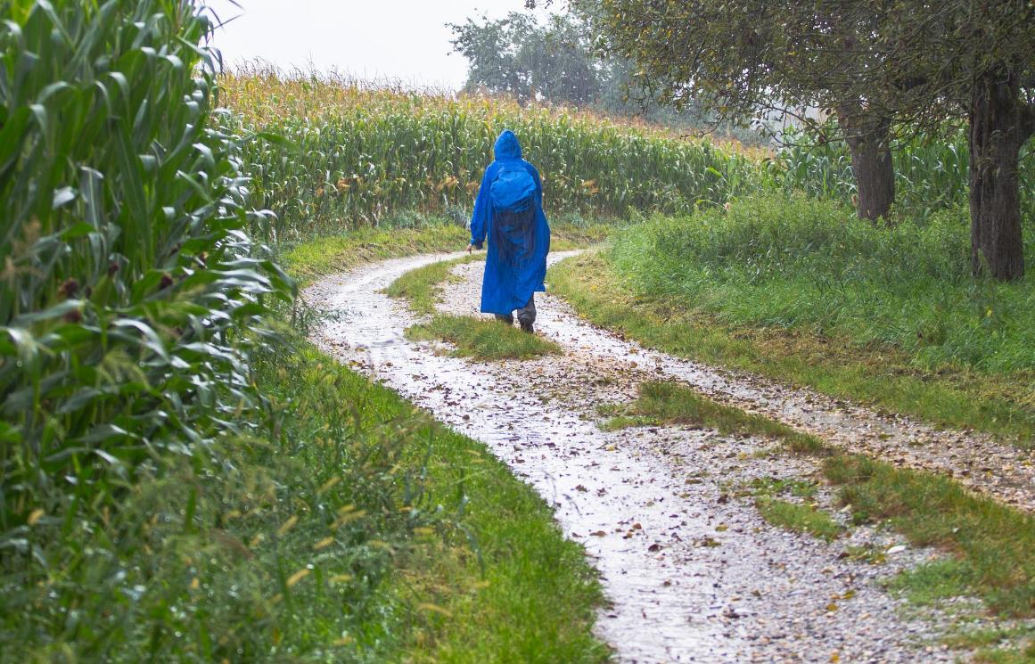
Is it weather or is climate?
It has rained everyday this week

Slide 14
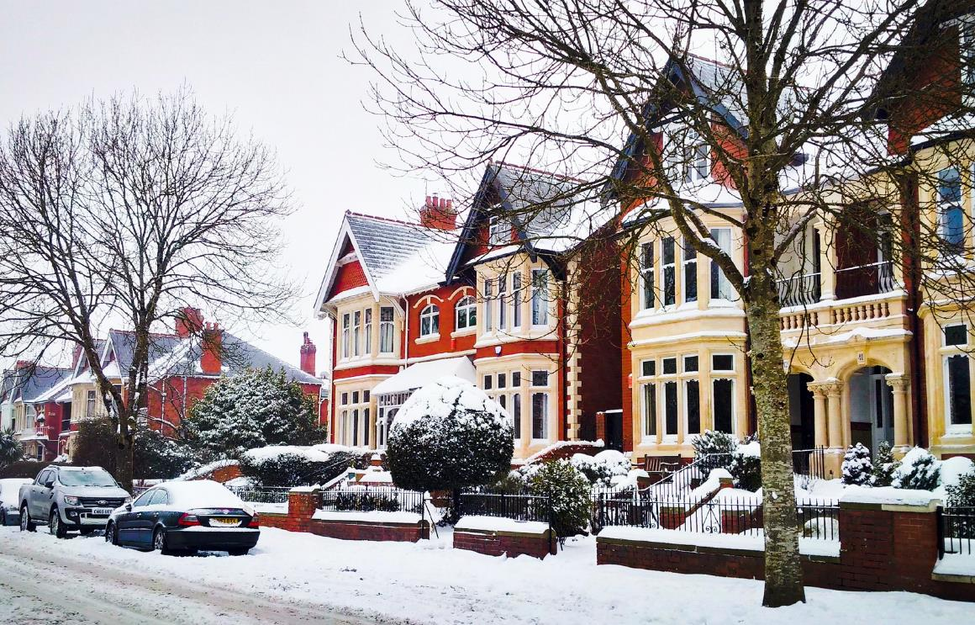
Is it weather or is climate?
It is more likely to snow in January than in August

Slide 15
What is Climate Change?
Notes:
Link: https://youtu.be/y66KFJtmUuk?t=213 OR click the blue button in the top right hand corner to be taken to the video

Slide 16
The Atmosphere
The atmosphere is made up of what we call “greenhouse gases”.
Two of these gases are carbon dioxide and methane.
These gases act like a blanket keeping the earth and us warm and safe from space.
So that unlike astronauts we don’t need special suits to protect us!
The earth has a thick layer of air around it called the atmosphere.

Slide 17
What is the greenhouse effect?
The sun shines on earth.
The gases carbon dioxide and methane catch most of this heat and keeps it on earth so we stay warm.
Some sunshine is reflected back into space.
The more carbon dioxide and methane in the world, the hotter we get!
Some sunshine bounces off the atmosphere into space.
The heat can be reflected back out towards space.
½ of the sunshine reaches earth keeping us warm.

Slide 18
The enhanced greenhouse effect
The natural greenhouse effect is worsening because of the way that we live.
When there are too many greenhouse gases like carbon dioxide and methane released into the atmosphere the earth gets warmer.
It is like making the blanket keeping earth warm and safe thicker.

Slide 19
What is Climate Change?
Notes:
Link: https://youtu.be/y66KFJtmUuk?t=74 OR click the blue button in the top right hand corner to be taken to the video

Slide 20
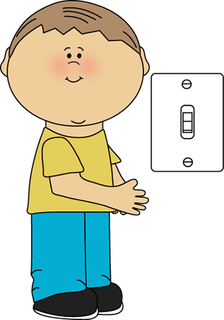
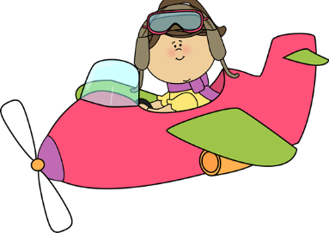
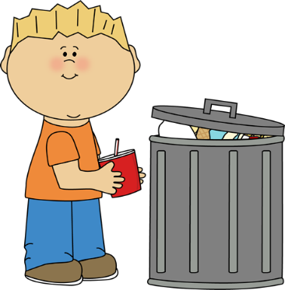
Where do you find greenhouse gases?
Task: Using the pictures on the next few slides, try to work out what is causing greenhouse gases.
Challenge: Can you think of other things that may produce these gases?

Slide 21
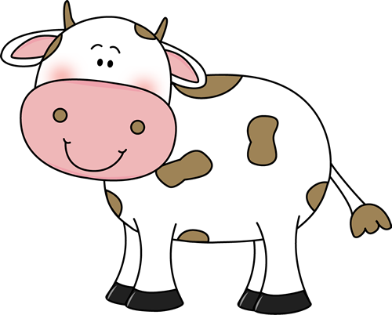
Can you guess the cause?
Farts and Breath!
When animals and people breath they produce carbon dioxide, when they fart they produce methane.
What is happening in this picture that might cause climate change?

Slide 22
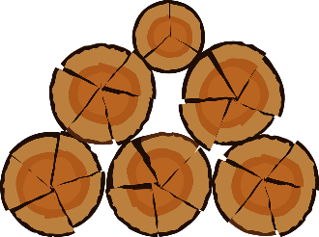
Can you guess the cause?
When we chop down trees they release carbon dioxide. This is called deforestation.
It also stops trees from absorbing carbon dioxide as they grow.
What is happening in this picture that might cause climate change?

Slide 23
Can you guess the cause?
When we use cars and planes and other transport we release carbon dioxide and methane as they burn petrol to move.
What is happening in this picture that might cause climate change?

Slide 24
Can you guess the cause?
When we burn oil, gas and coal for electricity we release carbon dioxide into the air.
What is happening in this picture that might cause climate change?

Slide 25
Can you guess the cause?
When volcanoes erupt they release carbon dioxide and other greenhouse gases in their smoke.
What is happening in this picture that might cause climate change?

Slide 26
Can you guess the cause?
When we throw food in the bin it goes to landfill where it releases methane as it rots because it doesn’t get enough oxygen.
What is happening in this picture that might cause climate change?

Slide 27
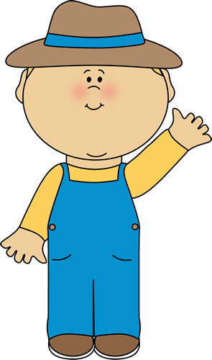
Can you guess the cause?
When we grow food we use fertilisers to help crops grow. These fertilisers have a greenhouse gas, nitrous oxide, in them.
What is happening in this picture that might cause climate change?

Slide 28
Will it cause climate change?
Task: Sort the activities on the cards into those that can and can’t cause climate change.
Challenge: Can you explain to your partner why it causes climate change? Can you think of any other examples?
Remember these examples may only create a small contribution to climate change.

Slide 29
Will it cause climate change?
Playing football
Flying to a holiday
Eating a picnic
Swimming
Going to the cinema
Driving a car
Planting trees
Having a hamburger
Having a nap
Cutting down a tree
Having a shower
Eating an ice cream
Eating in a restaurant
Turning the lights off
Playing video games

