Slide 1
International E-Waste Day
14th October 2023

Slide 2
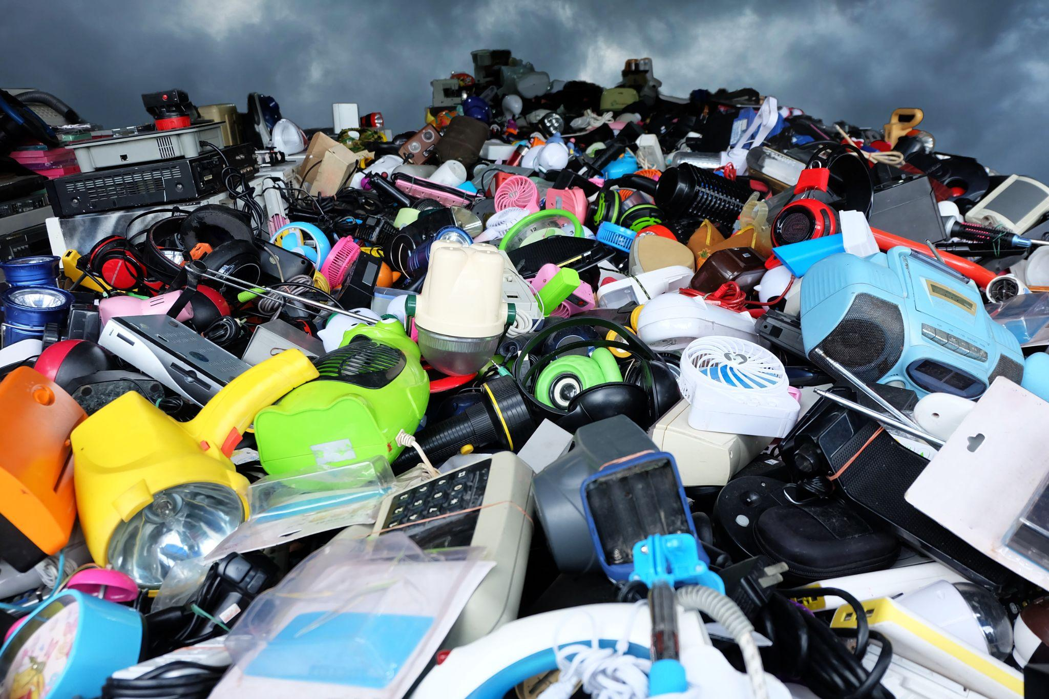
Today is International E-Waste Day…
Electrical waste (e-waste) is any broken or unwanted electrical or tech item with a plug battery or cable.
Notes:
Teacher’s notes:
So why do we have a whole day dedicated to e-waste?
E-waste is one of the fastest growing sources of waste in the world - and in the UK!
This means we are all throwing away more and more electricals.

Slide 3
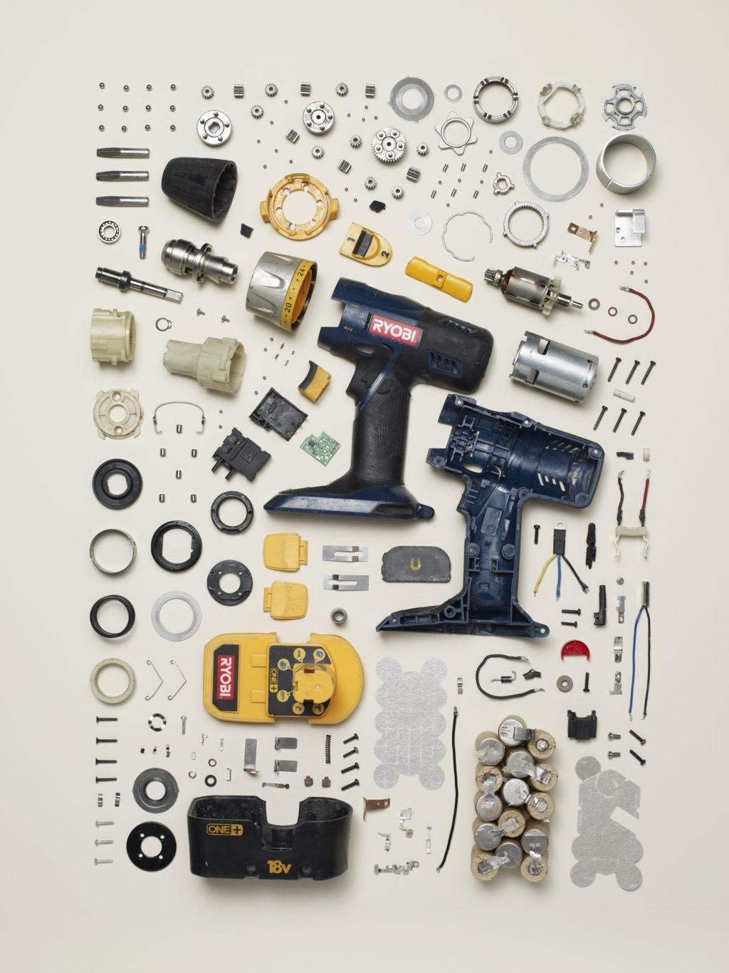
Have you ever thought about what’s inside electricals?
Gold
Copper
Aluminium
Silver
Notes:
Teacher’s notes:
Electricals are made of parts and components
They’re complex products, and can be made of hundreds of different parts and materials
These parts and components are made from raw materials which have often been dug up from the ground through mining
These precious raw materials can all be reused.
Image: Todd Mclellan Things Come Apart
(potential “Tear down” exercise with a few different products looking a the amount of parts they’re made of)

Slide 4
What is the issue?

Slide 5
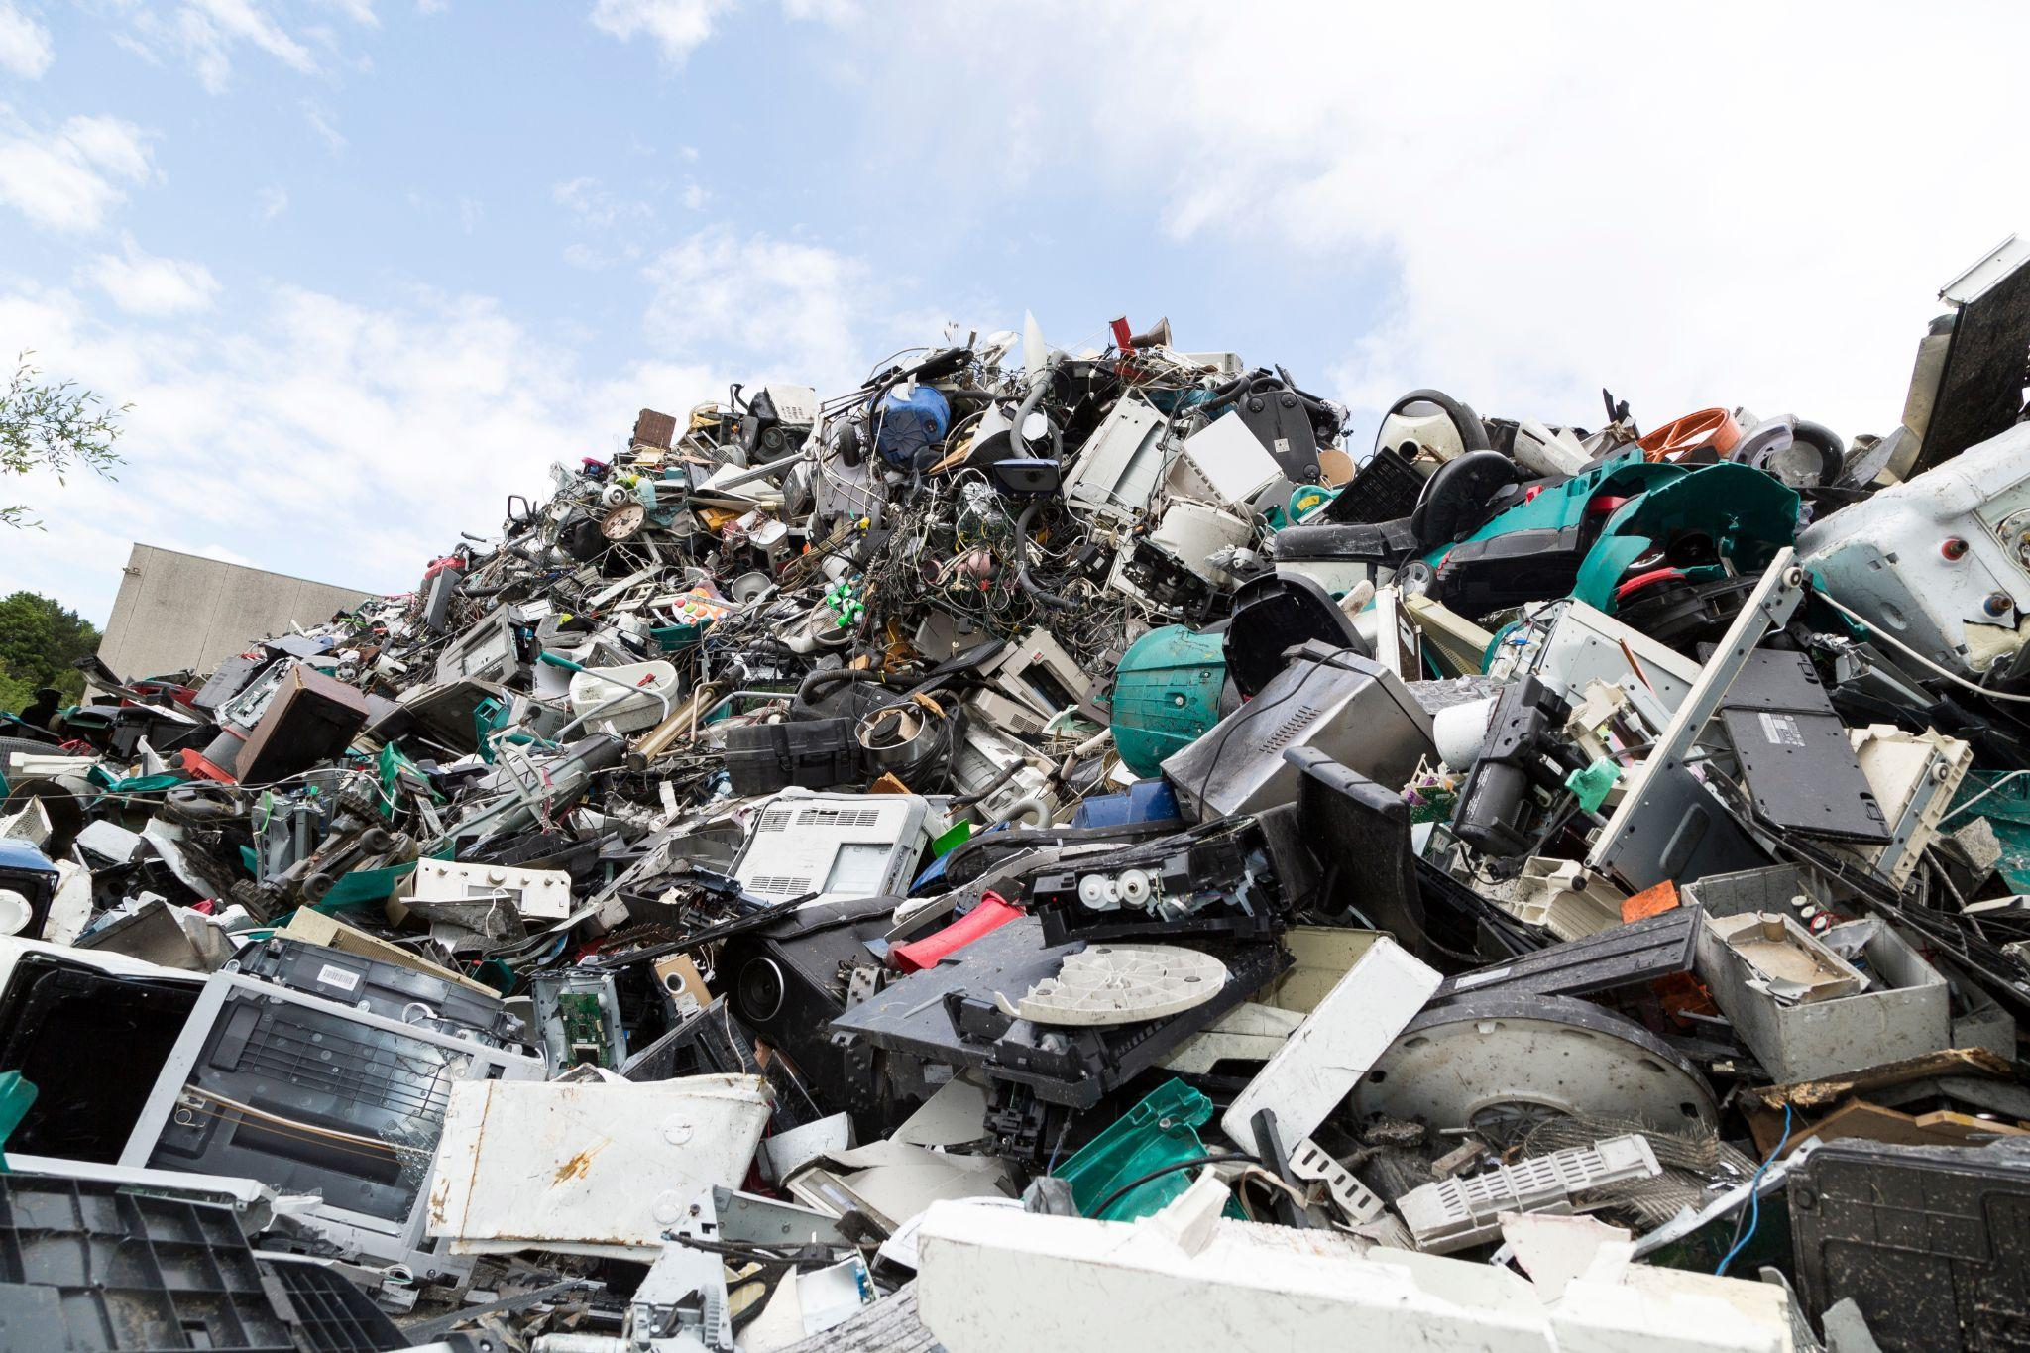
Fastest growing sources of waste
Notes:
Teacher’s notes:
Electrical waste is the fastest growing sources of waste in the world, and in the UK.
It’s growing faster than fast fashion.

Slide 6
Precious resources lost forever
Notes:
Teacher’s notes:
Lost resources
As we mentioned before electricals are made up of different parts and components.
Electricals contain valuable materials such as copper, iron, gold, platinum and palladium
If old electricals go to landfill, or are flytipped instead of being recycled, valuable resources are lost forever. That’s a big problem.
Discarded or hoarded household electricals cost the UK economy £370 million per year of lost valuable raw materials

Slide 7
Environmental damage
Notes:
Teacher’s notes:
When we lose those precious resources it means new materials have to be found.
This involved mining for new metals
Mining new metals creates millions of CO2 emissions which damages our environment
If we used recycled metals to make new products, 86% less CO2 emissions would be released.
Image - an example of a large open pit copper mine

Slide 8
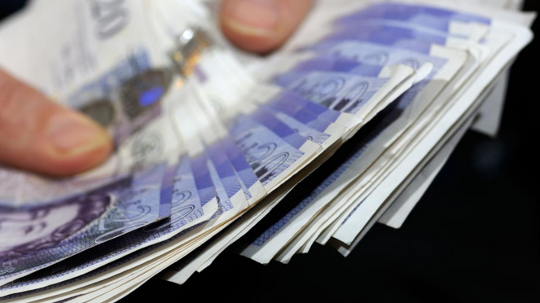
Losing Money
Notes:
Teacher’s notes:
Many electrical items that are thrown away can actually be donated
That includes your kettle, toys or laptops
The average UK household is hiding away 20 unwanted electricals
If we passed these on to charities they could make a big difference to people’s lives
Processed recycled electricals become commodities to buy and sell

Slide 9
But… Anything with a plug, battery or cable can be recycled!
Notes:
Teacher’s notes:
Did you know a typical iPhone contains precious metals like gold, silver, platinum, aluminium and copper!
The recycled metals from old electricals can be transformed into anything from bicycles to children’s playgrounds

Slide 10
How does electrical recycling work?
Notes:
Teacher’s notes:
HypnoCat will explain exactly how the process for electrical recycling works

Slide 11
What can you do to help?

Slide 12
What can you do to help?
Fix them!
Donate them!
Recycle them!
Notes:
Teacher’s notes:
Fix - before recycling old electrical items consider repairing them
Why?
Save money - you don’t have to buy a new one
Save resources - nothing will go to landfill
Learn a skill - It will teach you a practical skill that will last a lifetime!
Donate - You might not need your old electrical item, but someone else could.
Why?
Stop items that still work from going to landfill.
It’s good for the planet, good for people - Donating is a win-win – reducing demand for raw materials, curbing CO2 emissions and giving low-income households access to affordable goods.
Someone will thank you for it!
Recycle - If you can’t fix or donate it, then recycle
Why?
For all the reasons we’ve mentioned above
Save precious resources
Help the planet
Save money

Slide 13
A message from our mascot…

Slide 14
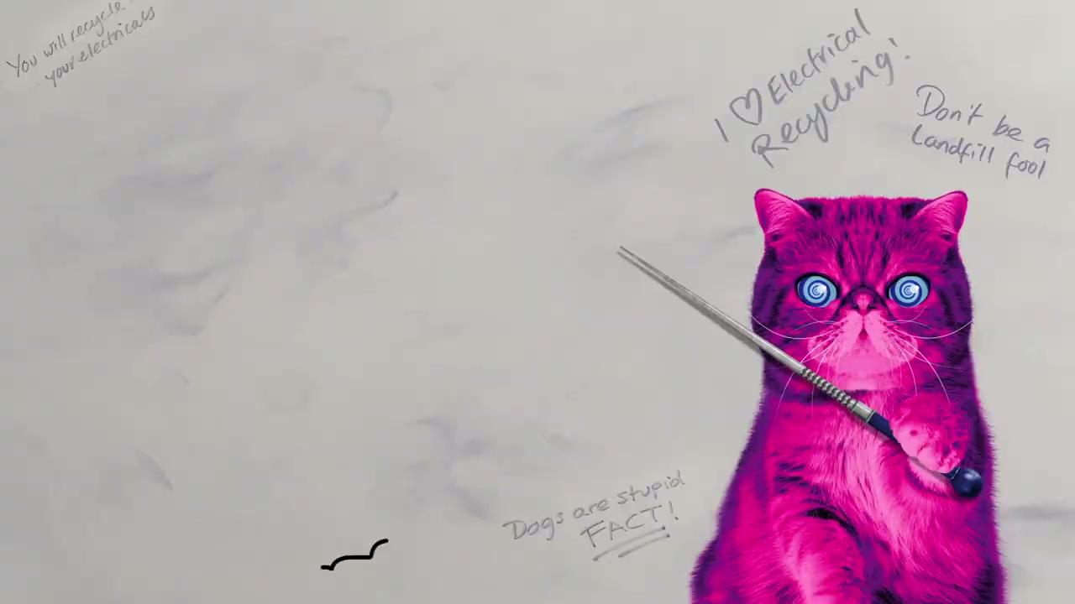
Activity time: Tech Treasure Hunt

Slide 15
Activity time: Tech Treasure Hunt
In our Tech Treasure Hunt at home you can discover your unwanted electricals and the hidden treasures that lie within them.
Hunt - Embark on your very own Tech Treasure HUNT and find the old electricals in your house!
Decide - Are you going to fix, donate, or recycle the electricals you have found?
Bag it - Pop the items you’re going to donate or recycle into separate bags and use the recycling locator to find your local donation or recycling drop off points
Find out more on our website:
https://www.recycleyourelectricals.org.uk/report-and-research/tech-treasure-hunt/

Slide 16
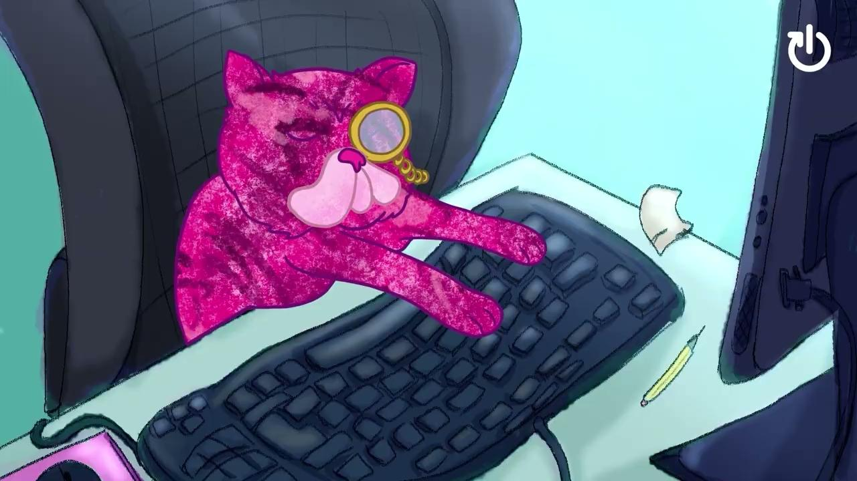
Find your local recycling points…

Slide 17
If you’re interested in finding out more about the campaign
You can follow us on social media
facebook.com/recycleyourelectricals
@recycleelectric
www.recycleyourelectrical.org.uk
@recycleyourelectricals_
Material Focus hello@materialfocus.org.uk
linkedin.com/company/materialfocus

