Slide 1
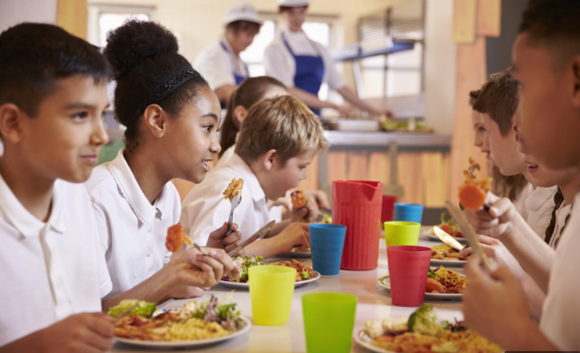
What is food waste?

Slide 2
Food Waste:
Food that is wasted, lost or uneaten along all parts of the supply chain - from farm, to production, to supermarkets and in our homes.

Slide 3
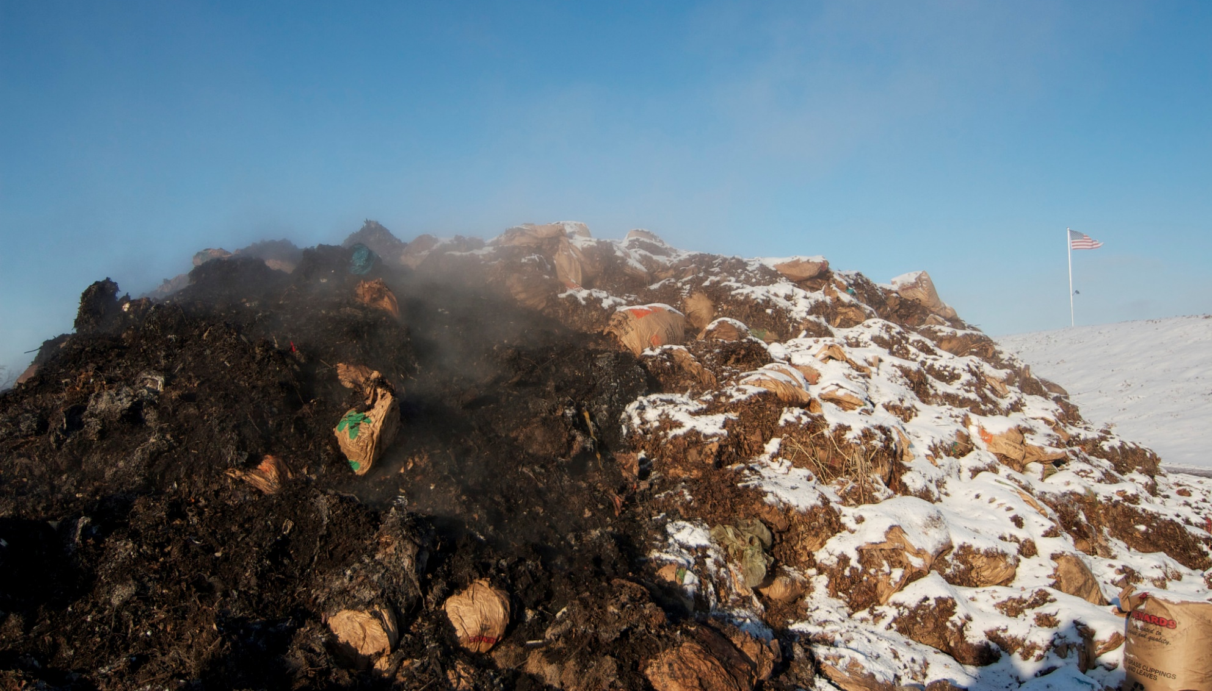
Each year 1.3 billion tonnes of food, about a third of all that is produced, is wasted
Commercial composting facility
Photo: MPCA Photos
This is enough to build a mountain 2 miles across and almost 8,000 feet high

Slide 4
We are going to think about how food waste can have an impact on climate change.

Slide 5
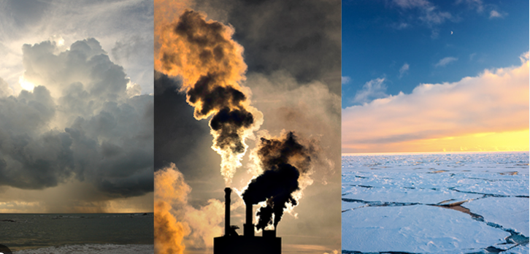
What is climate change?
Notes:
Changes in the world’s weather (heat and rain) as a result of human activity, which increases the level of carbon dioxide in the atmosphere. This causes more frequent extreme weather events , eg heatwaves, storms, droughts, fires.

Slide 6
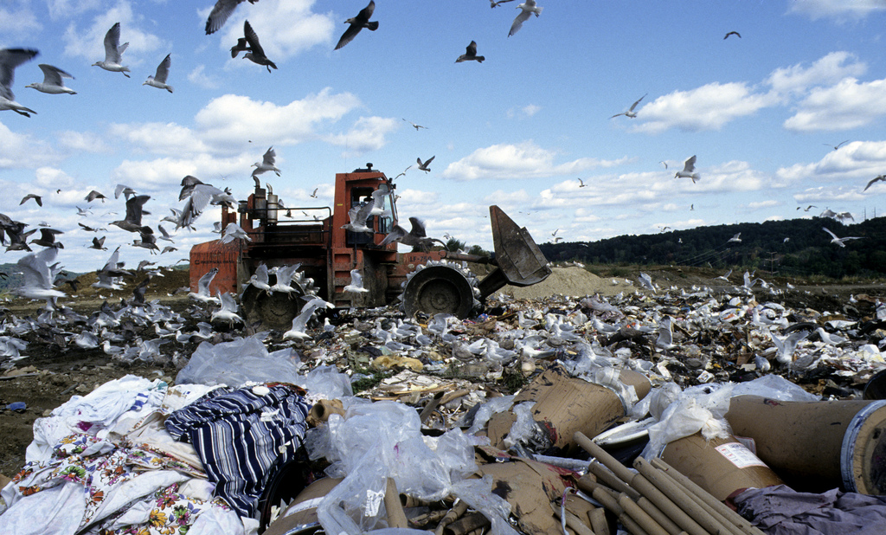
Tonnes of food ends up in landfill each year in the UK. As it rots, it releases methane which is a greenhouse gas.
Photo: United Nations Photo
Photo: United Nations Photo

Slide 7
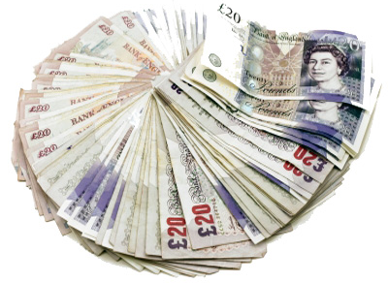
The cost of food waste to an average family with children is over £1,000 per year
Photo: AJ Cann

Slide 8
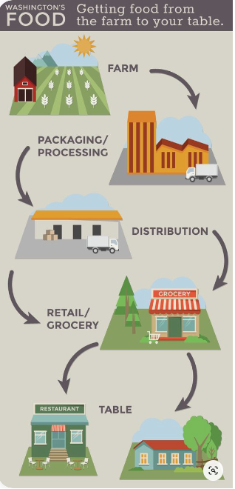
How can food production harm our environment?
How does each stage use resources from our planet?

Slide 9
Lifecycle of our food – how does it affect our planet?
Land we use to grow food (deforestation?)
Growing our food ( fertilizers, tractors)
Processing our food (e.g. energy used to turn potatoes into chips)
Getting our food to the shops ( transport)
Preparing food at home (energy for fridges/freezers/ovens/ microwaves)
Throwing food away (When we throw food away, it rots and releases methane, a greenhouse gas, into the atmosphere. Methane has more than 80 times the warming power of carbon dioxide)
Notes:
https://www.lovefoodhatewaste.com/take-action-save-food/our-planet-your-food?gclid=Cj0KCQjwkt6aBhDKARIsAAyeLJ0llyJD1CfYQNJiAKay5KkZg3dyr01DaFpRHTu4-ofTzupn60tA0YgaAlq1EALw_wcB

Slide 10
What can we do stop food waste?
What will you pledge to do?

Slide 11
Food redistribution schemes save food from being wasted and make sure it gets to those who need it
Photo: Nestle

Slide 12
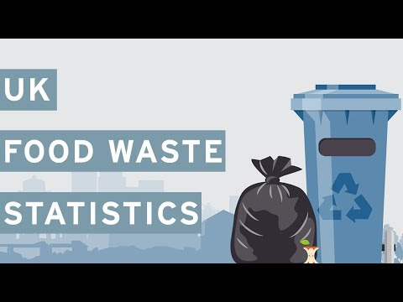
Notes:
https://www.youtube.com/watch?time_continue=8&v=89w-g-XmIOU&embeds_euri=https%3A%2F%2Fwww.ourcityourworld.co.uk%2F&feature=emb_logo

