Slide 1
What is this? What does it mean?

Slide 2
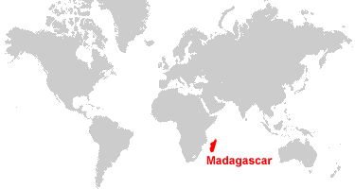
Notes:
https://www.google.com/search?q=chameleon+colour+change&rlz=1C1GCEU_enGB929GB929&source=lnms&tbm=vid&sa=X&ved=2ahUKEwjataex5IP9AhWGX8AKHYbwDoYQ_AUoAnoECAEQBA&biw=1920&bih=969&dpr=1#fpstate=ive&vld=cid:14377209,vid:hXMZ214pNZ4
Chameleons can be found in Madagascar (an island off the east of Madagascar). 90% of the reptiles and plant life on Madagascar can only be found there. Chameleons and Madagascar like the rest of our planet our suffering because of climate change.

Slide 3
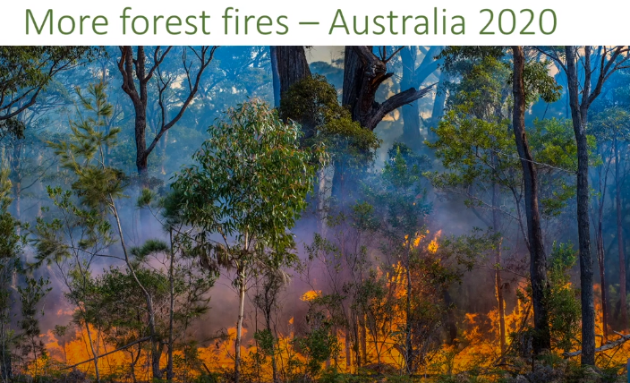
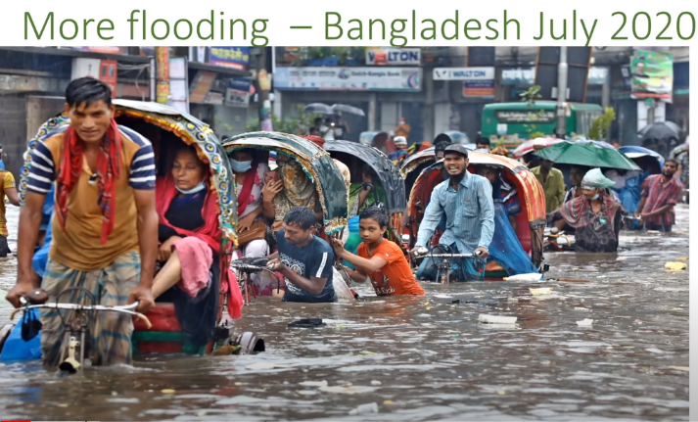
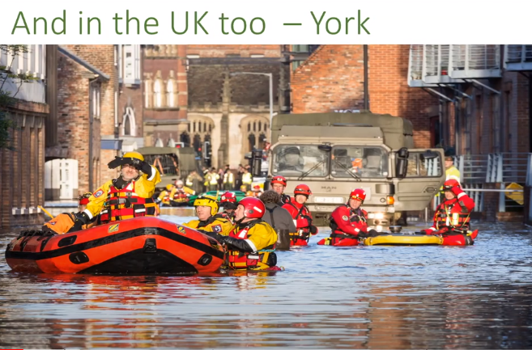
Notes:
Climate change is where our planet is getting hotter and our weather is becoming more extreme and unpredictable. Fossil fuels are emitting too much carbon into our atmosphere. This means we are beginning to see more rainfall, storms, droughts and forest fires, changing seasons and shrinking sea ice rising sea levels.

Slide 4
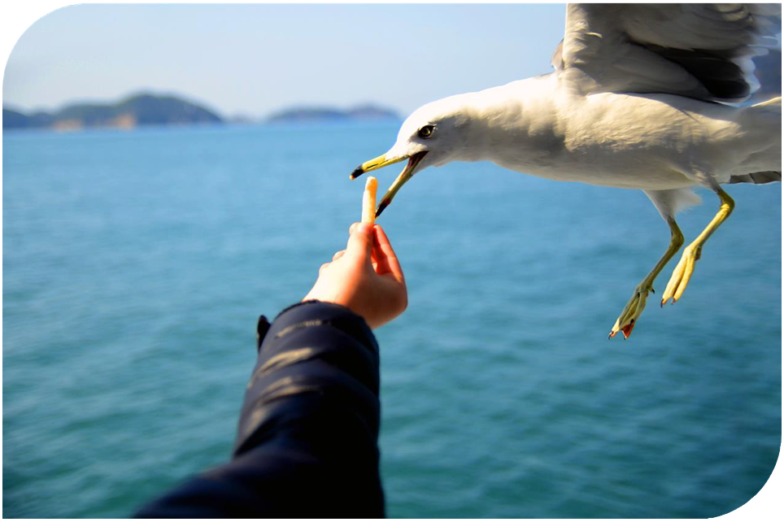
Why do we need to learn about climate change?
Notes:
Those were pretty emotional and sometimes upsetting photos and climate change is affecting lives all around the world.
We don’t intuitively understand how quickly things can grow when they are speeding up.
Our brains have evolved to only panic and act quickly when faced with immediate threats.
But there are lots of things we can do to help make the situation better

Slide 5
Notes:
Maybe you feel like one of these children here.
It is important to think about how doing things little by little becomes a lot

Slide 6
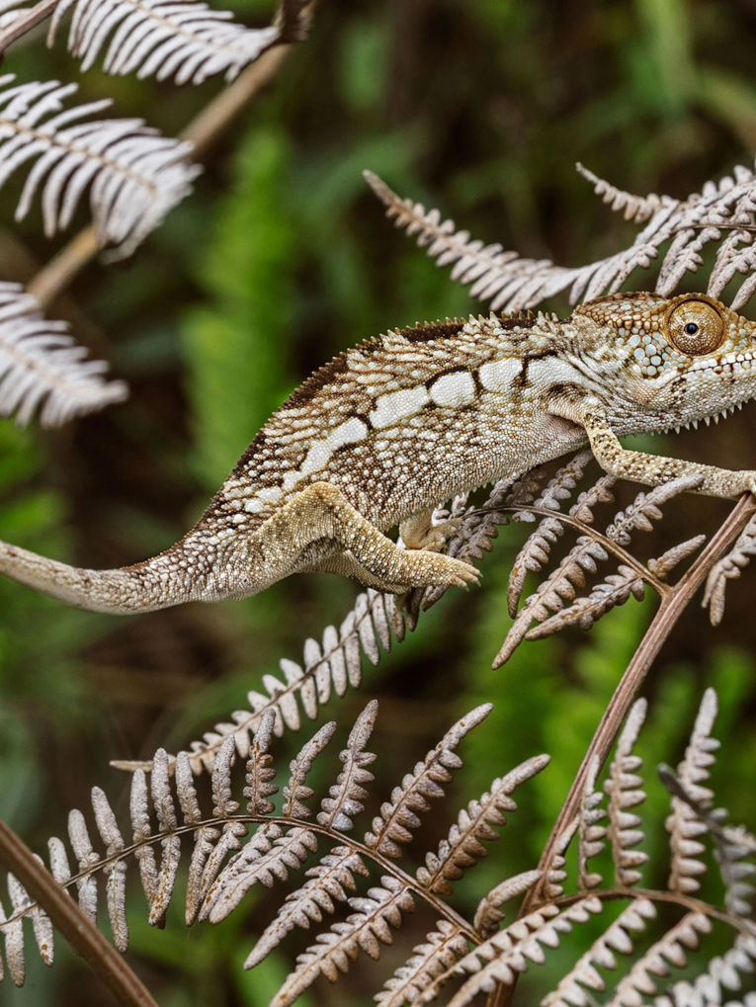
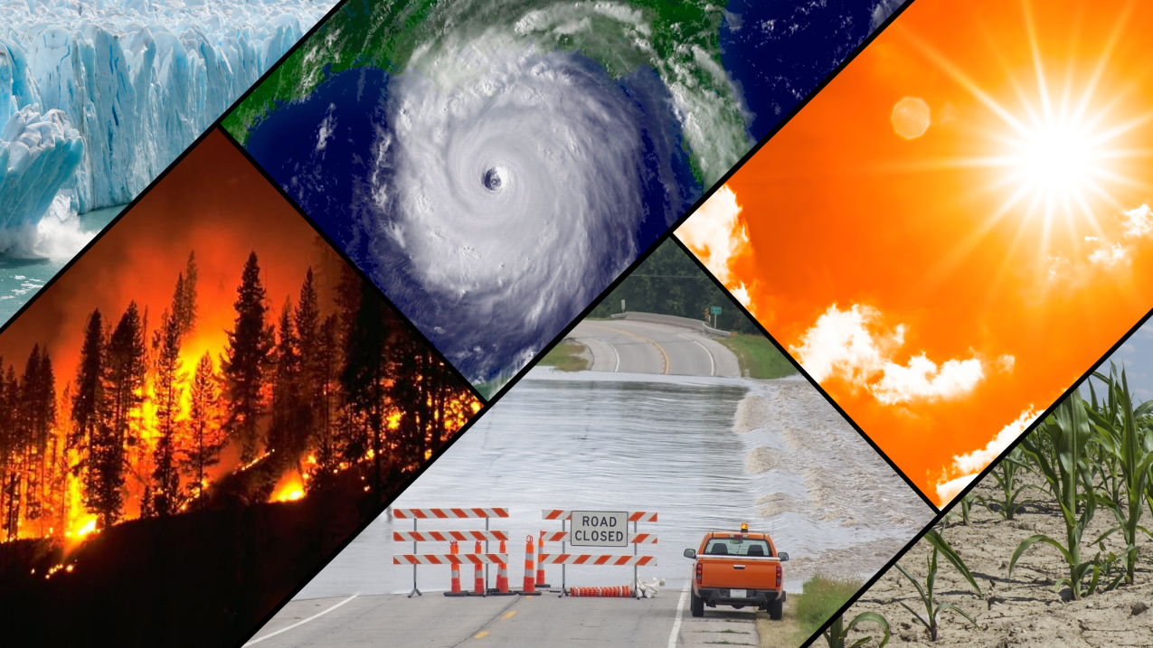
What is the link between chameleons and climate change?
Notes:
They can remarkably and dramatically change!
This is what we need to do to help combat climate change.
We learnt last week that chameleons can change colour in response to a new environment or situation.
We can learn from chameleons and change the way we do things now in response to climate change. Adapting to our new environment and reacting to the new knowledge we gain and tell others about it.

Slide 7
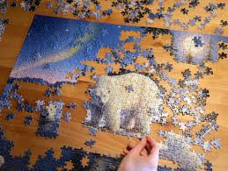
Notes:
If we take a look at a puzzle we can see that all the small pieces join together to create a final model that has huge value. The little pieces may seem a bit useless but if they are all working towards the same end they can be really meaningful. They can result in a remarkable and dramatic end result.

Slide 8
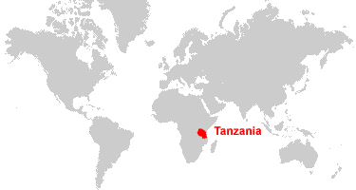
Little by little, a little becomes a lot.
Tanzanian proverb
Notes:
If we all do the same little things at the same time we can really make a big change. Its like team work if we all act together we can all make a big difference.
Its not just individuals that need to be a part of the solution. Its governments, scientists, engineers, farmers, teachers. EVERYONE has to work together.

Slide 9
Notes:
Let’s take a look at an issue we can help to solve. We waste things in many different ways and one thing we waste is food.
Take a look at these four vegetables we have carrots, broccoli, potatoes and beetroot and you need to remember them.

Slide 10
Which statement refers to which vegetable?
You can use the skins in mashed potato
Pesto can be made from the leaves
Just as tasty as spinach
Crunchy stems are delicious!
Notes:
Potatoes skins can be kept on chips or used in mash
Carrot tops can be used instead of basil to create pesto. The leaves aren’t always on carrots when you buy them in shops but if you buy them from a market or shops you can use them.
If you like spinach beetroot leaves taste very similar
Broccoli stalks are often thrown away but some believe it is the best part of the broccoli
You could try one of these things. Just like the chameleon you could adapt and change your ways to try one of these things. Or perhaps you have another way to reduce food waste.

Slide 11
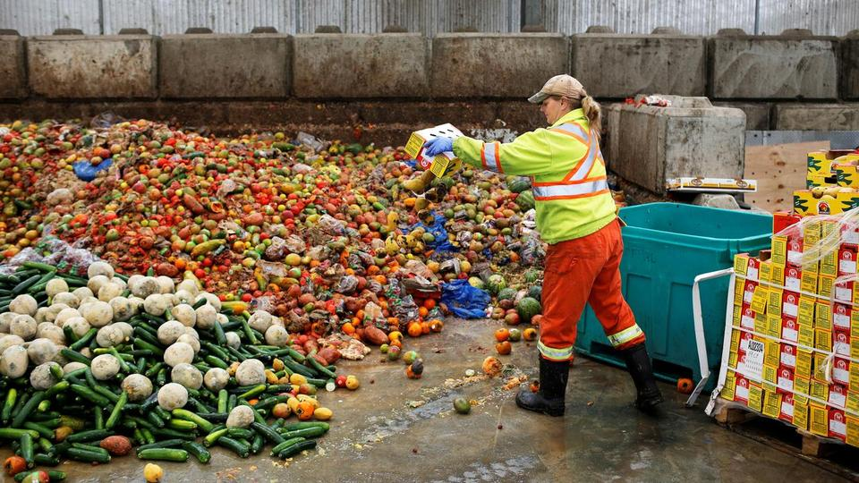
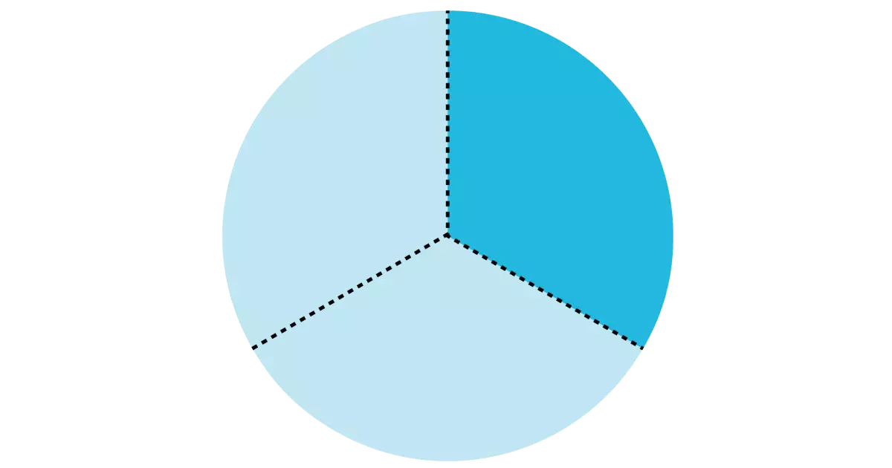
Why does food waste matter?
Notes:
Globally 800million people are undernourished meaning they aren’t getting enough food or enough of the right types of food to give them the nutrients they need to live a healthy life.
Yet 1/3 of all food produced globally is wasted!
Think of all the carbon that is produced growing packaging and transporting the food. That is all being wasted.
Food in landfills produce methane which is worse for climate change than carbon dioxide. And currently in the uk 40% ends up in landfill sites so it is really important that we do what we can to reduce our food waste. Every little action counts.

Slide 12
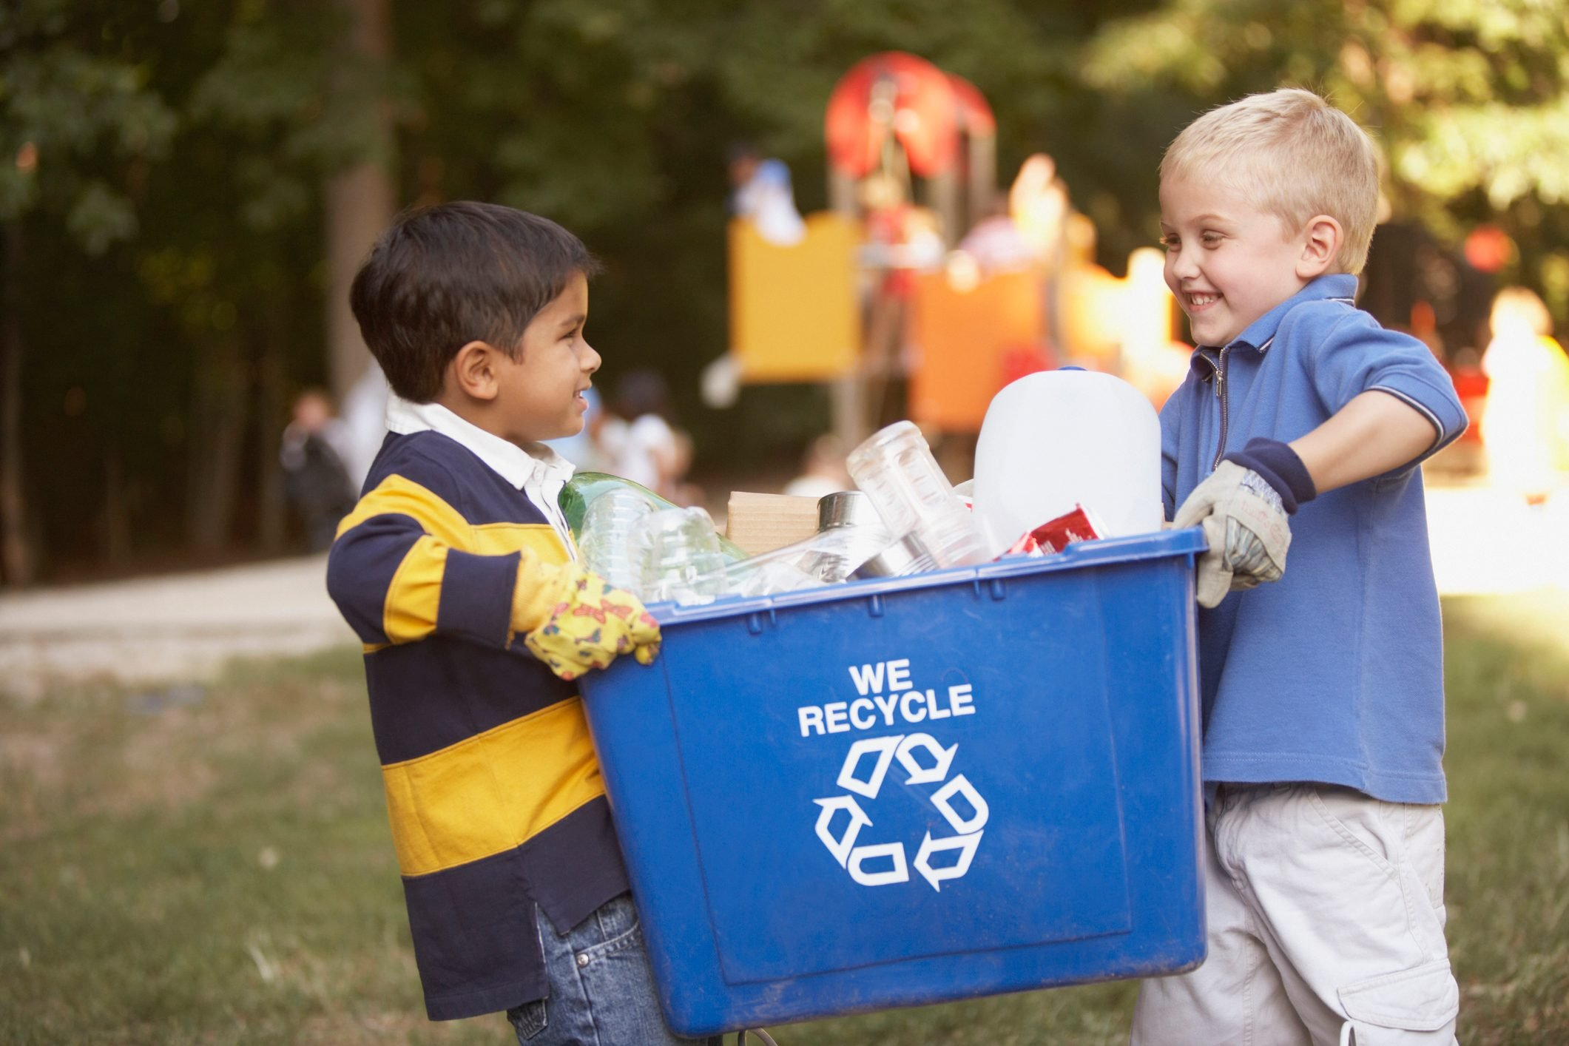
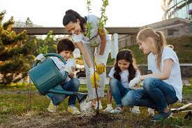
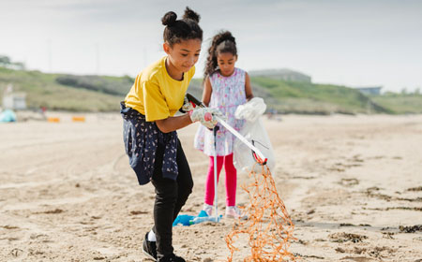
Little by little, a little becomes a lot
Notes:
Little by little, a little can truly become a lot and if like the chameleon we are prepared to adapt to our new situation and make small changes just like the puzzle pieces we can make all those changes matter.

Slide 13
What are some of the things we could change in school as part of the Our City, Our World project?

