Slide 1
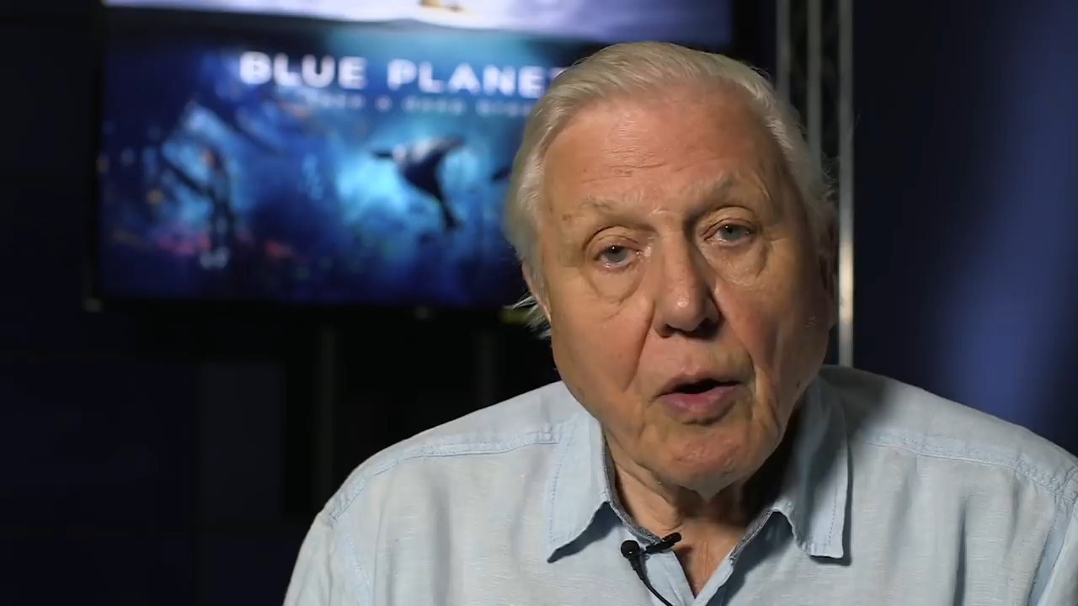
©BBC
Notes:
Play the video clip. After the video explain that naturalists such as David Attenborough are very important for getting people’s attention when it comes to important issues such as plastic.

