Slide 2
What is the theme of our assembly?
- It covers 75 per cent of the Earth’s surface. - We could not live without it for more than a week. - Two-thirds of your body is made of this.

Slide 3
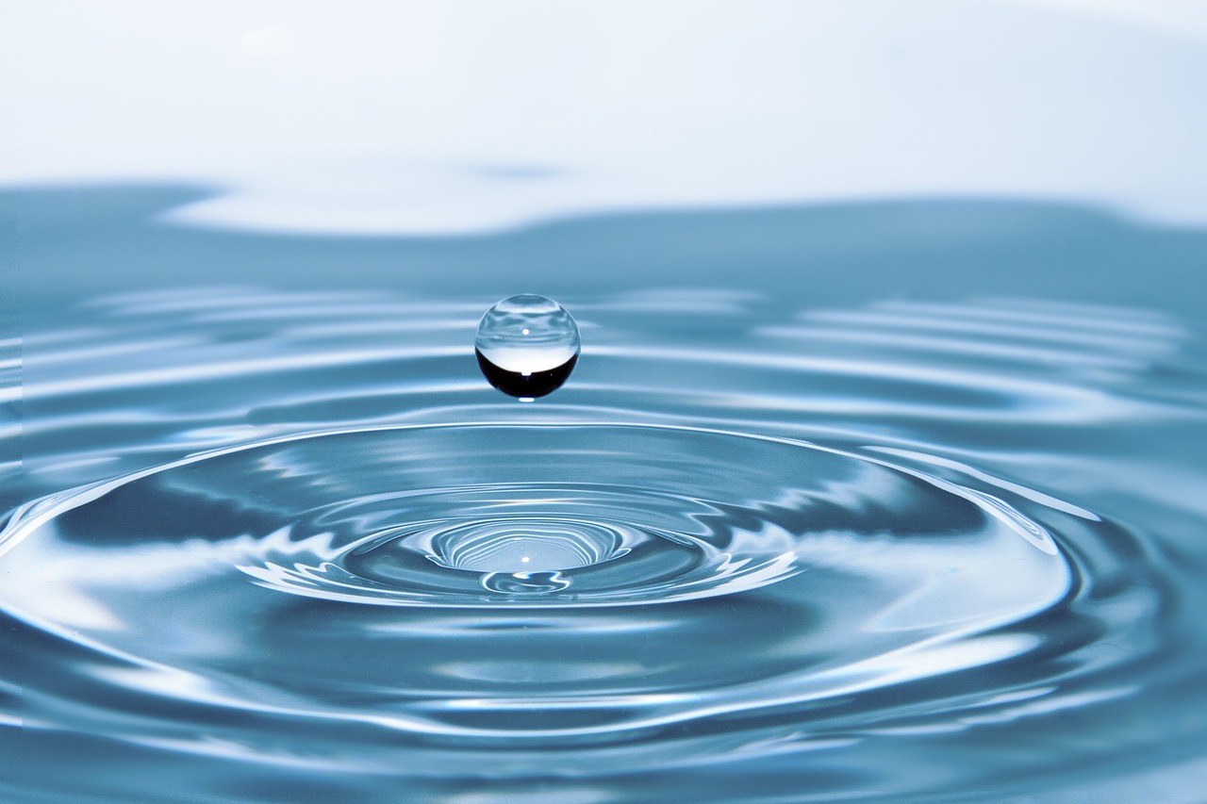
Notes:
https://www.assemblies.org.uk/pri/2870/water-is-wonderful

Slide 4
Let’s do a quiz!
Notes:
https://www.assemblies.org.uk/pri/2870/water-is-wonderful

Slide 5
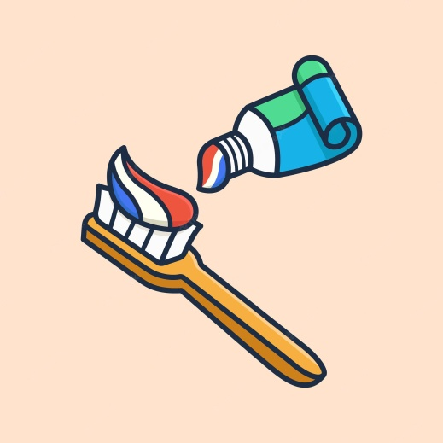
Question one. When brushing your teeth, should you: a) keep the tap running until you’ve finished? b) turn the tap off and rinse your mouth with water from a cup?

Slide 6
It’s definitely better to turn off the tap. You can still clean your teeth properly by using just one cup of water. Did you know that keeping the tap running when cleaning your teeth, wastes 6 litres of water a minute? And we all know we should clean our teeth for at least two minutes, so that’s a lot of wasted water!

Slide 7
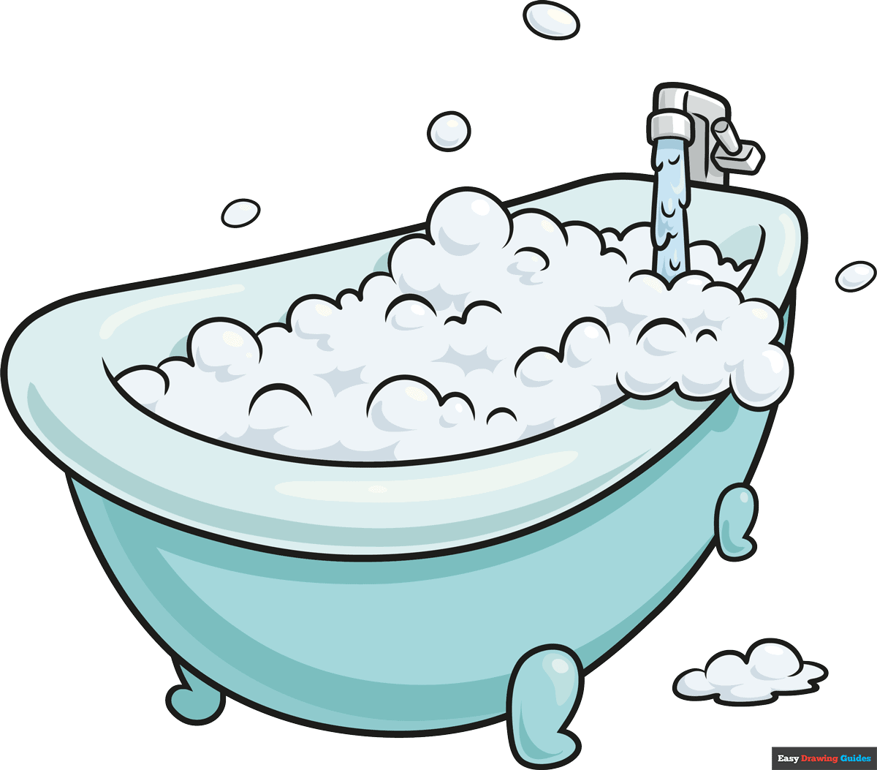
Now for question two. To keep yourselves clean and fresh do the members of your family usually choose to have: a) a soak in the bath? b) a four-minute shower?

Slide 8
A four-minute shower (as long as it’s not a power shower) only uses half as much water as a bath, so we save hundreds of litres of water every week, by taking showers rather than filling the bath.

Slide 9
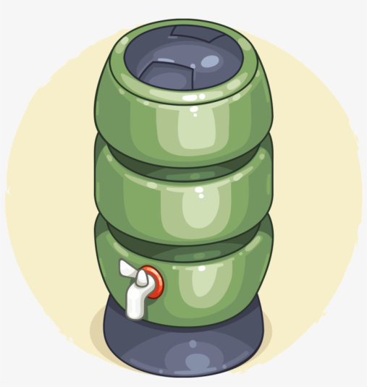
When using water outside, for example, when cleaning the car or watering the garden, should you: a) use a hosepipe? b) use a watering can, filled with rain water that’s been collected in a water butt? For those of you who aren’t sure, a water butt looks like this.
Notes:
A water butt is a large plastic container, which allows rain water to be collected from
the drain pipes around your home

Slide 10
If you use a hosepipe for about an hour a week, they’ll use over 100 buckets of tap water. In comparison a watering can holds less than one bucket of water and they’d probably only need to use about ten of these a week, which they could easily fill from a water butt.

Slide 11
If you use a hosepipe for about an hour a week, they’ll use over 100 buckets of tap water. In comparison a watering can holds less than one bucket of water and they’d probably only need to use about ten of these a week, which they could easily fill from a water butt.

Slide 12
Notes:
https://youtu.be/nTcFXJT0Fsc

Slide 13
What will you do?
Notes:
What will you do?

