Slide 1
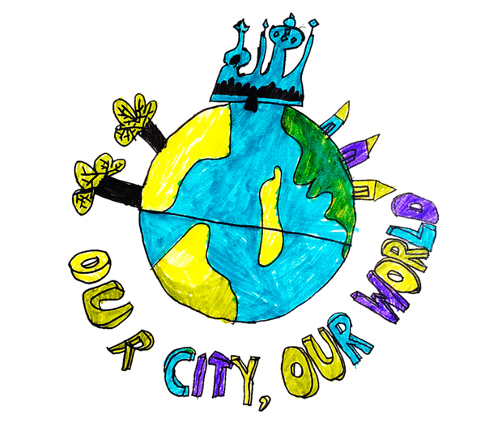
Think about our world as you watch

Slide 2
What can we do to help?
Planet Care
In our classrooms
As a whole school
As adults in school
As families at home

Slide 3
This term we are learning about: consumption (what we use)
Planet Care

Slide 4
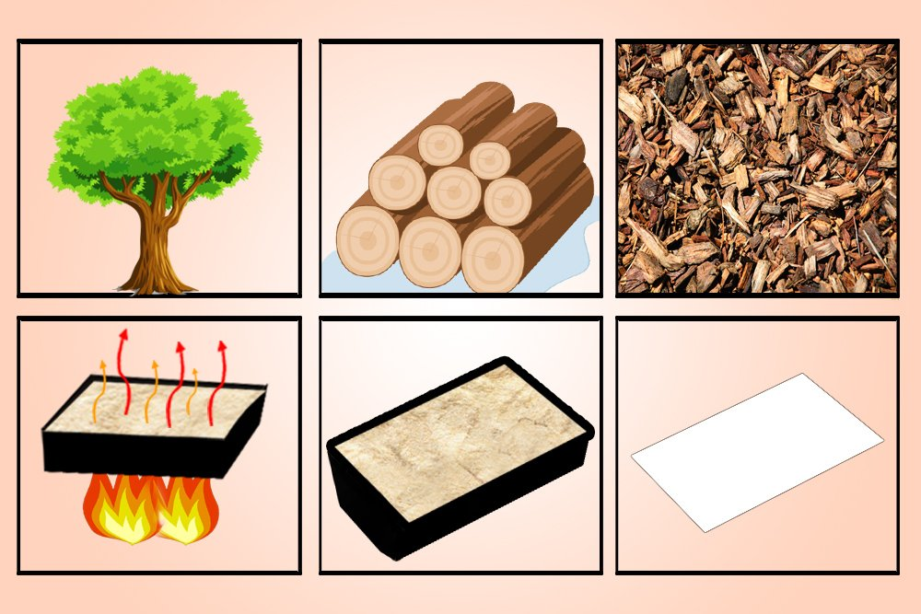
How does this affect the planet? paper – trees + energy which makes greenhouse gases = climate change

Slide 5
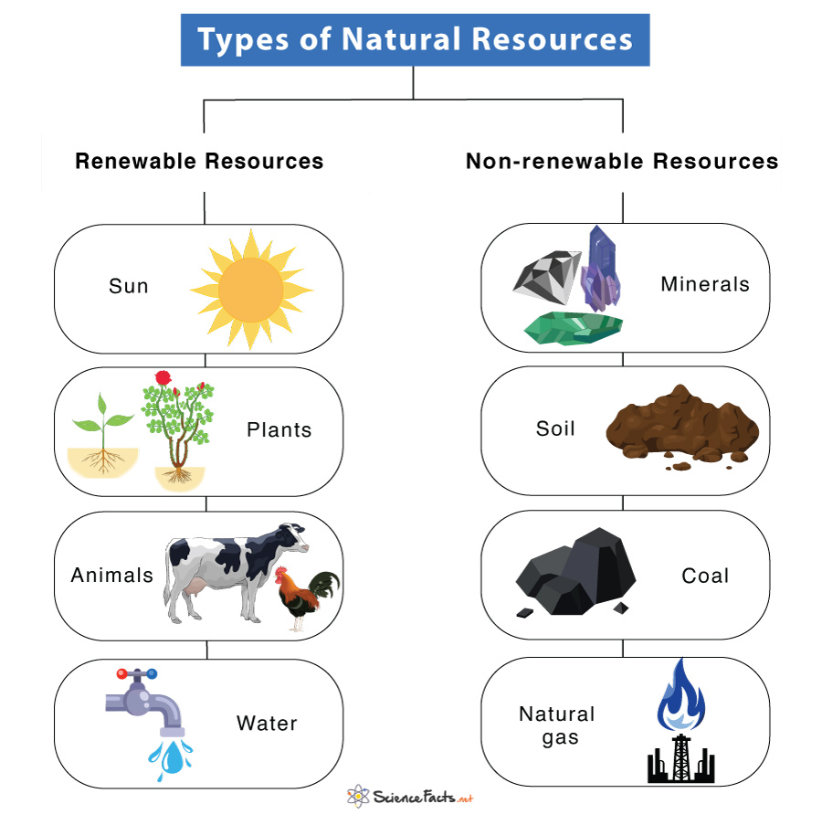
Most things we use are made
from natural resources.
So we need to think about
what we use…..
because whatever we use
creates waste!
See what Thomas thinks about
Ways you can help
Thomas

Slide 6
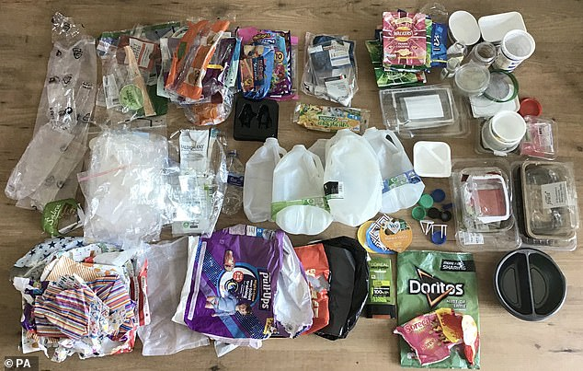
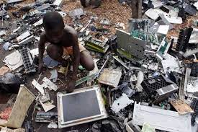
Reduce
Recycle
Refuse
Reuse
Rethink

Slide 7
What can we do? Can you talk about this with your teachers?
What can we do with our waste? How can we make sure we are reducing, recycling and reusing waste like paper and plastic in school?
Can we check we have a recycling bin and we all know how to use it? Do we have a scrap paper drawer to use? Are we turning the taps and lights off?

