Slide 1
It’s a wonderful world … We need to look after it
https://www.youtube.com/watch?v=TQk3B5hEabk

Slide 2
This term our Climate Change Journey… Learn about Consumption (using less natural resources) particularly plastics and packaging How is this linked to climate change? Watch this video

Slide 3
What can we do to help?
4 strands
In our classrooms
As a whole school
As adults in school
As families at home

Slide 4
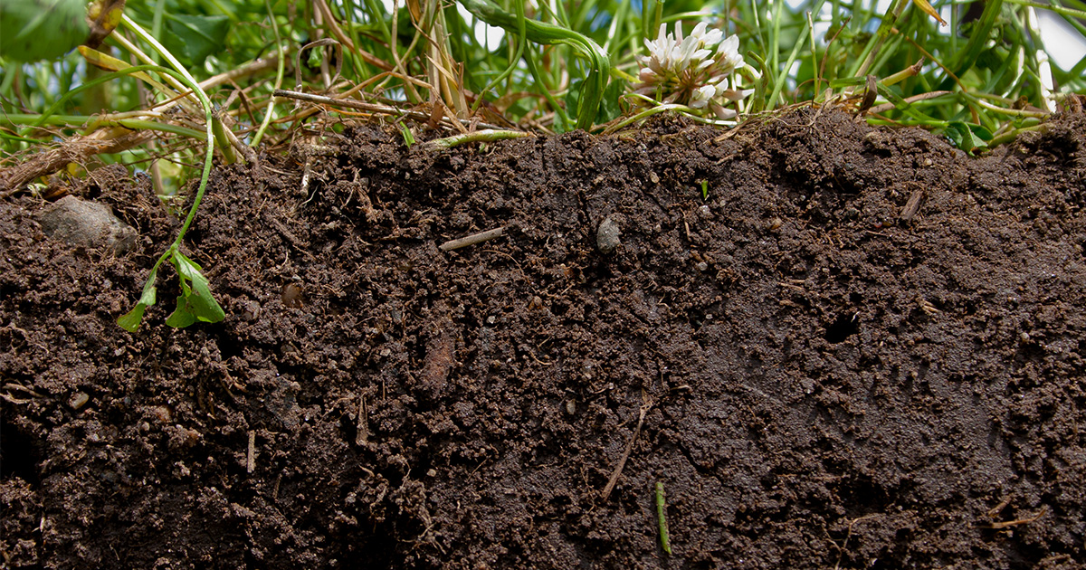
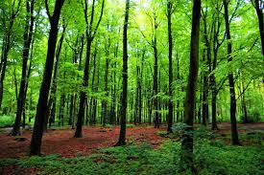
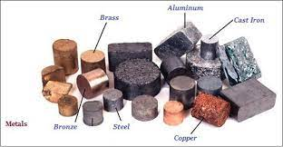
What links all of these together?

Slide 5
They are natural resources… Materials from the Earth that are used by humans – to support our lives and make things
Oil
Coal
Gas
Metals
Stone
Sand
Air (Wind)
Sunlight
Soil
Water
There is only a certain amount (finite) of some of these so once we’ve used them that’s it. Others are renewable.

Slide 6
What do we use natural resources for?
To make things
To grow food
To eat and drink
To travel
To make energy

Slide 7
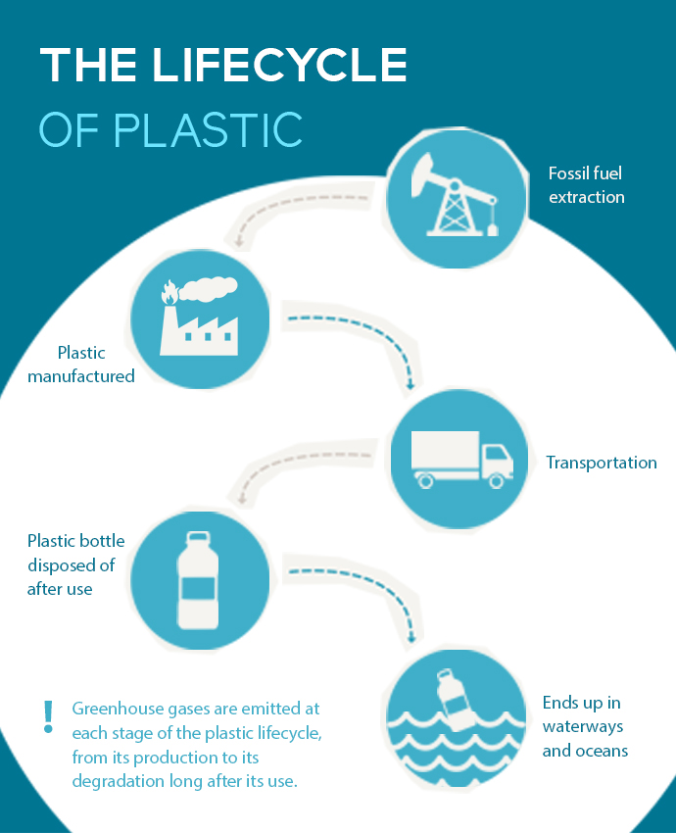
Making things
Plastic – oil + energy
which makes greenhouse
gases = climate change

Slide 8
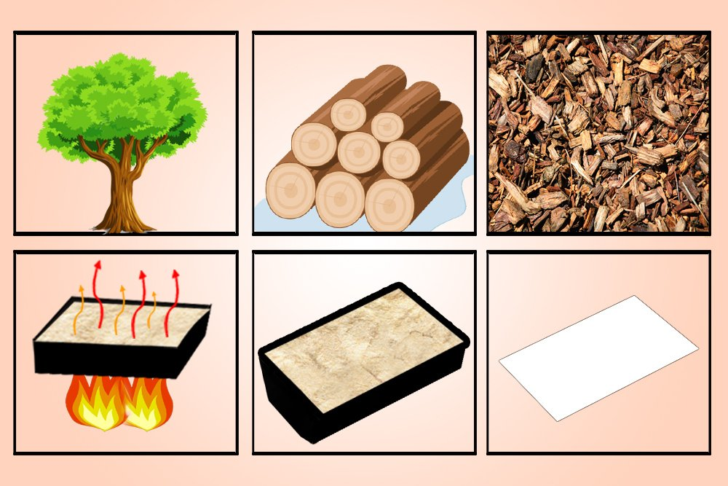
paper – trees + energy which makes greenhouse gases = climate change

Slide 9
Glass - sand + energy which makes greenhouse gases = climate change Look at the resources used to produce glass!

Slide 10
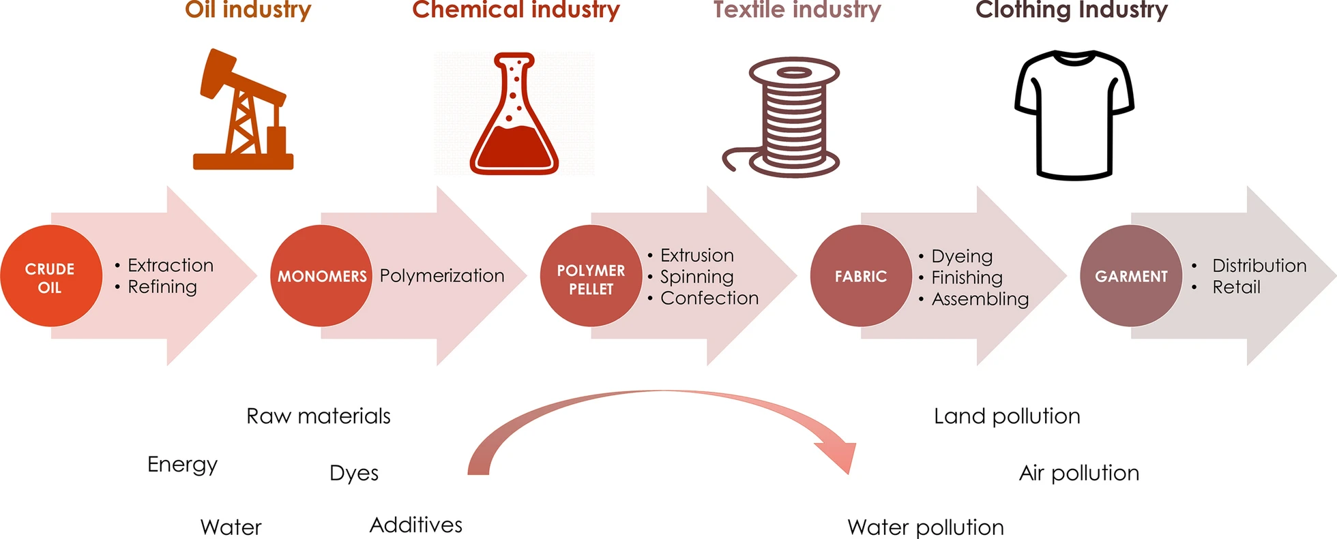
Clothes - plants (cotton), animals (leather, wool, down, silk) and petroleum (oil) (polyesters, acrylics) + energy

Slide 11
Session 2
Please think about this before our next assembly.
“The world has enough for everyone's need, but not enough for everyone's greed.”
Mahatma Ghandi

