Slide 2
Last week we talked about recycling in our classrooms.
Well done for talking about this with your class.

Slide 3
We have talked about recycling…. What about reducing?
needs video

Slide 4
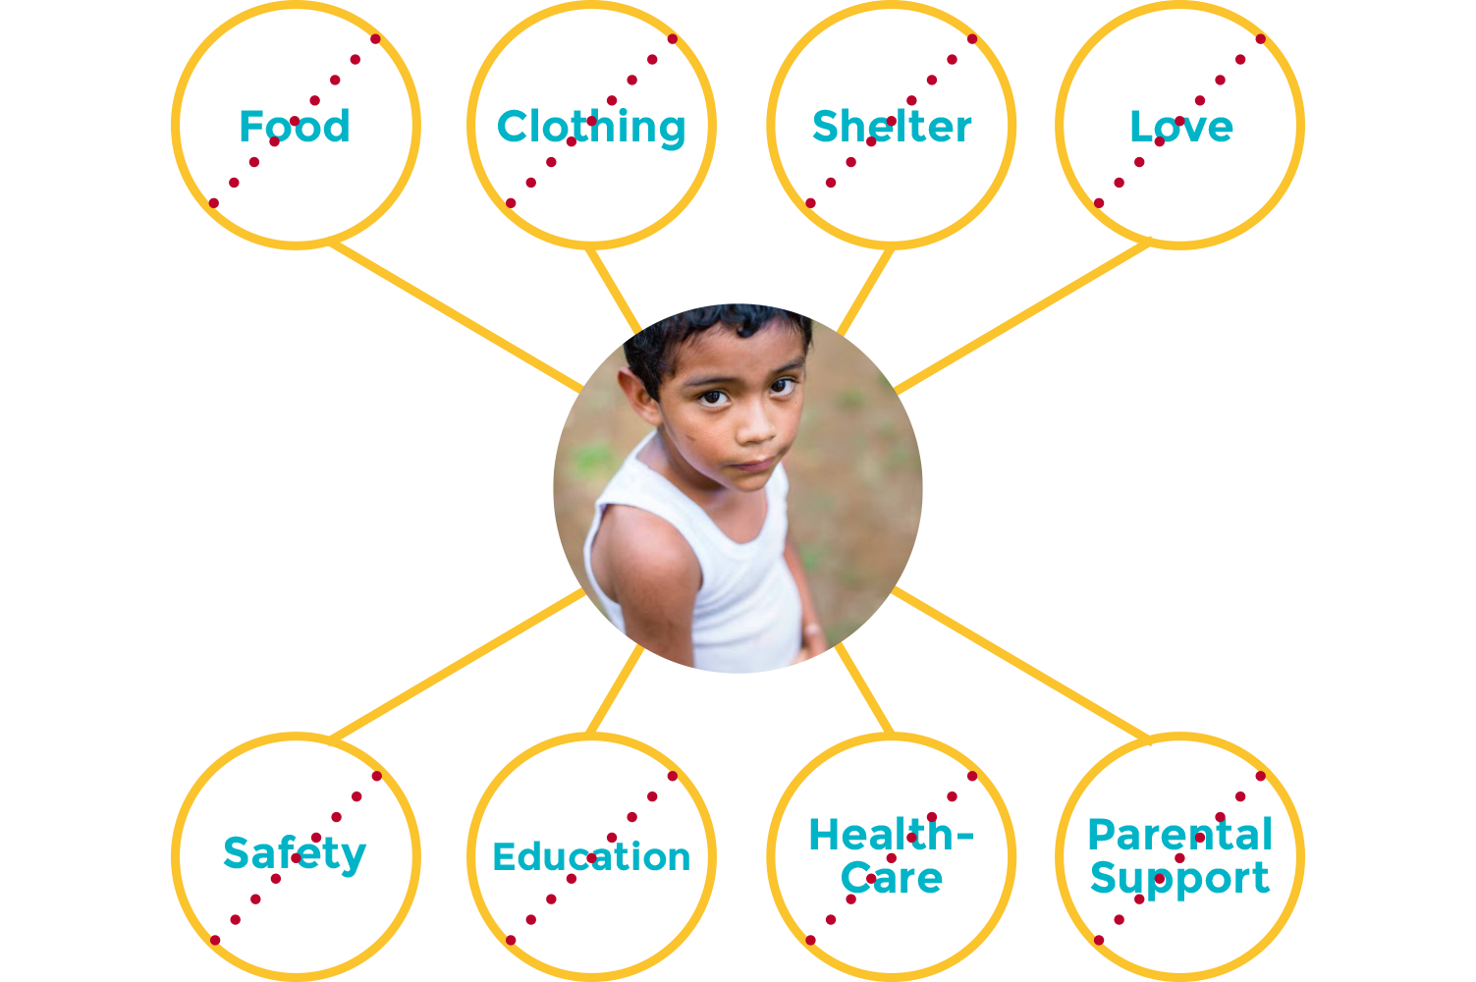
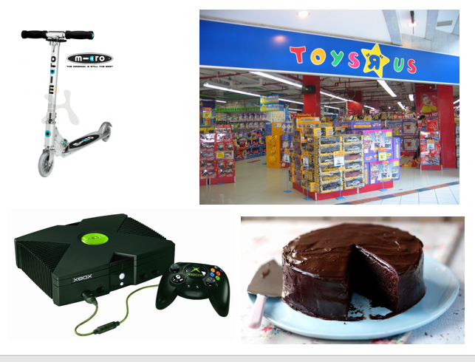
What do we need?
What do we want?

Slide 5
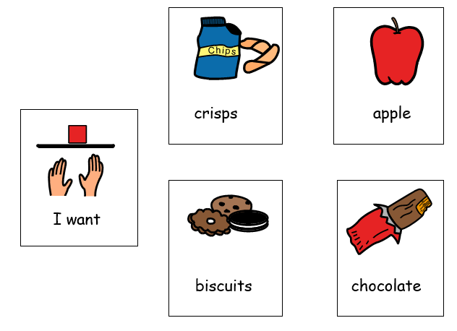

Slide 6
1.5 EARTHS to meet the needs of the world's population in a sustainable way.
2021
2050
3 EARTHS

Slide 7
So what next ? With your class this week can you discuss:
What can we do…..?
In classrooms
As a school
As adults in school
to reduce our use of natural resources?
Next week we will have a think about what we can do at home

