Slide 1
What did you think about this famous quote?
“The world has enough for everyone's need, but not enough for everyone's greed.”
Mahatma Ghandi

Slide 2
Give me some ideas of things we need.
I’ll write them on some paper and see if we agree.

Slide 3
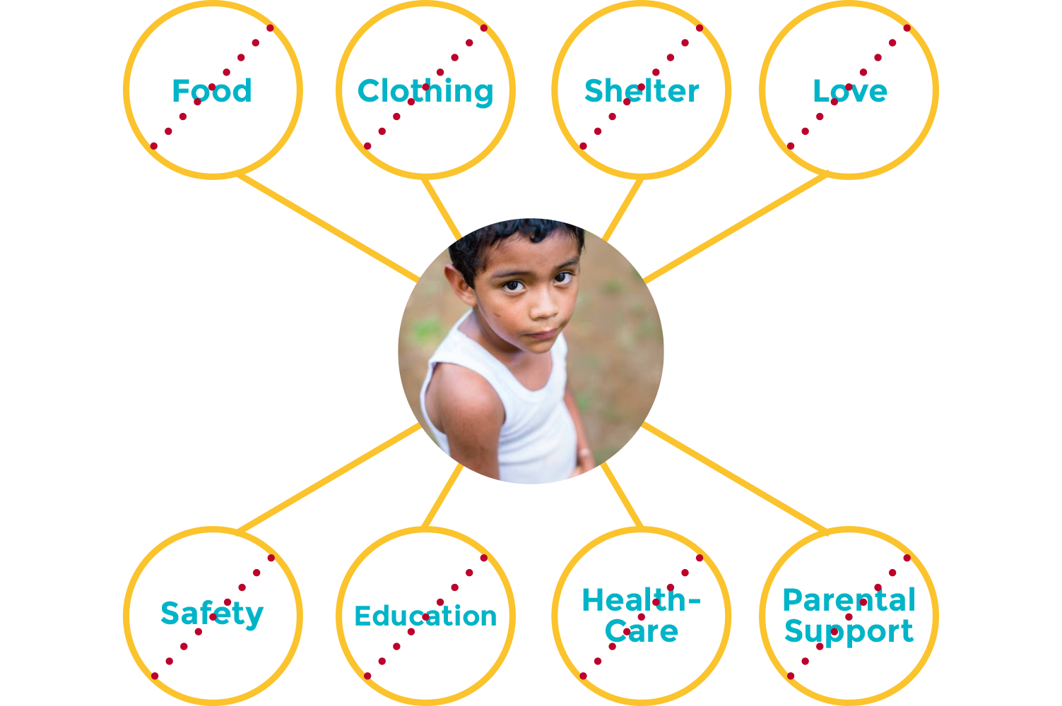
What do we need?
What do we want?

Slide 4
Why do we feel we need to buy all so many new things?
https://www.youtube.com/watch?v=HKH4YGKnOSs
Watch for a minute …
How do you feel about this?

Slide 5
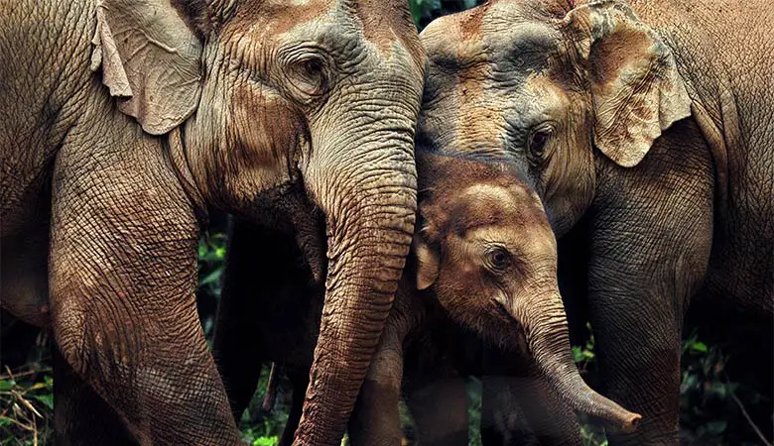
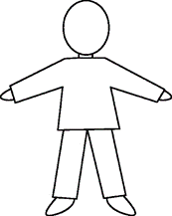
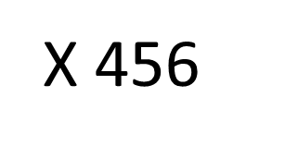
CONSUMPTION (currently per person)
X 10
2.5 elephants
This rate is expected to rise to between 170 and 184 billion tonnes by 2050.
18 tonnes/year for every person on Earth!

Slide 6
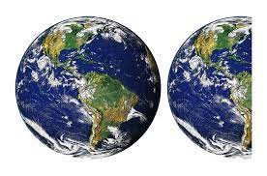
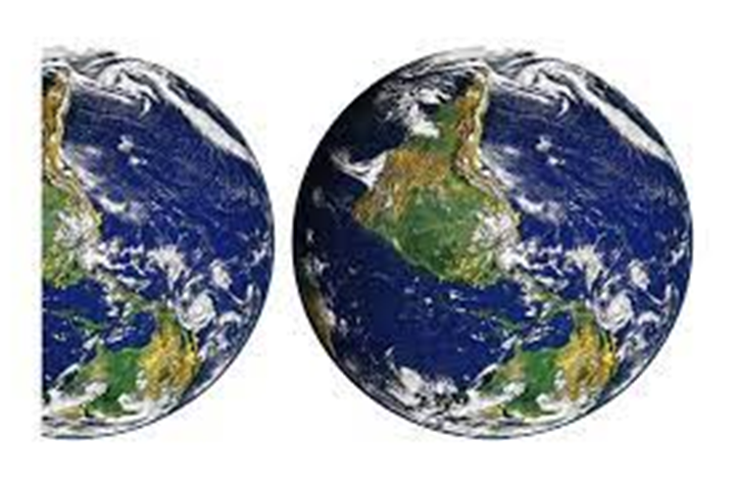
1.5 EARTHS to meet the needs of the world's population in a sustainable way.
2021
2050
3 EARTHS

Slide 7
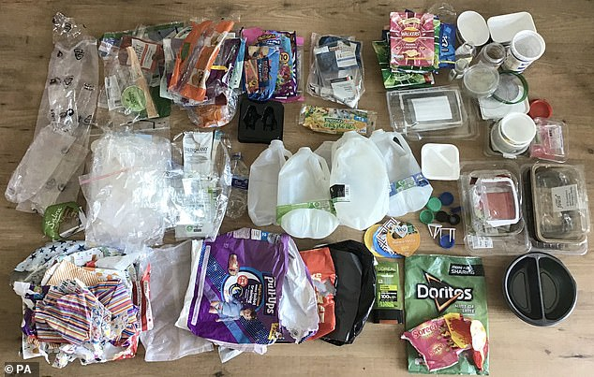
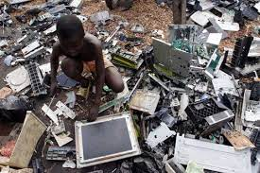
Reduce
Recycle
Refuse
Reuse
Rethink

Slide 8
So what next ? With your class this week can you discuss:
What can we do to:
In classrooms
As a school
As adults in school
to reduce our use of natural resources?
Next week we will have a think about what we can do at home

