Slide 1
What am I? Put your hand up when you think you know the answer.
• There’s only one of me…
• I’ve been here for millions of years…
• I look green and blue and sometimes partly white
• I’m partly solid, partly liquid, partly gas
• I’m home to many living things
• I spin around all the time; it takes me 24 hours to do one spin
• I’m warming up

Slide 2
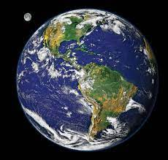

Slide 3
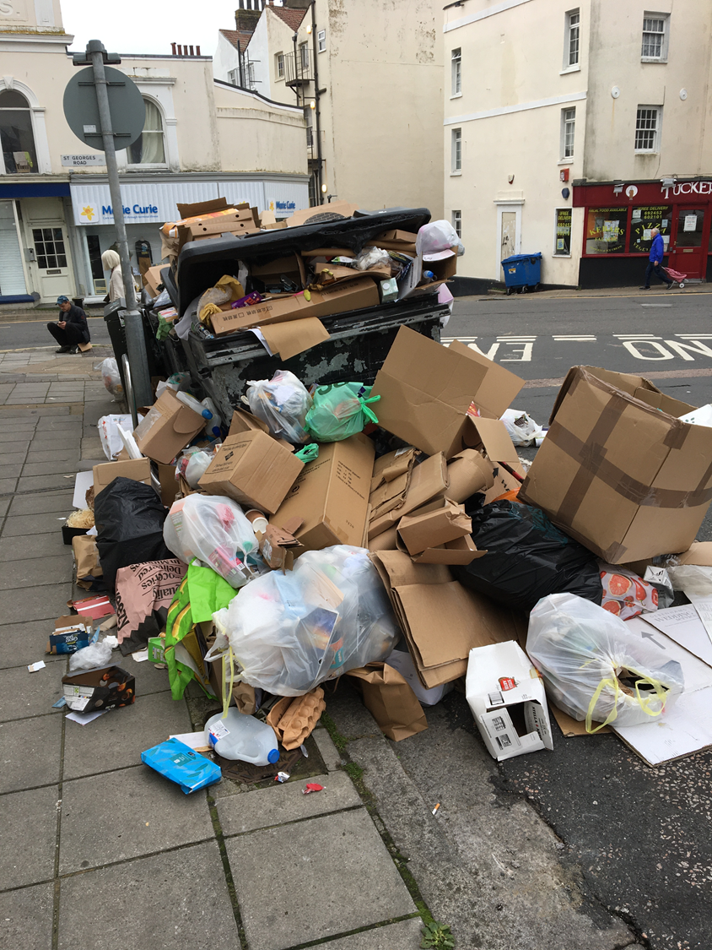
Cutting down our consumption at home
Spreading the word is how we can increase the amount of change

Slide 4
Over half term we talked about how you and your family could pledge to do one thing to try and be responsible consumers. How did you get on? What did you do?

Slide 5
There is so much we can do to help the planet and you are all doing a great job!

Slide 6
Turning off taps
Turning off lights and plugs
Eating all my food
Taking a bag shopping
Swapping a toy or book with my friend
Using a charity shop
Trying to buy things with less plastic

Slide 7
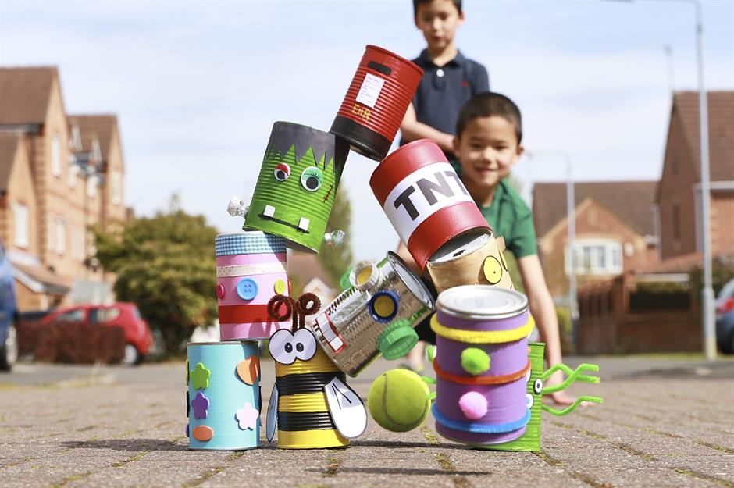
Upcycling

Slide 8
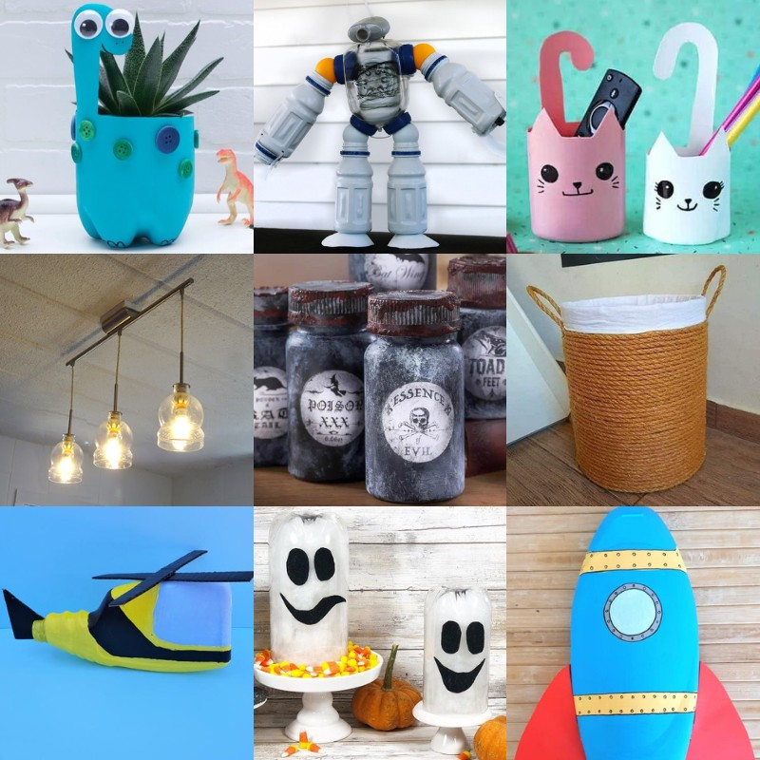
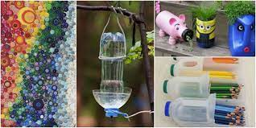
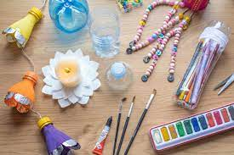
https://youtu.be/uK2ccgH5Q0E?si=iqBmCKXr9zBNWzh7

