Slide 1
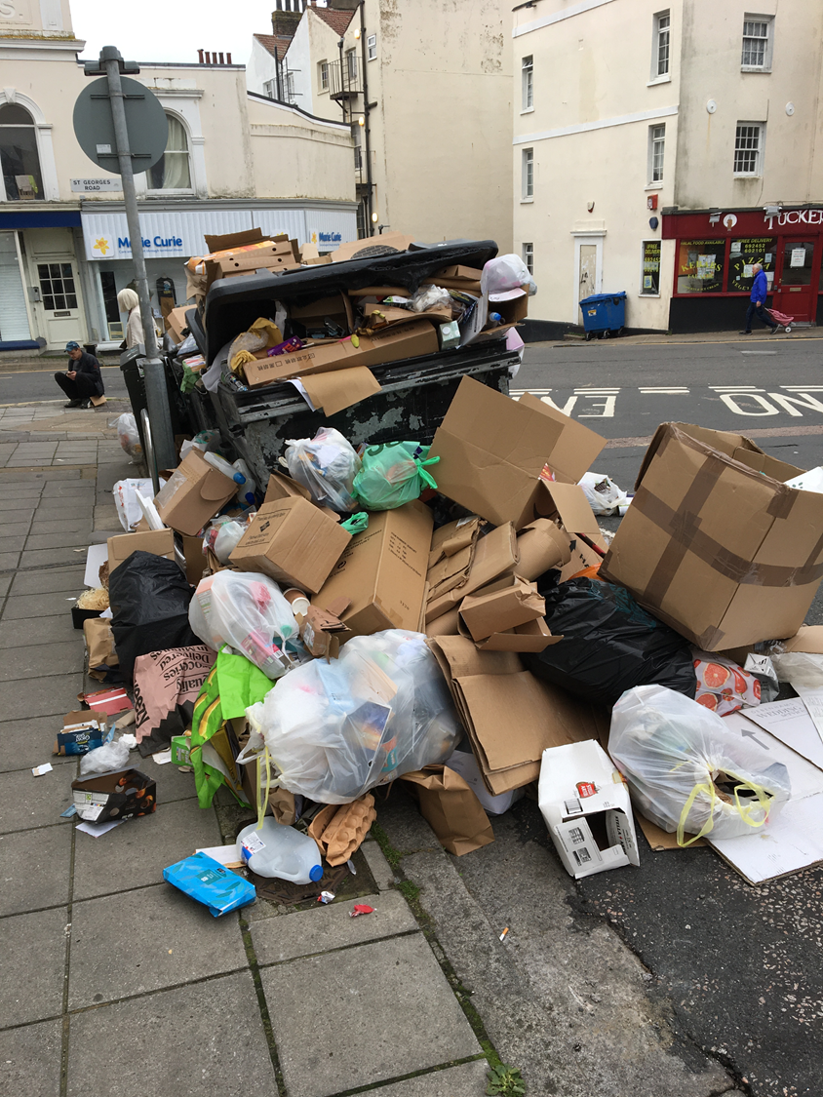
Cutting down our consumption at home
Spreading the word is how we can increase the amount of change

Slide 2
Over half term we talked about how you and your family could pledge to do one thing to try and be responsible consumers. How did you get on? What did you do?

Slide 3
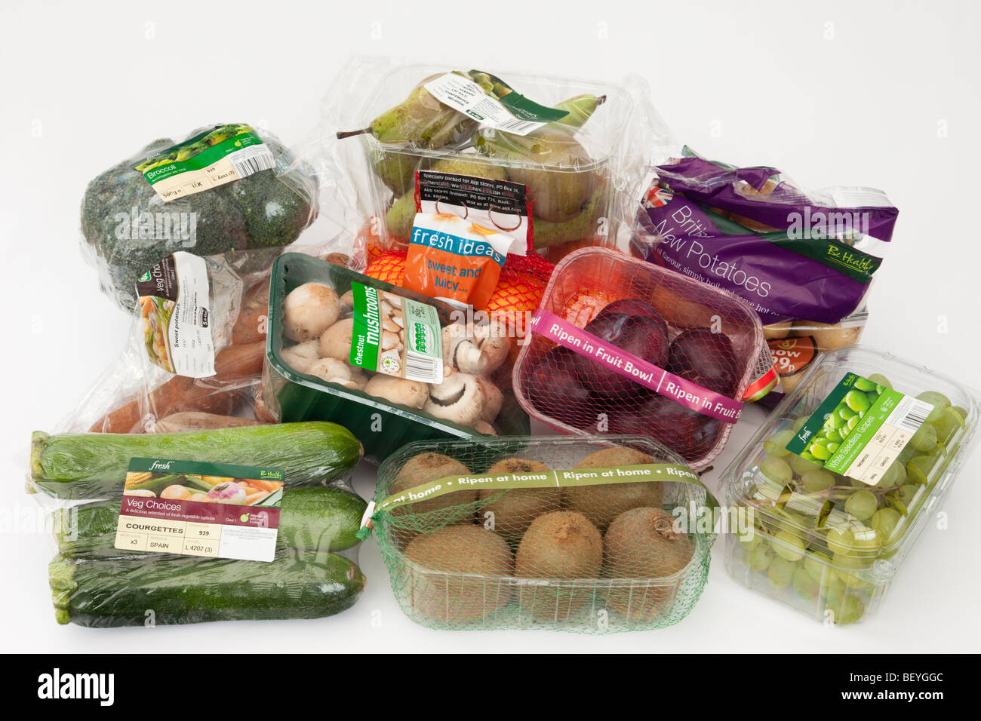
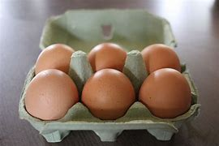
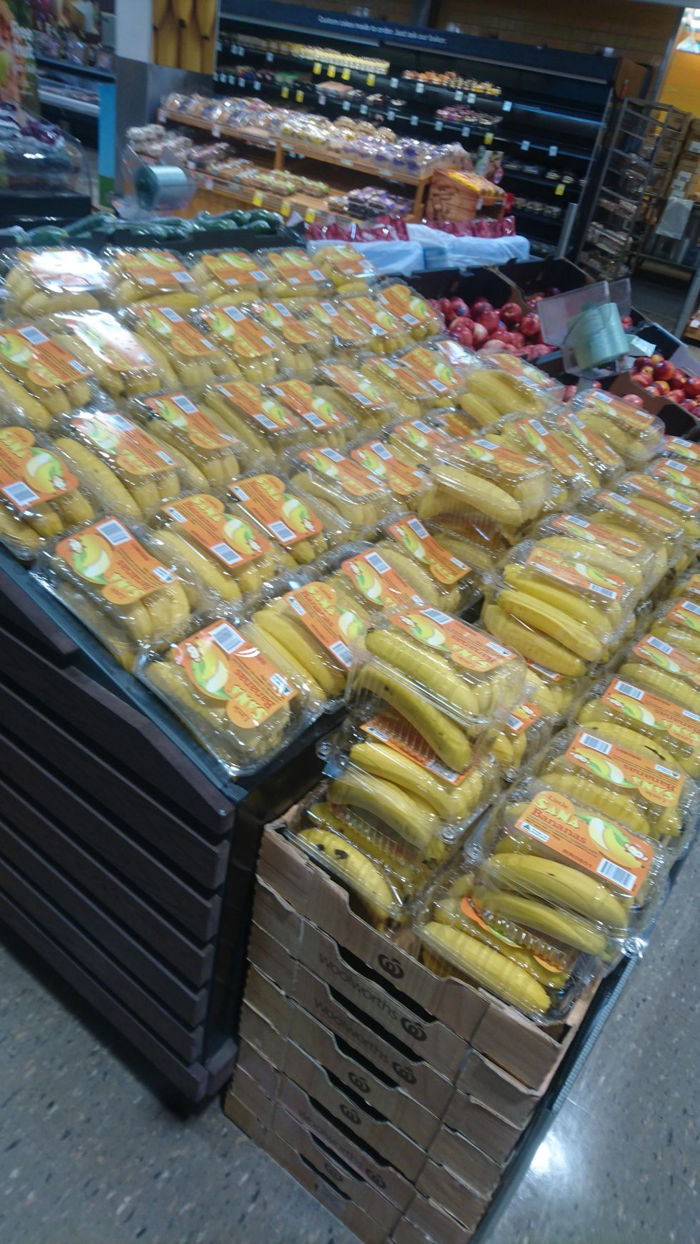
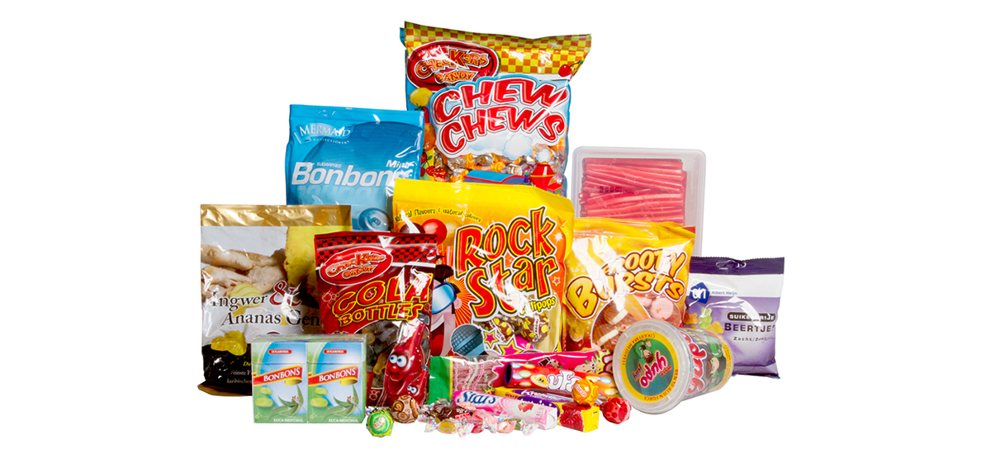
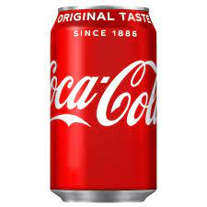
Let’s compare your shopping choices and see what a difference small changes to our choices make!
Imported vegetables
Factory farmed eggs
Plantation bananas
Biscuits and sweets
Coca Cola

Slide 4
Plantation bananas
Grown on a plantation, mass produced using lots of pesticides to kill the bugs which like bananas. Workers’ homes get sprayed with pesticides too – from the air. Many workers get sick from handling bananas soaked in pesticides. Sold in 2 layers of plastic packaging.

Slide 5
Imported vegetables
Arrived in UK by air! Think how much pollution planes cause and the effect that they have on global warming –too many food miles

Slide 6
Biscuits and sweets
Look at all the packaging! There’s layers of it on biscuits and sweets – if it gets thrown out with the rubbish it’ll get put in a hole in the ground and take hundreds of years to rot away

Slide 7
Coca Cola is made all over the world. In countries like India local people are running out of water! Wells used by local people are running dry because the company are using the water to make the coke
What would you think if children here didn’t have enough clean water because it was being used by a Coca Cola factory? Would you be happy?

Slide 8
Factory farmed eggs
• The hens who laid these are kept in small cages where they can hardly move – factory
farming uses lots of antibiotics to try to keep the birds and other animals healthy but this
can be unhealthy for you. They’re often fed on waste products too

Slide 9
Can you think of any alternatives?
Imported vegetables
Factory farmed eggs
Plantation bananas
Coca Cola
https://www.bing.com/videos/riverview/relatedvideo?&q=sustainable+food+shopping+for+kids+ks2&&mid=8CDE00E5975F6954BFA88CDE00E5975F6954BFA8&&FORM=VRDGAR
Biscuits and sweets

Slide 10
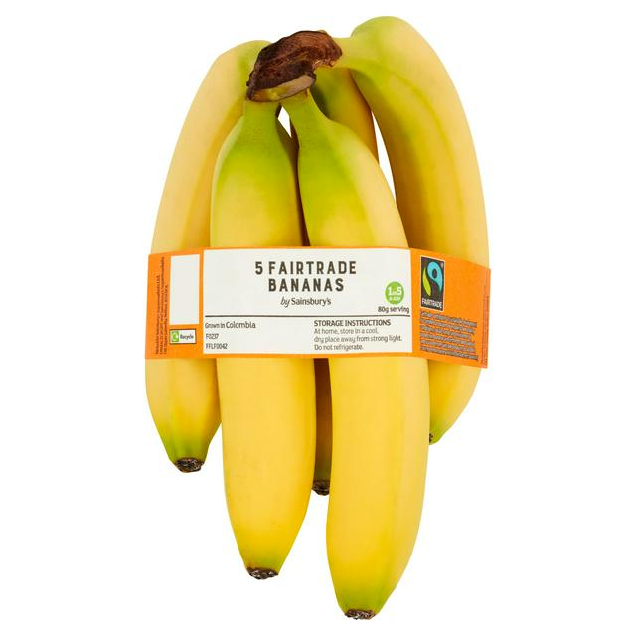
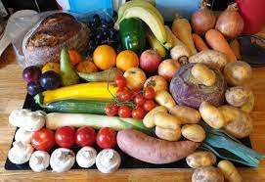
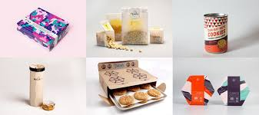
Possible alternatives…….
Fairtrade bananas
These bananas were grown on a small banana farm, not a plantation – they’ve got the Fairtrade Mark, so we know the workers are paid fairly, and they use fewer pesticides than the plantation bananas
Local veg
These have only travelled 30 miles instead of 3,000. Think of all the food miles, fuel and pollution that’s saved! Better still, why not grow your own vegetables at home or at school if you can?
Biscuits and sweets with less plastic packaging
That’s much less to recycle – much better for the planet

Slide 11
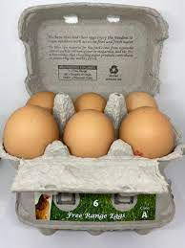
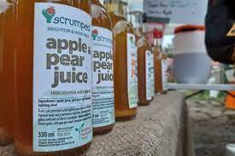
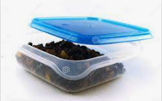
Free-range eggs
Happy hens and healthier for everyone. Don’t forget you can put the eggbox on the compost heap and that’s a great way of recycling
Local apple juice
This has been produced from apples grown in this part of England, where companies are checked so they don’t cause problems with the local water supply
Large packet of organic raisins
Its easy to divide those up for lunch boxes – less waste and a healthy organic treat
AND OF COURSE DON’T FORGET TO TAKE YOUR OWN SHOPPING BAG!!!

