Slide 1
What ideas did you come up with as a class?
Did you think of any ways to reduce how much
waste you produce?
Did you think of any ways you could recycle or reuse resources?
As a class, you could focus on one idea.
Is it possible? How will you know if you are successful? How will you measure?

Slide 2
Possible ideas:
Not going to use any new pens without proving the old one doesn’t work
Using pencils and only use pens when important to
Use scrap paper and pencil rather than pens on whiteboards
Do not leave the tap running
Sharing resources with other classes
Use exercise books very carefully and use up all the space
Use paper towels in a careful way – because you cannot recycle them
RETHINK – is there another way

Slide 3
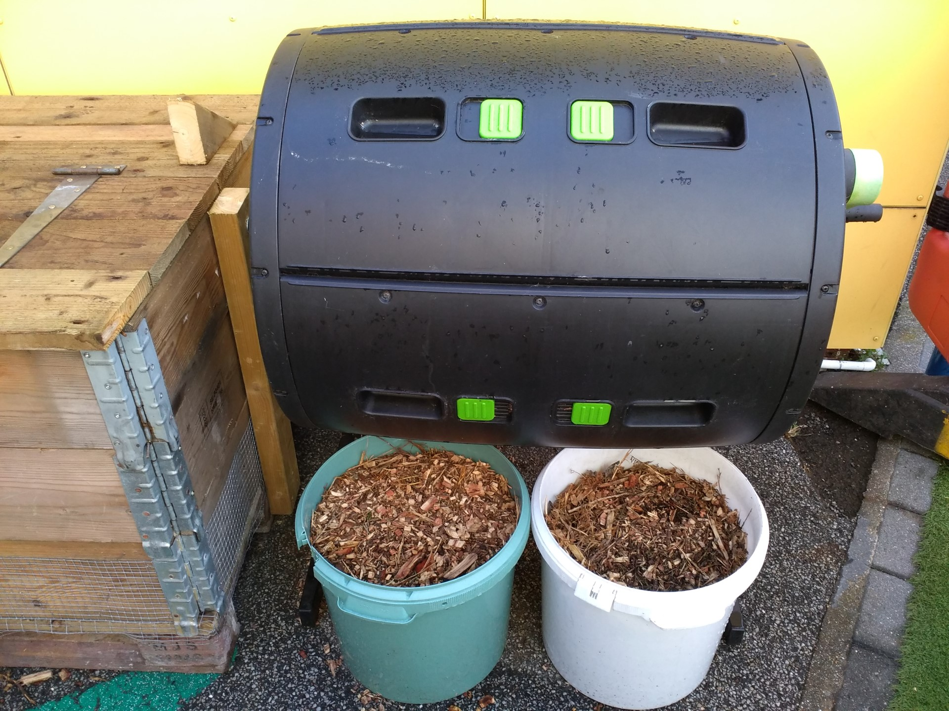
Compost bin

Slide 4
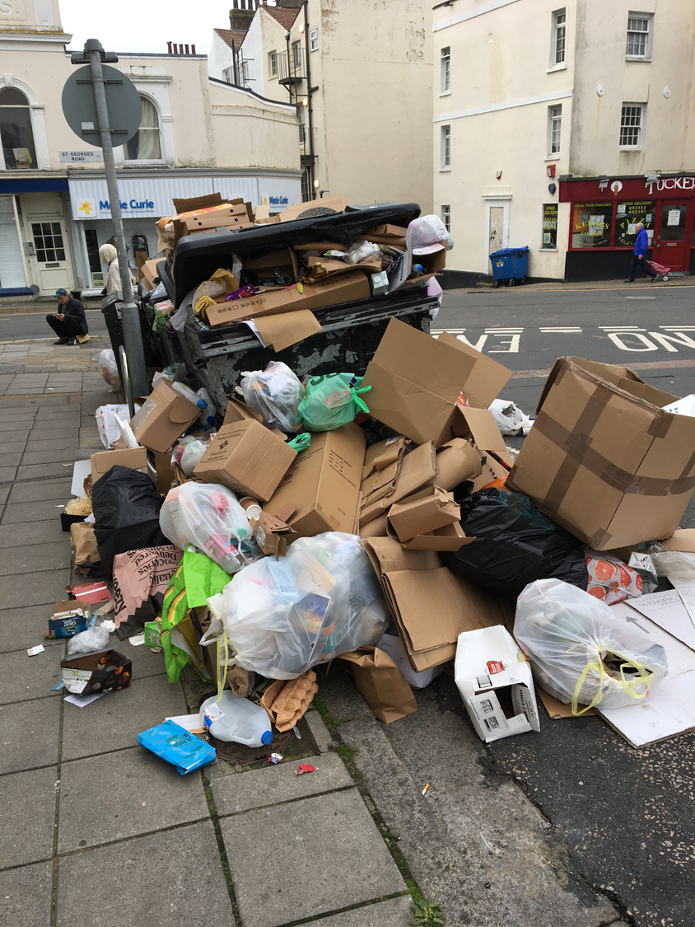
Cutting down our consumption at home
Spreading the word is how we can increase the amount of change

Slide 5
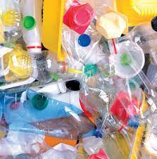
Recap - what is responsible consumption?
Look for some ideas of what we can do at home.

Slide 6
Over half term can you and your family pledge to do one thing to try and be responsible consumers?

Slide 7
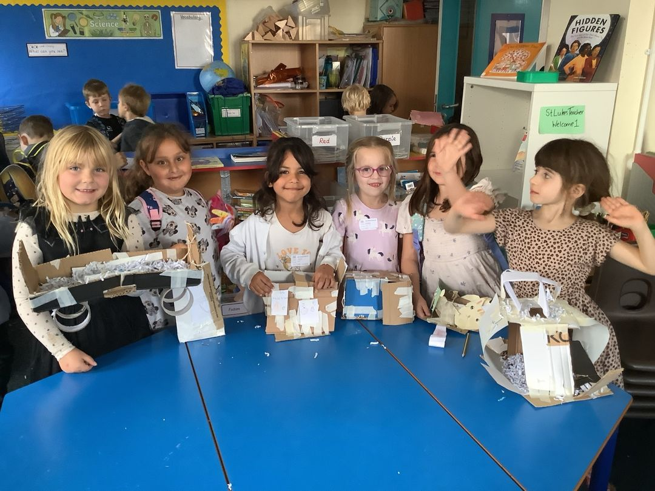
Some ideas for a pledge:
Try not to waste food – only cook what you need and eat it up.
Try and use paper or sustainable packaging – avoid plastic drinks bottles, packaging
Buy a big bag of crisps or popcorn and put what you need each day in a Tupperware box
Save water
Turn off the lights when you are not in the room
Recycle what you can
Reuse what you can
Rethink how you can use items
Swap a book with a friend
Swap a toy with a friend

Slide 8
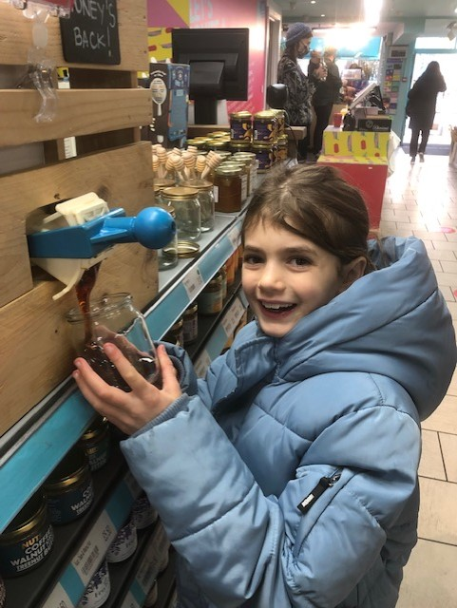
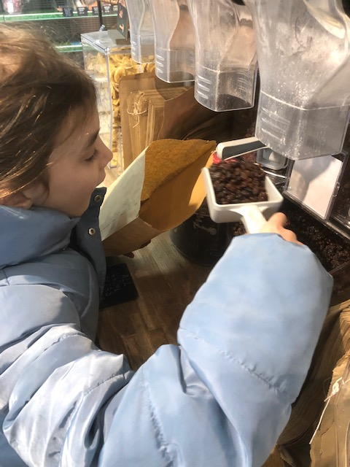
Refilling – take empty containers to HISBE

Slide 9
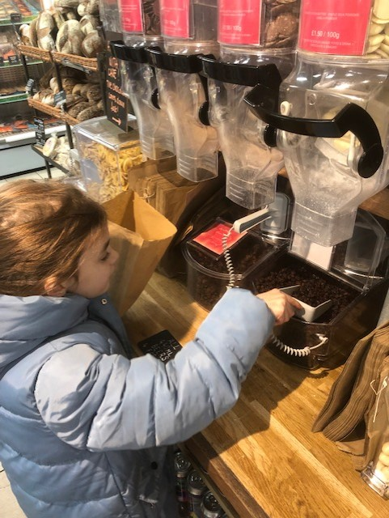
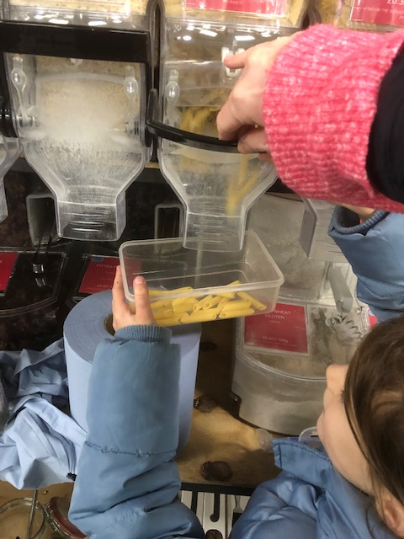

Slide 10
