Slide 1
Changemakers
This resource has been created to support the Our City Our World assembly programme. It highlights local, national and global changemakers, people working to raise awareness of the climate crisis or impact emissions.
Each slide contains basic information about and an image of the changemaker, usually a youtube link and details of where to find more information.
It's not intended that you use the presentation in it's current form – rather please take the slides relevant to topics you are studying and edit the content to suit your class. Some schools are focusing on a different changemaker each term.
Sharing stories of changemakers is important to maintain hope and optimism about the future of the planet. Children need to be aware of ways that individuals and groups, both locally and nationally, are having a positive impact on the world, and that their actions, however small, canhave a positive impact, especially when amplified by all the other good work going on.

Slide 2
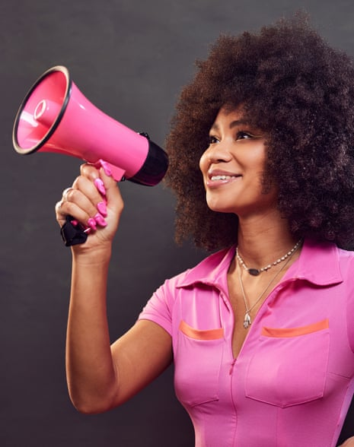
Local Climate Activist – Michaela Loach
Michaela Loach is a climate activist from Brighton. She became aware of the climate crisis when the beach in Jamacia, where she played as a child, almost disappeared due to climate change.
She started taking action age 5, baking cakes to raise money for victims of a large tsunami. Years later, she took the UK government to court over 'unlawful tax breaks to North Sea oil and gas companies.
Her first book was published
in 2023 is called 'It's Not That
Radical: Climate Action to
Transform Our World' which
promotes climate justice as
essential for tackling climate
change.
Watch Michaela talk about the importance of climate justice

Slide 3
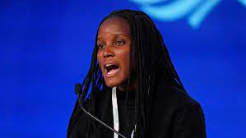
Climate Activist - Vanessa Nakate
Vanessa Nakate is a Ugandan climate justice activist.
She started the school climate strikes in Uganda and founded the Rise Up Climate Movement which aims to promote the voices of African climate activists.
She is also involved in helping Ugandan schools use renewable energy sources eg solar panels instead of fossil fuels. She believes 'If we are united and work together, we will be able to transform this world'
Listen to Vanessa talk about how climate change is affecting Uganda and other countries in Africa and what she is doing to as a climate activist.

Slide 4
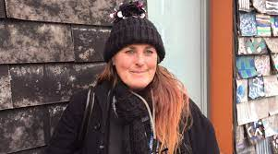
Local Waste Changemaker – Cat Fletcher
Cat Fletcher works in and around Brighton & Hove.
She is one of the founders of Freegle UK -a website for reusing almost anything
She helped create the Brighton Waste House.
She helps Brighton and Hove City Council find new homes for equipment and furniture
She runs Brighton Open Market’s ‘Free Shop’
Listen to Cat Fletcher talk about SDG 12 – responsible consumption and production and how we need to minimise waste.

Slide 5
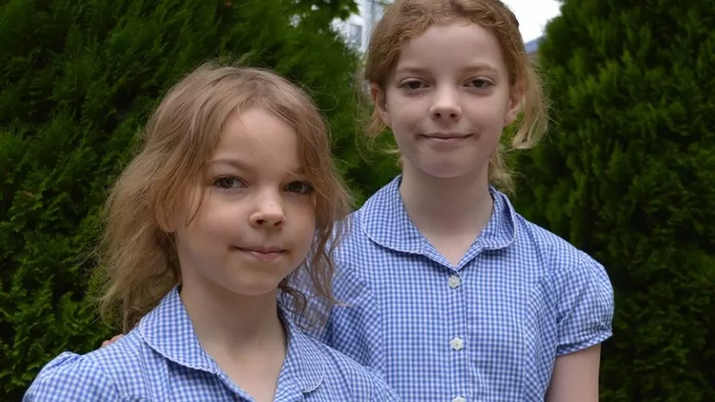
Waste Changemakers – Ella + Caitlin McEwan
The problems that can be caused by plastic toys
Ella and Caitlin McEwan from Southampton are two sisters who made a petition asking fast food restaurants to stop putting plastic toys in kids' meals.
Ella and Caitlin gathered more than 400,000 signatures. Since then McDonalds said its customers would be able to choose between a toy and a fruit and Burger King said it will remove the plastic toys altogether.
The sisters on national news

Slide 6
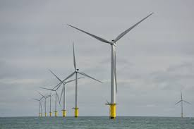
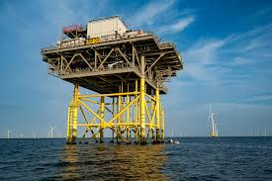
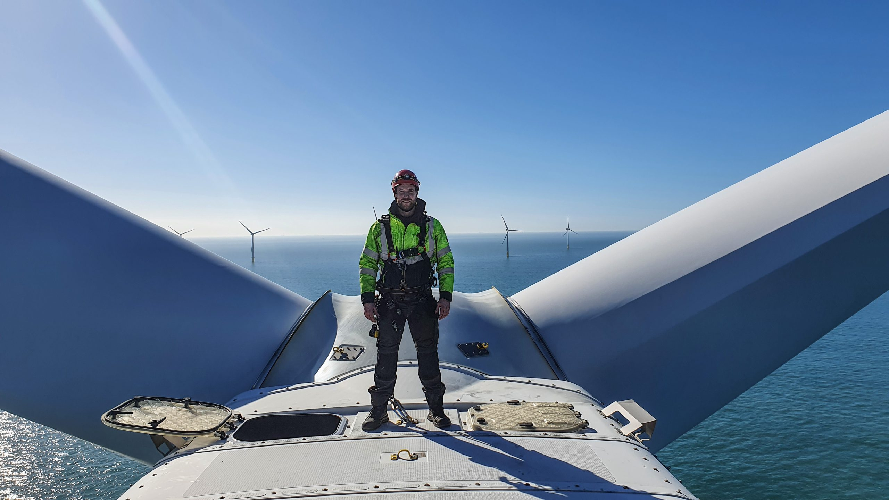
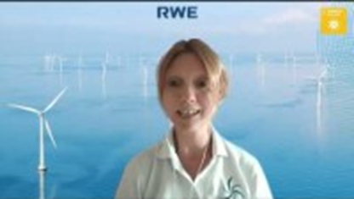
Local Energy Changemaker – Rampion
Watch the wind farm working
The Rampion wind farm provides clean, green, sustainable energy for 350,000 houses – that’s nearly enough for half of Sussex.
There are 116 turbines, each is 80m tall and the blades are 112m long.
The wind farm has been working since 2018.
There are plans to extend it so we will have even more sustainable energy in Sussex.
Listen to Katie Scanlan, Rampion Visitor Centre Manager talk about SDG 7 Affordable and Clean Energy

Slide 7
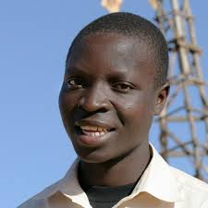
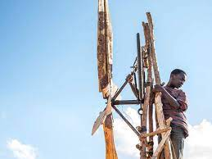
Energy Changemaker – William Kamkwamba
More about William’s story here.
Watch the trailer from the film made about William’s story.
William Kamkwamba, from Malawi, was 14 years old when his parents could no longer afford for him to go to school.
He went to the library and taught himself how to build a wind generator. He didn’t have a lot of materials so made it out of wood, a bicycle frame, an old tractor fan and other materials he could find.
He used it to pump out water from the ground, helping his local community survive during a drought.
You can also read the book about him.

Slide 8
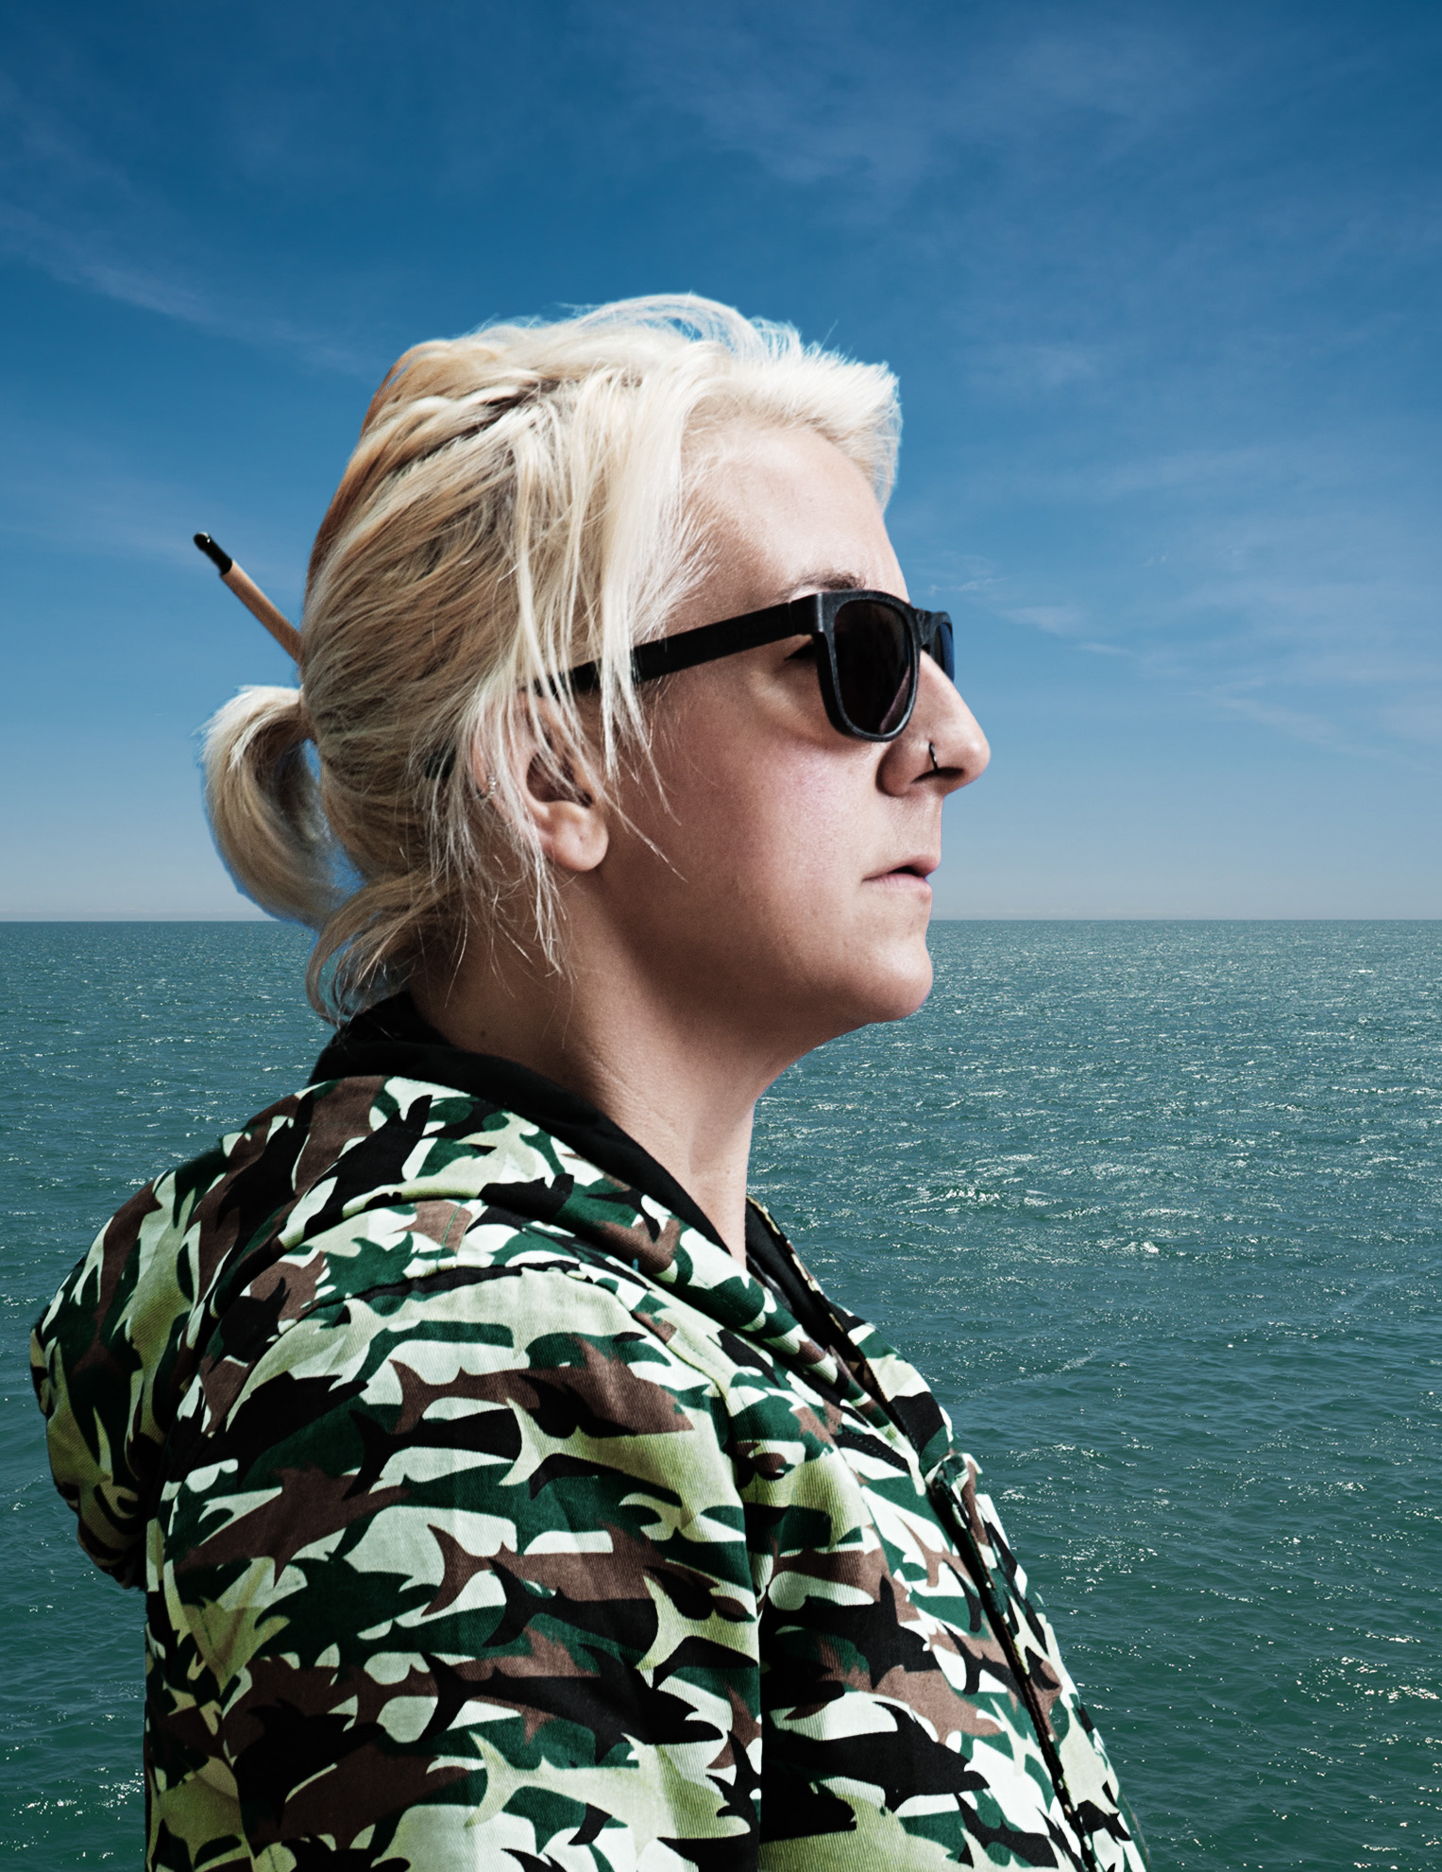
Local Water Changemaker – Claire Potter
volunteering with Surfers Against Sewage as a Regional Rep and running the now international behaviour change campaign Plastic Free Pledge she co-founded in 201

Slide 9
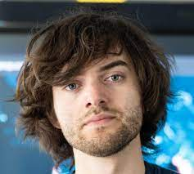
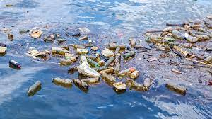
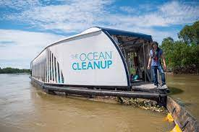
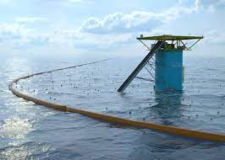
Water Changemaker – Boyan Slat
Boyan Slat is a Dutch inventor who’s passionate about creating megaprojects to address planetary problems. He started the company The Ocean Cleanup which aims to rid the world's oceans of plastic.
His invention consists of a giant tube made of durable plastic and a nylon screen, so fish don't get caught. It uses ocean currents to collect and trap rubbish as small as 1cm.
Listen to Boyan Slat …….

Slide 10
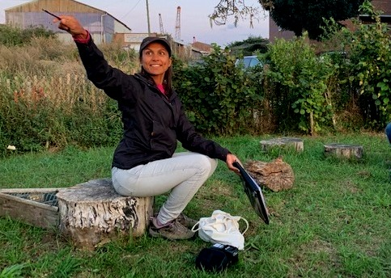
Local Biodiverstiy Changemaker Kim Dawson
Listen to Kim talk about SDG 15 'Life on Land' and why it's so important to protect our biodiversity and what's being done in Brighton & Hove .
Kim is an ecologist who works to protect habitats and species in Brighton & Hove.
You can listen to Kim talking about being an ecologist and jobs that involve protecting our environment here.

Slide 11
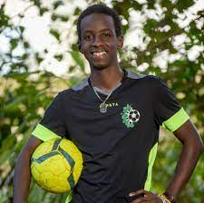
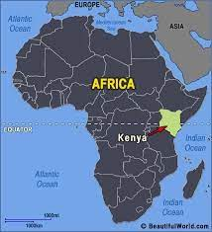
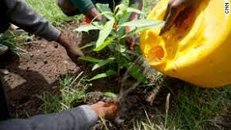
Global Biodiversity Changemaker Lesein Mutunkei
Lesein Mutunkei is a teenager from Kenya. After learning about pollution and deforestation at school when he was 12 years old, he founded Tree4Goals
Lesein plants 11 trees every time he scores a goal in football. So far he has planted over 3000 trees and encouraged his friends, schools and football clubs all over the world to get involved.
Find out more about Lesein here.

Slide 12
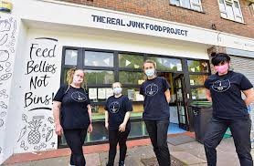
Local Food Changemakers Real Junk Food Project
The Real Junk Food Project Brighton tries to intercept food waste that would otherwise go to land fill and use it to feed people who need it, on a ‘pay as you feel’ basis. Find out more here.
Listen to Paul Loman, of the Real Junk Food Project talk about their work and SDG 2 – Zero Hunger

Slide 13
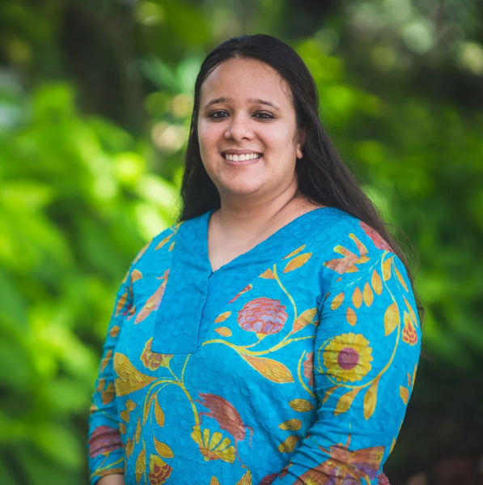
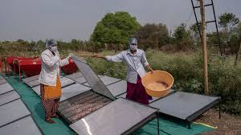
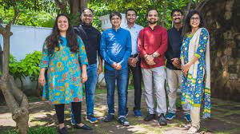
Global Food Changemaker – Nidhi Pant
Nidhi was born up in the Himalayas and lived in Mumbai, a large Indian city. As a young child travelling around India, she noticed how some communities were suffering terrible hunger and others had lots of food waste.
She studied engineering and designed a solar powered food dehydrator to help farmers preserve their crops without using chemicals, preventing food waste. Her work also supports and trains women in farming technology.
Listen to Nidhi talk about her work and the youth leadership award she has been given.

Slide 14
Global

Slide 15
Local Transport Changemaker –

Slide 16
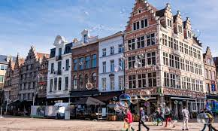
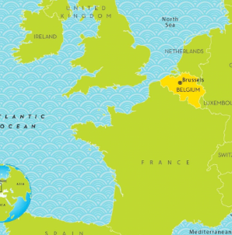
Global Transport Changemaker – Ghent
Ghent is a city in Belgium that has been almost car-free since 2017. Since going car-free, the city has less traffic jams and improved pedestrian and cyclist safety, energy and air quality and public transport. People also say it’s a much nicer place to be.

Slide 17
Global

