Slide 1
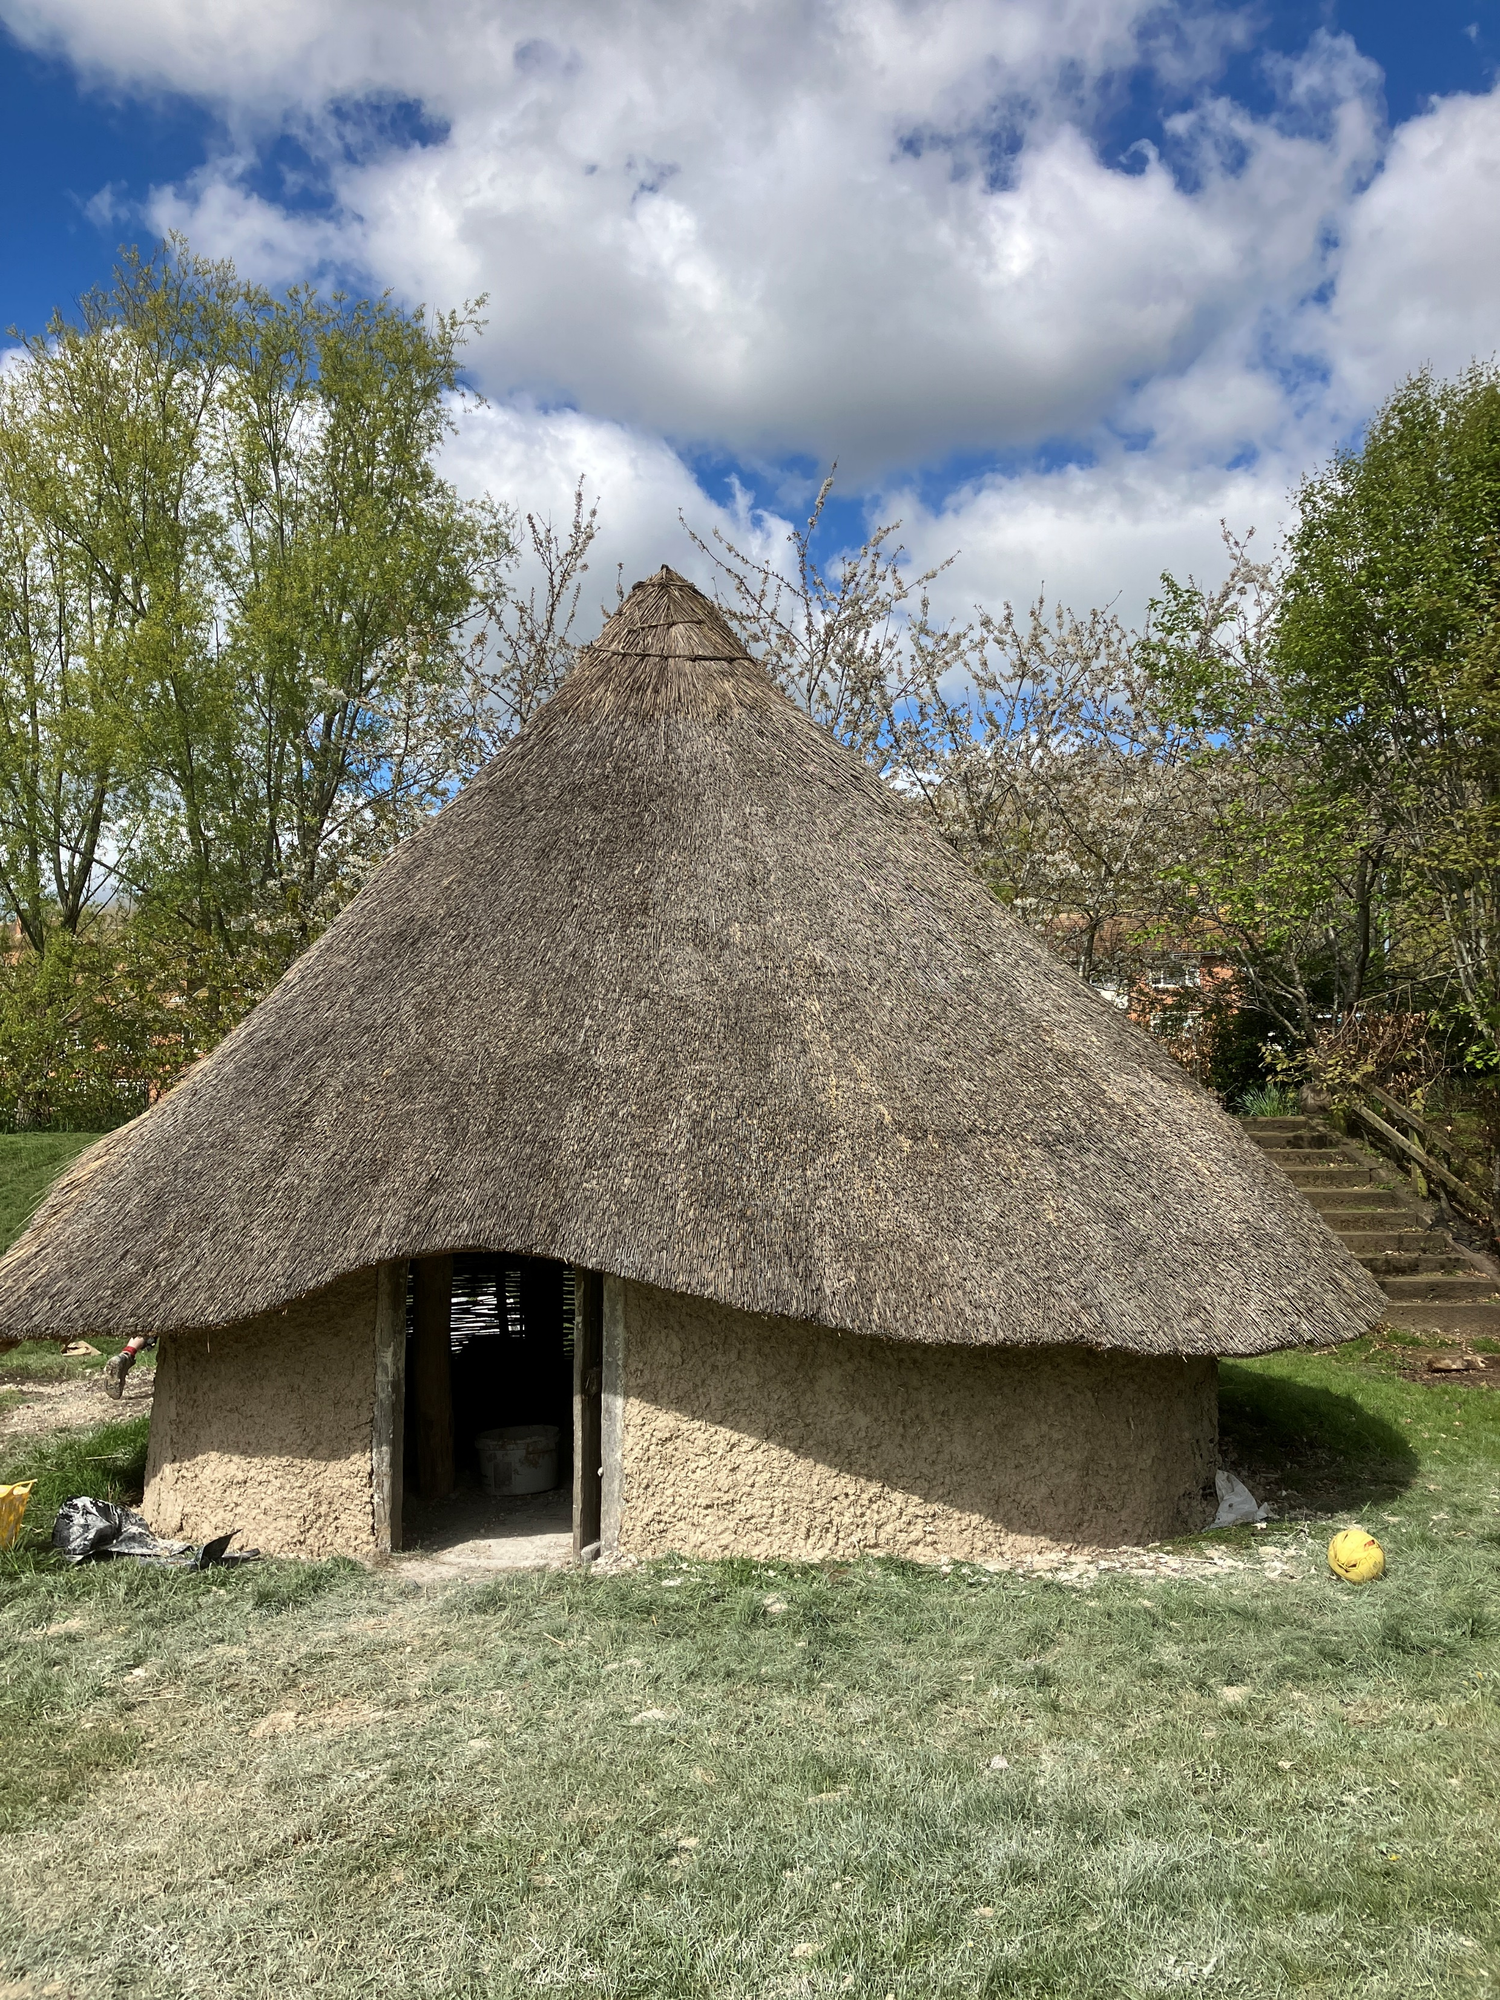




Ambassador School Launch Day
Moulsecoomb Primary School, Thursday 20th June
Moulsecoomb Primary School has been designated a South Downs National Park Ambassador School in recognition of the superb outdoor learning opportunities available in it’s grounds.
Schools in the city are invited to join the Ambassador School launch event on 20th June and find out how they can use the school grounds with their own classes.
We are offering 1 class from 6 Brighton & Hove primary schools to spend the day in the school and attend workshops focused around the Iron Age and Neolithic houses, WW2 Air-Raid shelter, Raingarden and South Downs National Park.
To find out more visit ………………………….Moulsecoomb Website or OCOW Website?
To book your place, email katie.eberstein@brighton-hove.gov.uk

