Slide 1
PROTECTING CHILDREN AND WILDLIFE FROM PESTICIDES
Josie Cohen
Head of Policy & Campaigns

Slide 2
Notes:
Concrete jungles, green deserts and ‘weeds’
Green cities, urban allotments, and pavement plants
Thinking of our urban spaces as diverse spaces: patchwork of solutions to manage plants.

Slide 3
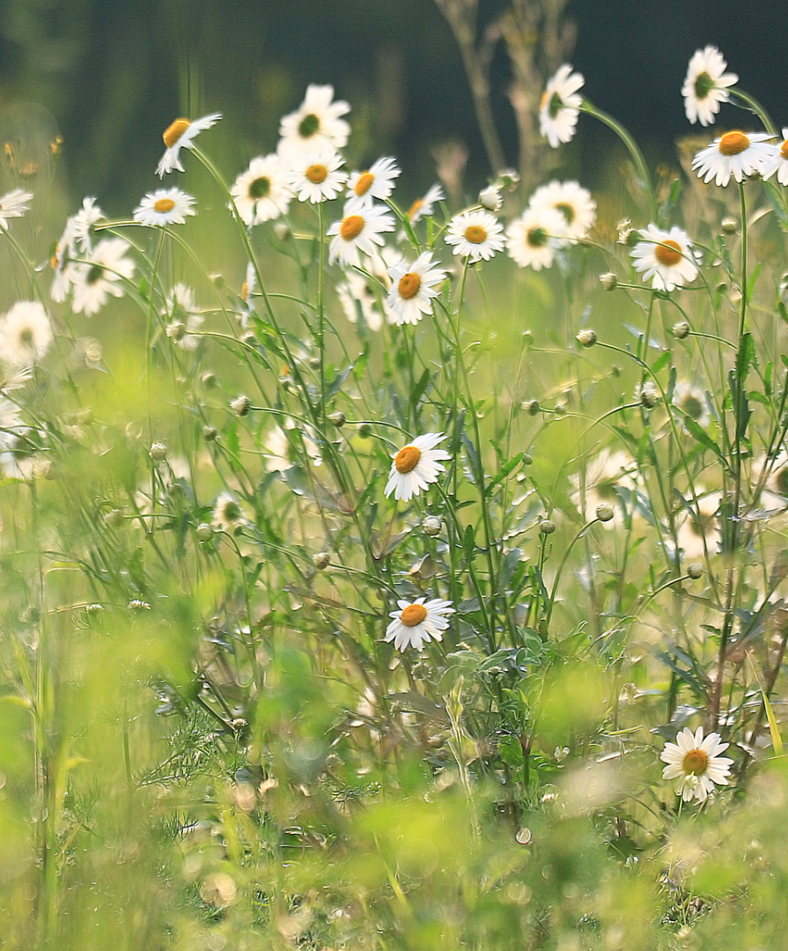
“It is ironic to think that man might determine his own future by something so seemingly trivial as the choice of an insect spray.”
~ Rachel Carson, Silent Spring, 1962

