Slide 1


Climate Action Planning
‘Your actions matter. No action or voice is too small to make a difference’
Vanessa Nakate
"There is an antidote to doom and despair. It's action on the ground, and it's happening in all corners of the earth.”
Christiana Figueres, UN Executive Secretary on Climate Change
(6 Nov 2024)
Katie Eberstein and Jonathan Cooper
Notes:
Beth – welcome from presenters

Slide 2

Agenda
Time | Session
9:00 | Arrival
9:15 | Introductions and Overview of OCOW
9:30 | The Climate Web
10:15 | Break
10:30 | Net Zero in Brighton & Hove
10:45 | Climate Action Plans + school emissions
12:30 | Lunch
13:15 | Count Your Carbon
13:30 | BHCC Officer Support
14:00 | Climate Action Planning – impact v ease v cost
14:00 | Climate Action Planning
15:15 | Next Steps + end by 3.30

Slide 3


Aims of Our City Our World
Develop an integrated environmental education curriculum gradually and systematically ‘greening’ the curriculum and supporting the development of green skills
Enable children and young people to develop a close connection with nature and our local biosphere
Create school organisational systems and practices which support sustainability and the school and regional Net Zero targets
Empower children and young people and their families to become changemakers both personally and collectively and inspire a strong sense of hope for the future

Slide 4

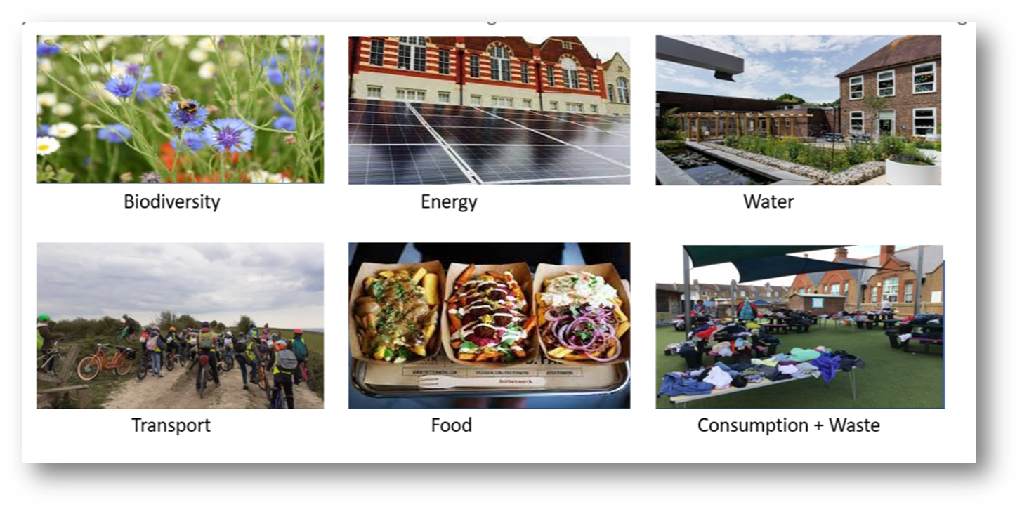
6 Themes

Slide 5

2 Year Rolling Programme
Curriculum
Concepts, Greening, Nature Connection
Theme 1
Assemblies
Actions
Theme 2
Assemblies
Actions
Theme 3
Assemblies
Actions
Theme 4
Assemblies
Actions
Theme 5
Assemblies
Actions
Theme 6
Assemblies
Actions
School Operations
Working towards Zero Carbon

Slide 6
The process
School Community
Training
Nature Connection
School
Surveys
Assemblies + Action
Local Authority
Local experts and organisations
Strategy Group
Net Zero Audits
Launch
Curriculum Review
Student and stakeholder voice

Slide 7
Strategy Group
Headteacher | Lead the vision and strategy Facilitate the delivery of OSOW
Governor | Ensure OSOW is on FGB and committee agendas Monitoring and evaluation
Senior Programme Lead | Lead and monitor the implementation of the framework alongside headteacher Coordinate training and establish links between the school, local organisations and Climate Action Advisors

Slide 8

Strategy Group
School Business Manager | Lead on the decarbonisation and procurement element of the Climate Action Plan and support work on biodiversity, adaptation and resilience Support the implementation of the framework through practical actions e.g. sending out surveys
School Site Manager | Provide practical support and advice to the School Business Manager around school operations, identify opportunities to reduce emissions and increase biodiversity in school buildings and grounds
Others e.g. parents, local community, local organisations, young people | Link schools, families and local communities Bring in expertise to enrich the strategy

Slide 9

















Our Schools, Our World
Who is involved?
Brent | Devon | Bedfordshire | Leicester | Suffolk | Brighton and Hove
Notes:
Katie/Jonathan

Slide 10


Slide 11


Slide 12
Climate Change Basics
CAUSE
CONSEQUENCE
Human Activity
Greenhouse Gases
Greenhouse Effect
Climate Consequences
Impact on the Planet
Impact on Humans
Impact on Biodiversity
SOLUTIONS ?

Slide 13

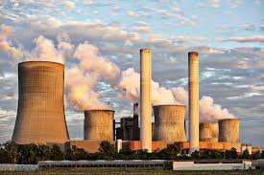

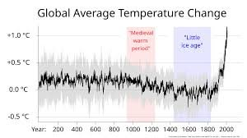


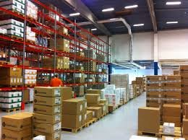
CAUSE
CONSEQUENCE
Human Activity
Greenhouse Gases
Greenhouse Effect
Impact on our Climate
Impact on the Planet
Impact on Humans
Impact on Biodiversity
SOLUTIONS ?

Slide 14

https://youtu.be/rWuKYuEOI9k

Slide 15


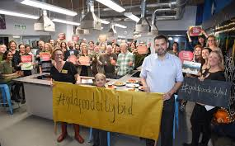
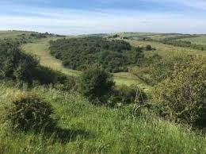

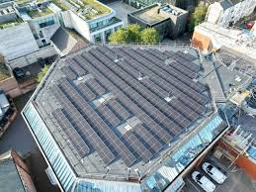
Good news stories from Brighton & Hove

Slide 16

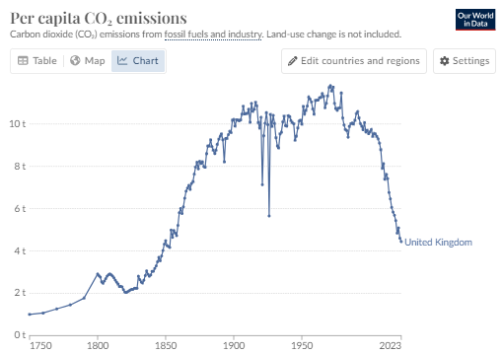
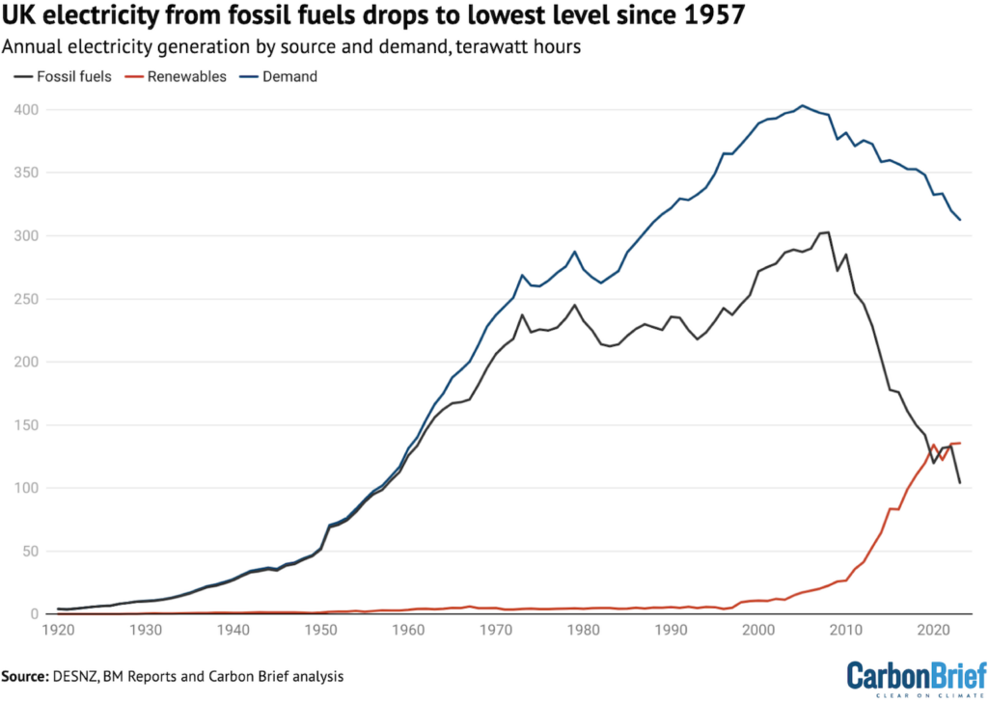
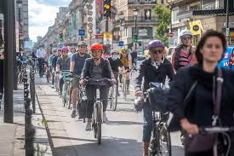
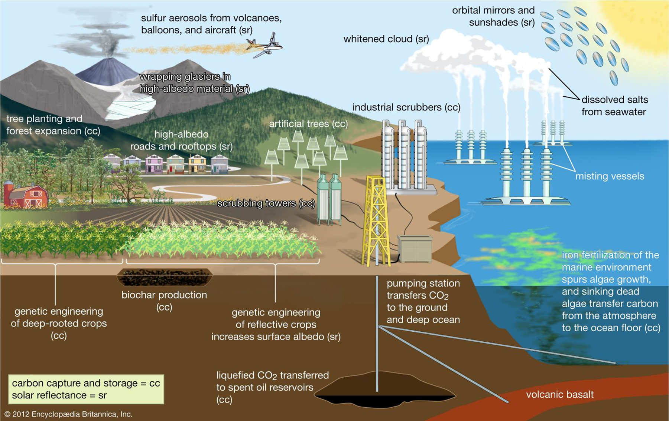

Reasons for optimism
Reasons for Optimism – nationally & globally

Slide 17

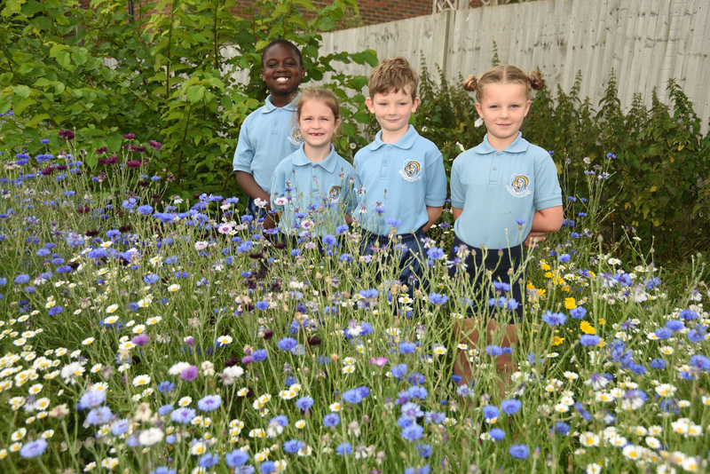
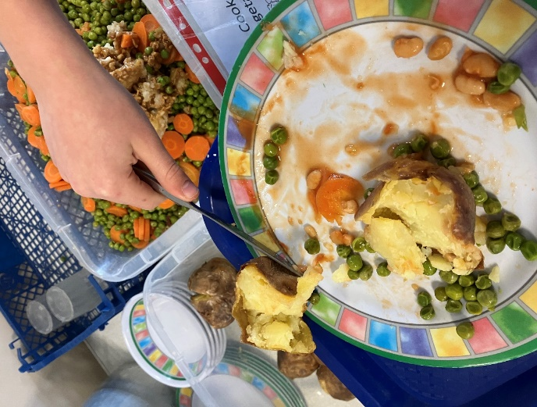
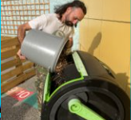
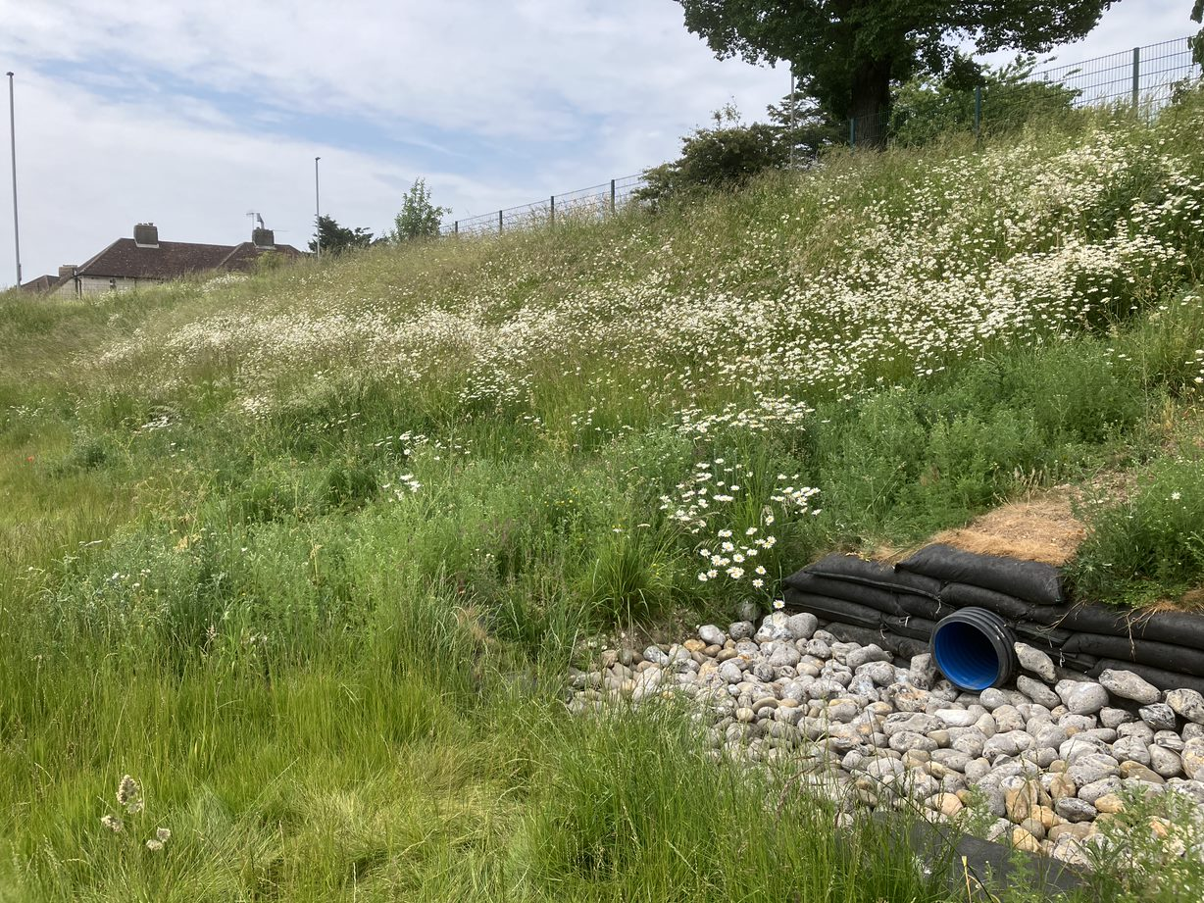

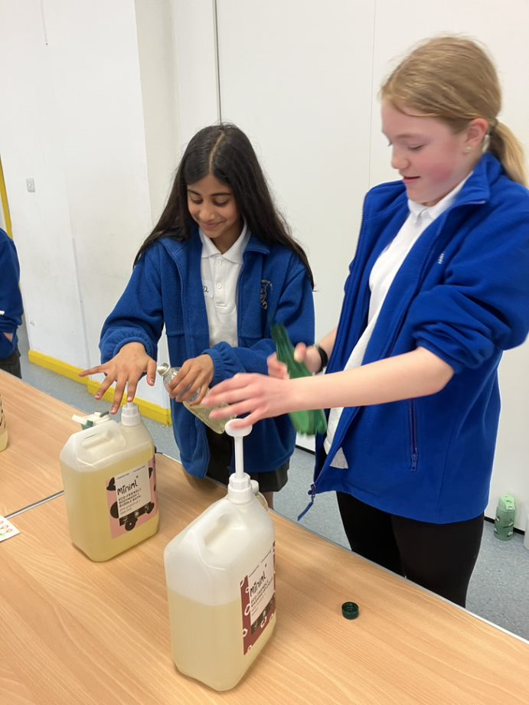
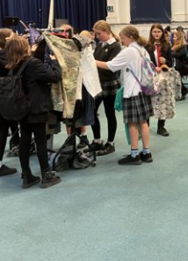
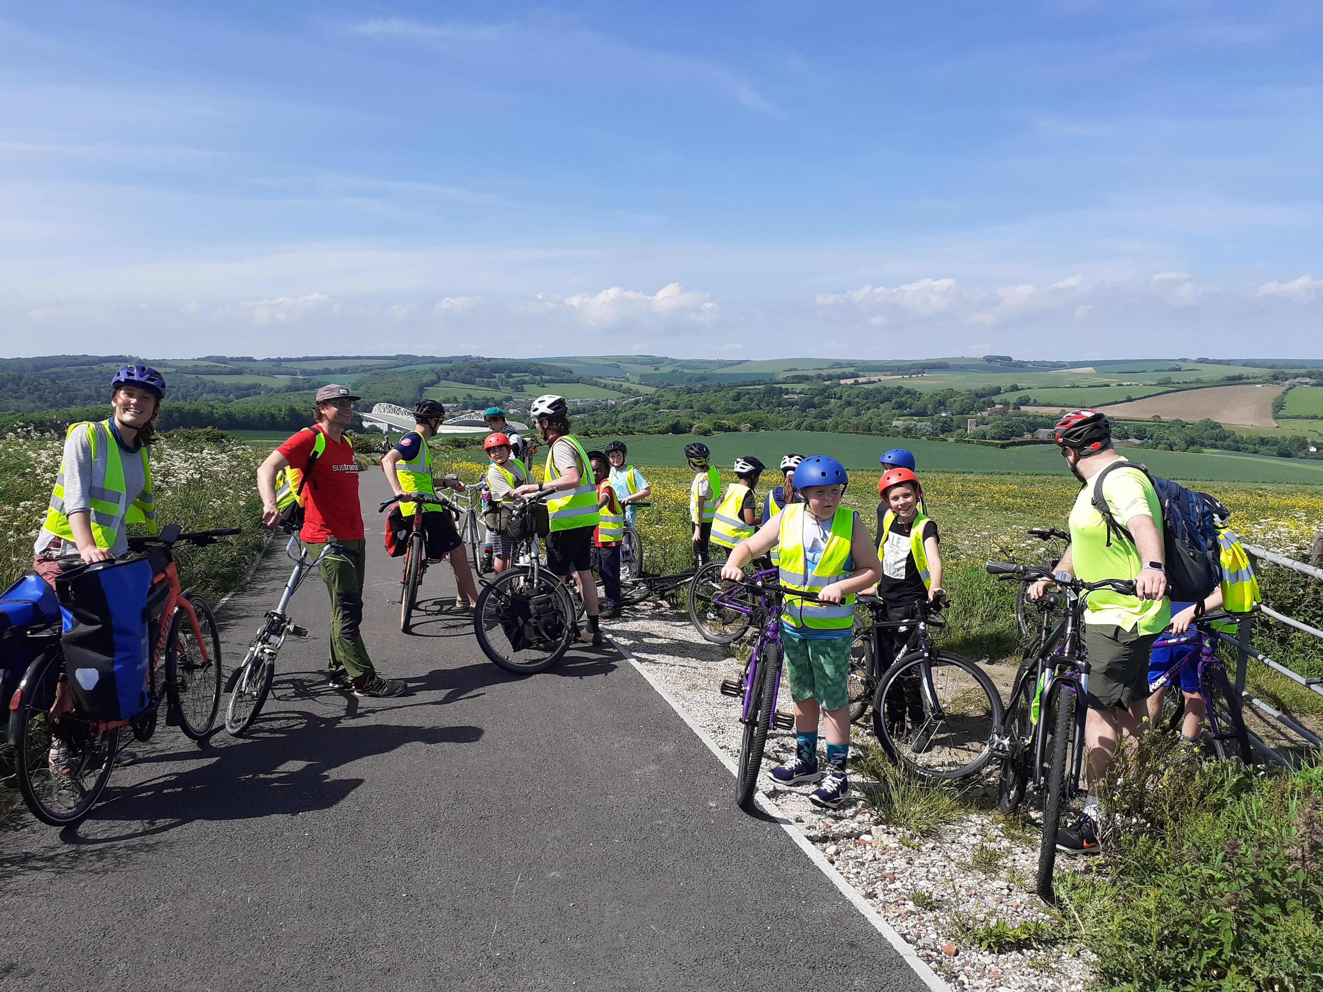
Positive action in our schools - sharing good news
Biodiversity Food Water
Energy Consumption & Waste
Transport

Slide 18
DfE Sustainability & Climate Change
Cllr Tim Rowkins
Cabinet Member for Net Zero & Environmental Services

Slide 19
Planning for Effective Action
Set ‘smart’ targets – balance of impact and ease
Roles and responsibilities
Education and understanding
Campaigning
Audit / establish baselines
Cultural, behavioural and operational change evaluated
SMART
Specific
Measurable
Achievable
Relevant
Timetabled
Action

Slide 20

A New Vision
What if…
Energy
Consumption and Waste
Transport
What if…
Food
Water
Biodiversity

Slide 21

DfE Sustainability & Climate Change
Sustainability and Climate Change Strategy
By 2025:​
All education settings will have nominated a sustainability lead
​
All education settings will have put in place a climate action plan
  decarbonisation
  adaptation and resilience
  biodiversity
  climate education and green careers

Slide 22
DfE Sustainability & Climate Change
Sustainability and Climate Change Strategy
By 2025:​
All education settings will have nominated a sustainability lead
​
All education settings will have put in place a climate action plan
  Decarbonisation – energy, transport, food, consumption & waste
  adaptation and resilience
  biodiversity
  climate education and green careers

Slide 23
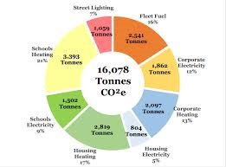
Decarbonisation - Energy
Carbon emissions in B&H

Slide 24
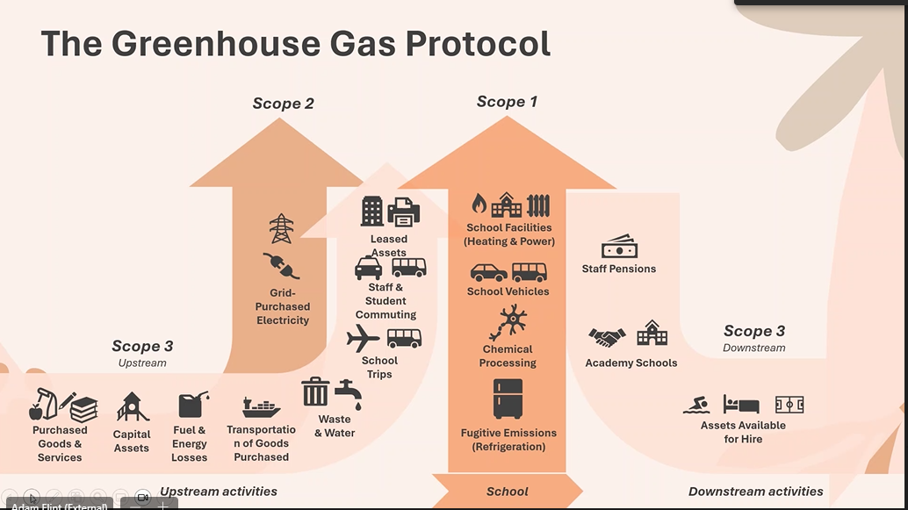
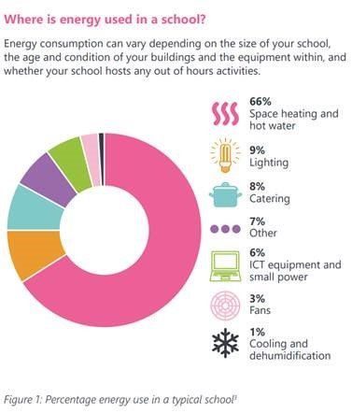
Decarbonisation – scope 1,2,3 emissions

Slide 25
Decarbonisation – School Emissions
Can you put the following in the correct order?
Transport
Food
Energy
Waste
Procurement
Lowest Emissions
Highest Emissions

Slide 26
Decarbonisation – School Emissions
Waste
Food
Energy
Transport
Procurement
1%
8%
23%
33%
36%
Lowest Emissions
Highest Emissions

Slide 27
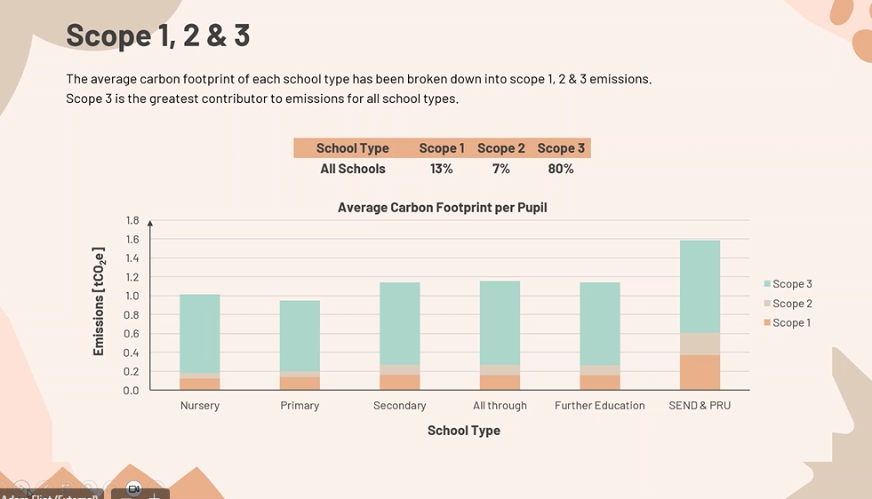
Scope 1,2 & 3 emissions

Slide 28
Decarbonisation Pathway Report
Brighton & Hove Decarbonisation Pathways Report
School | Page | Project
St Marks | 37 | Potential priority areas for non-domestic fabric retrofit projects
Downs Infant School St Nicholas | 49-50 | Non-domestic heat pump deployment priority projects
Downs Infants | 54 | Largest PV potential capacities
Contact: alice.berry@brighton-hove.gov.uk

Slide 29
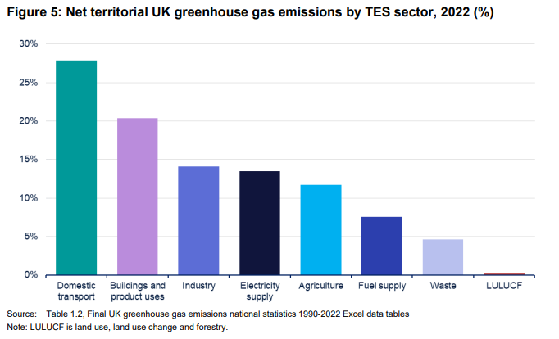
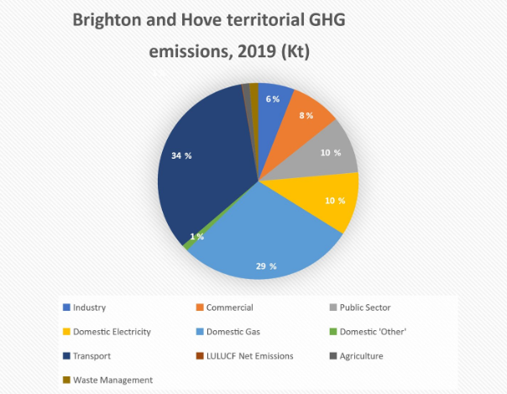
Decarbonisation - transport
What responsibility do schools have for emissions caused by journeys to school?​
What implications does this have for school trips?

Slide 30
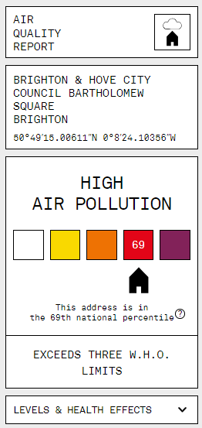
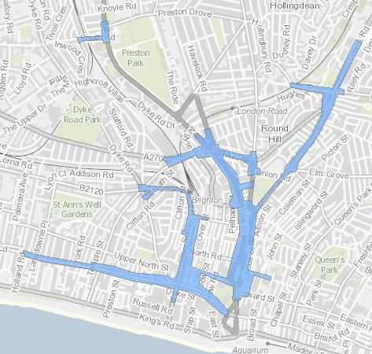
Decarbonisation – transport + air quality
175 early deaths per year
addresspollution.org

Slide 31
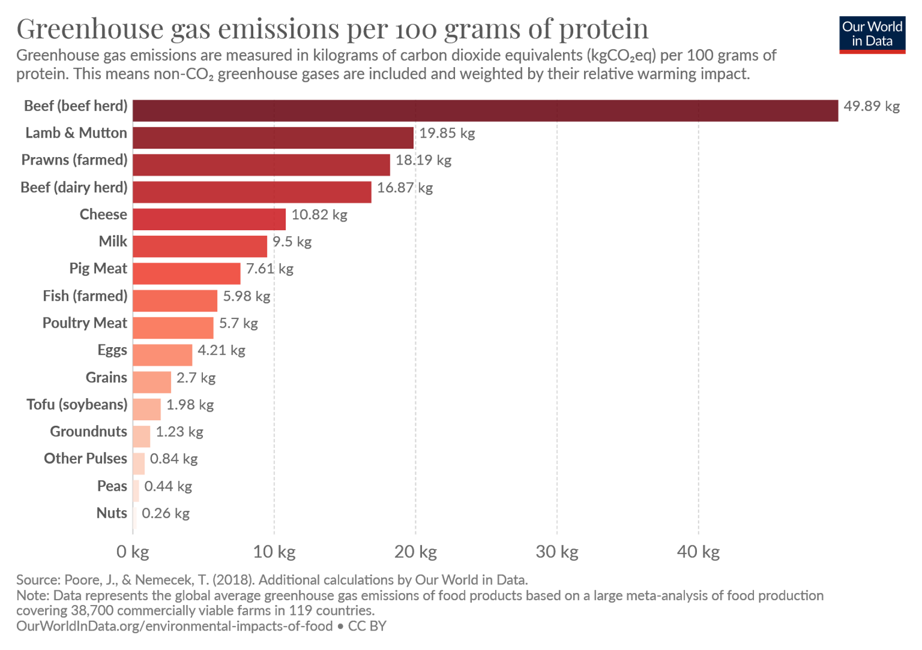
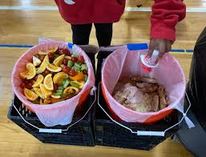
Decarbonisation - Food
Considering the GHG emissions of red meat and food waste
60%+ of food GHG
10%+of all human induced GHG
What questions should we be asking about our school food provision?

Slide 32
Decarbonisation - food
Caterlink – responsible food statement
Animal welfare
Sustainable diets
  Design menus to reflect the natural growing or production period for the UK, highlighting in-season produce on menus
  Avoid food transported by air
  Continue to nudge customers to making lower carbon, plant-based choices through menu placement and descriptions
  Ensure that plant-based and vegetarian menu choices are as attractive and appetizing as possible
  Ensure that our wrapped grab & go range of sandwiches, salads and desserts are no higher than 5% scoring below a C carbon rating
Deforestation – RSPO, BCI
Printing & packaging
Operations – waste<3% total cost. Divert 100% by 2030
Monitoring and communication
Does our present school food provision support a move towards greater decarbonisation?

Slide 33
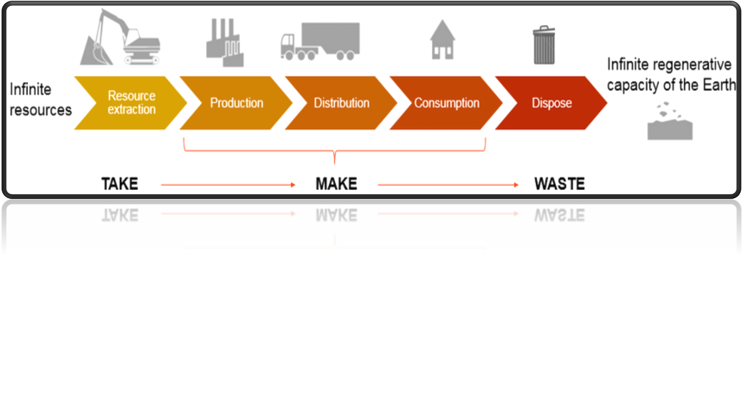



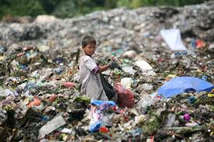
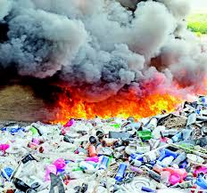
Resources

Slide 34
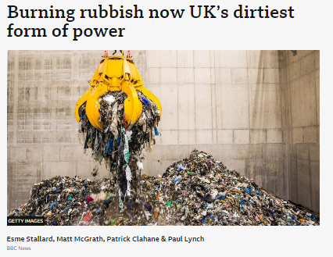
Our Schools Our World

Slide 35
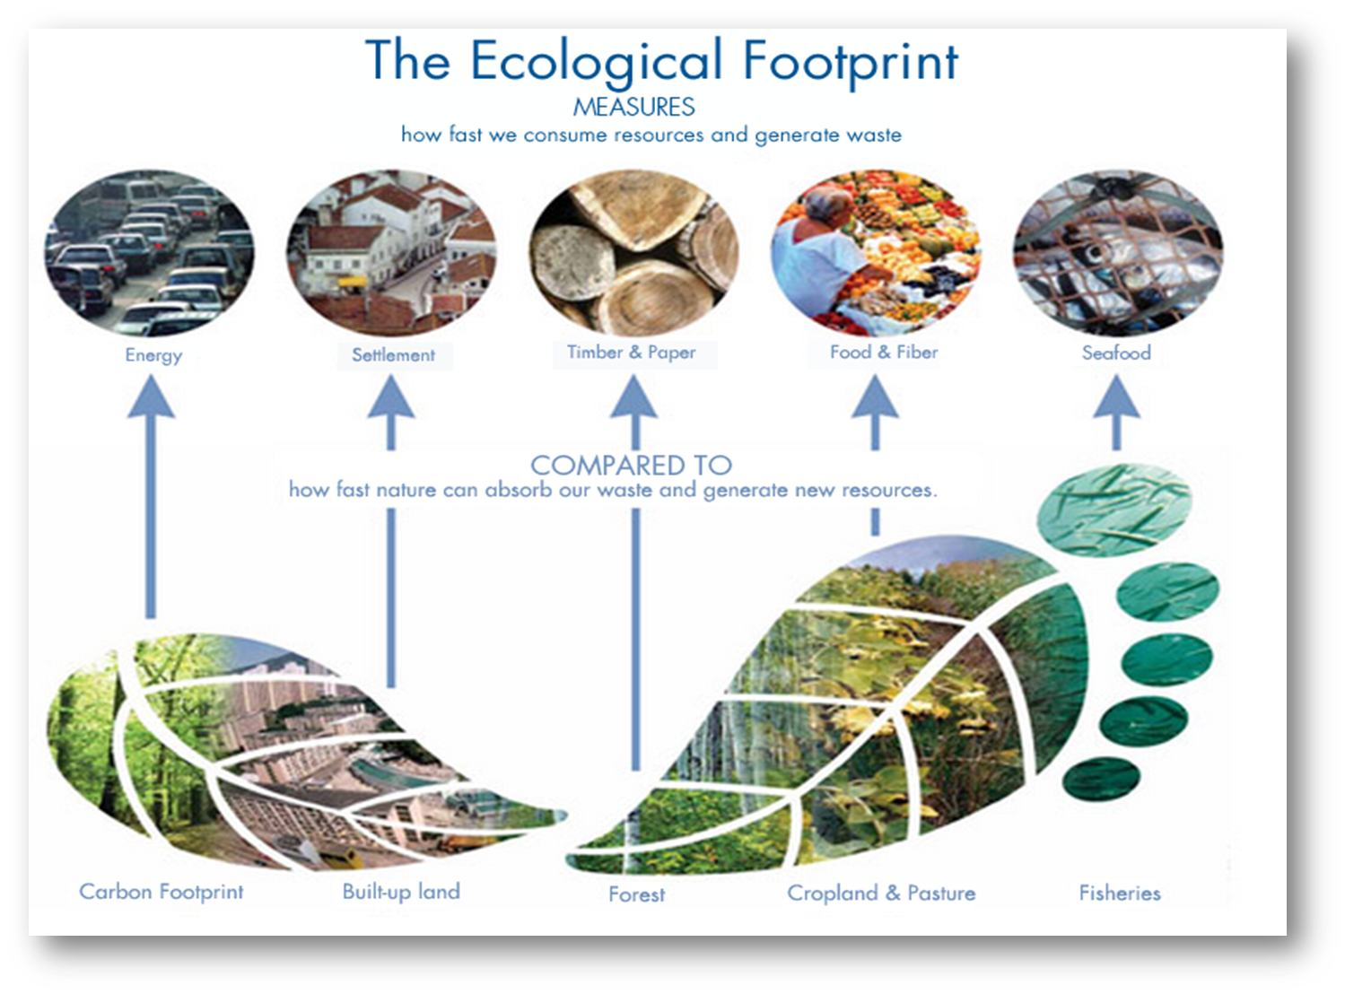
Procurement & Ecological Footprint

Slide 36
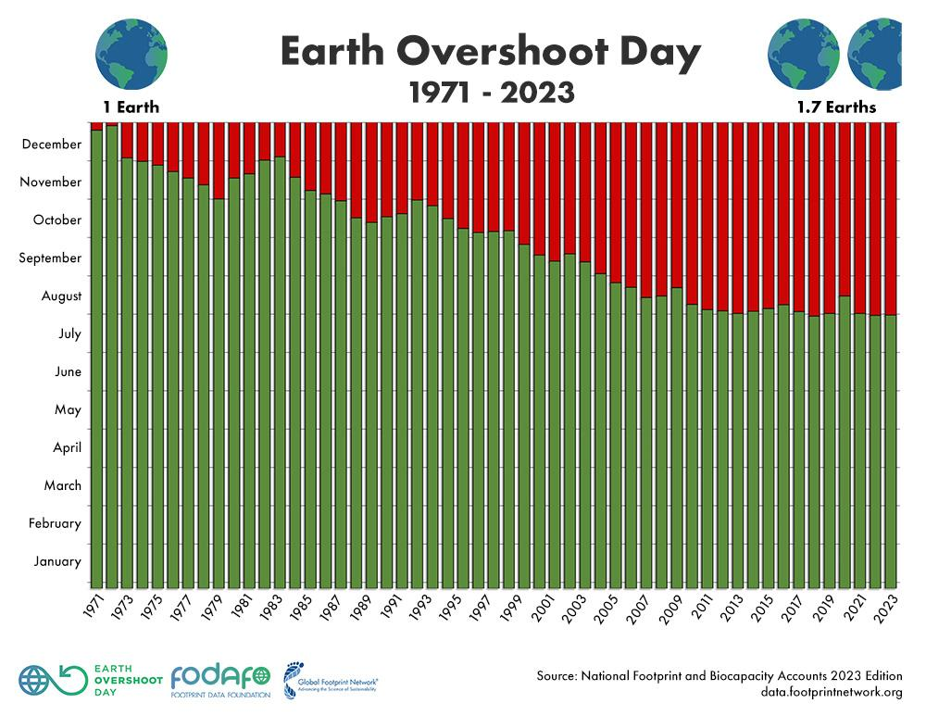
Earth Overshoot Day

Slide 37

A global perspective

Slide 38

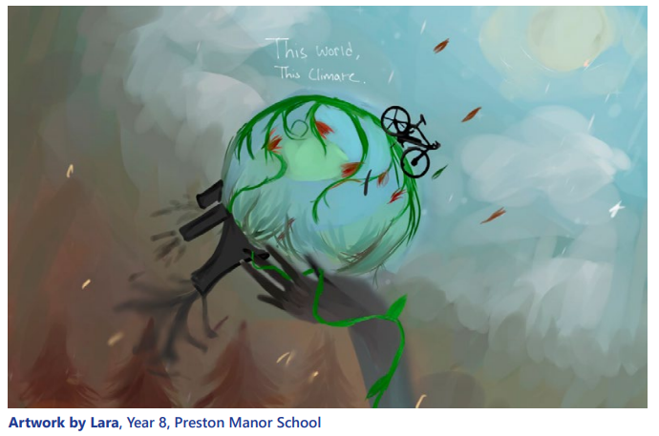
Our Schools Our World
Climate Basics – Climate Justice
Climate Justice
What does Climate Justice mean?
Climate justice is about acknowledging and addressing how disadvantaged or vulnerable communities around the world experience greater effects of climate change, even though they have contributed fewer emissions.
Notes:
Beth

Slide 39
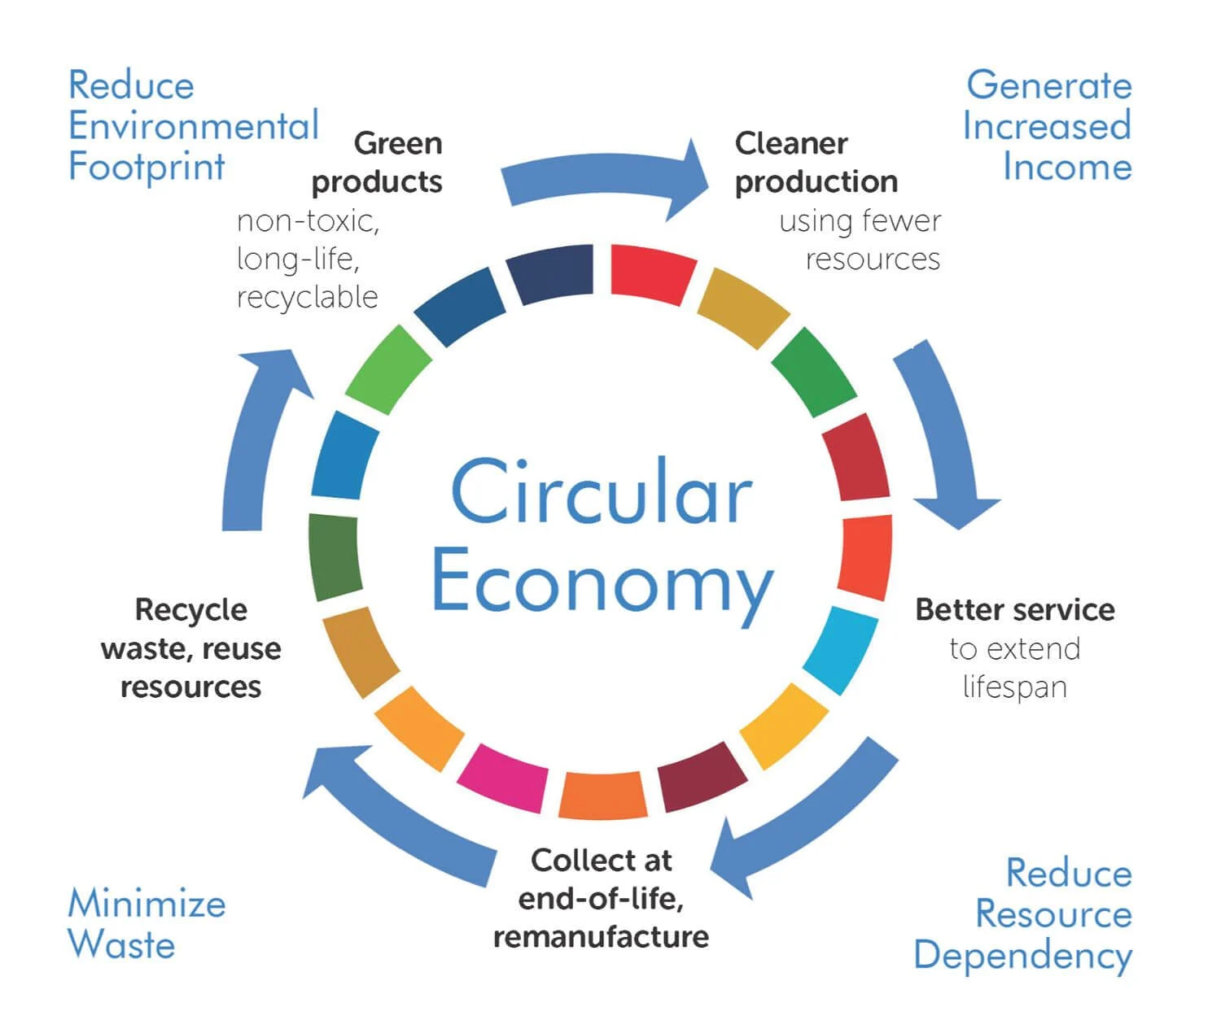
Circular Economy

Slide 40
Change Our Approach
1.REFUSE
2.REDUCE
3.REUSE
4.REPAIR
5.REPURPOSE
6.RECYCLE
7.RECOVER

Slide 41
Procurement
A good procurement decision
Initial cost
Greener product e.g. fair trade, energy efficient, recycled
Delivery
Running costs
Management/Servicing
Disposal
42% of school carbon emissions come from procurement

Slide 42
Procurement
Is your purchase necessary? What alternative solutions may be available?
  Sharing equipment or services with another school
  Taking from a local business
  Working in a different ways
  Reducing
  Reducing waste
  Reusing
  Repairing
  Repurposing
  Amnesty
  Extended warranties
Consider an audit e.g. a print audit
Could you gain from economies of scale by delaying short-term purchases where possible/sharing purchases with another school? Bundling together purchases from the same supplier can cut down delivery costs – less mileage means less fuel consumed to supply you.

Slide 43
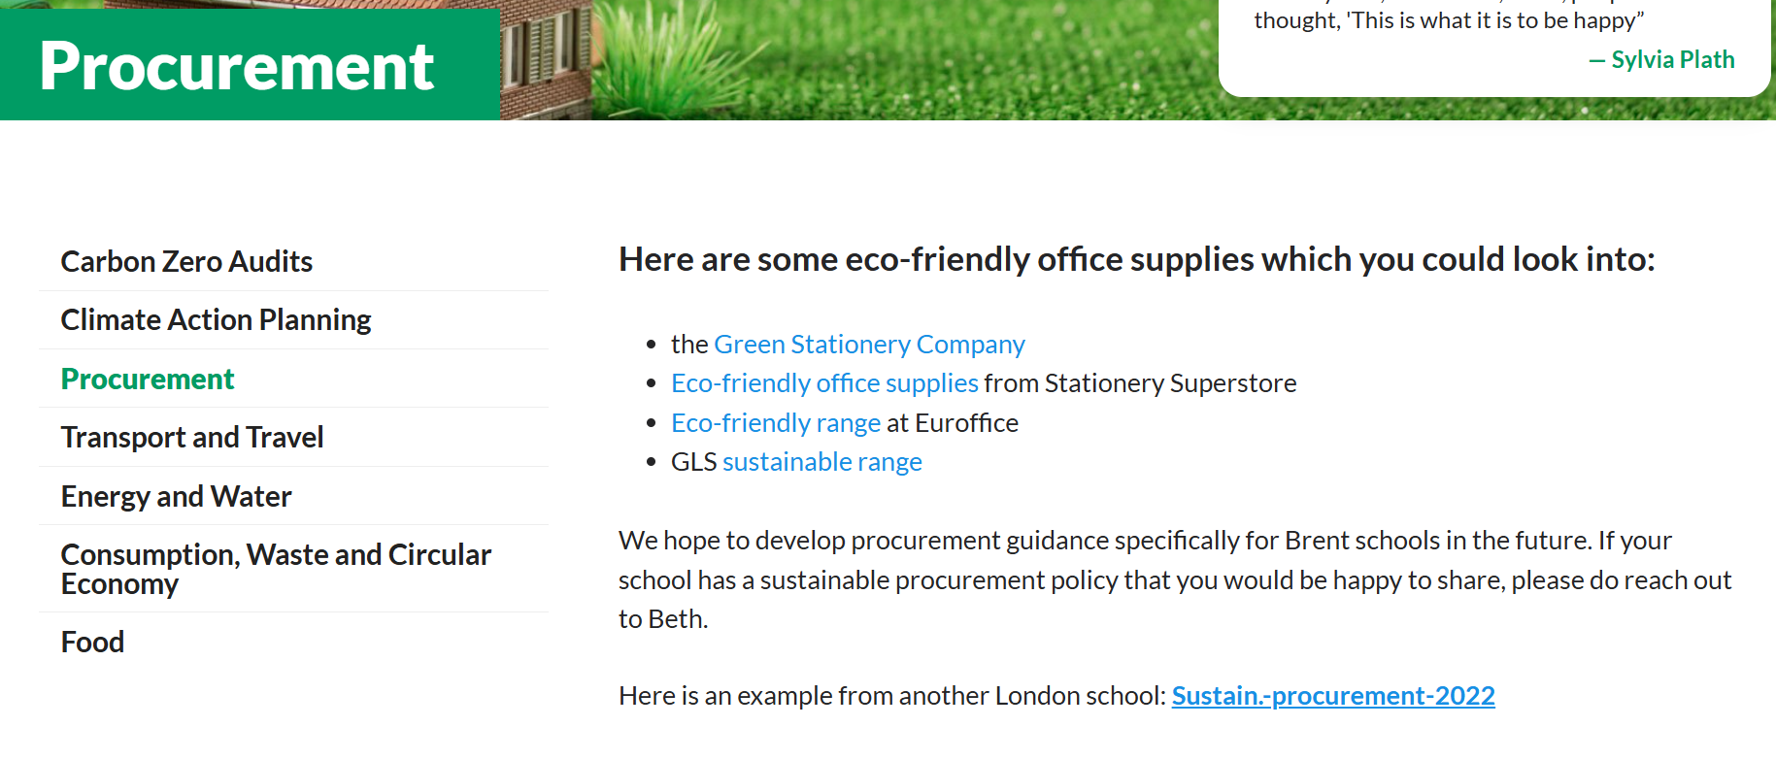
Procurement

Slide 44
DfE Sustainability & Climate Change
Sustainability and Climate Change Strategy
By 2025:​
All education settings will have nominated a sustainability lead
​
All education settings will have put in place a climate action plan
  decarbonisation
  adaptation and resilience - water
  biodiversity
  climate education and green careers

Slide 45
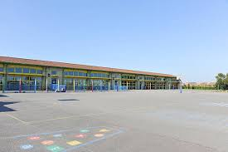
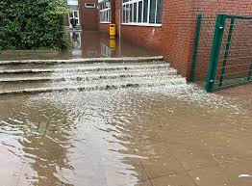
Adaptation & Resilience
Are our schools prepared for hotter summers and wetter winters?

Slide 46
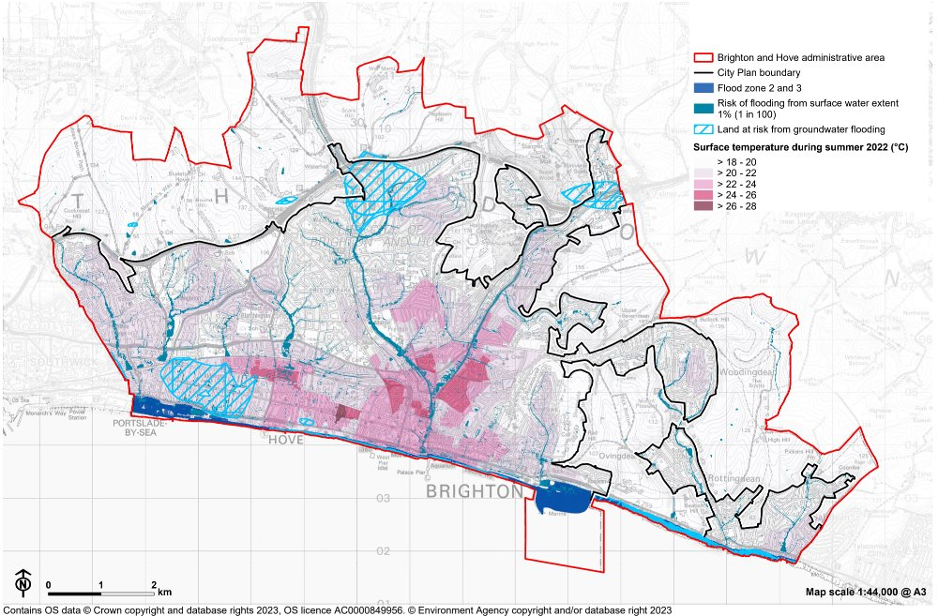
Adaptation & Resilience
Notes:
Explore the Climate of your Local Authority

Slide 47
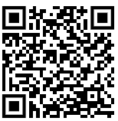
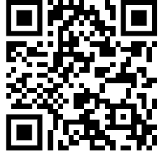
Adaptation and Resilience
Scan for UK Government flood risk map
Scan for UK Government heat risk map
Notes:
the long term flood risk for an area in England
the possible causes of flooding
how to manage flood risk

Slide 48
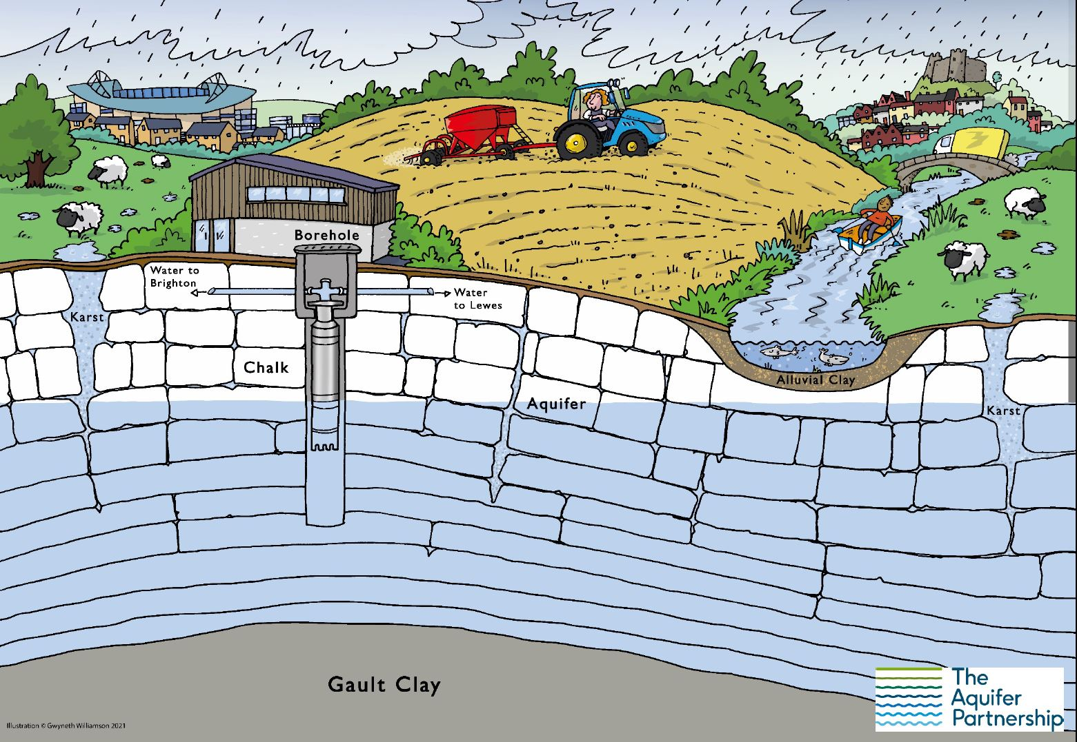
Adaptation & Resilience - Water

Slide 49
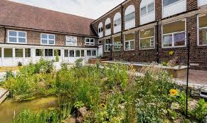
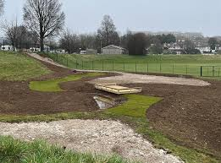
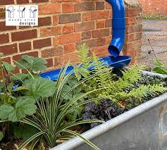
Adaptation & Resilience - Water
Other schools that suffer flooding internally or externally?
Collect photographs / evidence
Get in touch!

Slide 50
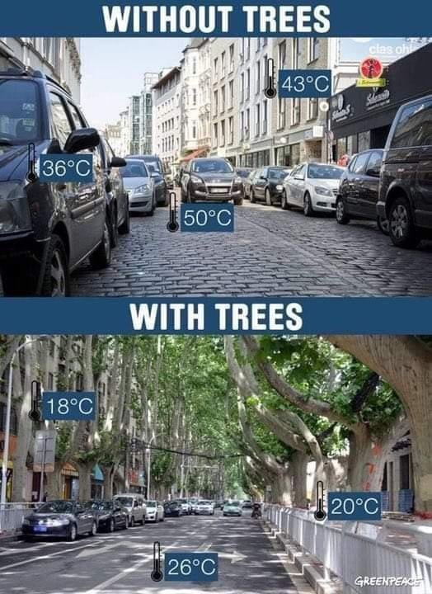
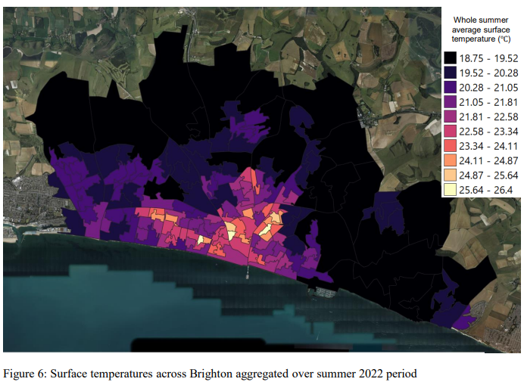
Adaptation & Resilience
Nature Based Solutions

Slide 51
DfE Sustainability & Climate Change
Sustainability and Climate Change Strategy
By 2025:​
All education settings will have nominated a sustainability lead
​
All education settings will have put in place a climate action plan
  decarbonisation
  adaptation and resilience
  biodiversity
  climate education and green careers

Slide 52
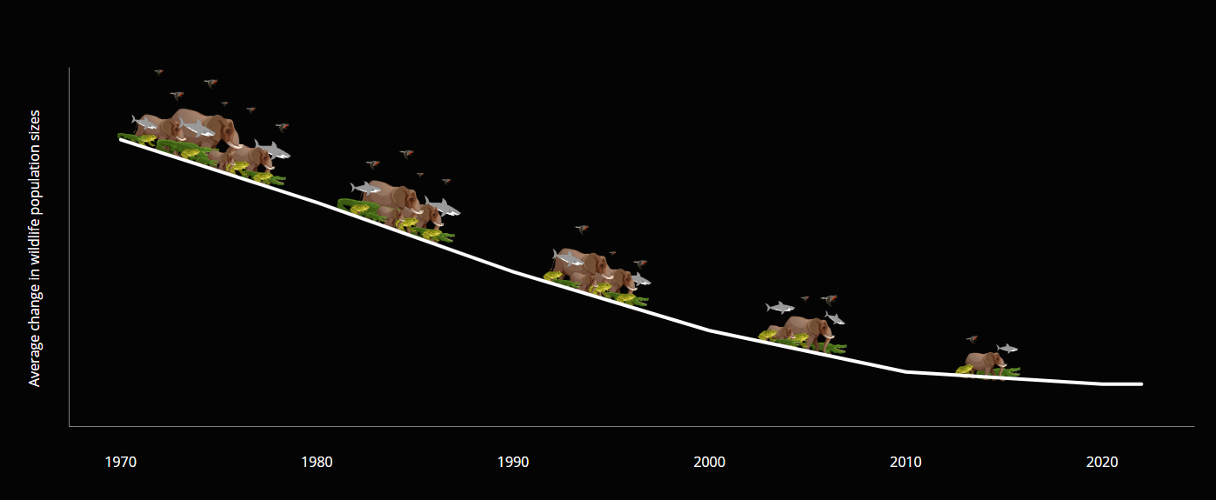

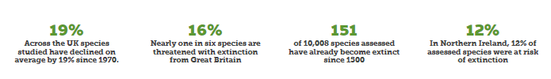
Biodiversity Loss – Living Planet Report 2024

Slide 53













Slide 54
DfE Sustainability & Climate Change
Sustainability and Climate Change Strategy
By 2025:​
All education settings will have nominated a sustainability lead
​
All education settings will have put in place a climate action plan
  decarbonisation
  adaptation and resilience
  biodiversity
  climate education and green careers

Slide 55

Climate Education & Green Careers
www.ourcityourworld.co.uk B&Hocow2022

Slide 56
Decarbonisation – opportunity for pledges
Waste: Remove single use plastics from our classes, staffroom, catering operations and school events
Food: Promote a lower emissions menu, a greater plant-based offering and a significant reduction in food waste
Energy: Reduce carbon emissions from energy by 20%
Water: Reduce water use by 20%
Biodiversity: Increase the amount of land given over to supporting biodiversity by 10%
Transport: Reduce staff car travel to school by 20% (one day less a week)
Leadership: Track carbon emissions using the Count Your Carbon tool

Slide 57


Our Schools Our World
Support - National
Let’s Go Zero
The national campaign for all schools, colleges and nurseries to be zero carbon by 2030.
4,200+ schools
Climate Action Advisors

Slide 58














































How we work with schools
Initial meeting
with designated Climate Action Advisor (CAA)
Sustainable Leadership established within school
School
contacts
Let’s Go Zero
to request support.
Recommended actions, templates, guides, advice about potential funding and local and national support schemes.
Site visit or virtual audit
CAA
gathers information about school
School decides
what to include
in their Climate Action Plan
CAA provides Sustainability
Report
and supporting resources.
School’s
carbon emission baseline calculated by CAA.
Repeat steps
4-10 each year
School
celebrates and communicates actions and achievements
School
takes action
and measures progress
against targets
CAA checks
in regularly
to provide
additional
support.
Share successes and engage with others
Notes:
Briefly describe the journey for how Climate Action Advisors support schools.
Key message is our provision of bespoke support to schools, meeting them where they're at in their sustainability journey and supporting them to not only meet DfE's expectations but also achieve their emission reduction targets and overall sustainability goals.

Slide 59


National Support - Energy
Energy Sparks
energy management tool, which monitors energy use and provides bespoke, simple low / no-cost recommendations, provided weekly.
Costs £545 a year - but the average primary school saves £3,000 per year (some free places)
Learning opportunities through interactive pupil dashboard and education programme
Tailored induction webinars for range of school staff.
Set targets and track progress. Score points and compete with other schools.

Slide 60


£100 a week saving
£300 a week saving
£200 a week saving

Slide 61


Slide 62


Local Support - Energy
Brighton Energy Cooperative BHESCO

Slide 63


National Support - Transport
Workplace Charging Scheme for state-funded education institutions enables schools to apply for grants to cover 75% of the cost to buy and install chargepoints.
Funding is confirmed until 31 March 2025. Eligibility criteria applies.
See guidance for more information.
Installers can enable different tariff rates for staff and members of the public.
A national awards scheme that recognises schools, businesses and other organisations that have shown excellence in supporting cycling, walking and other forms of sustainable and active travel.
Provides comprehensive toolkit that assists in developing, implementing and monitoring/evaluation Travel Plans.
Free for schools to participate! Schools automatically have a brand new national standard School Travel Plan upon completion of application.

Slide 64


National Support – Consumption & Waste
From 31 March 2025, all schools must collect and recycle food waste and key recyclable materials.
Support for getting your school ready
Food Waste Recycling - food waste can no longer be placed in general waste bins or mixed with other recyclable materials and must be put into a specific food waste container for collection.
Mixed Recycling - schools must recycle paper. cardboard, plastic (bottles, containers, tubs, trays), metal, glass
Pupil led campaign to eliminate SUP in schools and empower children with campaigning skills

Slide 65


Local Support - Water
Southern Water
Free water audits
Free water butts
Visits to water treatment center (Peacehaven)
4000+ litres day = 1.135 million litres year

Slide 66






National Support - Biodiversity

Slide 67
Biodiversity – funding
South Downs National Park – Re-Nature Fund for Schools – 75 x £1000
Learning Through Landscapes – Local Nature Grant - £500 + training
National Education Nature Park - £10,000 - lower-layer super output area (LSOA) in category 1 of Natural England’s (NE) accessible natural greenspace inequalities indicator
National Education Nature Park – funding guide
Free trees and hedgerows – Woodland Trust and see NENP guide

Slide 68

Our Schools Our World
Biodiversity – Grey to Green

Slide 69
Biodiversity – Pesticide Free Schools
Pesticide Free School model policy
Step by step guide
Resources for pupils and families
Individual support for schools available

Slide 70





National Support - other
https://ops.ukssn.org/

Slide 71


Scan here for Climate Action Advisor support:
Get started by completing our expression of interest form at letsgozero.org/climate-action-advisors
Let’s Go Zero is a campaign led by Ashden,
and supported by Green Future Investments Ltd.
All content © 2024 Ashden. Registered number: 05062574, Charity number: 1104153.
www.letsgozero.org
charity no: 1104153

Slide 72
Lunch

Slide 73

Climate Action Plans
Adam Flint – Keep Britain Tidy

Slide 74
2 Year Rolling Programme
Curriculum
Concepts, Greening, Nature Connection
Theme 1
Assemblies
Actions
Theme 2
Assemblies
Actions
Theme 3
Assemblies
Actions
Theme 4
Assemblies
Actions
Theme 5
Assemblies
Actions
Theme 6
Assemblies
Actions
School Operations
Working towards Zero Carbon

Slide 75
O
Climate Actions
Cost - circle
Impact
Ease
Can you share any other actions?

Slide 76


Who am I?
Juliet Evans
Waste Minimisation Officer
Environmental Services:
Waste and Recycling collection
and street cleaning

Slide 77

what do I do?
Raise awareness of Recycling Right
Increase Recycling
Reduce Contamination (wrong stuff)
Engagement
Communications & website
Work towards waste reduction

Slide 78






Brighton & Hove Recycles

Slide 79



Currently BHCC only collect 7 items for recycling:
Plastic Bottles (clean, lids, pumps, triggers on)
Food tins (clean)
Drink cans (clean)
Aerosols (empty)
Cardboard (clean, flattened)
Paper (dry, not shredded)
Separately:
7. Glass (clean, metal lids on)
Recycle Right: keep it clean, dry and loose!

Slide 80









Putting the right stuff in the right bin is important
Everything else in recycling is Contamination!

Slide 81


Contamination Jan 21 – Mar 24
33% waste & black bags of waste
11% Glass
31% is cartons / tetrapak, pots tubs and trays, other plastic packaging and film

Slide 82





Face to face engagement
Recycling Week October
Churchill Square & The Open Market
Fabuloso – Pride in the Park - August
Housing Conference for Council Housing Residents October

Slide 83








Pride in the park – Photo Frame!

Slide 84



Why do we Recycle?
A recycled aluminum can saves enough energy to run a tv for 3 hours
Recycled drinks cans from old products uses 95% less energy than making it from scratch.
Save Energy & Resources
(raw materials)
25 plastic bottles could make a new fleece top
Recycling one glass bottle saves enough energy needed to recharge your smartphone over 6 times

Slide 85


Recycling & Sustainability
Through the process of recycling some materials deteriorate to the point they can no longer be recycled.
We can think of this as having a number of lives before it essentially dies (usually incinerated / burnt for energy production).
PAPER - can be recycled 7 to 9 times
CARDBOARD - can be recycled 7 to 9 times
DRINK CANS - for ever . . . infinity
FOOD CANS - for ever . . . infinity
AEROSOLS - for ever . . . infinity
GLASS BOTTLES & JARS - for ever . . . infinity
PLASTIC BOTTLES - can be recycled just 1 to 2 times
Reuse as much as possible before recycling…

Slide 86

Recycling is good but we can do better!
Image courtesy of Out of the Box Creative Arts / Carden Primary

Slide 87



Hierarchy of Waste
More
Less
Rethink
Refuse
Reduce
Reuse
Repair
Repurpose
Recycle
Recovery

Slide 88



What happens to our recycling in Brighton & Hove?
Mixed recycling and glass
Hollingdean Materials Recovery Facility (MRF)

Slide 89

What happens to our household waste in Brighton & Hove?
Newhaven Energy Recovery Facility (ERF)
It processes approximately 210,000 tonnes of waste per year.
The facility converts waste unsuitable for recycling into over 19. megawatts of electrical energy - enough power to supply 25,000 homes.
The electricity produced is then supplied to the National Grid.

Slide 90



What happens to our Garden waste in Brighton & Hove?
Woodlands In-Vessel Composting Facility
Creates compost for gardening and soil improver for farmers
When we have food waste collections this will also go here

Slide 91
Simpler Recycling – Schools and Businesses
Legislation:
Simpler recycling: workplace recycling in England - GOV.UK,
Guides:
Business of Recycling | WRAP
Guide: Simpler Recycling and food collections - preparing for change
BHCC is able to offer increased services from 1st April 2025
Environment Act 2021Simpler Recycling legislation requires that all businesses (excluding micro-businesses with fewer than 10 fte employees) will be required to have implemented appropriate arrangements for the collection and disposal of:
A core set of materials; plastic, paper and card, glass, metals (cans, tins & foil), cartons
Food Waste – collected weekly separated from general waste
BHCC customers will be able to include within their existing mixed recycling containers:
Aluminium foil and foil food trays
Cartons / Tetrapak
Pots, tubs and trays (PTTs)
In order to receive a quotation for food waste collections, please email the commercial waste via: commercial.waste@brighton-hove.gov.uk

Slide 92
CHANGES in RECYCLING in 2025!
Additional Materials will be added to 'dry mixed recycling’ in Spring
Pots, tubs and trays
Foil and foil trays
Cartons / Tetrapak

Slide 93



CHANGES in RECYCLING in 2025!
38% of Brighton and Hove bins is Food Waste!
Food Waste Collection Service will start later this year

Slide 94
But for now, stick to these 7:
Plastic Bottles (clean, lids, pumps, triggers on)
Food tins (clean)
Drink cans (clean)
Aerosols (empty)
Cardboard (clean, flattened)
Paper (dry, not shredded)
Separately:
7. Glass (clean, metal lids on)
And Remember to Recycle Right:
keep it clean, dry and loose!

Slide 95


Questions?
?
?
?
?
?
?

Slide 96
Legislation:
Simpler recycling: workplace recycling in England - GOV.UK,
Guides:
Business of Recycling | WRAP
Guide: Simpler Recycling and food collections - preparing for change
And the videos of the 3 facilities:
• Hollingdean MRF – Materials Recovery Facility – sorts dry mixed recycling. Glass also goes here in a separate area.
• Woodlands IVCF – In-Vessel Composing Facility – garden waste goes here and food waste will too when it starts later in the year.
• Newhaven ERF – Energy Recovery Facility – household waste is burnt to create energy. Around 0.5% of our waste goes to landfill each year the rest goes here. It’s not the perfect solution by any means and makes it all the more important to reduce, reuse and recycle as much as possible…

Slide 97

Our City Our World
Energy & Water Update
Energy & Water Team

Slide 98



Water Saving
AMR Devices
Rollout of Automatic Meter reading devices underway across priority sites.
Half-hourly data should allow us to identify wastage usage and leaks before they show up on billing.
Monitoring software allows us to set profile alarms that raise issues if consumption falls outside of normal parameters.
Southern Water Funding Streams
Water Saving Audits – Southern Water
Could your business benefit from installing a water butt?

Slide 99

EV Charge Point Funding – Deadline 31st March 2025
Government offering funding to install electric vehicle charge point sockets at school sites.
Installations usually cost around £1,500 to £2,500, depending on the area and type of installation.
You can get 75% off the cost to buy and install charge points up to a maximum of:
    £2500 Per Socket
    Maximum of 40 sockets
Please note that site surveys must be carried out by an installer prior to making an application.
Successful applicants will then receive a voucher that is valid for 180 days from the date of issue.
Brighton & Hove City Council’s EV team are able to assist with any queries and advise on this scheme – they can be contacted directly by emailing: electric.vehicles@brighton-hove.gov.uk.

Slide 100

Energy & Water Web Portal
Available to all Schools that sign up to the Energy Management Service through BEEM.
Energy Manager Live - Log In
Logins sent to all Business Managers, Site Managers and Caretakers
Can also be sent to Eco-coordinators for use in curriculum learning
Allows users to Analyse Energy Usage, Run various reports, View financial information, Target setting, Submit manual meter reads.

Slide 101

Carbon Reduction Opportunities Report
Energy & Water Team are in the process of preparing a bespoke report for each school building detailing:
  Summary of Identified Projects, including estimate cost, payback, Energy & CO² savings.
  Breakdown of energy consumption and emissions and any savings achieved.
  List of guidance documents, contacts and useful links around how to best to progress energy efficiency work.

Slide 102
Contacts
Useful Links
Kelvin Newman
Energy & Water Manager I Property & Design Kelvin.newman@Brighton-Hove.gov.uk
Aazita Eghbal
Carbon & Utilities Project Manager I Property & Design Aazita.Eghbal@Brighton-Hove.gov.uk
EWT Inbox
EWT@Brighton-Hove.gov.uk
Schools Energy Efficiency Guidance
Energy efficiency: guidance for the school and further education college estate - GOV.UK (www.gov.uk)
DFE Additional Capital Funding
Investment to shield schools from high energy bills and boost to budgets
EV Charging Scheme
Workplace Charging Scheme for state-funded education institutions - GOV.UK.

Slide 103
Support for Sustainable and Health Food – Public Health
Public Health Schools can support schools to work towards their Our City Our World aims in a number of ways around consuming more sustainable, healthy foods and reducing food waste. Please see some of our current opportunities below, and please do encourage any schools with questions to email ph.schools@brighton-hove.gov.uk
School Food Ambassadors
More info and book here: School Food Ambassadors | BEEM
New project for pupils to feed into the school meals system, reduce food waste and improve the school dining experience. Supported by a toolkit and PowerPoint lesson plans. All resources available on Padlet. Free training on Teams over two 1-hour sessions. Delegates should attend both sessions.
Session 1: Wednesday 30 April 2025, 4.00-5.00pm. Session 2: Wednesday 7 May 2025, 4.00-5.00pm
Taste Fund: £100 grant to buy fruit and vegetables for activities promoting healthy eating
More info: Taste Fund: Small grants to support with healthy eating activities | BEEM
Public Health Schools is offering small grants for schools to purchase fruit and vegetables for projects that encourage pupils to taste and have positive experiences of fruit, vegetables and other plant-based nutritious foods.
Examples of eligible projects:
Fruit and vegetables to run TastEd sessions for a year group
Plant-based cooking sessions for pupils or families
Healthy Eating Week event
Purchasing Veg Power materials to use in school
TastEd: Free resources to support children to try new fruits and vegetables
Link: Primary School Resources | Taste Education
TastEd is has a lot of really helpful resources and session plans to encourage children to try new fruits and vegetables. The sensory food education model provides a safe and fun way for children to develop a positive relationship with healthy foods. These resources would be great to use with pupils in terms of trying the fruits and veg that you grow. We had a training session this year and had great feedback from the schools who attended- we will possibly run this training again next year. In the meantime, you can create a free account on TastEd and access all of their resources.

Slide 104
Billy Vickers
School Travel Advisor
Hello :)

Slide 105
Council-wide corporate
What I can do to support:
Work with you on your School Travel Plan
Assist with transport/active travel related questions/enquiries
Help with any cycling/scooting events you want to do
Provide resources/information

Slide 106

Council-wide corporate
School Travel Plans
Document unique to each school site
Lists issues around school
Lists actions the school is doing/will do to combat the issues
Designed to increase active travel
Notes:
A STP is a comprehensive document created by the school to promote safer, more active and sustainable travel to and from school. It outlines strategies to reduce the number of cars on the road and encourages alternatives like walking, cycling, scooting and public transport.
Key goals:
Reduce traffic congestion – less cars around school means less localised pollution and increased safety for the children and parents. Encourage park and stride. Children are disproportionately negatively impacted by car exhausts both inside and outside cars. 1 in 4 cars on the road in the morning are on the school run.
Promote physical activity – walking, cycling and scooting are great ways for children and adults to get exercise. Even 2 lots of 5 minutes is better than nothing. 2 lots of 10 minutes is better still! Studies have shown a positive link between active travel and increased academic performance within children.
Enhanced road safety – STP include initiatives to improve ped and children safety around schools.
I can work with you or a member of staff on this document – it doesn’t take a huge amount of time as most (if not all) schools in the city have one already. It just needs updating

Slide 107
How to do it:
Use Modeshift STARS – a nationally recognised award scheme which offers support and rewards to schools who promote better forms of transport to and from school

Slide 108

Modeshift Stars
Notes:
It has all the required fields and you fill them in.
I can help host surveys etc.
Very easy to do a STP. I can help/provide ongoing support. It just takes an initial bit of time and then it is just updating annually.
Schools who show they put in effort get recognised by Modeshift and you can be invited to an award ceremony and get awards etc.
A STP is essential for schools to receive any help/infrastructure changes from the Council.
It is also great for helping the kids to get into school safely and calmly.

Slide 109
Resources
I can provide various resources to support the ongoing battle against dangerous driving. Such as postcards, banners, stickers, A Boards.
I have a stash of raincoats/umbrellas/tote bags so if you know of any families who need one to help them choose active travel then let me know!

Slide 110
Contact:
School.travel@brighton-hove.gov.uk
Or billy.vickers@brighton-hove.gov.uk
Ask any questions you have and I'll try to help.

Slide 111

Climate Action Plans

Slide 112

Climate Action Plans

Slide 113

Climate Action Plans

Slide 114

Climate Action Plans

Slide 115

Climate Action Plans

Slide 116
How many actions have you taken?
Pillar | Example Actions
Energy | Monitor energy use and take regular actions (Energy Sparks) | Ensure BMS has efficient timings and temperatures e.g. 6am-1pm at 18°C in classrooms. | Switch to 100% LED lighting and install motion sensors in corridors and toilets | Install solar panels (Solar for Schools) | Implement a 'Power Down Policy' including both pupils and staff
Transport | Carry out travel surveys and create an Active Travel Plan (Modeshift STARS) | Run an 'Active Travel’ week each term | Install sufficient amount of bike and scooter racks | Run cycle proficiency classes (Bikeability) | Install electric vehicle charge-points
Food | Have 1-2 plant-based days a week | Review menu to make more sustainable (Pro-Veg) | Food waste recycling in all areas where food is produced and consumed. | Measure and reduce food waste from canteen | Grow a wide range of food in a school garden.
Procurement | Reduce branding on uniform and school items. | Implement a ‘Sustainable Procurement Policy’ and consider environmentally ethical items and companies. | Switch to a 100% renewable energy supplier | Switch to a green ethical bank | Ban use of pesticides / herbicides and use eco-friendly cleaning products
Waste | Recycling bins in all classrooms and offices with clear signage. | Set up a permanent second-hand uniform scheme | Take part in waste-reducing initiatives and ban single-use plastic bottles (Plastic Free Schools) | Hold regular community swap events for clothes, books, toys. | Establish community recycling collections e.g. textiles, batteries, ink cartridges, (many generate funds / vouchers)

Slide 117


Step 4: Planning for Action 10 mins
Select 5-6 actions you could include in your school’s draft plan.
Consider:
  Who from your school would lead on this action?
  What resources or support might be needed?
  What is your target and how might you measure your progress?
Discuss with your group the actions you chose and why.
  Many similarities?
  How could you network and support each other?
Action | Responsibility and Key Stakeholders | Information and/or resources required | Target/ Measure

Slide 118

Operations
UKSSN Operations Group

Slide 119

Our Schools Our World
Operations

