Slide 1

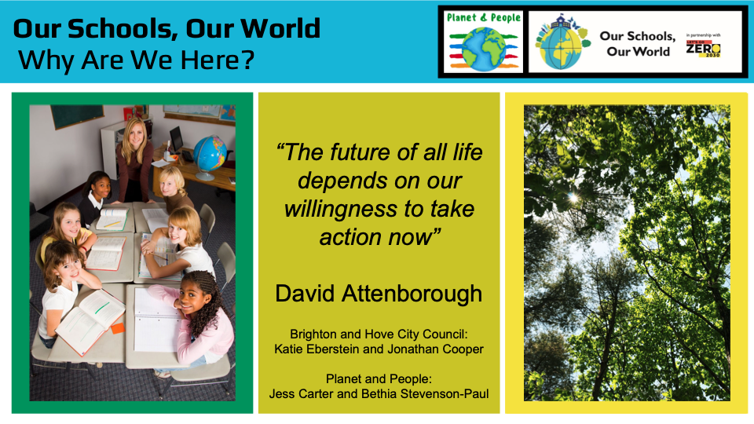
Our Schools, Our World
'The future of all life depends on our willingness to take action now’
David Attenborough
Brighton & Hove City Council
Katie Eberstein and Jonathan Cooper

Slide 2
Our Schools, Our World Housekeeping
Fire exits
Toilets
Photographs
Tea/Coffee breaks provided
Wifi Password: inspiring
Notes:
Beth

Slide 3
Our Schools, Our World Agenda
Time | Session
9:00 | Attendees arriving
9:05 | Introductions
9:25 | Climate Basics
10:10 | Local Picture
10.30 | Break
10.45 | Leading for Sustainability – the research
12:30 | Lunch
13:00 | Leading for Sustainability – the framework
14:15 | Action Planning
15:15 | Next steps
15:30 | Finish

Slide 4
Our Schools

Slide 5
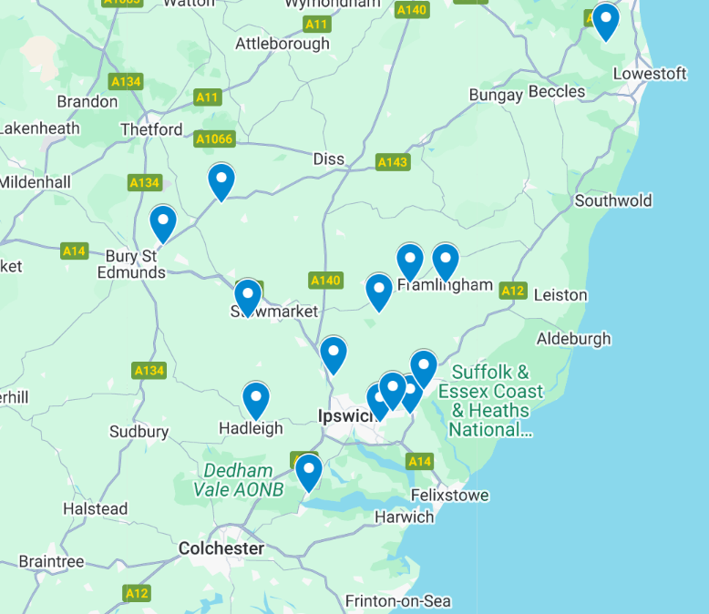



??
???
???
Notes:
Marc to add map and QR code

Slide 6

Our Schools, Our World
Introductions
Talk to those around you:
Name, Role, School
Why are you here today?

Slide 7
Our Schools, Our World Training Overview
Day One
Leading for Sustainability
Attending: Heads, governor, SPL
------------------------------------------------------
9.05am – 3.30pm
Climate/Nature Basics
BREAK
The Local Picture: David Walton
Leading for Sustainability – Research
LUNCH
The OSOW Framework
Action Planning
Day Two
Curriculum Development
Attending: SPL
------------------------------------------------------
9.05am – 3.30pm
Curriculum Development
BREAK
Curriculum Assessment
LUNCH
Nature Connection & Outdoor Learning
How to Talk About Climate Change
(ThoughtBox)
Day Three
Climate Action Planning
Attending: SBM, Site Manager, SPL
------------------------------------------------------
9.05am – 3.30pm
Climate/Nature Basics
BREAK
Climate Action Planning – background
‘Let’s Go Zero’ Climate Action Advisors
LUNCH
Measuring Carbon
Climate Action Planning - practical
Notes:
Marc to intro agenda, thank venues

Slide 8
Our Schools, Our World Aims of OSOW – Nationally Pioneering Work
Develop an integrated environmental education curriculum gradually and systematically ‘greening’ the curriculum and supporting the development of green skills
Enable children and young people to develop a close connection with nature
Create school organisational systems and practices which support sustainability and the school and regional Carbon Neutral 2030 targets
Empower children and young people and their families to become changemakers both personally and collectively and inspire a strong sense of hope for the future
Notes:
Marc – intro osow framework and the Leicester website

Slide 9


















Our Schools, Our World Who’s Involved
Suffolk Devon Brent Bedfordshire Leicester Brighton & Hove

Slide 10

Notes:
Marc: What do you see? What do you know? What do you wonder?
Think, pair, share

Slide 11



Our Schools Our World Climate Basics
Lots of different levels of experience and knowledge within this room
With those around you - Discuss the climate knowledge of your whole staff and pupils
Notes:
Scales exercise?

Slide 12
Our Schools, Our World
Climate Change Basics
CAUSE
CONSEQUENCE
Human Activity
Greenhouse Gases
Greenhouse Effect
Climate Consequences
Impact on the Planet
Impact on Humans
Impact on Biodiversity
SOLUTIONS ?

Slide 13
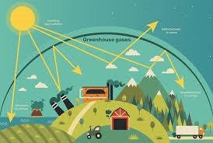
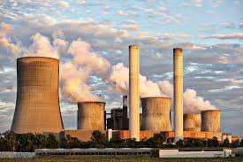
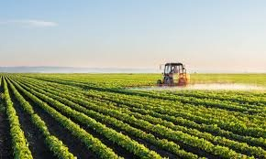
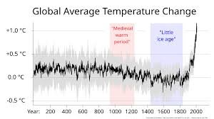
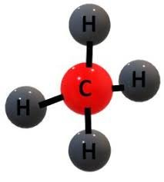

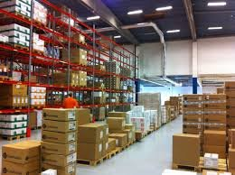
CAUSE
CONSEQUENCE
Human Activity
Greenhouse Gases
Greenhouse Effect
Climate Consequences
Impact on the Planet
Impact on Humans
Impact on Biodiversity
SOLUTIONS ?

Slide 14
Our Schools, Our World
What does climate change mean for you personally?
What does climate change mean for you professionally?
What does climate change mean for your school?

Slide 15
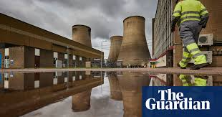
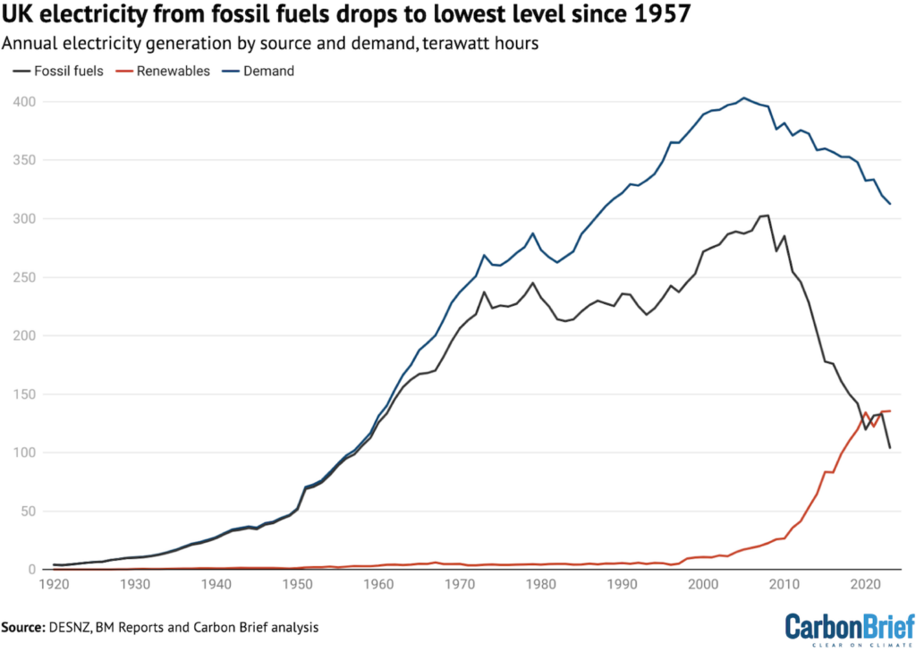
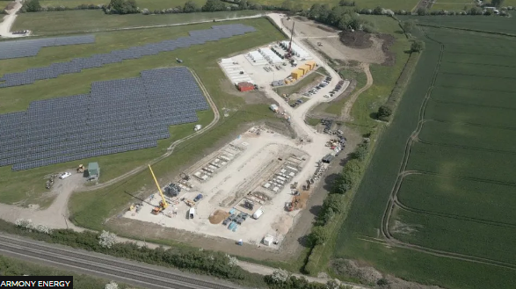
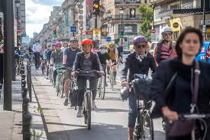
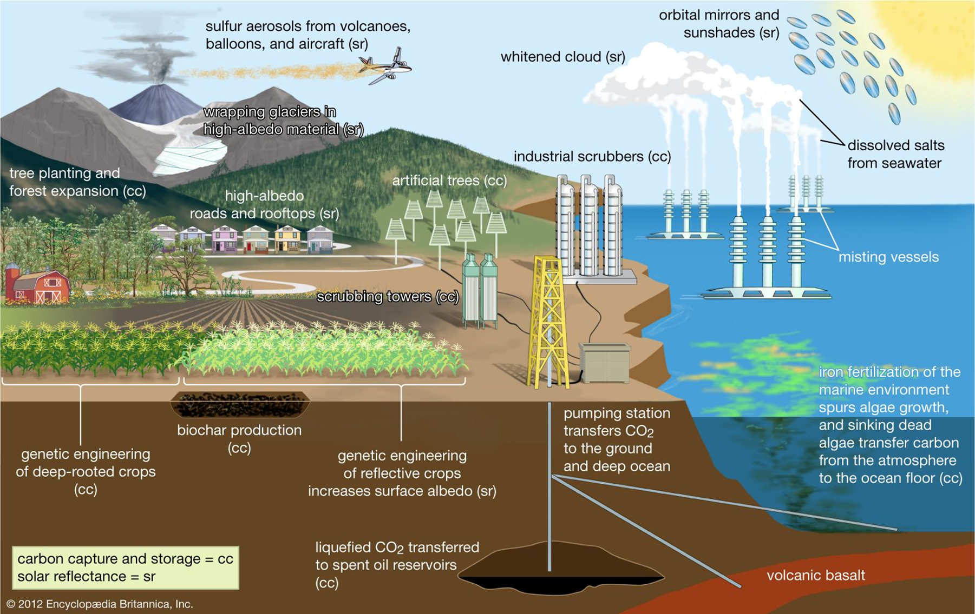
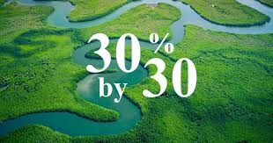
Reasons for optimism
Our Schools Our World Reasons for Optimism – nationally & globally
Replace with more recent slides

Slide 16
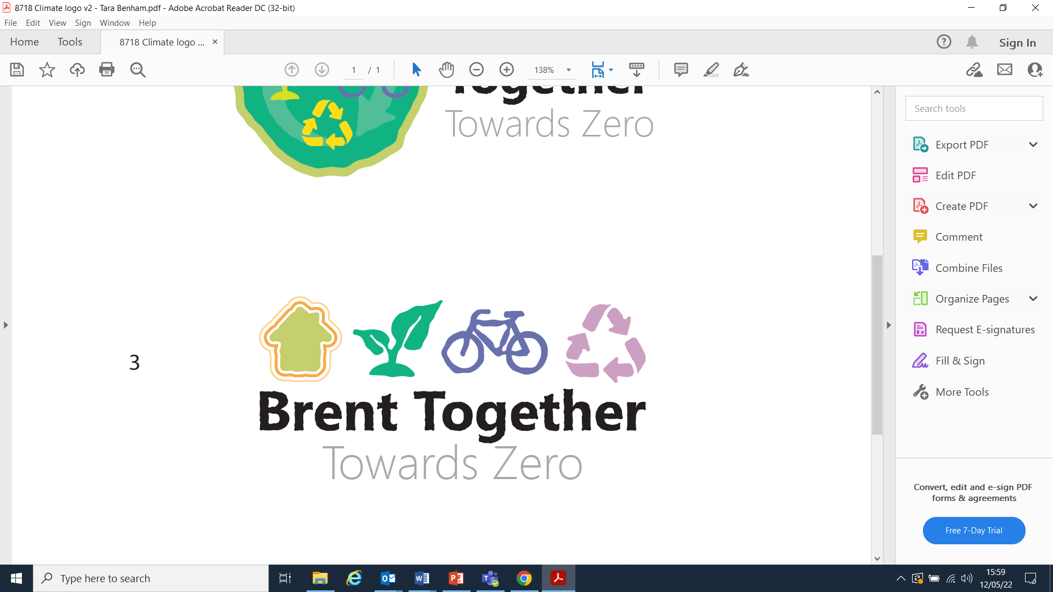

Reasons for optimism
Our Schools Our World Reasons for Optimism - schools
Sharing positive news stories from our schools
Notes:
Photos and good practice to share and add to website?

Slide 17
LOCAL CONTEXT INSERT LOCAL NET ZERO / CLIMATE PLANS

Slide 18
Break

Slide 19
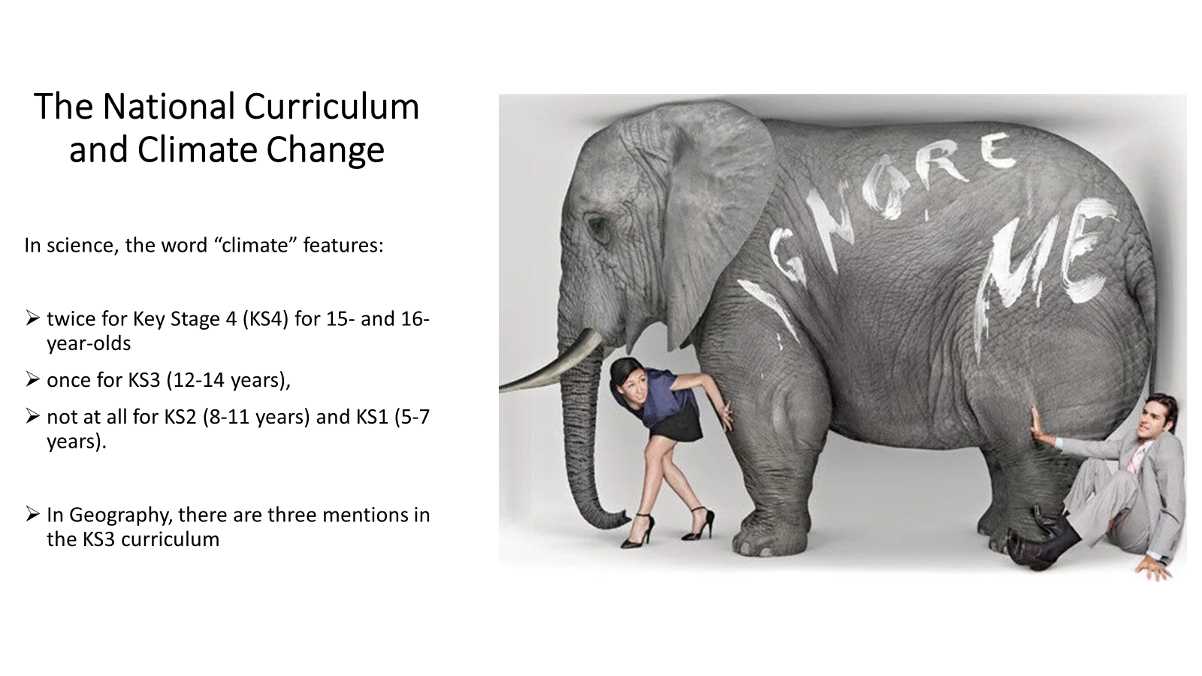
Our Schools, Our World Current NC provision
Notes:
NC does not prepare for the future – to be active and informed citizens. Not addressing this as an education system. Need to give knowledge given the challenges they will be facing.

Slide 20

Our Schools, Our World Our responsibility
50% of young people are unsure of how they can personally help
Notes:
We pride ourselves in helping young people keep themself safe. Their choices will impact everyone. We need yp are given the right knowledge.

Slide 21

DfE requirements
By 2025:​
All education settings will have nominated a sustainability lead
​
All education settings will have put in place a climate action plan
Decarbonisation
Adaptation and Resilience
Biodiversity
Climate Education and Green Careers
Notes:
' A placebo policy'?
OSOW about moral purpose – why we're in education.
CAP section is useful. Very little on climate ed. Leadership is key in making programme work.
Leadership is key to making this work.

Slide 22
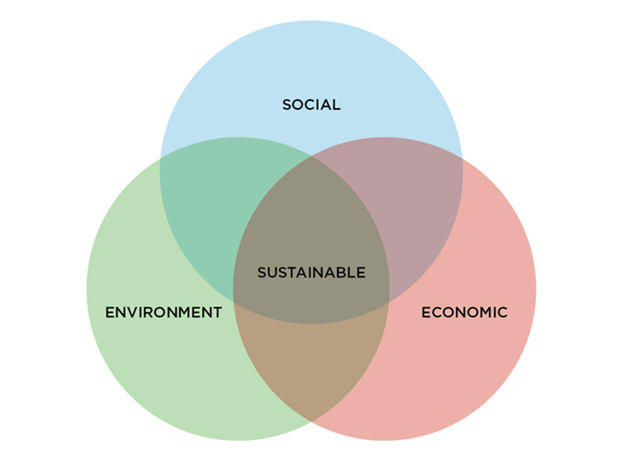
Our Schools, Our World Defining Sustainability
Avoid the depletion of natural resources
Keep an ecological balance
Not allow the quality of life of modern societies and future generations to decrease
Notes:
Elicit - What is sustainability?
Resources – what are we using and what impact is this having?
Have to consider all aspects. Use eg of astroturf – need to consider social, environmental and economic factors.
Use

Slide 23
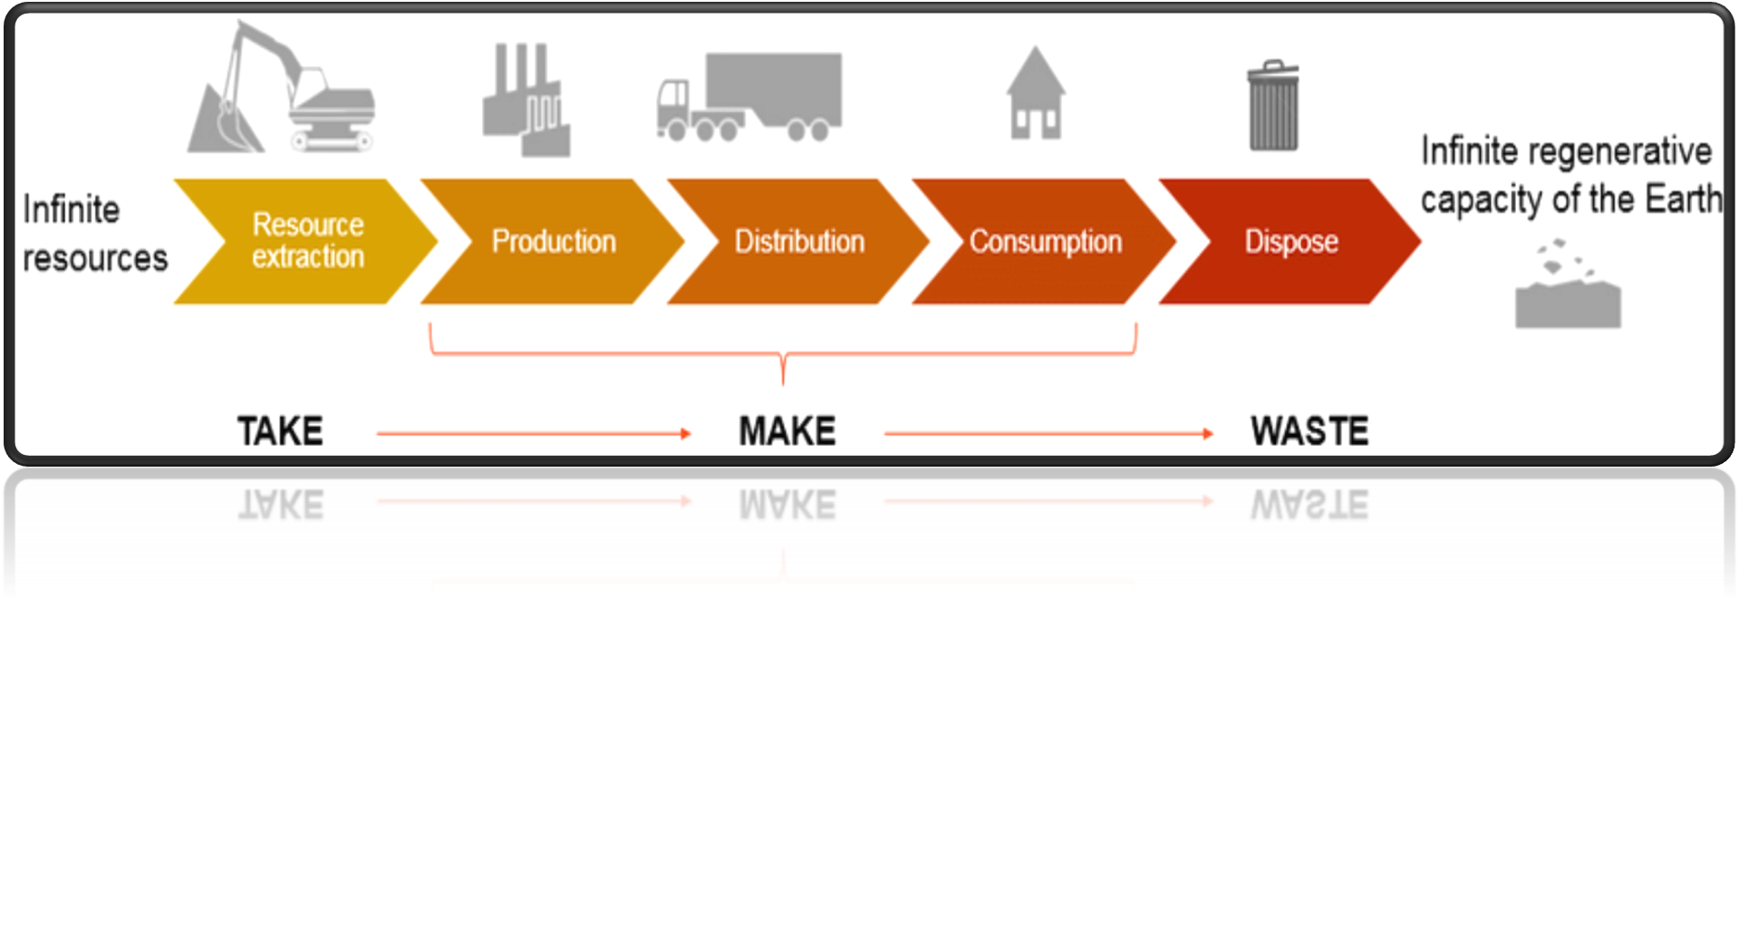
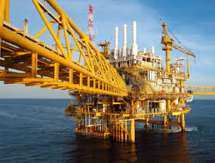
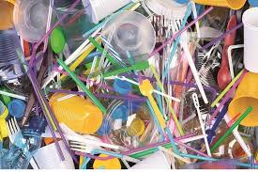
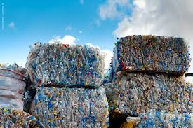
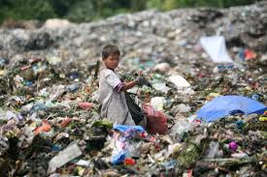
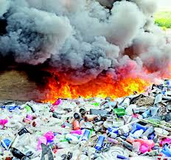
Our Schools Our World Linear Economy
Notes:
Schools often operate as a linear economy – especially when there is budget.
Do we ask, have we already got it, can we reuse/borrow etc?

Slide 24

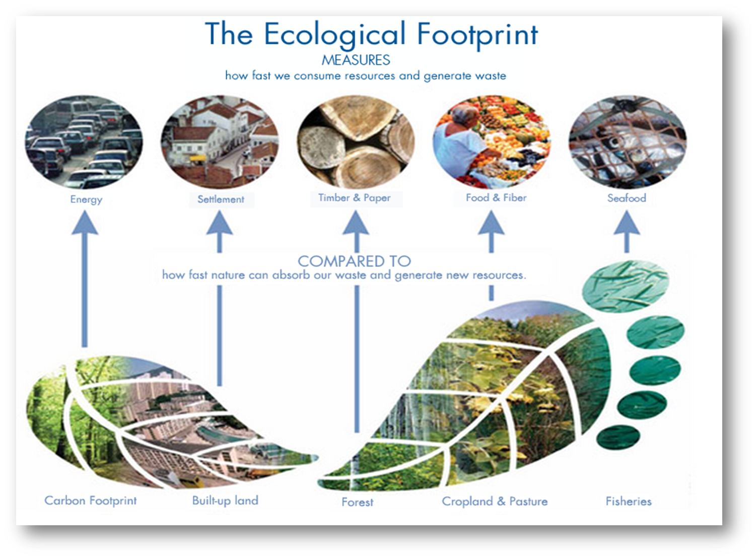
Our Schools, Our World Ecological Footprint
Notes:
Ecological footprint – how much of worlds resources we use balanced with how much the world can replace

Slide 25
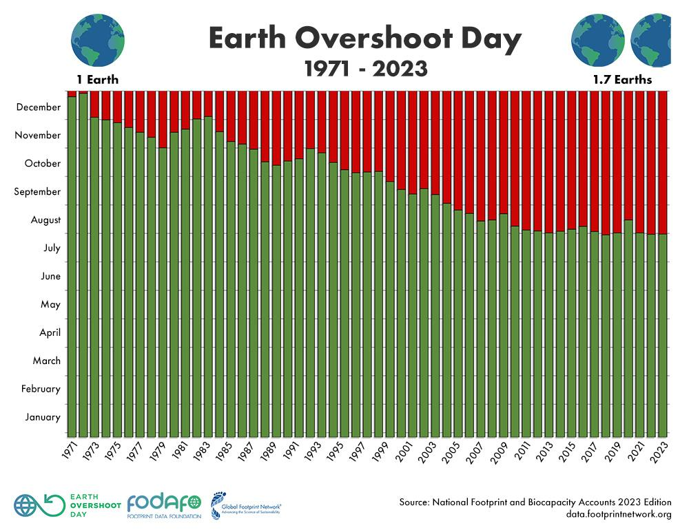
Our Schools, Our World
Notes:
In 1971 we were in balance – used 1 years worth of resources that could be replenished – needed one earth
Now – the way we're consuming resources, we use a years worth of resources by July. Need 1.7 earths.

Slide 26

Our Schools, Our World
Notes:
Eg Quatar – use by Feb 11
UK – June 7th
Poorer countries – creating less emissions but ones that are suffering most – climate justice. Need to consider circular economy.
Need to change our behaviours

Slide 27
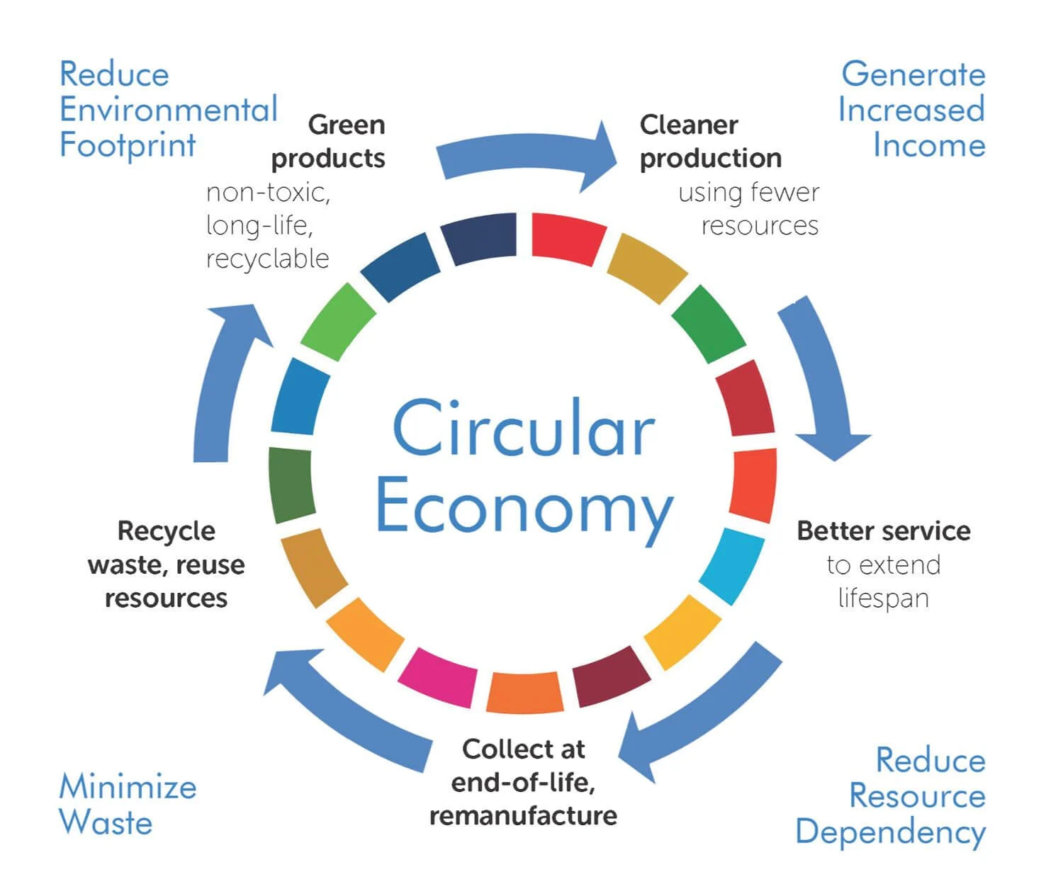
Our Schools, Our World Circular Economy
Notes:
Need to think about cost but also whole lifecycle of product.
Procurement =42% of school emissions

Slide 28
Our Schools, Our World Change Our Approach
1.REFUSE
2.REDUCE
3.REUSE
4.REPAIR
5.REPURPOSE
6.RECYCLE
7.RECOVER
Notes:
Recycling gives impression that we can continue using resources in current way.
Recycling is at the end of the approach – close to burning
Need to change the way we think about use of plastic / resources.
Challenge ourselves and other staff about this.

Slide 29
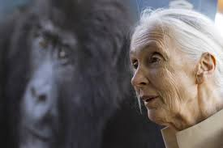
Our Schools, Our World
‘We have not borrowed our children’s future,
we have stolen it and we are still stealing it’
Jane Goodall, Naturalist

Slide 30
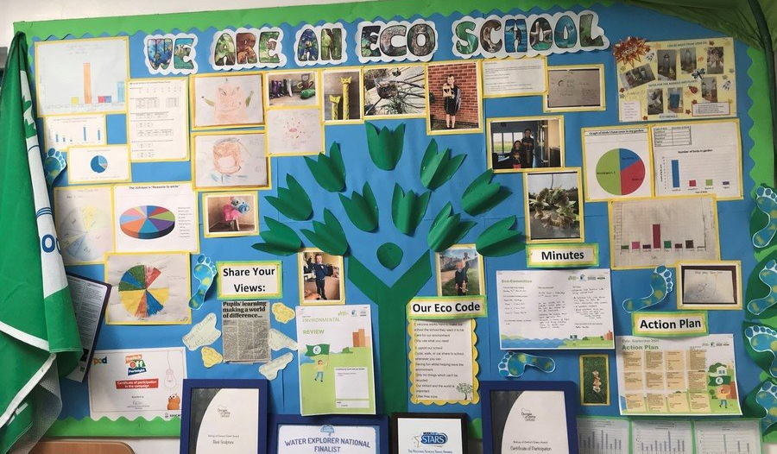
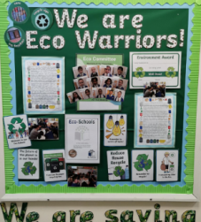
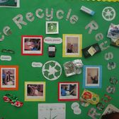
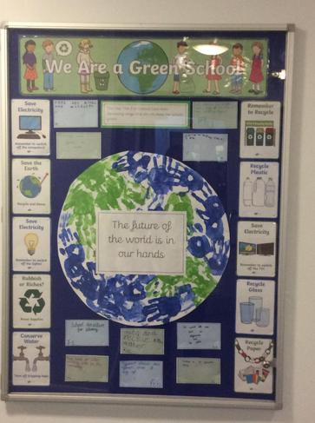
LEADERSHIP FOR SUSTAINABILITY – excellence in practice based on a meta-analysis of research Including: Dr David Dixon - Leadership for Sustainability 2022/Marouli, C. (2021). Sustainability education for the future? Challenges and implications for education and pedagogy in the 21st century/Mogaji, I. M., & Newton, P. (2020). School leadership for sustainable development: A scoping review. Journal of Sustainable Development/Awodiji (2023) School leadership development for sustainability in the post-digital era

Slide 31
The process
School Community
Leadership Commitment
Working group
Research Findings
School sustainability strategies are most effective when schools are:
'driven by moral purpose'
authentic and creative
Changemakers
Whole School
Training
Audit
and
Action
Council/MAT
Local experts and organisations
Nature Connection
Vision and Culture
Launch
Curriculum and Assemblies
Student + stakeholder voice
Notes:
Whole School is at centre of community – huge power to influence child, staff and community behaviour.
Why we came into education – our moral purpose
We need to be authentic – walk the walk, kids will see hypocracy
Leader needs to ensure whole school sees this as their responsibility -
Working group essential – head, governor, site manager, business manager, parent etc. Meets 1x a term to oversee termly actions.
6 themes over 2 years (rolling)

Slide 32


Roles and responsibilities
Our Schools, Our World Roles and Responsibilities
Headteacher | Senior Programme Lead | Lead Governor
Leading the vision and strategy Establishing termly working group for whole school action Facilitating curriculum development opportunities and CPD opportunities Ensuring completion and monitoring of OSOW Framework and Climate Action Plan | Supporting vision and strategy Leading on curriculum development strategy (linking to whole school action) Undergoing training in: Climate Change/Carbon Literacy Supporting eco-anxiety Climate Change curriculum structures Training other staff Linking with schools/organisations/initiatives On-going liaison/joint work with hub leader and climate adviser | Key member of the strategy group Ensures OSOW/sustainability is key FGB item and on committee agendas Monitoring and evaluation: Communication of and engagement with OSOW programme Vision and OSOW planning Impact of OSOW plan Implementation + impact of Climate Action Plan Curriculum improvement and impact
Notes:
SPL cannot do this on their own.
Head – lead vision and support SPL
SPL – rolling out training
Gov – oversee strategy and monitor impact

Slide 33
The process
School Community
Working group
Research Findings
School sustainability strategies are most effective when schools are committed to:
staff development
induction
succession planning
Changemakers
Whole School
Training
Audit
and
Action
Council/MAT
Local experts and organisations
Nature Connection
Vision and Culture
Launch
Curriculum and Assemblies
Student + stakeholder voice
Notes:
75% of teachers don’t treat about cc because they don't feel confident.
Training in climate science, eco anxiety, curriculum development.
Need to give time in staff meetings / inset. Whole staff not just teaching.

Slide 34
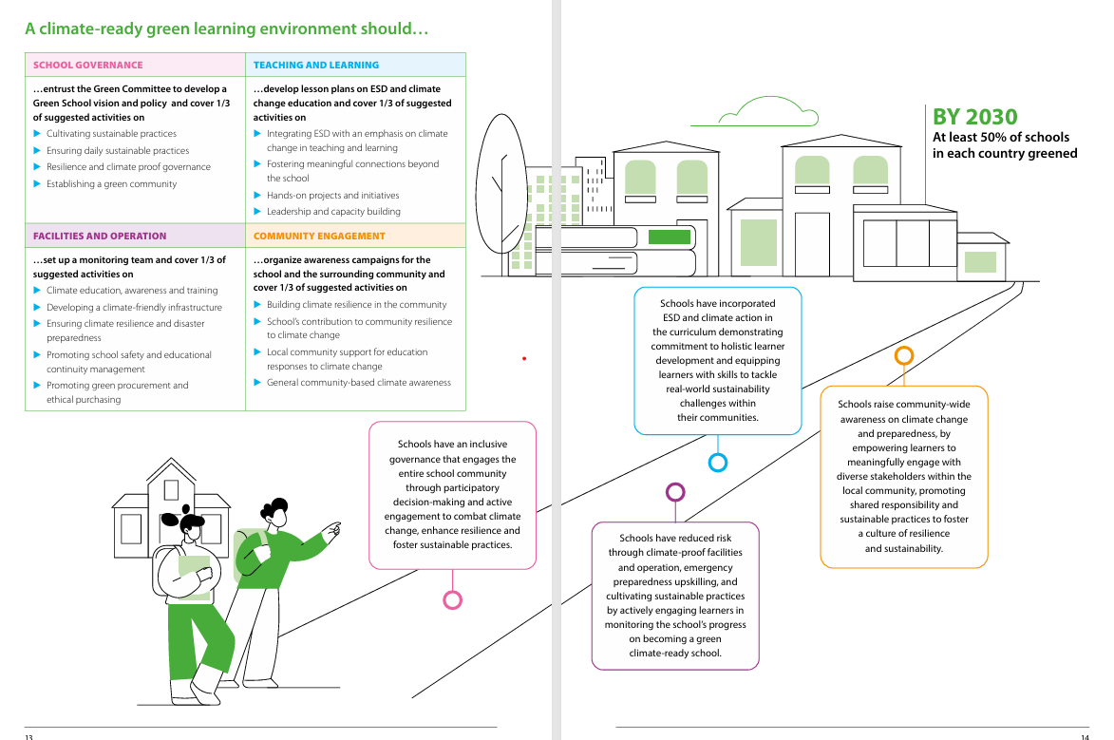

Is this needed? could it just be mentioned?

Slide 35
Our Schools, Our World
CPD framework/schedule
Year 1
Year 2
Climate Science Establish vision | INSET day
Supporting Eco Anxiety | 1 x staff meeting
Mapping Conceptual Milestone | 2 x staff meetings (over 2 terms)
Greening the Present Curriculum | 1 x staff merting (for 3 terms)
Creating Assembly Programme | Plan through network and website resources
Review Success of Curriculum (based on assessment) | 1 x staff meeting
Outdoor Learning Practice and Planning | 2x staff meetings

Slide 36
Our Schools, Our World
CPD framework/schedule
Suggested Time | Training | When | To whom | Resources
Year 1 term 1 | Climate Basics | INSET | All school staff | ‘Great Big Lesson for Climate & Nature’ - video in training section of website
Year 1 term 1 or 2 | How to talk to young people about climate change | INSET / staff meeting | Teaching staff and TAs | ThoughtBox video in training section of website
Year 1 term 2 or 3 | Curriculum Development ‘Conceptual milestones’ X2 | Staff meeting | Teaching staff | Conceptual Milestones document
Year 1 term 2 or 3 | Curriculum Development ‘Greening the Curriculum’ 1 | Staff meeting | Teaching staff | Greening the curriculum documents
Subsequent term | ‘Greening the Curriculum’ 2 | Staff meeting | Teaching staff | Greening the curriculum documents
Subsequent term | ‘Greening the Curriculum’ 3 | Staff meeting | Teaching staff | Greening the curriculum documents
Year 2 | Reviewing success of initial curriculum | Staff meeting | Teaching staff | Use of assessment resources
Year 2 | Outdoor Learning Practical techniques and planning | Staff meeting | Teaching staff | Outdoor learning resources on OSOW website
Notes:
Eg of how you might want to roll out training

Slide 37
The process
School Community
Working group
Research Findings
School sustainability strategies are most effective when schools:
develop a strong culture and shared vision for a better world
Changemakers
Whole School
Training
Audit
and
Action
Council/MAT
Local experts and organisations
Nature Connection
Vision and Culture
Launch
Curriculum and Assemblies
Student + stakeholder voice
Notes:
Vision is vital – you need to get the culture right. Need to involve everyone- INSET day?
What would we like to see in our school around sustainability?
Visioning an alternative world – imagine what could be better?
Rob Hoskins - 'What If' - we cant react because we're so bogged down with what's infront of us. Without imagining the future, we wont have control.
Need to take time out to imagine other possibilities

Slide 38
Our Schools, Our World Bringing People With You - Culture
Passion and commitment
Training and knowledge
Shared vision
Clear communication of vision and plans
Pupil voice central
Clear roles and expectations – personal and professional
PM structures
Collective impact
Organic developments as well as planned improvements
Regular celebration of impact
Notes:
What structures have you got to develop culture?
Sustainability in performance management? – part of their role
Termly structure enables people to see bigger picture and when their ideas will be taken up / considered.

Slide 39
The process
School Community
Working group
Research Findings
School sustainability strategies are most effective when schools:
challenge and focus on solutions
Changemakers
Whole School
Training
Audit
and
Action
Council/MAT
Local experts and organisations
Nature Connection
Vision and Culture
Launch
Curriculum and Assemblies
Student + stakeholder voice

Slide 40


Our Schools, Our World Our Mantra!
Is it green?
Could it be greener?
Notes:
Challenge.
Eg of school grounds – how can we encourage people to look for more solutions

Slide 41
The process
School Community
Working group
Changemakers
Research Findings
School sustainability strategies are most effective when :
stakeholder voice is enabled and empowered
Whole School
Training
Audit
and
Action
Council/MAT
Local experts and organisations
Nature Connection
Vision and Culture
Launch
Curriculum and Assemblies
Student + stakeholder voice
Notes:
Student, staff, parent voice is vital.
Write to parents term before to ask for expertise in that theme. Come into school to see alternative futures/ parents as changemakers
Pupil voice – assembly, surveys
Assemblies are an important way of ensuring whole school voice on one particular theme.

Slide 42
Our Schools, Our World Pupil Voice
Understanding the issues
Surveys
Identifying priorities and solutions
Representation on groups
Class/school/family action
Curriculum development
Family influencer
Assemblies
Notes:
Talk about pledges
Eg no mow may – school to stop mowing – how many parents can stop mowing? What acreage can you leave wild for wildlife using gardens?

Slide 43
Our Schools, Our World Engaging Families
Launch
Regularly sharing plans/targets
Sharing curriculum aims
Skills audit/engagement
Regular joint activities/pledges
Speakers
Representation on key groups
PTA
Events
Tours of school
Website/twitter
Notes:
Launch – eg whole day launch or learning to learn / art / book week. 'This is how we are moving forward.'
Parents get frustrated if you don’t use their offers – termly approach helps structure their help.
PTA – sustainability guide

Slide 44
The process
School Community
Working group
Changemakers
Research Findings
School sustainability strategies are most effective when schools:
integrate rather than layer
Whole School
Training
Audit
and
Action
Council/MAT
Local experts and organisations
Nature Connection
Vision and Culture
Launch
Curriculum and Assemblies
Student + stakeholder voice

Slide 45

Our Schools, Our World School Values and Learning Attitudes
Notes:
How do you school values and learning attitudes link to sustainability?
Give egs of how care / respect / kindness relate to sustainability?
Green skills = engineering etc but also challenge / curiosity / collaboration etc.
Not another layer – but all part of school culture

Slide 46
Our Schools, Our World Curriculum Development - Zones
Interwoven in lessons
Action and empowerment
Connections with nature
Culture
School organisation – sustainable practices
Link to the UN SDGs
Assemblies
Connecting locally, nationally and internationally
Family and local community
Special projects
Staff commitment through pledges
School values and learning attitudes
Climate Change Curriculum zones of provision and influence
Pupil voice
Staff / community voice
Notes:
Try to get text bigger – Beth

Slide 47
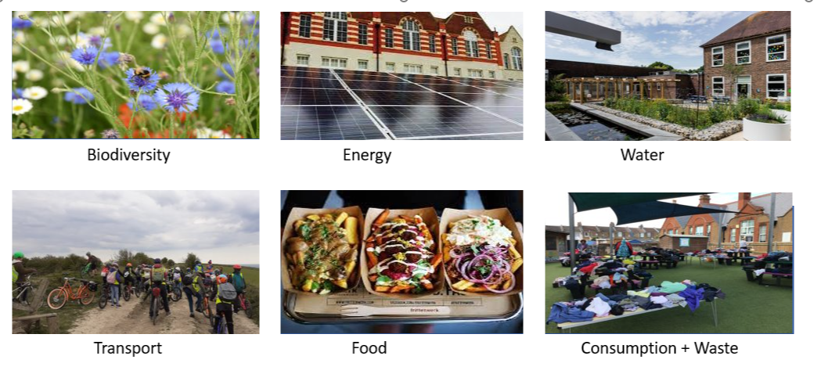
Our Schools, Our World Overarching Themes
Notes:
6 themes – assembly enables whole school engagement in learning and action. 2 year spiral curriculum.

Slide 48
Our Schools, Our World Conceptual Milestones
Our Schools, Our World Conceptual Milestones
End of Year 2
Key Concepts | Year Group/Term/Subject/Assembly
Local/national/global
Weather
Climate
Environment
Global warming
Monoculture
Biodiversity
Extinction
Rewilding
Wood wide web
Conservation
Energy
Waste
Consumption
Pollution
By end of Year 4
Key Concepts | Year Group/Term/Subject/Assembly
Climate change
Atmosphere
Greenhouse effect
Greenhouse gas emissions
Carbon
Carbon emissions
Notes:
Curriculum – came from teachers deciding what children could learn. What vocab / concepts do children know to enable them to understand and talk about cc. Much of these fit into existing topics. Can move them around.
Need staff meeting to audit existing curriculum and another to try to fit in those that aren't already there.

Slide 49
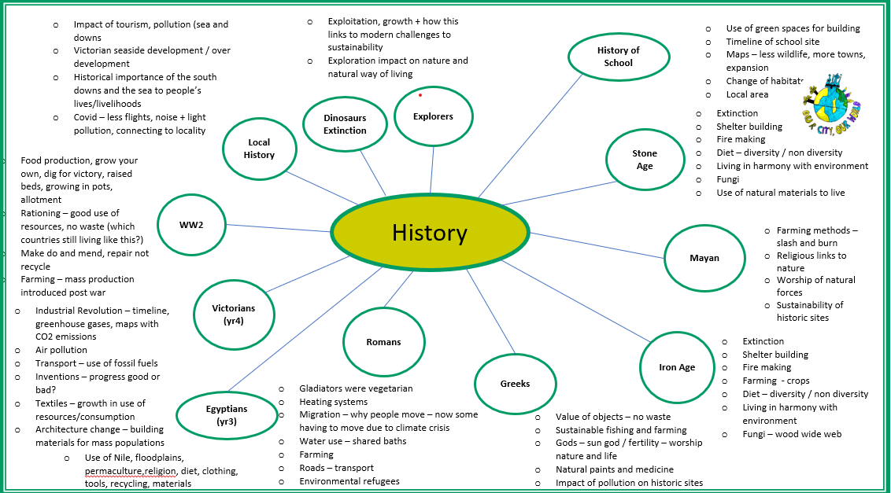
Our Schools, Our World Conceptual Milestones
Our Schools, Our World Greening the Curriculum
Notes:
Curriculum – came from teachers deciding what children could learn. What vocab / concepts do children know to enable them to understand and talk about cc. Much of these fit into existing topics. Can move them around.
Need staff meeting to audit existing curriculum and another to try to fit in those that aren't already there.

Slide 50
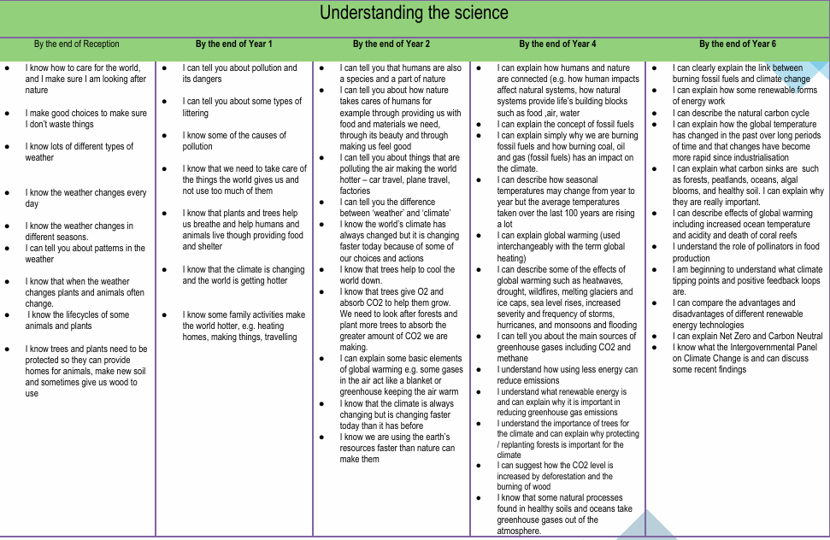
Our Schools, Our World Progression in Skills and Knowledge
Notes:
Ensures rigour to use when conferencing with children at end of units etc.

Slide 51
Our Schools, Our World Additional Resources
Biodiversity
Autumn 24
Assembly Concepts | Diversity
Assembly Knowledge | Celebration of our natural world - What is biodiversity and why is it important? Ecosystems and trophic cascade Our local ecosystem - Our Living Coast 30 days wild in June Human impact on biodiversity The school environment UN Sustainable Development Goals 14 and 15 – Protect life on land and in water
Key concepts | What is biodiversity and what is its value? Ecosystems Life in our biosphere - living coast Impact of actions on biodiversity and ability of planet to adjust
Class/School action | https://www.rspb.org.uk/globalassets/downloads/documents/positions/education/top-tips-for-schools-to-engage-with-biodiversity.pdf On-going help with biodiversity areas – development of specific infant playground area Development of use of pond and forest garden – more planting School growing projects – plant trees Composting 30 days Wild June
Family Commitment/ Pledge | How can we encourage biodiversity at home – flats/houses –guides provided Challenge – learn the names of the trees in our neighbourhood Community celebration – Me and my plants. Photos + names of plants we love at home or on the way to school What can you find in a metre squared of grass? Competition – types of plants/insects 30 days wild
Notes:
Examples of what schools might want to do under each topic.
Use audits on website to systematically assess your school and use to plan actions

Slide 52

Our Schools, Our World Sustainable Development Goals
Notes:
Some schools use these – can layer in the programme into these goals.
Used more with secondary schools.

Slide 53
The process
School Community
Working group
Research Findings
School sustainability strategies are most effective when schools:
fully recognise the benefits of nature connection
Whole School
Changemakers
Training
Nature Connection
Council/MAT
Local experts and organisations
Vision and Culture
Audits and Action
Launch
Curriculum and Assemblies
Student + stakeholder voice
Notes:
Cant care about something unless you've experienced it.
75% of children spend more time inside than prison inmates
If not going out at home – need to go out at school.
Should wet play be indoors? Learning outdoors should be embedded in curriculum

Slide 54
Our Schools, Our World Research Into The Impact of Environmental
and Sustainability Education
Greater well-being
Increased social engagement and positive environmental behaviours
Higher levels of concentration and resilience
Enhancing critical thinking skills and problem solving skills
Effective teamwork skills
Personal growth and life skills including confidence, autonomy, and leadership
More effective acquisition of STEM skills due to purposeful/meaningful context
Development of Green Career skills
Notes:
When children go out – lots of benefits for learning. Also helping with green skill building

Slide 55
The process
School Community
Working group
Research Findings
School sustainability strategies are most effective when schools:
think systematically and as 'systems thinkers'
Whole School
Changemakers
Training
Audit
and
Action
Council/MAT
Local experts and organisations
Vision and Culture
Nature Connection
Launch
Curriculum and Assemblies
Student + stakeholder voice

Slide 56
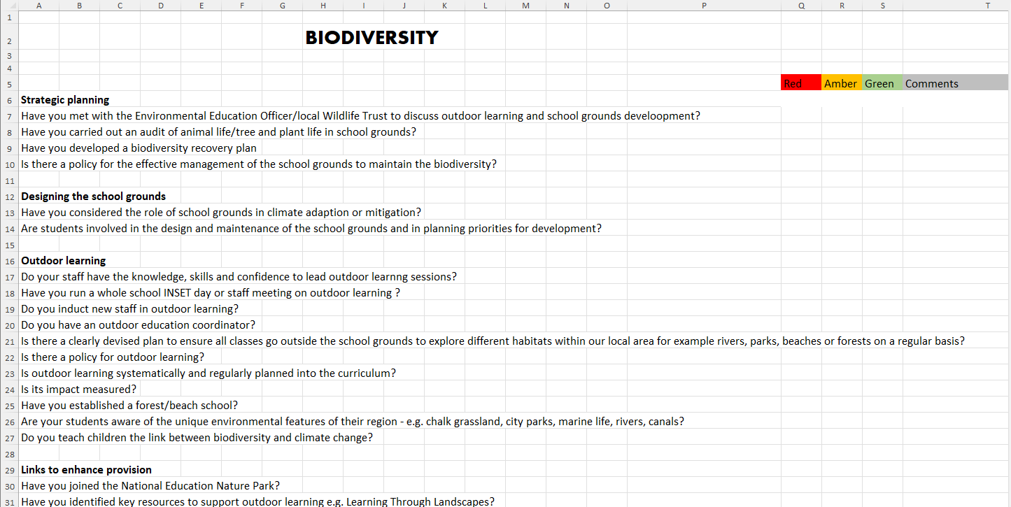
Our Schools, Our World Audits

Slide 57
Our Schools, Our World A Systematic Approach to School Operational Action Areas
Environmental education
Travel and transport
Biodiversity
Water management
Captaincy
Curriculum
Campus action
Community Culture
Procurement and third parties
Waste management
Food and catering
Building and construction
Energy and carbon management
Community engagement

Slide 58

Our Schools, Our World Our Mantra!
What’s the impact of:
buying one less t-shirt?

Slide 59
Our Schools, Our World Systems Thinking Organisation
Continual awareness of:
our impact globally as well as locally of all our decisions: social, economic and environmental
a circular economy approach
an understanding that healthy systems generate healthy decisions and healthy actions

Slide 60
The process
School Community
Working group
Changemakers
Research Findings
School sustainability strategies are most effective when schools are:
reveals the power of collectivism
Whole School
Training
Audit
and
Action
Council/MAT
Local experts and organisations
Nature Connection
Vision and Culture
Launch
Curriculum and Assemblies
Student + stakeholder voice
Notes:
Changemakers -

Slide 61
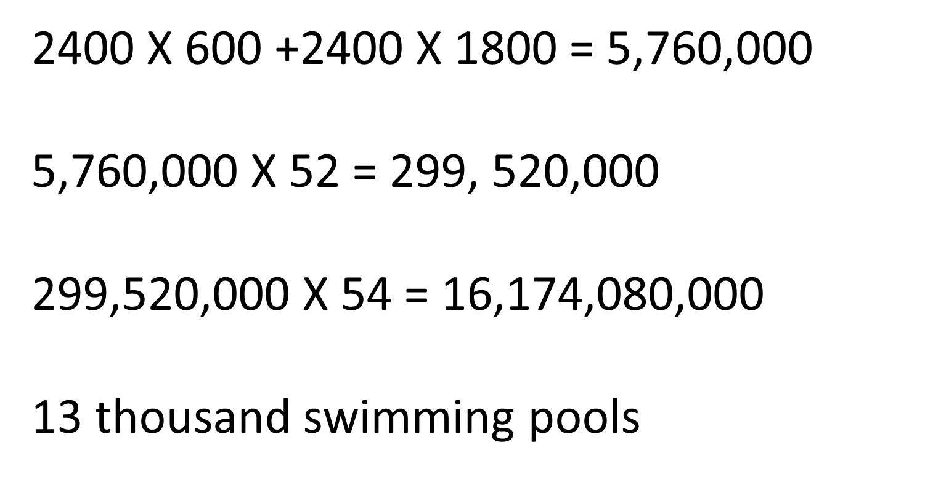
Our Schools, Our World Collectivism
Notes:
How much water would we save if we all ate one less burger each week.
1 burger – needs 2400L of water
2400 x pupils in school + their family members
X every week of the year
X number of schools in the city / hub
Shows power of collectivism

Slide 62
The process
School Community
Working group
Changemakers
Whole School
Research Findings
School sustainability strategies are most effective when schools are:
focused on well-being
Training
Audit
and
Action
Council/MAT
Local experts and organisations
Nature Connection
Vision and Culture
Launch
Curriculum and Assemblies
Student + stakeholder voice
Notes:
School and children to use language of self care, people, planet care

Slide 63

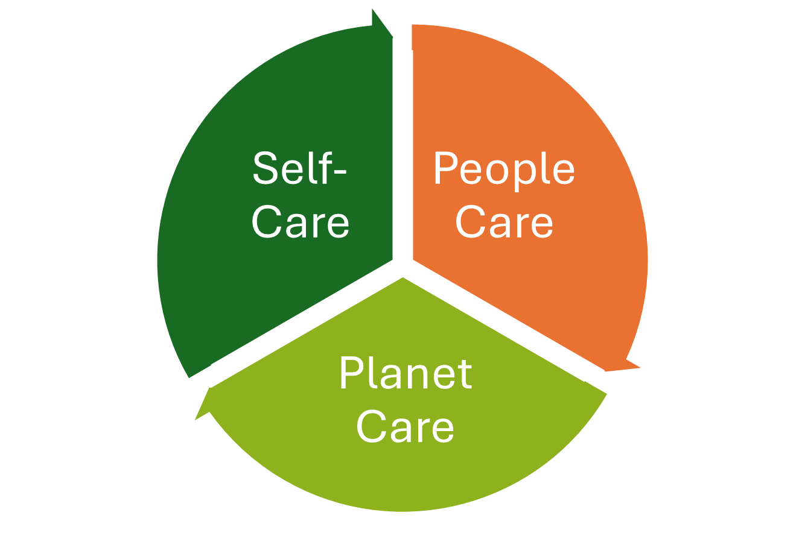

Our Schools, Our World Addressing Modern Disconnect

Slide 64





Our Schools, Our World 5 Ways to Wellbeing - MIND
CONNECT
BE ACTIVE
TAKE NOTICE
KEEP LEARNING
GIVE
Notes:
Approach fits in with 5 ways to wellbeing – not another layer but integrated

Slide 65
The process
School Community
Working group
Changemakers
Research Findings
School sustainability strategies are most effective when schools are:
builds on social capital
Whole School
Training
Audit
and
Action
Council/MAT
Local experts and organisations
Nature Connection
Vision and Culture
Launch
Curriculum and Assemblies
Student + stakeholder voice
Notes:
Builds on social capital – use expertise of local organisations. Website to document local organisations to make it easy to find changemakers

Slide 66
Our Schools, Our World 2 Year Rolling Programme
Curriculum
Concepts, Greening, Nature Connection
Theme 1
Assemblies
Actions
Theme 2
Assemblies
Actions
Theme 3
Assemblies
Actions
Theme 4
Assemblies
Actions
Theme 5
Assemblies
Actions
Theme 6
Assemblies
Actions
School Operations
Working towards Zero Carbon
Notes:
Overview

Slide 67
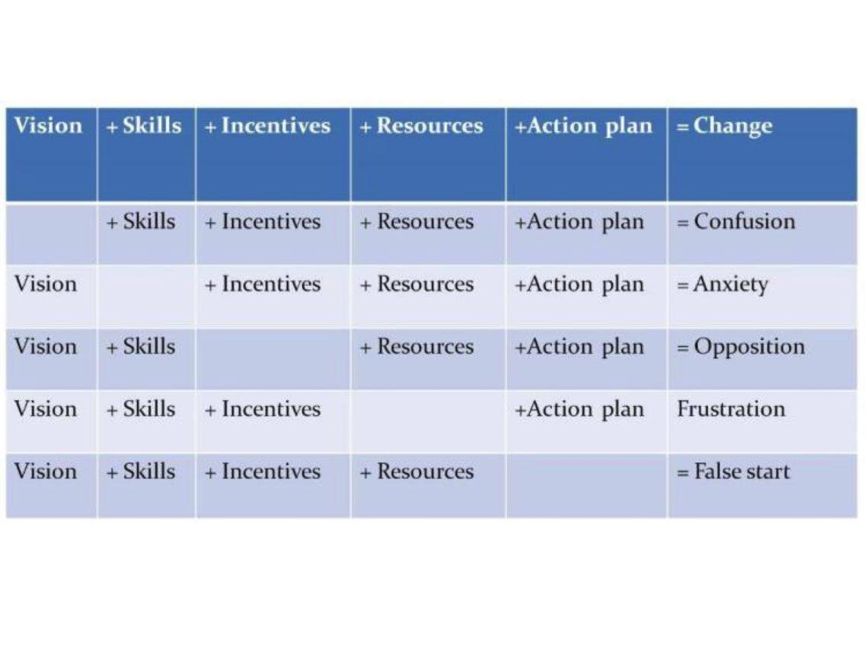
Our Schools, Our World Ensuring Effective Strategy
Notes:
What happens when we don’t have elements of the strategy – eg no vision – causes confusion etc

Slide 68
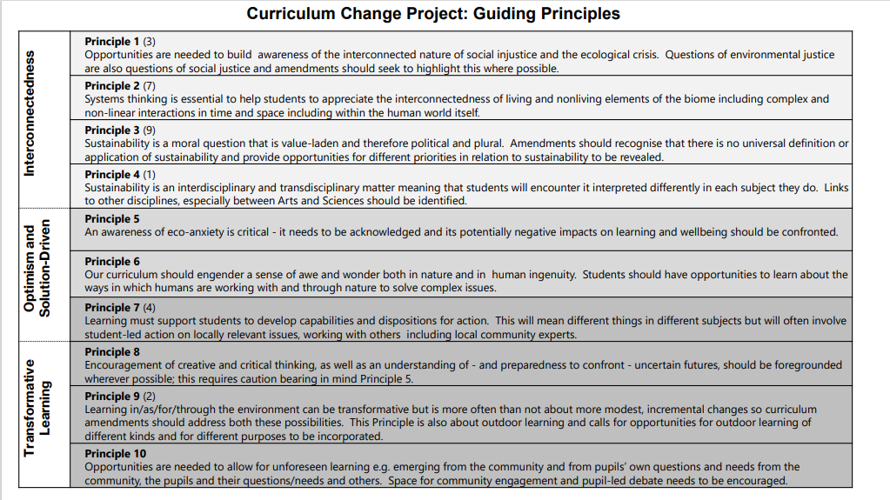
Our Schools, Our World Teach the Future – Guiding Principles
Notes:
Teach the Future – driven by young people. Their research on what makes effective teaching – aligns with OSOW

Slide 69
Notes:
UNESCO 'greening education partnership' also aligns closely with OSOW

Slide 70
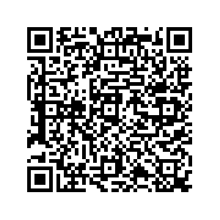
Our Schools, Our World Lunch 12:30– 1:00
Group Photo!
Signing up to Let's Go Zero
Notes:
If not already signed up to Let’s Go Zero please complete form now
OSOW is being funded for by Let’s Go Zero – we will have a guest speaker join us on Wednesday. Please complete baseline data form

Slide 71
LEADERSHIP FOR SUSTAINABILITY – Strategy and Framework

Slide 72
Environment (grounds etc) Curriculum Community Campus (emission reduction) Initiatives/projects Other
Our Schools, Our World
School Strengths

Slide 73
Our Schools, Our World 2 Year Rolling Programme
Curriculum
Concepts, Greening, Nature Connection
Theme 1
Assemblies
Actions
Theme 2
Assemblies
Actions
Theme 3
Assemblies
Actions
Theme 4
Assemblies
Actions
Theme 5
Assemblies
Actions
Theme 6
Assemblies
Actions
School Operations
Working towards Zero Carbon

Slide 74
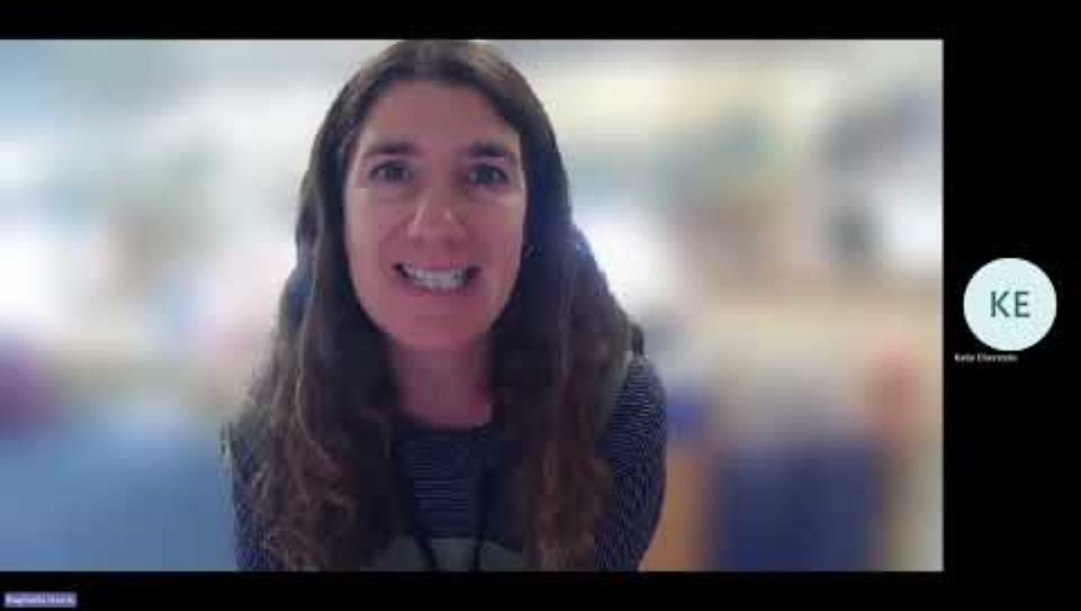
Our Schools, Our World Ensuring Effective Strategy

Slide 75
1. Yellow 2. Grey 3. Orange 4. Green
Our Schools, Our World
The Framework

Slide 76
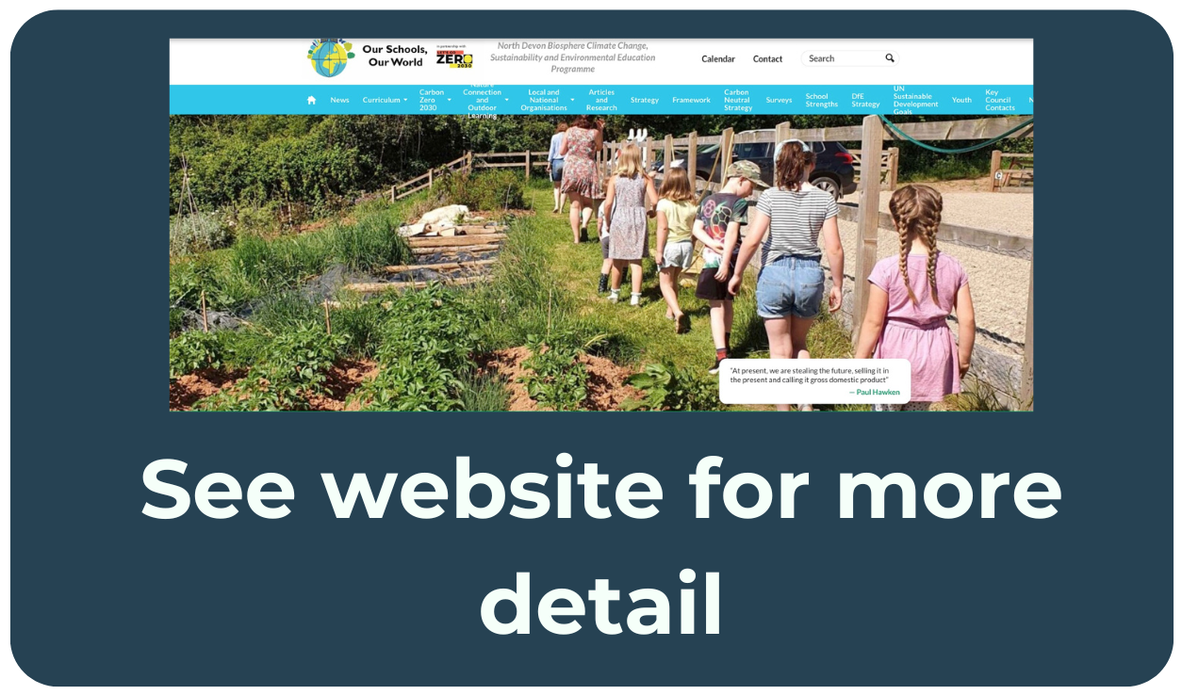
Our Schools, Our World The Framework – Stage One
Launch with governors
Standing item in staff meeting and governors meeting agenda
Survey school community
Set up sustainability working group
Launch programme with staff
Train staff in climate science and eco-anxiety
Create a sustainability vision
Integrate OSOW into school SIP
Notes:
Marc – intro activity, schools given “cards” with different school initiatives/actions, need to put in order of which to do first (some might need to be done simultaneously)

Slide 77
Our Schools, Our World The Framework – Stage Two
‘Green’ the curriculum
Develop assembly programme
Launch the OSOW programme
Complete carbon audits Plan ‘green events’ – Switch Off Fortnight’, Arts Week etc.
Engage PTFA, families, governors
Analyse procurement
Add OSOW to newsletter/website/noticeboards

Slide 78
Our Schools, Our World The Framework - Stage Three
Plan for organisation/community/ business engagement
Network with other schools
Plan for nature connection and outdoor learning
Create induction pack for new staff
Include sustainability in interviewing for new staff Include OSOW in school presentations for new parents
Establish a programme of assessment/evaluation

Slide 79
Our Schools, Our World The Framework – Stage Four
Completion of a Net Zero Route Map
Develop a nature recovery plan to increase biodiversity Include UN Sustainable Development Goals in lesson planning Provide opportunities for children to support campaigns locally or nationally Site manager and SBM establish sustainability meeting schedule

Slide 80
Our Schools, Our World Pledges
Brighton & Hove Primary & SEND School Pledges
By December 2026 we pledge to:
Waste: Remove single use plastics from our classes, staffroom and catering operations
Food: Promote a lower emissions menu, a greater plant-based offering and a
significant reduction in food waste
Energy: Reduce carbon emissions from energy by 20%
Water: Reduce water use by 20%
Biodiversity: Increase the amount of land given over to supporting biodiversity by 10%
Transport: Reduce staff car travel to school by 20%
Leadership: Track carbon emissions using the 'Count Your Carbon' tool
What would be possible in Suffolk?
Climate Action Plans
Notes:
Marc
All HTs in Bright & Hove made these pledges. Could we do similar as a group of schools in Leicester? Powerful for our young people to hear the commitment and pledge from their HTs – could share this with local community through local newspaper?

Slide 81
Our Schools, Our World First Support Visit
Add info about support visits
Notes:
Marc – will meet with each school next term to help with their planning and implementing to ensure they’re ready to launch in the summer term. Online

Slide 82
Our Schools, Our World
Connection with nature | Biodiversity areas development in school Downs and diversity – exploring on trip Plant a tree campaign https://www.woodlandtrust.org.uk/blog/2020/03/nature-detectives/ Swift project Wildlife walk with picnic – whole school David Attenborough film spectacular
Outdoor learning | More outdoor classroom - https://www.ltl.org.uk/free-resources/
Ethical purchasing/sustainable practice as a school | Palm oil/local produce/commit to vegan lunch days http://www.worldwiseschools.ie/downloads/Ethical-Purchasing-Guide.pdf
Political Engagement | Work with school lunch company – more vegan options https://www.wwf.org.uk/updates/8-things-know-about-palm-oil Campaign against palm oil - letter writing MPs
Connecting with local organisations | Class Talks and Assemblies Just one tree https://www.justonetree.life/ RSPB -Find a local group near you Local wildlife Campaigners Suffolk Wildlife Trust Welcome to Suffolk Wildlife Trust | Suffolk Wildlife Trust
Staff Behaviour | Environmental volunteering opportunities Outdoor relaxation area created
Emotional Resilience/Learning Behaviours/Relationships | Mindfulness within nature activities

Slide 83
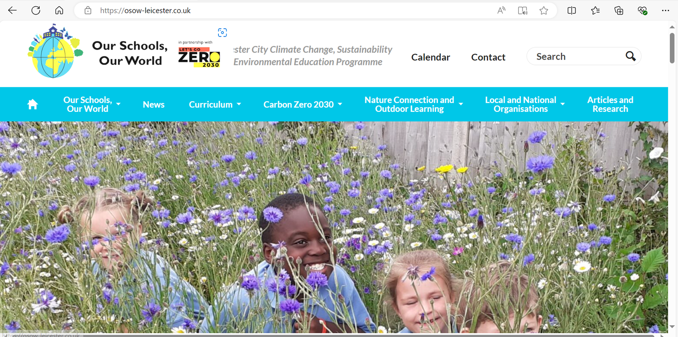


Our Schools Our World www.osow-suffolk.co.uk
Climate999
Notes:
Claire

Slide 84
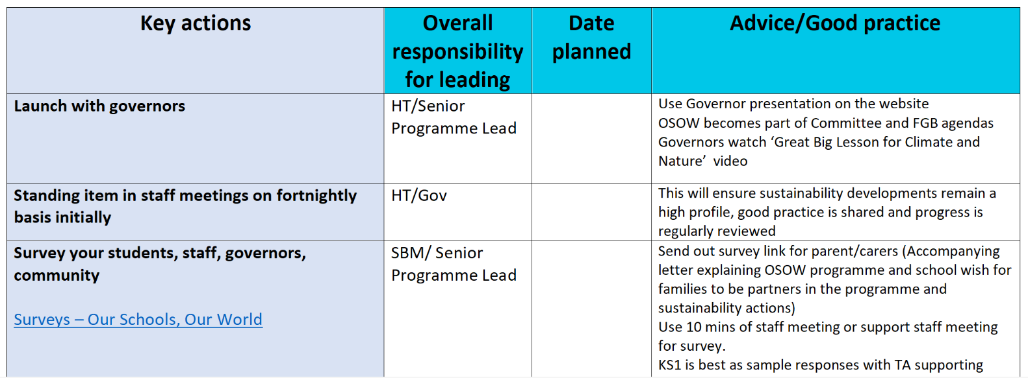
Our Schools, Our World Action Planning
“Process with guidance & advice” Document available here:
OSOW Framework

Slide 85
Our Schools, Our World Tomorrow
Amend if needed
SPLs to arrive 8.30 for 9:00 start
Please bring laptop and example of medium-term curriculum plans
Please also bring school ID’s
Thursday – please confirm if site managers and business managers are attending and arrange a time to discuss content with them afterwards

Slide 86
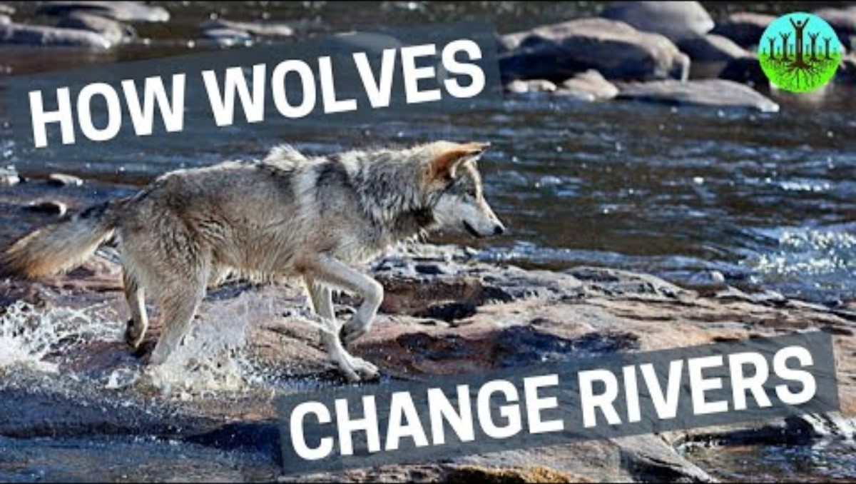
Our Schools, Our World Be the change

Slide 87
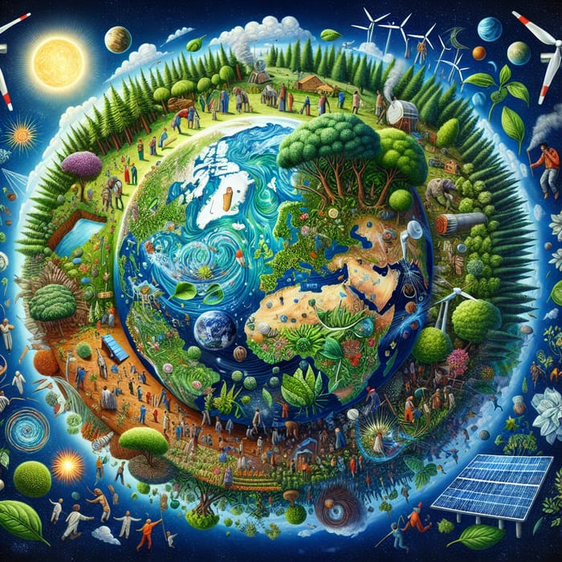
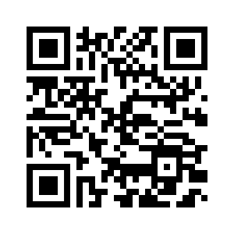
Our Schools, Our World Evaluation
Thank you

Slide 88
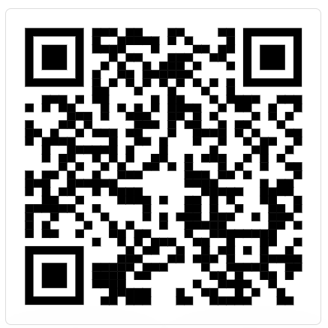

Sign up your school to Let’s Go Zero

