Slide 1

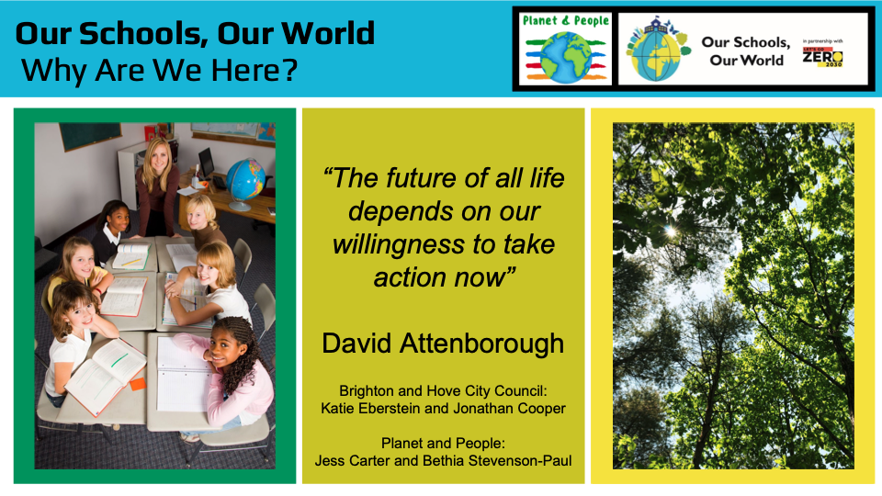
Our Schools, Our World
‘Your actions matter. No action or voice is too small to make a difference’
Vanessa Nakate
Brighton & Hove City Council
Katie Eberstein and Jonathan Cooper
Notes:
Beth – welcome from presenters

Slide 2
Our Schools, Our World Training Overview
Day One
Leading for Sustainability
Attending: Heads, governor, SPL
-----------------------------------------------------
9.05am – 3.30pm
Climate/Nature Basics
BREAK
The Local Picture: David Walton
Leading for Sustainability – Research
LUNCH
The OSOW Framework
Action Planning
Day Two
Curriculum Development
Attending: SPL
----------------------------------------------------
9.05am – 3.30pm
Curriculum Development
BREAK
Curriculum Assessment
LUNCH
Nature Connection & Outdoor Learning
How to Talk About Climate Change
(ThoughtBox)
Day Three
Climate Action Planning
Attending: SBM, Site Manager,
-----------------------------------------------------
9.05am – 3.30pm
Climate/Nature Basics
BREAK
Climate Action Planning – background
‘Let’s Go Zero’ Climate Action Advisors
LUNCH
Measuring Carbon
Climate Action Planning - practical
Notes:
Marc to intro agenda, thank venues

Slide 3
Our Schools

Slide 4
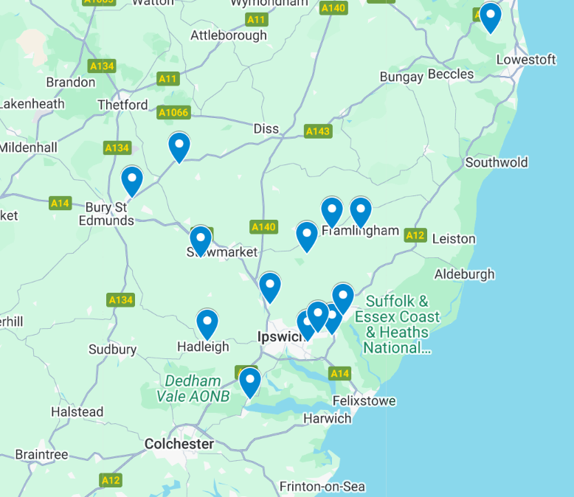



??
??
??
Notes:
Marc to add map and QR code

Slide 5
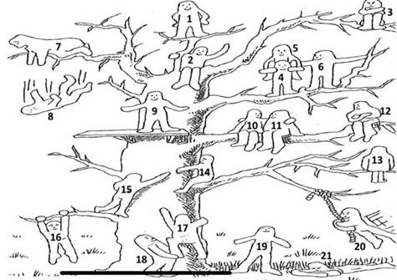
Our Schools, Our World Introductions
Who are you?
What do you do?
What would you like from today?
How are you feeling today?

Slide 6
Our Schools, Our World Agenda (fit in tour of the school where convenient)
Time | Session
9:00 | Attendees arriving
9:05 | Welcome
9:20 | Curriculum Development
10:20 | Break
10:40 | Curriculum development and assessment
12:30 | Lunch
13:05 | Outdoor Learning
13:45 | How to talk about climate change with young people - ThoughtBox
3:15 | Finish

Slide 7
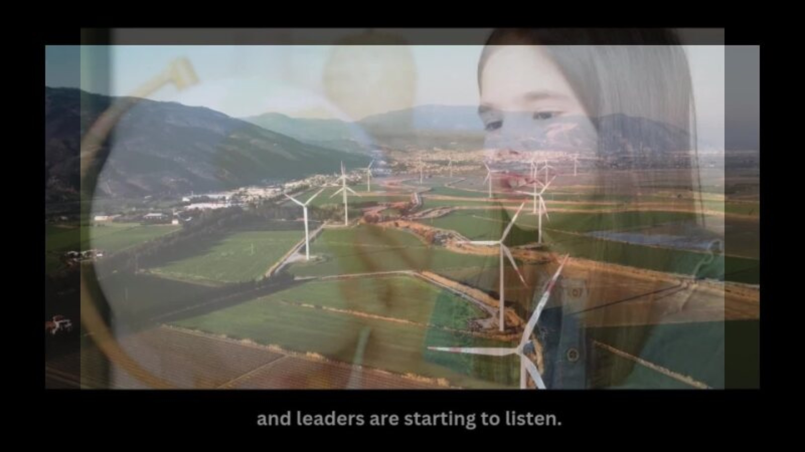
Notes:
May be useful for staff meeting

Slide 8
Our Schools, Our World A 2 year rolling programme
Curriculum
Concepts, Greening, Nature Connection
Theme 1
Assemblies
Actions
Theme 2
Assemblies
Actions
Theme 3
Assemblies
Actions
Theme 4
Assemblies
Actions
Theme 5
Assemblies
Actions
Theme 6
Assemblies
Actions
School Operations
Working towards Zero Carbon
Notes:
The OSOW programme is covered through six key overarching sustainability, climate change and environmental education themes. The delivery of the programme should be over a 2 year period with 1 theme covered per term. Curriculum content and larger operational changes are ongoing.

Slide 9
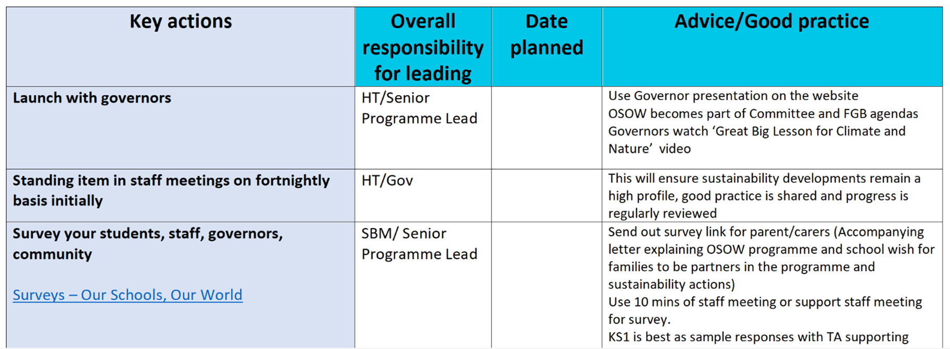
Our Schools, Our World The Framework - recap
Notes:
A reminder that the planning document offers guidance for actions to help embed and implement the framework, but you set the timeframe and you know what will and won’t work in your setting

Slide 10
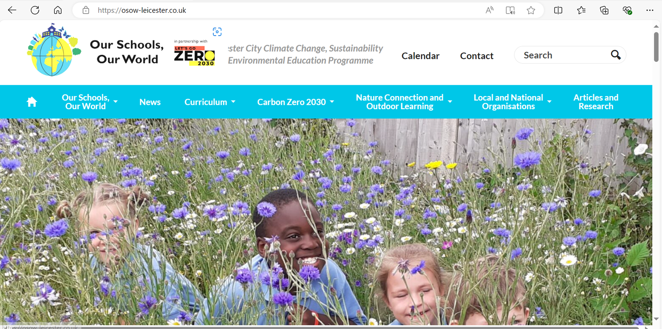


Our Schools Our World www.osow-suffolk.co.uk
Climate999

Slide 11
Our Schools, Our World Curriculum Development – SPL role
Working with the leadership team:
Plan against the framework
Implement and analyse surveys
Implement training in;
Climate Science
Supporting Eco-Anxiety
Curriculum development
Engage all members of school with the development of vision
Ensure assembly programme is implemented
Head & SPL
Staff
Head & SPL
Notes:
The head = visionary strategist, changing hearts and minds, getting everyone onboard.
SPL – work with head. Run logistics as on slide.
Training on website (curriculum tab)
Climate Basics / Science – all staff to set culture. INSET day ideal. Video or climate web cards
Eco-Anxiety – video. Link with good PSHE

Slide 12
Our Schools, Our World Curriculum Development – SPL role
Working with the leadership team:
Support the strategy team in developing termly plans for thematic approach
Devolve actions to pupils, staff and the wider community
Engage in and encourage networking
Monitor and measure impact and respond accordingly
Attend half-termly twilight network meetings
Notes:
Delegate! This is not your sole responsibility. Success = when everyone takes responsibility
Networking – between teachers and also between pupils (via Teams/Zoom)

Slide 13
Our Schools, Our World
CPD framework/schedule
Suggested Time | Training | When | To whom | Resources
Year 1 term 1 | Climate Basics | INSET | All school staff | Great Big Lesson for Climate and Nature Video in training section of website
Year 1 term 1 or 2 | How to talk to young people about climate change | INSET / staff meeting | Teaching staff and TAs | Thought Box Training in training section of website
Year 1 term 2 or 3 | Curriculum Development ‘Conceptual milestones’ X2 | Staff meeting | Teaching staff | Conceptual Milestone Documents
Year 1 term 2 or 3 | Curriculum Development ‘Greening the Curriculum’ 1 | Staff meeting | Teaching staff | Greening the Curriculum Document
Subsequent term | ‘Greening the Curriculum’ 2 | Staff meeting | Teaching staff | Greening the curriculum documents
Subsequent term | ‘Greening the Curriculum’ 3 | Staff meeting | Teaching staff | Greening the curriculum documents
Year 2 | Reviewing success of initial curriculum | Staff meeting | Teaching staff | Use of assessment resources
Year 2 | Outdoor Learning Practical techniques and planning | Staff meeting | Teaching staff | Outdoor learning resources on OSOW website
Notes:
Green the Curriculum before – eg Green autumn term plans in Summer term. Continue for 1 year and then should be embedded. Also starts happening naturally when sustainability fully embedded in school.

Slide 14
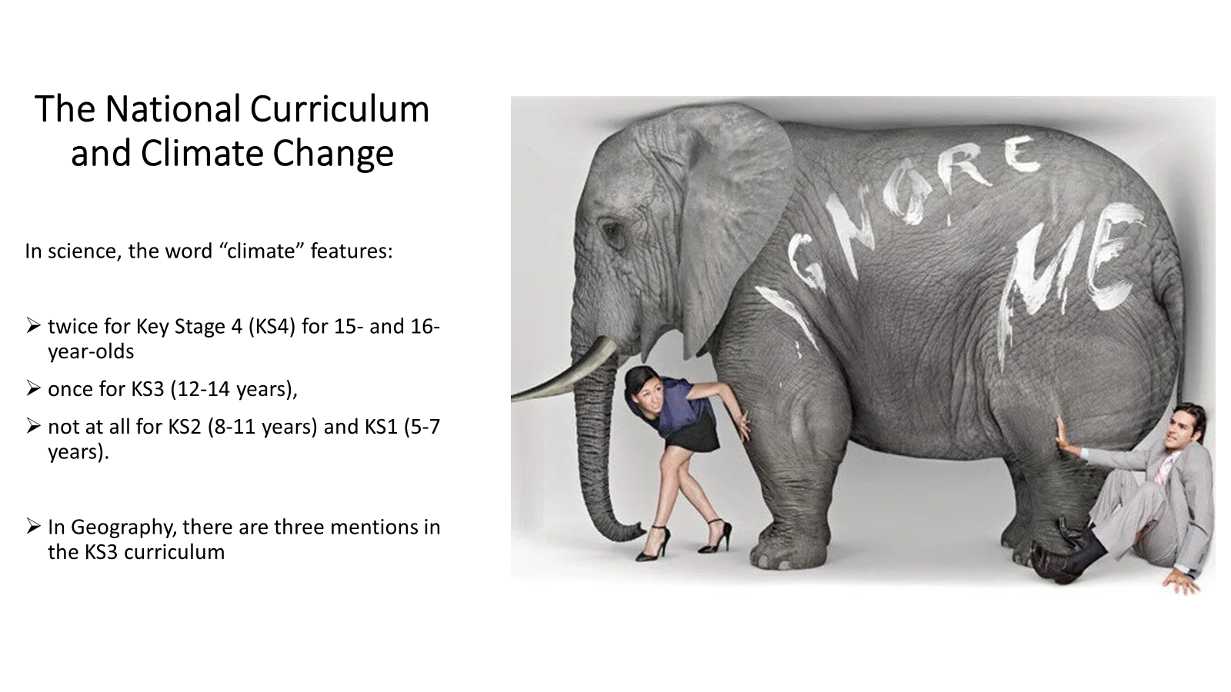
Our Schools, Our World Current NC provision

Slide 15
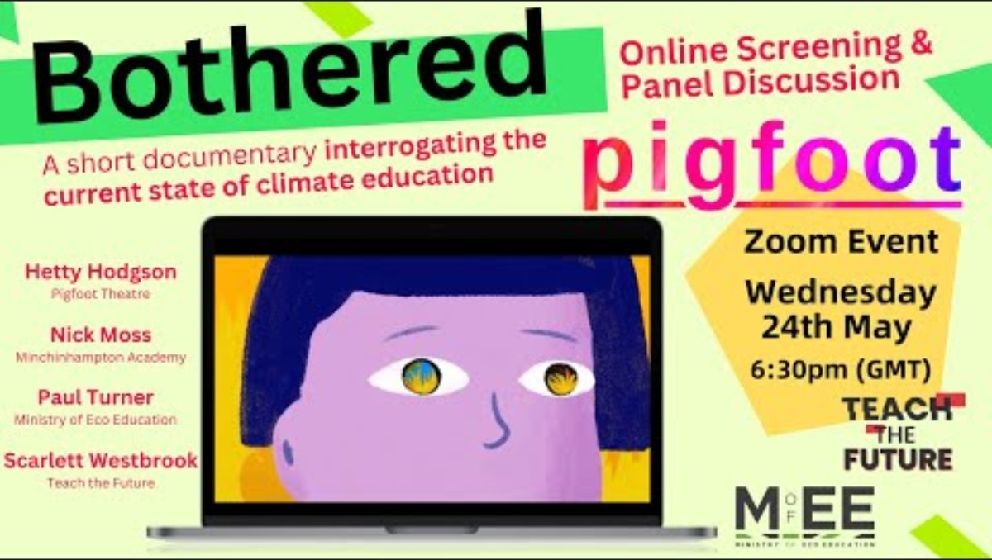
Our Schools, Our World Curriculum Development – Pupil Voice
Start 4:51min
Notes:
Video shows student voice – what young people are thinking
Intersectionality so important – climate justice
As educators we need to stand up for what we know is right

Slide 16
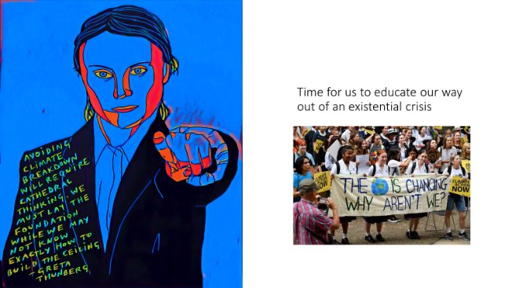
Our Schools, Our World Curriculum Development – Establishing a Vision
Notes:
In school we are laying foundations for an inspiring future – we don’t know what the future will be but we do need to gt the foundations right so they can make informed choices

Slide 17
Our Schools, Our World Curriculum Development - Zones
Interwoven in lessons
Action and empowerment
Connections with nature
Culture
School organisation – sustainable practices
Link to the UN SDGs
Assemblies
Connecting locally, nationally and internationally
Family and local community
Special projects
Staff commitment through pledges
School values and learning attitudes
Climate Change Curriculum zones of provision and influence
Pupil voice
Staff / community voice
Notes:
Wider curriculum - these are all the opportunities to give them exposure to climate change – not just the formal curriculum

Slide 18

Our Schools, Our World A New Vision
What if…
Notes:
Rob Hospkins - What if ….
Eg what if all staff and children walked to school….
What if all lessons were taught outdoors….
**You must not use the word 'But'!
Run activity thinking about Campus, Curriculum, Captaincy (leadership), Community, Culture

Slide 19
Our Schools, Our World School Vision – an example
Our school aims to be a truly sustainable school through a holistic and integrated approach to our curriculum, campus and community.
We will greatly increase the site biodiversity, substantially cut our carbon footprint, connect more deeply with nature, fully integrate outdoor learning and promote social justice for all.
We will provide a rich and relevant curriculum which will give all our children the skills and knowledge they need to engage with the challenges of the future and enable them to find solutions.
We will ensure we engage our students, staff and families in positive action and empower them to be changemakers to shape the future.
We will support greater mental well-being through encouraging all our school family through this work to connect with other people, to be physically active, to learn new skills, to give to others and to pay attention to the present.
We will develop close links with the council, schools, like-minded people and organisations to share and develop new and exciting ideas and practice
example
Notes:
This is what you want to achieve - useful to evaluate how effective you've been after eg a year.

Slide 20
Our Schools, Our World Curriculum Development - research
Most effective approaches to climate change and environmental education
Identifying effective climate change education strategies: a systematic review of the research
Martha C. Monroe, Richard R. Plate, Annie Oxarart, Alison Bowers & Willandia A. Chaves 2017
Weblink

Slide 21
Our Schools, Our World Curriculum Development - research
is learner-centred – active, hands-on inquiry-based learning opportunities
connects to personally relevant experiences or building on student ideas
helps students learn from each other by allowing them to compare ideas and discuss viewpoints
makes thinking visible by using models, visuals, data collection and analysis
promotes systems thinking
connects with nature
Notes:
Must be enquiry based – need space to bring in childrens experience and ideas

Slide 22
Our Schools, Our World Curriculum Development - research
supports emotional resilience – a curriculum of hope
is centred in the local community but makes global connections
is solution focused and leads to practical action
is inspired by changemakers

Slide 23
Assembly Concept | Diversity
Assembly Knowledge | Celebration of our natural world - What is biodiversity and why is it important? Ecosystems and trophic cascade Our local ecosystem - Our Living Coast 30 days wild in June Human impact on biodiversity The school environment
Key concepts | What is biodiversity and what is its value? What is an ecosystem? Life in our biosphere - living coast Impact of actions on biodiversity and ability of planet to adjust
Class/School action | Enhancement and expansion of biodiversity areas – e.g. development of infant playground area Playground identification guides Development of use of pond and forest garden – more planting and resourcing Join Meadow Project No Mow May School growing project – plant fruit trees Plants in each class Composting established 30 days Wild June
Family Commitment/ Pledge | How can we encourage biodiversity at home – flats/houses –guides provided Challenge – learn the names of the trees in our neighbourhood Community celebration – Me and my plants. Photos + names of plants we love at home or on the way to school What can you find in a metre squared of grass? Competition – types of plants/insects 30 days wild No mow may in home gardens

Slide 24
Assembly Concept | Diversity
Connection with nature | Biodiversity areas development in school Downs and diversity – Each class to explore annually on at least one trip Plant a tree campaign https://www.woodlandtrust.org.uk/blog/2020/03/nature-detectives/ Swift project Wildlife walk with picnic – whole school David Attenborough film spectacular
Outdoor Learning | More outdoor classroom focusing on well-being - https://www.ltl.org.uk/free-resources
Ethical purchasing/sustainable practice as a school | Palm oil/local produce/commit to vegan lunch days http://www.worldwiseschools.ie/downloads/Ethical-Purchasing-Guide.pdf
Campaigning | Work with school lunch company – more vegan options https://www.wwf.org.uk/updates/8-things-know-about-palm-oil Campaign against palm oil - letter writing MPs
Connecting with local organisations
Staff Behaviour | Environmental volunteering opportunities/staff relaxation area outside
Learning Behaviours/Values/Relationships | Celebration of diversity/beauty of nature – mindfulness and imagination in nature activities

Slide 25

Our Schools, Our World Wider Resources (National)
Notes:
These are all great resources – many of them modular – eg lessons around food waste / energy etc
Our approach is to integrate
These resources also useful for assemblies

Slide 26
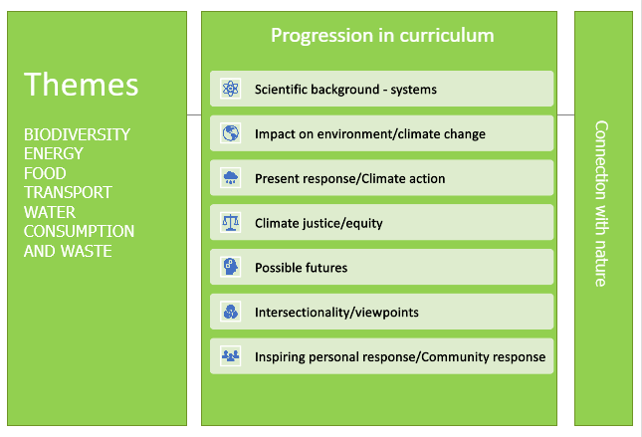
Our Schools, Our World Curriculum Development- progression
Notes:
Stages to take children through in curriculum
Are we covering scientific background / impact etc

Slide 27
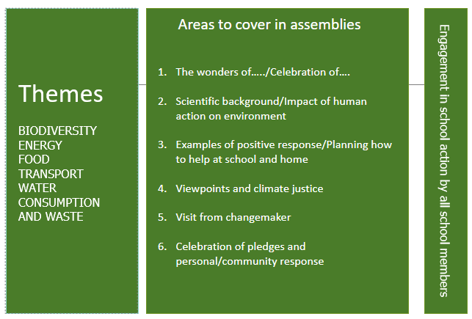
Our Schools, Our World Curriculum Development - assemblies
Areas to cover in assemblies
The wonders of ….. / Celebration of …
Scientific background / impact of human activities on environment
Changemakers – local, national, global. Link to climate justice
School and class actions
5. Family actions
6. Celebration of pledges and personal / community response
Notes:
Suggested pattern for assembly structures – see website for egs

Slide 28
Our Schools, Our World Curriculum Learning Outcomes – 4 key areas
The science
The impact of climate change
Our role as changemakers
Climate Justice
Notes:
Your curriculum should touch on all these 4 areas.
Start slowly – gradually greening the curriculum
Eventually you should be able to see impact in these areas

Slide 29
Our Schools, Our World School Curriculum Statement
In developing the taught curriculum, we have:
Consulted pupils, staff and families
Taken into account the context of our school and all the characteristics of our pupils
Sought to foster a sense of hope through encouraging pro-environmental behaviours and solution focussed thinking
Mapped the key knowledge, skills and attitudes to live with and in a changing climate
Ensured our pupils understand systems thinking
Notes:
Talk to children to find out about impact – choices and behaviours.

Slide 30
Our Schools, Our World School Curriculum Statement
In developing the taught curriculum, we have:
Considered research into effective curriculums
Linked the learning to action
Integrated environmental education across subjects
Significantly increased the regularity of outdoor learning and nature connection
Provided the opportunity to explore global environmental issues and climate justice
Laid the foundations in green technology skills and green careers

Slide 31
Our Schools, Our World
The OSOW curriculum framework

Slide 32
Our Schools Our World www.osow-suffolk.co.uk
Climate999

Slide 33
Our Schools, Our World Assessing Impact
Why assess?
Shows how well children are learning
Helps you evaluate teaching methodology
Identifies curriculum strengths and gaps
Informs future planning
Enables you to celebrate success

Slide 34
Our Schools, Our World Zones of impact
Children’s learning and attitudes
Staff knowledge and confidence
Family attitudes and engagement
Progress against climate action plan
Notes:
Measure impact in 4 areas of skills + knowledge – science, impact, climate justice, children as changemakers
Also want to look at whether we've impacted hope and empowerment as well as knowledge
Staff knowledge – make sure new staff are inducted in this through eg induction pack containing videos
Have families changed attitudes?

Slide 35
Our Schools, Our World
Methodology for assessment of learning
Pupil conferencing - sample of pupils representing range of pupil characteristics
• Pupil self- assessment
• Planning evaluation
Methodology for assessment of attitudes
•Surveys
Notes:
Conversation with pupils is main / best way of assessing impact

Slide 36
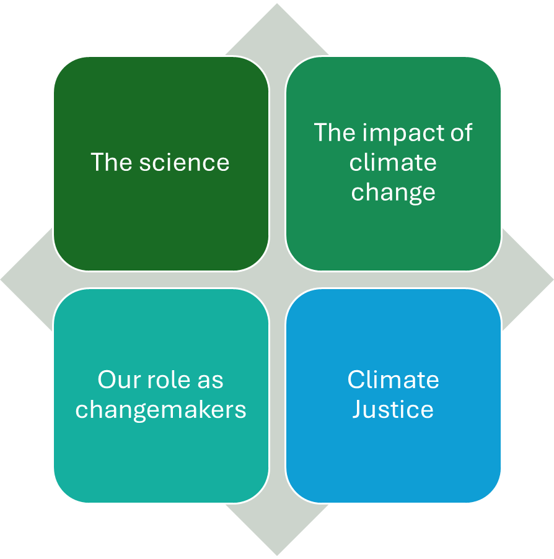
Our Schools, Our World
Four key areas of assessment
Impact on children’s learning from curriculum, assemblies and action

Slide 37
Our Schools, Our World
Power of pupil conferencing

Slide 38
Our Schools, Our World
End of Year 2
Key Concepts | Year Group/Term/Subject/Assembly
Local/national/global
Weather
Climate
Environment
Global warming
Monoculture
Biodiversity
Extinction
Rewilding
Wood wide web
Conservation
Energy
Waste
Consumption
Pollution
Notes:
Pictures eg those below show the concepts highlighted here.
Use to ask children what's happening / what they see / why it's important – general discussion to tease out their knowledge

Slide 39

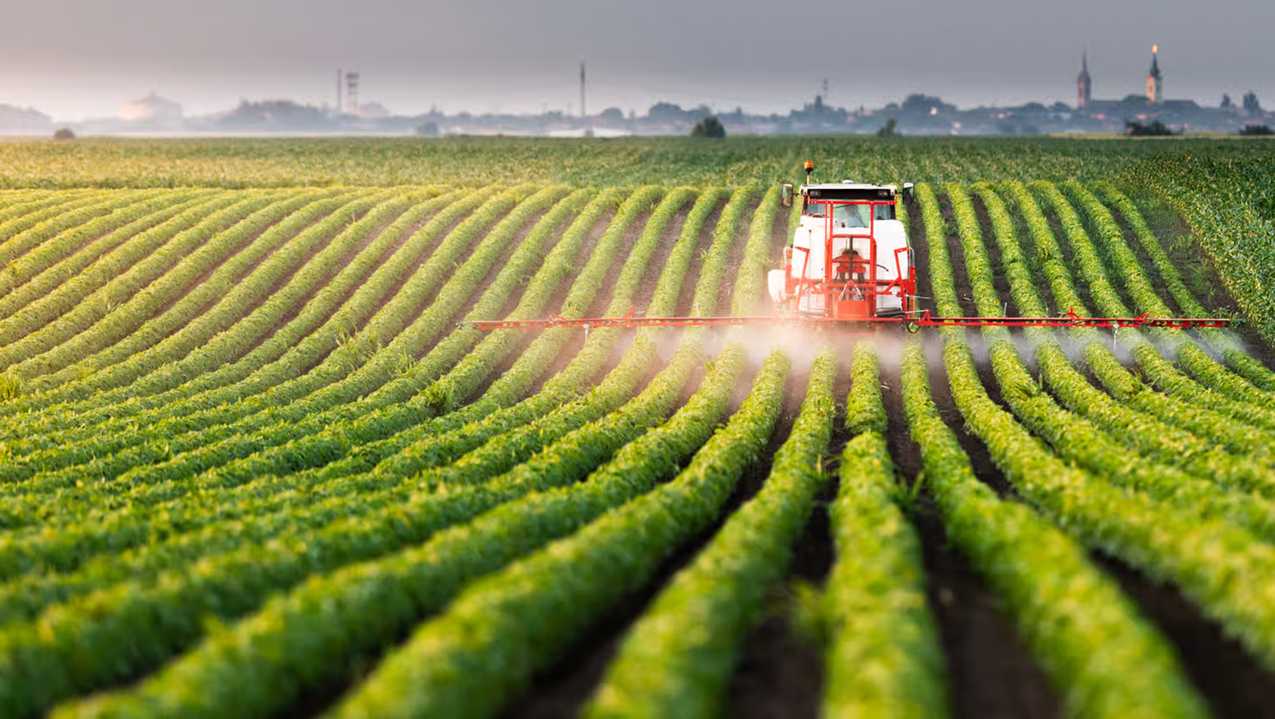
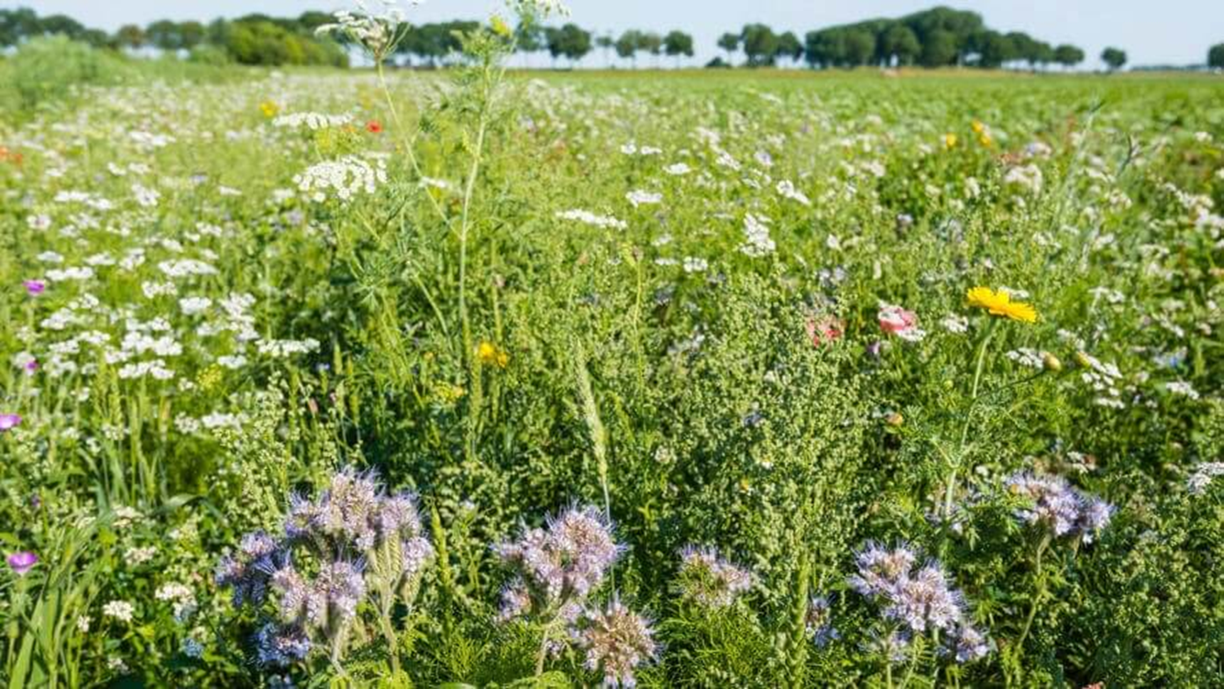
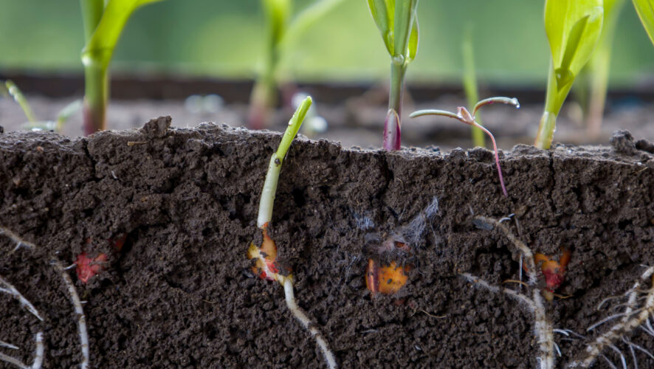
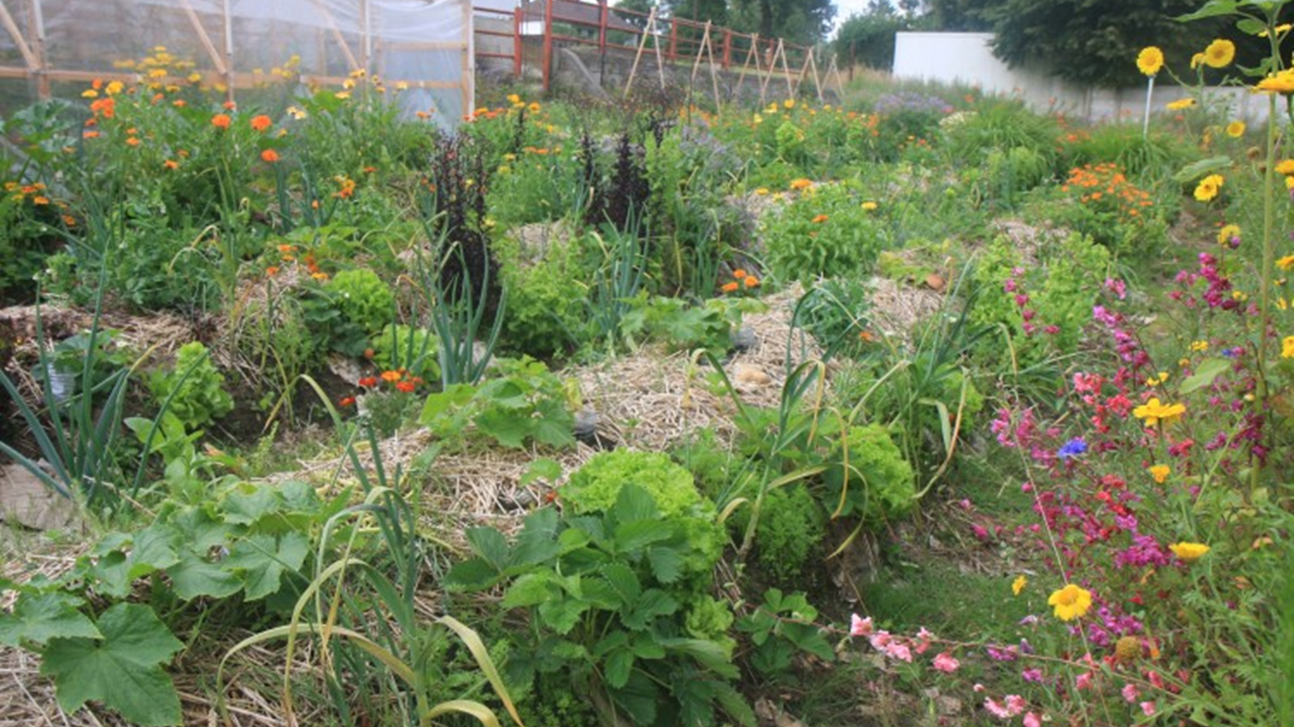

Slide 40
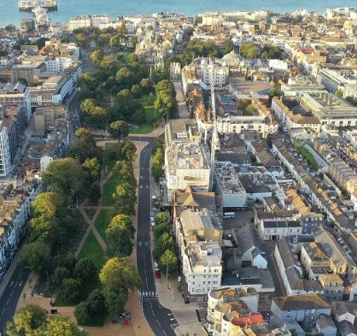
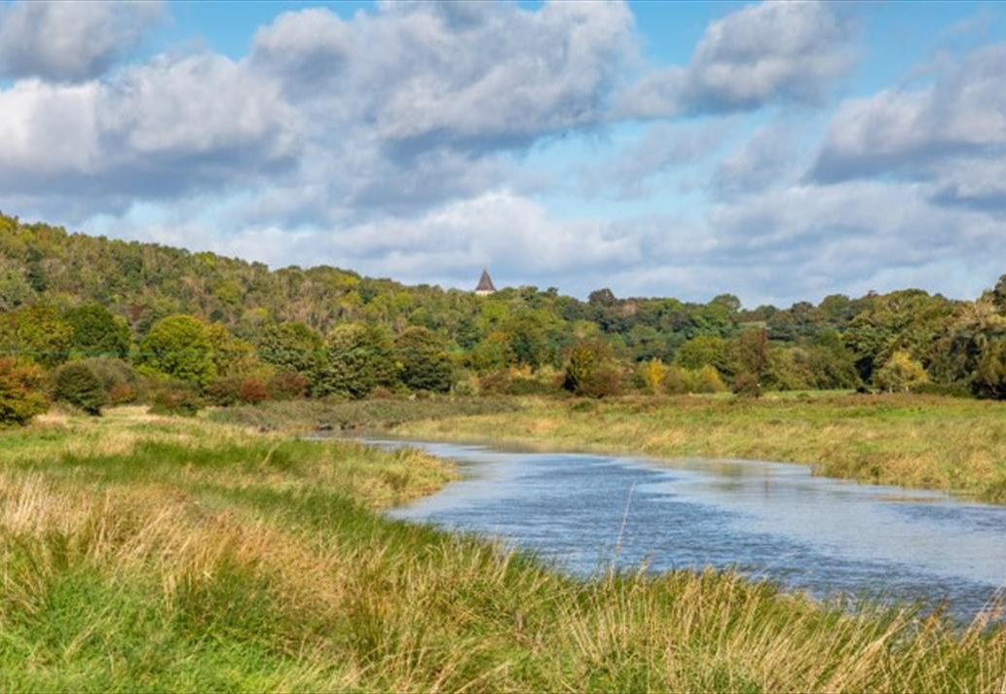
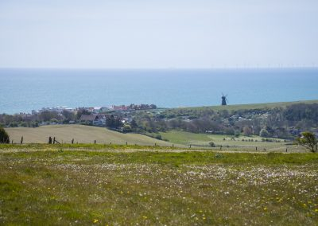
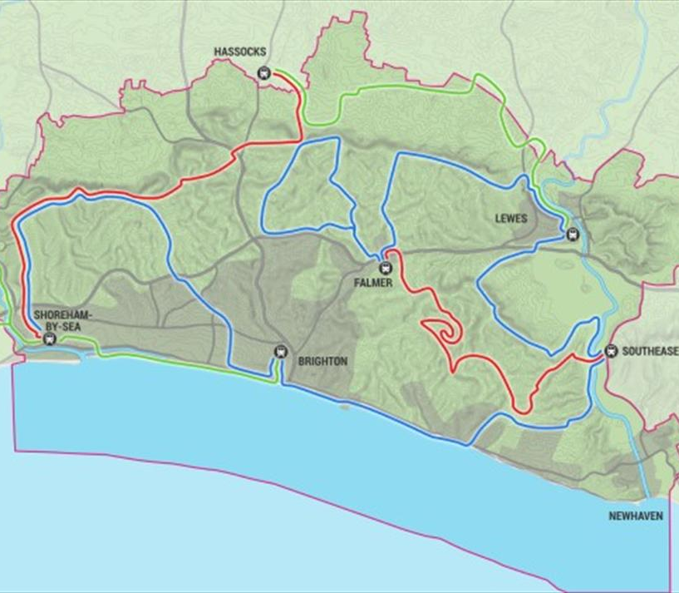
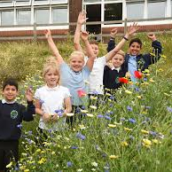
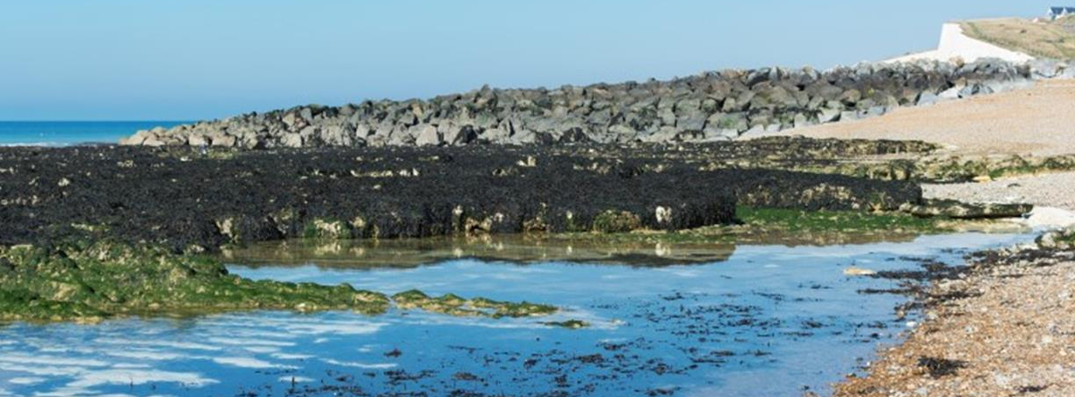
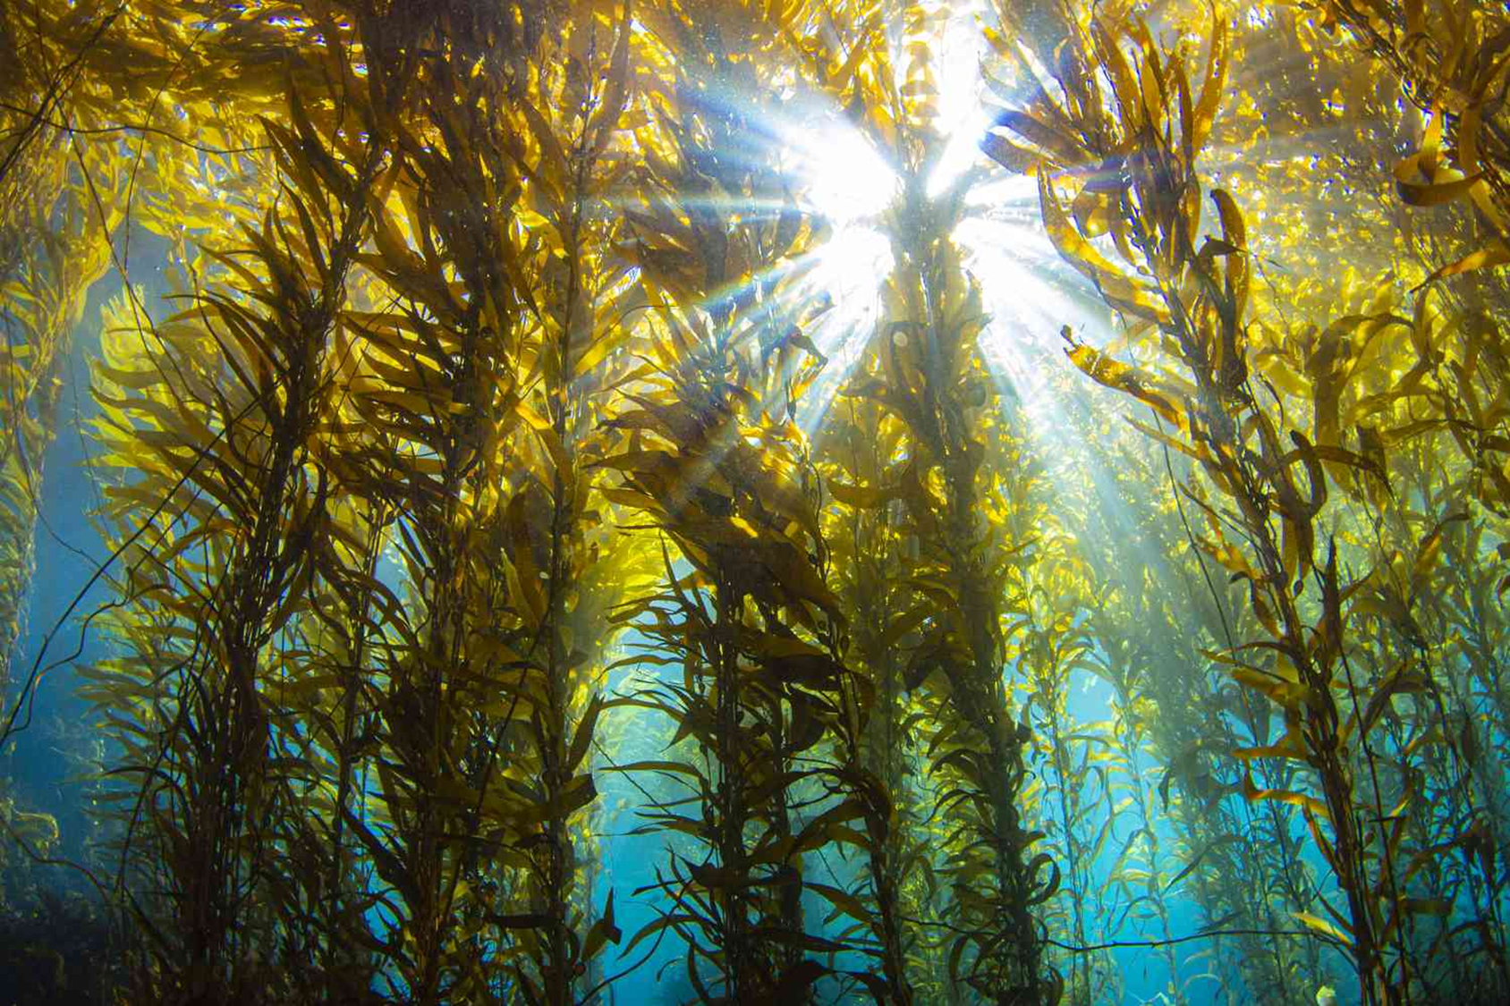

Slide 41
Our Schools, Our World
Self-assessment
Use E-Portfolios + common self-assessment templates
Notes:
Eportfolios are particuarly useful for photos / outdoor learning

Slide 42
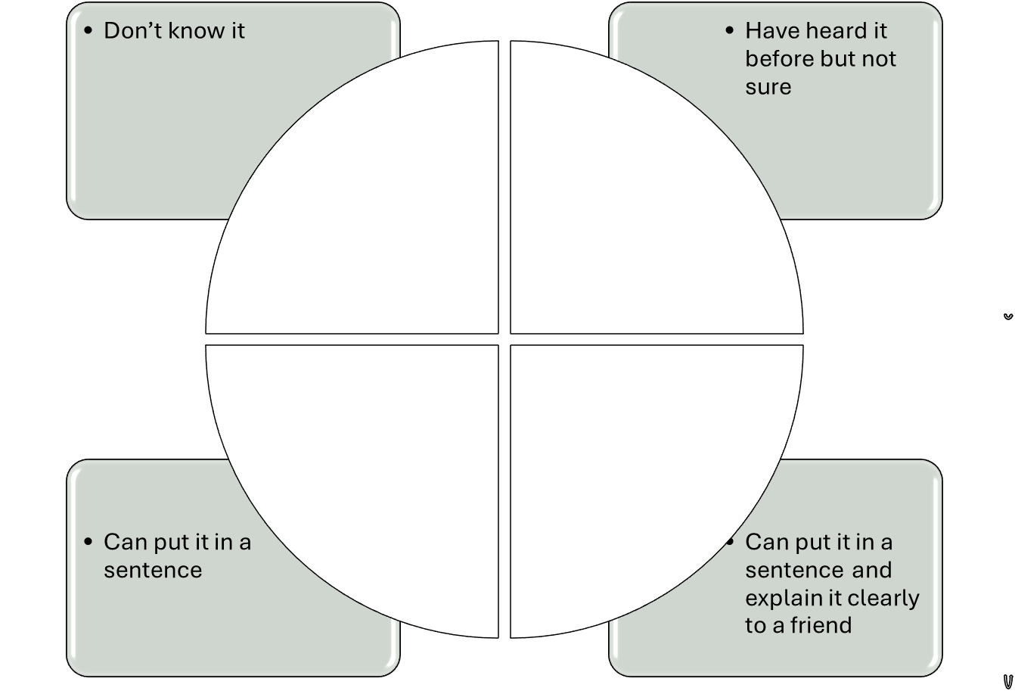
Our Schools, Our World
Vocabulary and concept self-assessment – before and after

Slide 43
Our Schools Our World Teacher Survey
E.g. scaling exercies 1-5
 | Before OSOW | After implementation of OSOW
How good is your knowledge of climate change?
How confident are you teaching about climate change and sustainability?
How confident do you feel in supporting pupils’ emotional response to climate change?

Slide 44
Our Schools, Our World Family Engagement Survey
E.g. scaling exercies 1-5
 | Before OSOW | After the implementation of OSOW
Do you feel your children display a good knowledge of the causes and the impact of Climate Change?
Do you feel your children display a good knowledge of how to behave sustainably?
How good is your family’s sustainable behaviour
How would you rate your engagement with family pledges?
Notes:
Need to prepare for this so families are fully aware of the programme

Slide 45
Our Schools, Our World
Progress against Climate Action Plan

Slide 46
Our Schools, Our World Climate Action Plan – SMART targets
•Decarbonisation, for example calculating and taking actions to reduce carbon emissions, such as becoming more energy efficient
•Adaptation and resilience, such as taking actions to reduce the risk of flooding and overheating
•Biodiversity, for example engaging with the National Education Nature Park
•Climate education and green careers, such as ensuring the education you provide gives knowledge-rich and comprehensive teaching about climate change, and that your teaching staff and lecturers feel supported to offer this

Slide 47
Our Schools, Our World Assessing – SMART targets
Decarbonisation – reduce carbon emissions from energy use by 20%
Adaptation and resilience – install playground shade and plant trees in playground to provide sufficient cover for 50% of children
Biodiversity - increase areas for biodiversity by 15%
Climate education and green careers – ensure 90% of year 2 children understand and can use vocabulary and concepts in the infant progression framework

Slide 48
Our Schools, Our World Lunch
Please be ready to start promptly at 1:05pm

Slide 49
Outdoor learning – outdoors ?

Slide 50

Our Schools Our World Planning for Outdoor Learning
Learning IN the outdoors
Learning THROUGH the outdoors
Learning ABOUT the outdoors
Learning FOR the outdoors
The inside or outside classroom
Where would learning be most effective?

Slide 51


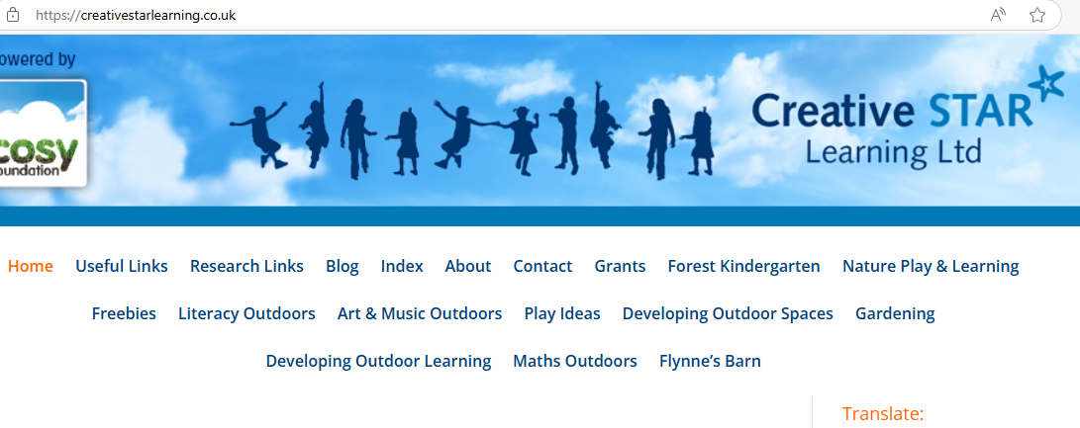
Our Schools Our World Planning for Outdoor Learning
www.ltl.org/free-resources/
www.creativestarlearning.co.uk

Slide 52
95% of children enjoyed learning outside more than inside
94% of children felt more connected to nature after learning outside
93% of children showed improved social skills after learning outside
92% of children engaged more with their learning outside than inside
57% increase in children’s attainment after outdoor learning
References:
National Connections Demonstration project
The Children’s People & Nature Survey 2023
Natural England: Children & Nature Programme
85% of children showed improved behaviour after learning outside
92% of children reported an increase in wellbeing after learning outside
13% of parents feel confident with their child playing outside
20% of children don’t play outside at all on an average day
74% of children spend less time outdoors than prisoners
20% of KS2 children are categorised as ‘obese’
37% of children leave primary school at an ‘unhealthy weight’
16% of children have a vitamin D deficiency
25% of children spend less than 30 minutes outside a week (out of school)
79% of teachers reported positive impacts on their teaching practice from teaching outdoors
37% of children have never seen a fruit or vegetable growing
88% of children say spending time in nature makes them feel very happy
13% of US children are on Ritalin for ADHD
37% of children actively notice nature when spending time outside
69% of teachers reported increased job satisfaction when teaching outdoors

Slide 53
Our Schools, Our World Lunch
Our Schools, Our World Local Organisations
Knowledge from the group

Slide 54

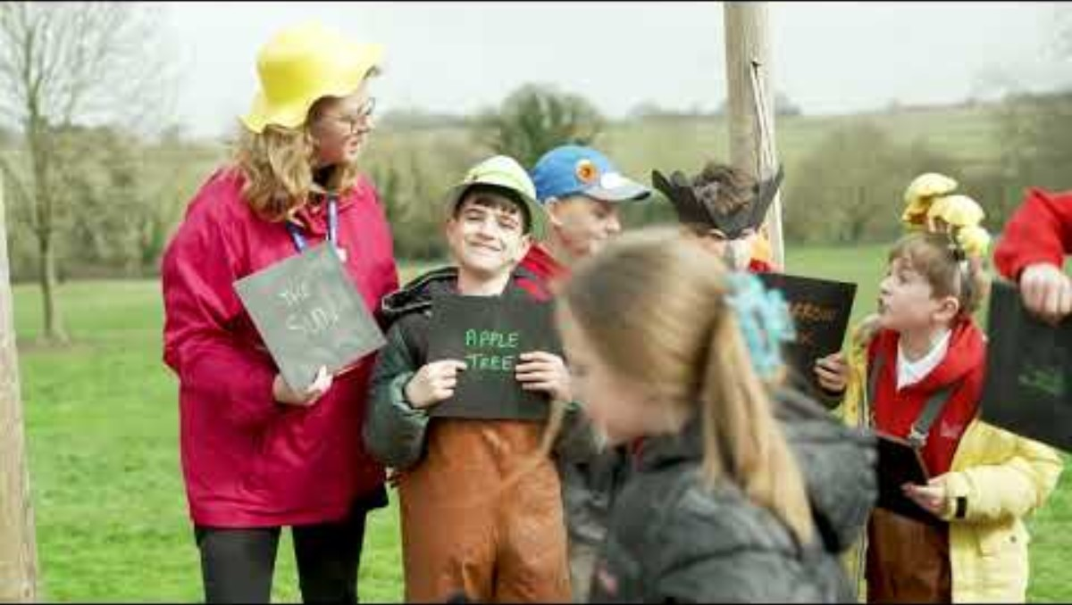
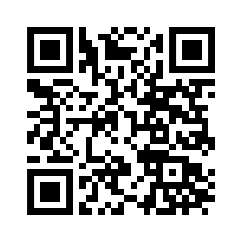
Our Schools Our World National Education Nature Park
www.educationnaturepark.org.uk

Slide 55



Our Schools Our World www.thoughtboxeducation.com

Slide 56
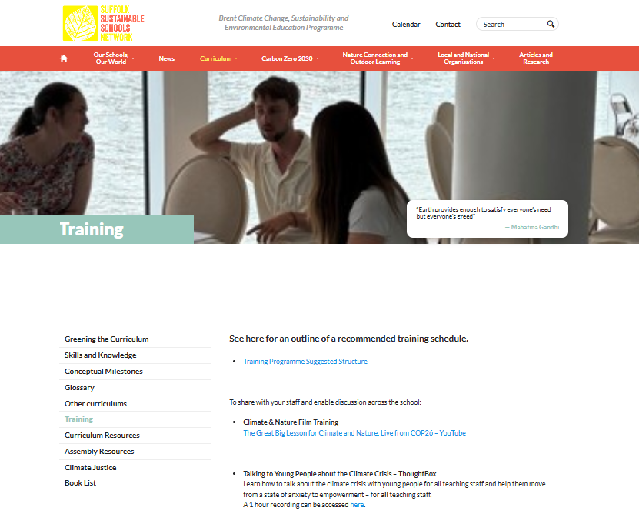
Replace with local version
ThoughtBox training video
on www.osow-suffolk.co.uk
under 'Training'
Password Climate999

Slide 57
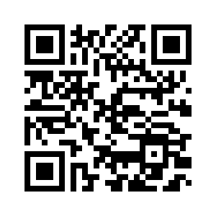
Our Schools Our World Next Steps
Thank you for your time today. Please complete the following evaluation.
Plan in meeting with head
Plan in meeting with business and site manager
Book in time with xxxxxx

Slide 58
Our Schools, Our World Finish
Site Managers and Business Managers tomorrow
Any SPLs joining?

Slide 59
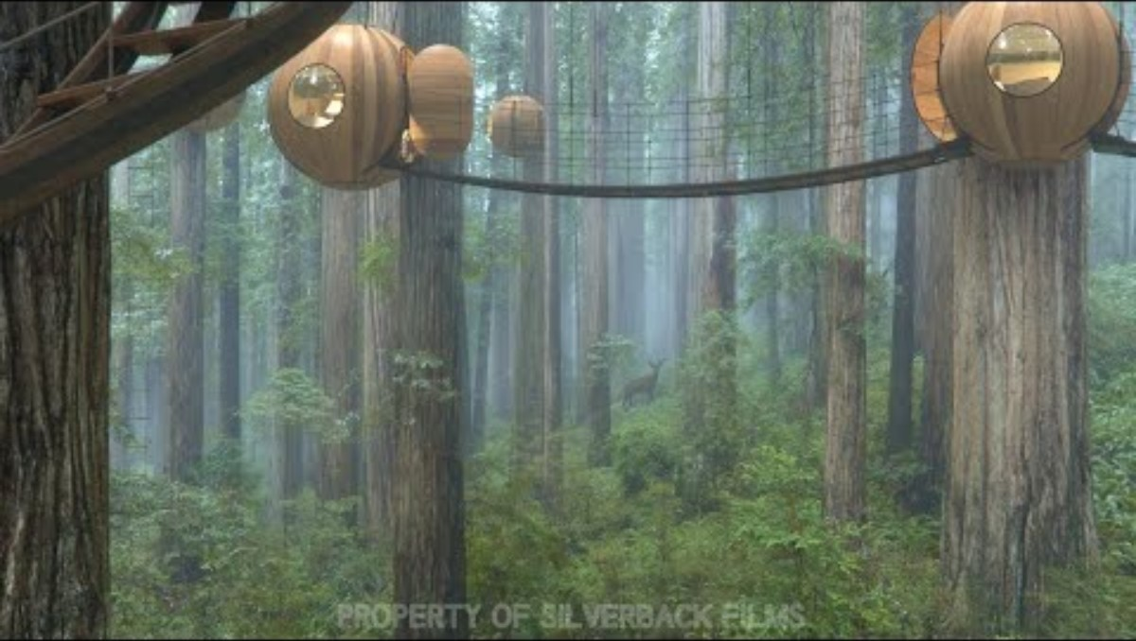
Our Schools, Our World

